Slide 1

5.1 Neural Network Structure
Peter H. Chen

Slide 2

5.1 Neural Network Structure
https://www.youtube.com/watch?v=6kOvmZDEMdc&list=PL58zEckBH8fCt_lYkmayZoR9XfDCW9hte&index=5
Neural Network Structure (00:16-00:17/19:10)
We start from the basic structure of Neural Network.

Slide 3
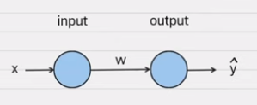
5.1 Neural Network Structure
https://www.youtube.com/watch?v=6kOvmZDEMdc&list=PL58zEckBH8fCt_lYkmayZoR9XfDCW9hte&index=5
Neural Network Structure (00:16-00:35/19:10)
Below is the basic structure of two nodes neural network.
We have one node at the input with input x and one node at the output layer.
Since the output is a prediction, we use ŷ to represent the prediction.
In the middle, we have W as the weight.
Usually, we have a defined problem, then we construct a neural network.

Slide 4
5.2 Problem

Slide 5

5.2 Problem
https://www.youtube.com/watch?v=6kOvmZDEMdc&list=PL58zEckBH8fCt_lYkmayZoR9XfDCW9hte&index=5
Problem (00:36-00:45/19:10)
Usually, we have a defined problem, then we construct a neural network to solve the problem.

Slide 6
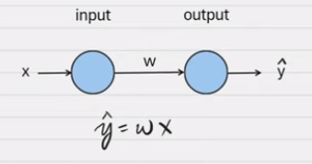
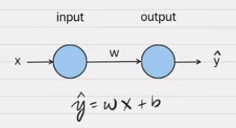
5.2 Problem
https://www.youtube.com/watch?v=6kOvmZDEMdc&list=PL58zEckBH8fCt_lYkmayZoR9XfDCW9hte&index=5
Problem (00:46-01:10/19:10)
However, since we only have two nodes, what can we possibly solve the problem with two nodes network?
1. Let’s see, the equation for this structure is ŷ = W * x. Is this easy?
2. It is the standard formula for a line. Usually, there is a intercept.
But, we will exclude the intercept for now.
1
2

Slide 7
5.3 Linear Regression

Slide 8
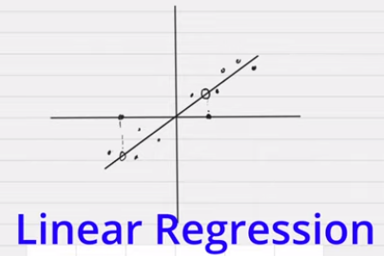
5.3 Linear Regression
https://www.youtube.com/watch?v=6kOvmZDEMdc&list=PL58zEckBH8fCt_lYkmayZoR9XfDCW9hte&index=5
Linear Regression (01:11-01:40/19:10)
So, what can a line do?
Let’s say, we have some data points on a graphs.
What we can do is approximately fit a line through these points.
Once we have this line, we will be able to use this line to make estimation.
For each x, we will have y for each x.
This is called Linear Regression. Linear Regression is a fancy name.
Linear means “a line”. Regress means “to go back”. So, “Linear Regression” means “We want to know the new point through the old point (or go back to old point)”.

Slide 9
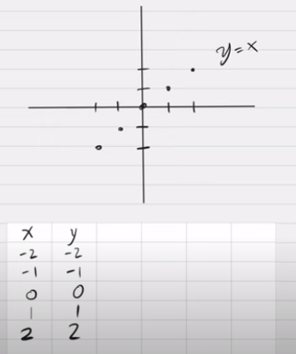
5.3 Linear Regression
https://www.youtube.com/watch?v=6kOvmZDEMdc&list=PL58zEckBH8fCt_lYkmayZoR9XfDCW9hte&index=5
Linear Regression (01:41-02:20/19:10)
For example, we have a table and points on the graph.
We have y = x. In this case, we do not need the neural network to solve it.
We use the super simple example to understand the neural network.

Slide 10
5.4 Linear Regression w/ NN

Slide 11
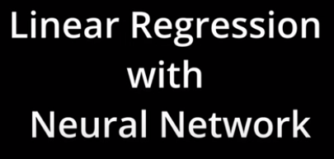
5.4 Linear Regression w/ NN
https://www.youtube.com/watch?v=6kOvmZDEMdc&list=PL58zEckBH8fCt_lYkmayZoR9XfDCW9hte&index=5
Linear Regression w/ NN (Neural Network) (02:21-02:25/19:10)
Assume we do not know what is the line look like.
How do we use data and Neural Network to find the line?

Slide 12
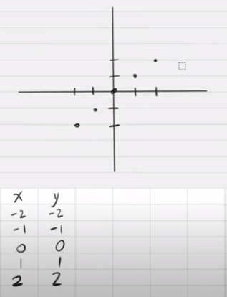
5.4 Linear Regression w/ NN
https://www.youtube.com/watch?v=6kOvmZDEMdc&list=PL58zEckBH8fCt_lYkmayZoR9XfDCW9hte&index=5
Linear Regression w/ NN (Neural Network) (02:26-02:35/19:10)
Given the below table, how to use Neural Network to fit these points?

Slide 13
5.5 Import Library

Slide 14
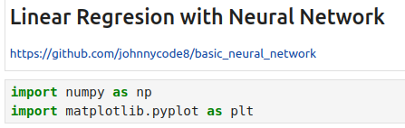
5.5 Import Library
https://www.youtube.com/watch?v=6kOvmZDEMdc&list=PL58zEckBH8fCt_lYkmayZoR9XfDCW9hte&index=5
Import Library (02:36-02:37/19:10)
We have Jupiter Notebook Python code.
1. import the numpy for calculation and
2. import matplotlib fro graph

Slide 15
5.6 Define/Plot Data

Slide 16

5.6 Define/Plot Data
https://www.youtube.com/watch?v=6kOvmZDEMdc&list=PL58zEckBH8fCt_lYkmayZoR9XfDCW9hte&index=5
Define/Plot Data (02:38-02:40/19:10)
1. We define data points shown as bottom below.
2. On the right below is the data we showed on the white board before.
1
2

Slide 17
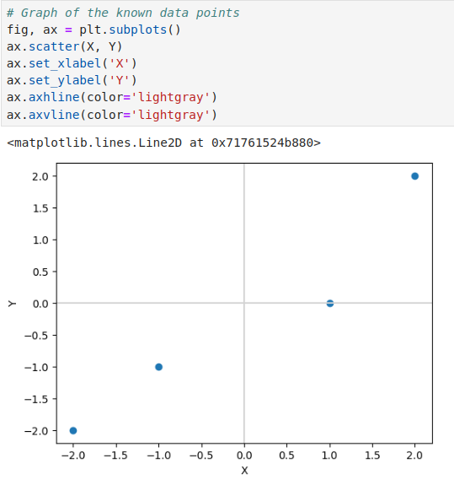
5.6 Define/Plot Data
https://www.youtube.com/watch?v=6kOvmZDEMdc&list=PL58zEckBH8fCt_lYkmayZoR9XfDCW9hte&index=5
Define/Plot Data (02:41-02:45/19:10)
1. We plot the data points shown as bottom below.
2. We compare the data on the right below which we showed on the white board before.
1
2

Slide 18
5.7 Define Forward Function

Slide 19
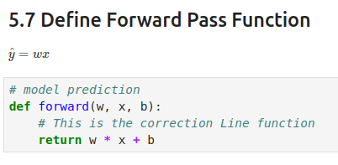
5.7 Define Forward Function
https://www.youtube.com/watch?v=6kOvmZDEMdc&list=PL58zEckBH8fCt_lYkmayZoR9XfDCW9hte&index=5
Define Forward Function (02:46-03:00/19:10)
1. We define the forward pass function left below.
2. On the right below, the forward function is the same function that we showed on the whiteboard before.
We call this is a forward pass because we are following the direction of the arrows going forward.
Note: Here, we ignore the bias b.
1
2

Slide 20
5.8 Guess Weight and Plot

Slide 21
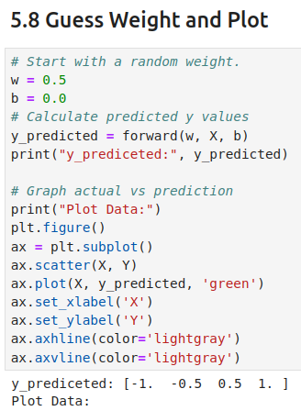
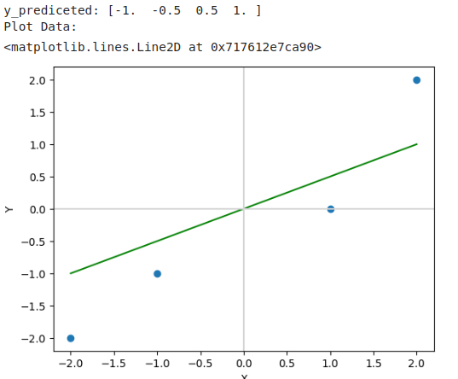
5.8 Guess Weight and Plot
https://www.youtube.com/watch?v=6kOvmZDEMdc&list=PL58zEckBH8fCt_lYkmayZoR9XfDCW9hte&index=5
Guess Weight and Plot (03:01-03:30/19:10)
1. We guess a random weight, let’s say w = 0.5, b = 0.0.
2. Then calculate the predicted y values
3. Print and plot the data.
We can adjust the weight see the curve rotating with different weight.
1
2
3

Slide 22
5.9 Measure Loss with MSE

Slide 23

5.9 Measure Loss with MSE
https://www.youtube.com/watch?v=6kOvmZDEMdc&list=PL58zEckBH8fCt_lYkmayZoR9XfDCW9hte&index=5
Measure Loss with MSE (03:31-03:50/19:10)
We need some way to measure how good of the weight W.
Image you are hike in the forest and you got lost.
We want to go down the hill to the valley.
We need to measure and go down.
Here, we use predicted and current location to calculate how loss we are.
LOSS

Slide 24
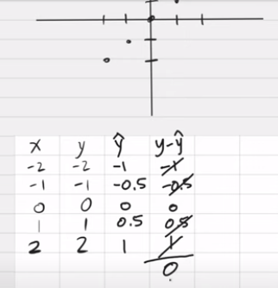
5.9 Measure Loss with MSE
https://www.youtube.com/watch?v=6kOvmZDEMdc&list=PL58zEckBH8fCt_lYkmayZoR9XfDCW9hte&index=5
Measure Loss with MSE (03:41-04:20/19:10)
First, we calculate the deviation of y and ŷ: y – ŷ.
These value will cancel each other and got zero.
The deviation does not work.

Slide 25

5.9 Measure Loss with MSE
https://www.youtube.com/watch?v=6kOvmZDEMdc&list=PL58zEckBH8fCt_lYkmayZoR9XfDCW9hte&index=5
Measure Loss with MSE (04:21-04:40/19:10)
The Deviation does not work.
We need MSE (Mean Square Error) which will not cancel each other for Loss Function.

Slide 26
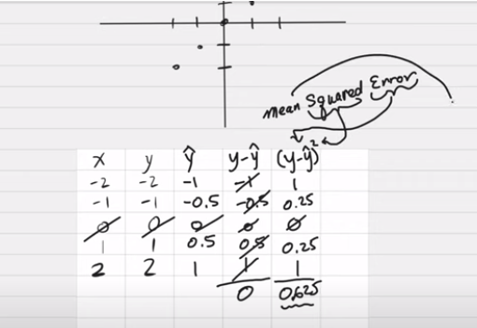
5.9 Measure Loss with MSE
https://www.youtube.com/watch?v=6kOvmZDEMdc&list=PL58zEckBH8fCt_lYkmayZoR9XfDCW9hte&index=5
Measure Loss with MSE (04:41-05:10/19:10)
We take square of the error and take away of 0 (no use) and square them, sum them, and take average.
This way, we call MSE (Mean Square Error).
1. “Error” means take the deviation of (y – ŷ),
2. “Square” means take power 2, and
3. “mean” means take average.

Slide 27
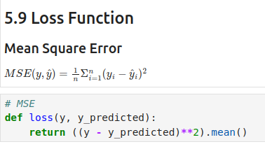
5.9 Measure Loss with MSE
https://www.youtube.com/watch?v=6kOvmZDEMdc&list=PL58zEckBH8fCt_lYkmayZoR9XfDCW9hte&index=5
Measure Loss with MSE (04:21-05:30/19:10)
Define MSE (Mean Square Error) for Loss Function.

Slide 28
5.10 How Weights Affect Loss

Slide 29

5.10 How Weights Affect Loss
https://www.youtube.com/watch?v=6kOvmZDEMdc&list=PL58zEckBH8fCt_lYkmayZoR9XfDCW9hte&index=5
How Weights Affect Loss (05:31-05:40/19:10)
Let’s see how weight affects loss.
Our first guess w = 0.5. We will add several more guesses and plot the predictions.

Slide 30
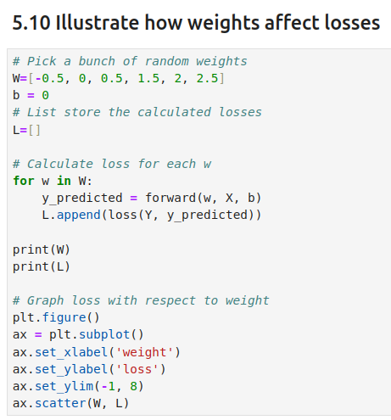
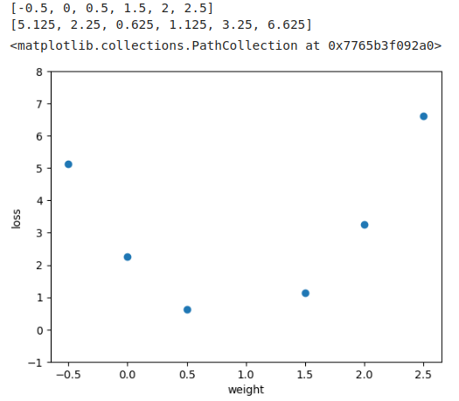
5.10 How Weights Affect Loss
https://www.youtube.com/watch?v=6kOvmZDEMdc&list=PL58zEckBH8fCt_lYkmayZoR9XfDCW9hte&index=5
How Weights Affect Loss (05:31-05:40/19:10)
We change weight and plot the loss.

Slide 31
5.10.1 Backpropagation

Slide 32
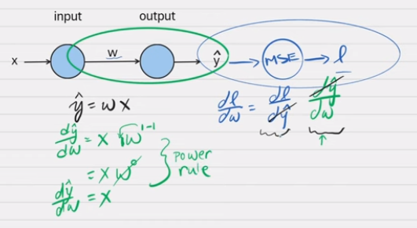
5.10.1 Backpropagation
https://www.youtube.com/watch?v=6kOvmZDEMdc&list=PL58zEckBH8fCt_lYkmayZoR9XfDCW9hte&index=5
Backpropagation (06:41-07:50/19:10)
We have done the forward pass/
Now, we do the backpropagation. Here, we ignore the bias b.
1. We start from MSE and find the Loss l.
2. We take derivative of loss l vs weight w.
3. Back propagate from back to front.

Slide 33
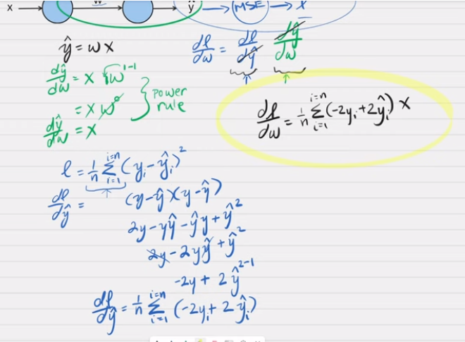
5.10.1 Backpropagation
https://www.youtube.com/watch?v=6kOvmZDEMdc&list=PL58zEckBH8fCt_lYkmayZoR9XfDCW9hte&index=5
Backpropagation (07:51-11:05/19:10)
b
ŷ = W * X + b

Slide 34
5.11 Derivative of Loss vs Weight

Slide 35
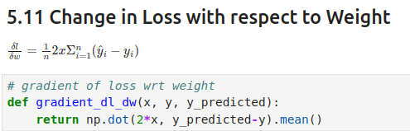
5.11 Derivative of Loss vs Weight
https://www.youtube.com/watch?v=6kOvmZDEMdc&list=PL58zEckBH8fCt_lYkmayZoR9XfDCW9hte&index=5
Derivative of Loss vs Weight (11:06-11:30/19:10)
We take derivative to Loss vs Weight

Slide 36
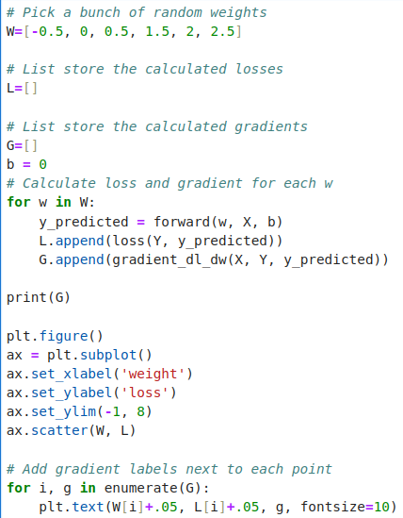
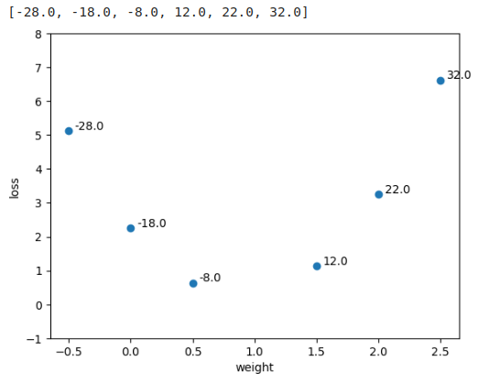
5.11 Derivative of Loss vs Weight
https://www.youtube.com/watch?v=6kOvmZDEMdc&list=PL58zEckBH8fCt_lYkmayZoR9XfDCW9hte&index=5
Derivative of Loss vs Weight (11:31-11:40/19:10)
We take derivative to Loss vs Weight at each weight

Slide 37
5.12 Derivative of Loss vs Bias

Slide 38
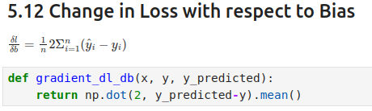
5.12 Derivative of Loss vs Bias
https://www.youtube.com/watch?v=6kOvmZDEMdc&list=PL58zEckBH8fCt_lYkmayZoR9XfDCW9hte&index=5
Derivative of Loss vs Bias (11:41-11:50/19:10)
We take derivative to Loss vs Bias.

Slide 39
5.13 Training

Slide 40
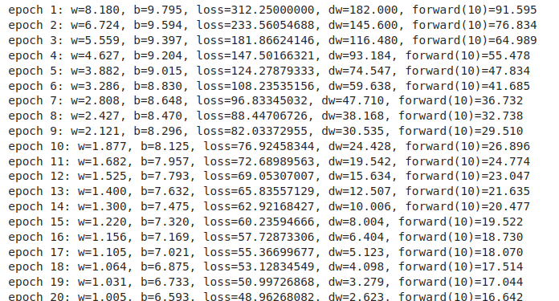
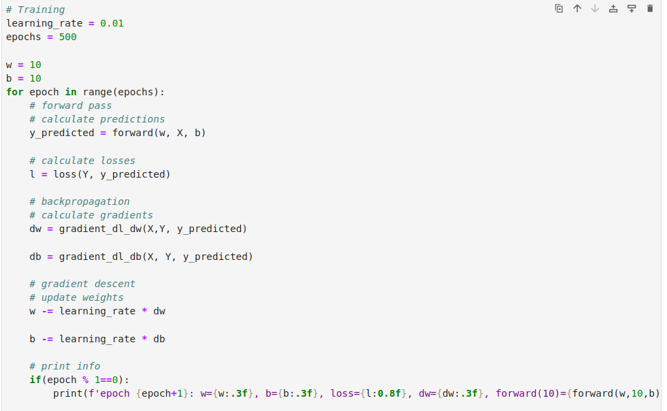
5.13 Training
https://www.youtube.com/watch?v=6kOvmZDEMdc&list=PL58zEckBH8fCt_lYkmayZoR9XfDCW9hte&index=5
Training (11:51-13:10/19:10)
Change w and b.

Slide 41
5.14 Learning Rate

Slide 42

5.14 Learning Rate
https://www.youtube.com/watch?v=6kOvmZDEMdc&list=PL58zEckBH8fCt_lYkmayZoR9XfDCW9hte&index=5
Learning Rate (13:11-13:30/19:10)
At the end, step size getting smaller and smaller

Slide 43
5.14 Learning Rate
https://www.youtube.com/watch?v=6kOvmZDEMdc&list=PL58zEckBH8fCt_lYkmayZoR9XfDCW9hte&index=5
Learning Rate (13:31-14:30/19:10)
Step size

Slide 44
5.15 y = -2x

Slide 45
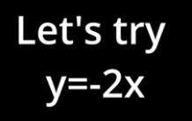
5.15 y = -2x
https://www.youtube.com/watch?v=6kOvmZDEMdc&list=PL58zEckBH8fCt_lYkmayZoR9XfDCW9hte&index=5
y = -2x (14:41-15:00/19:10)

Slide 46

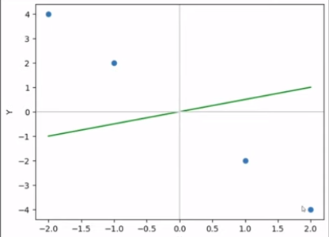
5.15 y = -2x
https://www.youtube.com/watch?v=6kOvmZDEMdc&list=PL58zEckBH8fCt_lYkmayZoR9XfDCW9hte&index=5
y = -2x (15:01-15:30/19:10)
Change the data y = -2x and do the training again

Slide 47
5.16 Bias

Slide 48

5.16 Bias
https://www.youtube.com/watch?v=6kOvmZDEMdc&list=PL58zEckBH8fCt_lYkmayZoR9XfDCW9hte&index=5
Bias (15:31-15:50/19:10)

Slide 49
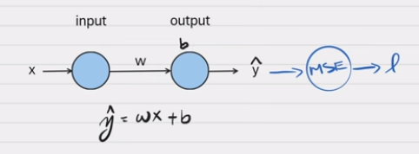
5.16 Bias
https://www.youtube.com/watch?v=6kOvmZDEMdc&list=PL58zEckBH8fCt_lYkmayZoR9XfDCW9hte&index=5
Bias (15:01-16:10/19:10)
At beginning, we remove the bias b.
Now, we add the bias back and re-run again.

Slide 50
5.17 Gradient of Bias

Slide 51

5.17 Gradient of Bias
https://www.youtube.com/watch?v=6kOvmZDEMdc&list=PL58zEckBH8fCt_lYkmayZoR9XfDCW9hte&index=5
Gradient of Bias (16:11-16:20/19:10)

Slide 52
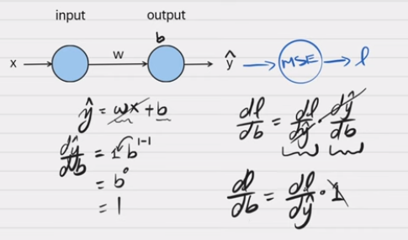
5.17 Gradient of Bias
https://www.youtube.com/watch?v=6kOvmZDEMdc&list=PL58zEckBH8fCt_lYkmayZoR9XfDCW9hte&index=5
Gradient of Bias (16:21-17:10/19:10)
Take derivative of bias.

Slide 53

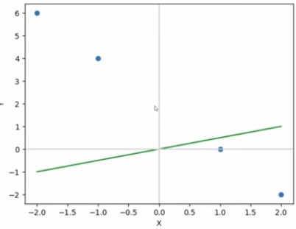
5.17 Gradient of Bias
https://www.youtube.com/watch?v=6kOvmZDEMdc&list=PL58zEckBH8fCt_lYkmayZoR9XfDCW9hte&index=5
Gradient of Bias (17:11-18:30/19:10)

Slide 54
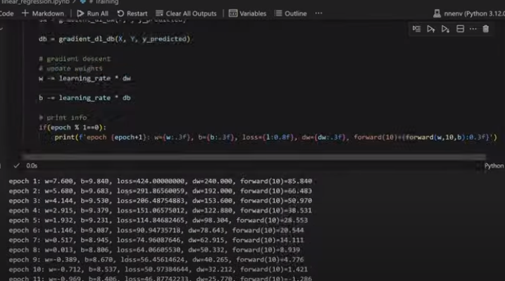
5.17 Gradient of Bias
https://www.youtube.com/watch?v=6kOvmZDEMdc&list=PL58zEckBH8fCt_lYkmayZoR9XfDCW9hte&index=5
Gradient of Bias (18:31-19:10/19:10)
Training again.

Slide 55
End

