Slide 1

12 SAC Agent
Peter H. Chen

Slide 2
12 SAC Agent
https://www.tensorflow.org/agents/tutorials/7_SAC_minitaur_tutorial
SAC Agent
We discuss SAC (Soft Actor-Critic) with Soft Actor Critic agent on the Minitaur environment.
We have worked through the DQN. For SAC, we have the below differences:
1. Change the agent from DQN to SAC.
2. Train on Minitaur: Minitaur is a much more complex environment than CartPole. The Minitaur environment aims to train a quadruped robot to move forward.
3. Here, we use the TF-Agents Actor-Learner API for Distributed Reinforcement Learning.
4. In this example, the SAC Agent API supports both distributed data collection using an experience replay buffer and variable container (parameter server) and distributed training across multiple devices.
5. The SAC API is designed to be very simple and modular. We utilize Reverb (Reverberation) for both replay buffer and variable container and TF DistributionStrategy API for distributed training on GPUs and TPUs.

Slide 3
12.1 Install Library

Slide 4
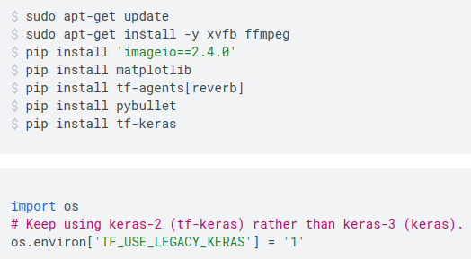
12.1 Install Library
https://www.tensorflow.org/agents/tutorials/7_SAC_minitaur_tutorial
Install Library
Install the below frameworks and libraries
1. tf-agents[reverb]: Reverb (Reverberation) framework is an efficient, extensible, distributed replay, and easy-to-use replay system by Deepmind.
2. tf-keras: Neural network.
3. pybullet: Real time physics simulation for robot.

Slide 5
12.2 Import Library

Slide 6
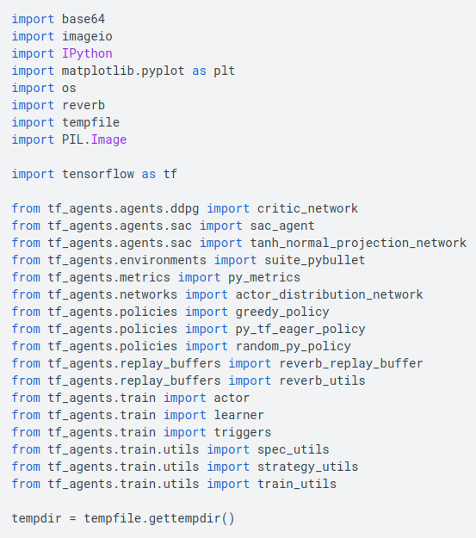
12.2 Import Library
https://www.tensorflow.org/agents/tutorials/7_SAC_minitaur_tutorial
Import Library
Import the below frameworks and libraries
1. reverb: Reverb (Reverberation) framework is for distributed replay with environment.
2. imageio: Python Library for Read/write/replay of image and video.

Slide 7
12.3 Hyperparameter

Slide 8
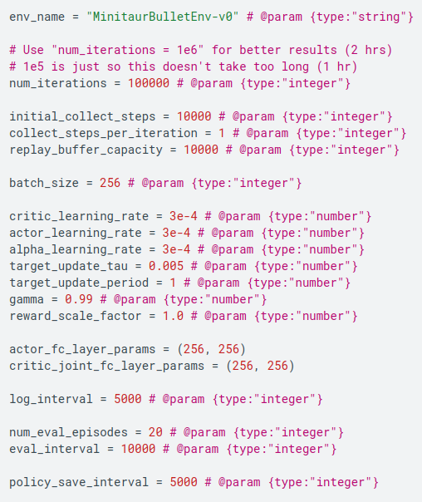
12.3 Hyperparameter
https://www.tensorflow.org/agents/tutorials/7_SAC_minitaur_tutorial
Hyperparameter

Slide 9
12.4 Environment

Slide 10

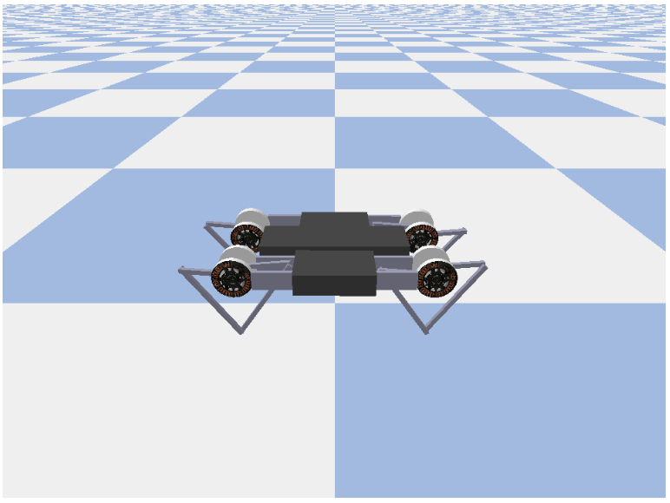
12.4 Environment
https://www.tensorflow.org/agents/tutorials/7_SAC_minitaur_tutorial
Environment
Environments in RL represent the task or problem that we are trying to solve.
Standard environments can be easily created in TF-Agents using suites.
We have different suites for loading environments from sources, such as, the OpenAI Gym, Atari, DM (DeepMind) Control, etc., given a string environment name.
Below, we load the Minitaur environment from the Pybullet suite.

Slide 11
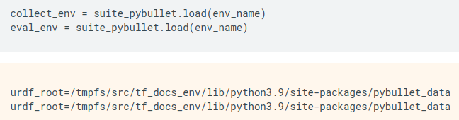
12.4 Environment
https://www.tensorflow.org/agents/tutorials/7_SAC_minitaur_tutorial
Environment
The observation is fairly complex.
We receive 28 values representing the angles, velocities, and torques for all the motors. In return the environment expects 8 values for the actions between [-1, 1].
These are the desired motor angles.
Usually we create two environments:
1. one for collecting data during training and
2. one for evaluation.
The environments are written in pure python and use numpy arrays, which the Actor Learner API directly consumes.

Slide 12

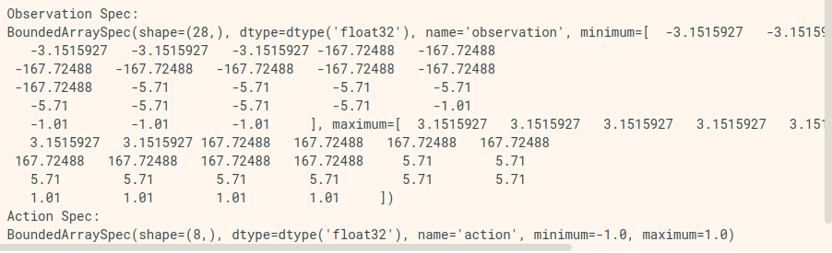
12.4 Environment
https://www.tensorflow.org/agents/tutorials/7_SAC_minitaur_tutorial
Environment
In this environment the goal is for the agent to train a policy that will control the Minitaur robot and have it move forward as fast as possible.
Episodes last 1000 steps and the return will be the sum of rewards throughout the episode.
Here, the information the environment provides as an observation which the policy will use to generate actions.

Slide 13
12.5 Distributed Training

Slide 14
12.5 Distributed Training
https://www.tensorflow.org/agents/tutorials/7_SAC_minitaur_tutorial
Distributed Training
We use the DistributionStrategy API to enable running the train step computation across multiple devices such as multiple GPUs or TPUs using data parallelism.
The train step:
  1. Receives a batch of training data
  2. Splits it across the devices
  3. Computes the forward step
  4. Aggregates and computes the MEAN of the loss
  5. Computes the backward step and performs a gradient variable update
With TF-Agents Learner API and DistributionStrategy API it is quite easy to switch between running the train step on GPUs (using MirroredStrategy) to TPUs (using TPUStrategy) without changing any of the training logic below.
Enabling the GPU
If you want to try running on a GPU, you'll first need to enable GPUs for the notebook:
  1. Navigate to Edit→Notebook Settings
  2. Select GPU from the Hardware Accelerator drop-down

Slide 15
12.5 Distributed Training
https://www.tensorflow.org/agents/tutorials/7_SAC_minitaur_tutorial
Distributed Training
Picking a strategy
Use strategy_utils to generate a strategy. Under the hood, passing the parameter:
  1. use_gpu = False returns tf.distribute.get_strategy(), which uses CPU
  2. use_gpu = True returns tf.distribute.MirroredStrategy(), which uses all GPUs that are visible to TensorFlow on one machine

Slide 16
12.6 Agent

Slide 17
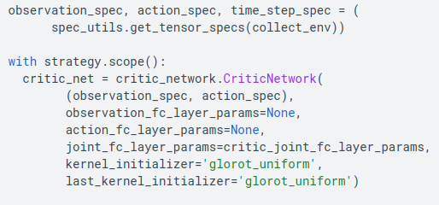
12.6 Agent
https://www.tensorflow.org/agents/tutorials/7_SAC_minitaur_tutorial
Agent
All variables and Agents need to be created under strategy.scope(), as you'll see below.
To create an SAC Agent, we first need to create the networks that it will train.
SAC is an actor-critic agent, so we will need two networks.
The critic will give us value estimates for Q(s,a).
That is, it will receive as input an observation and an action, and it will give us an estimate of how good that action was for the given state.

Slide 18
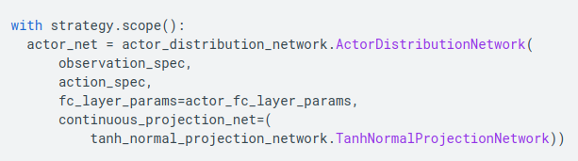
12.6 Agent
https://www.tensorflow.org/agents/tutorials/7_SAC_minitaur_tutorial
Agent
We will use this critic to train an actor network which will allow us to generate actions given an observation.
The ActorNetwork will predict parameters for a tanh-squashed MultivariateNormalDiag distribution. This distribution will then be sampled, conditioned on the current observation, whenever we need to generate actions.

Slide 19
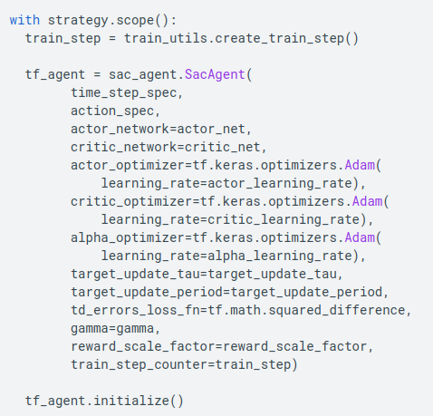
12.6 Agent
https://www.tensorflow.org/agents/tutorials/7_SAC_minitaur_tutorial
Agent
With these networks at hand we can now instantiate the agent.

Slide 20
12.7 Replay Buffer

Slide 21
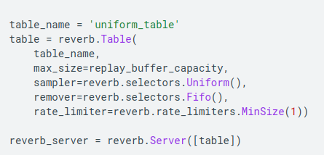
12.7 Replay Buffer
https://www.tensorflow.org/agents/tutorials/7_SAC_minitaur_tutorial
Replay Buffer
In order to keep track of the data collected from the environment, we will use Reverb, an efficient, extensible, and easy-to-use replay system by Deepmind.
Reverb stores experience data collected by the Actors and consumed by the Learner during training.
In this discussion, this is less important than max_size -- but in a distributed setting with async collection and training, you will probably want to experiment with rate_limiters.SampleToInsertRatio, using a samples_per_insert somewhere between 2 and 1000. For example:
rate_limiter=reverb.rate_limiters.SampleToInsertRatio(samples_per_insert=3.0, min_size_to_sample=3, error_buffer=3.0)

Slide 22
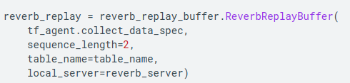
12.7 Replay Buffer
https://www.tensorflow.org/agents/tutorials/7_SAC_minitaur_tutorial
Replay Buffer
The replay buffer is constructed using specs describing the tensors that are to be stored, which can be obtained from the agent using tf_agent.collect_data_spec.
Since the SAC Agent needs both the current and next observation to compute the loss, we set sequence_length=2:

Slide 23

12.7 Replay Buffer
https://www.tensorflow.org/agents/tutorials/7_SAC_minitaur_tutorial
Replay Buffer
Now we generate a TensorFlow dataset from the Reverb replay buffer.
We will pass this to the Learner to sample experiences for training.

Slide 24
12.8 Policy

Slide 25
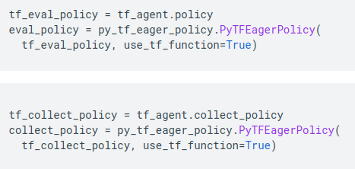
12.8 Policy
https://www.tensorflow.org/agents/tutorials/7_SAC_minitaur_tutorial
Replay Buffer
In TF-Agents, policies represent the standard notion of policies in RL: given a time_step produce an action or a distribution over actions.
The main method is policy_step = policy.step(time_step) where policy_step is a named tuple PolicyStep(action, state, info).
The policy_step.action is the action to be applied to the environment, state represents the state for stateful (RNN) policies and info may contain auxiliary information such as log probabilities of the actions.
Agents contain two policies:
  1. agent.policy — The main policy that is used for evaluation and deployment.
  2. agent.collect_policy — A second policy that is used for data collection.

Slide 26

12.8 Policy
https://www.tensorflow.org/agents/tutorials/7_SAC_minitaur_tutorial
Replay Buffer
Policies can be created independently of agents.
For example, use tf_agents.policies.random_py_policy to create a policy which will randomly select an action for each time_step.

Slide 27
12.9 Actor

Slide 28
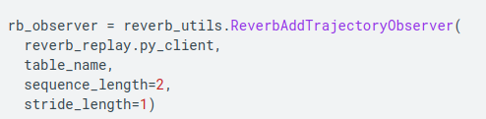
12.9 Actor
https://www.tensorflow.org/agents/tutorials/7_SAC_minitaur_tutorial
Actor
The actor manages interactions between a policy and an environment.
The Actor components contain an instance of the environment (as py_environment) and a copy of the policy variables.
Each Actor worker runs a sequence of data collection steps given the local values of the policy variables.
Variable updates are done explicitly using the variable container client instance in the training script before calling actor.run().
The observed experience is written into the replay buffer in each data collection step.
As the Actors run data collection steps, they pass trajectories of (state, action, reward) to the observer, which caches and writes them to the Reverb replay system.
We're storing trajectories for frames [(t0,t1) (t1,t2) (t2,t3), ...] because stride_length=1.

Slide 29
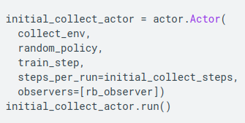
12.9 Actor
https://www.tensorflow.org/agents/tutorials/7_SAC_minitaur_tutorial
Actor
We create an Actor with the random policy and collect experiences to seed the replay buffer with.

Slide 30
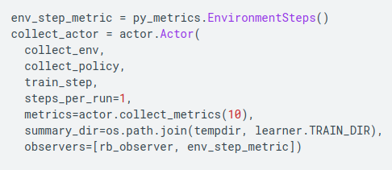
12.9 Actor
https://www.tensorflow.org/agents/tutorials/7_SAC_minitaur_tutorial
Actor
Instantiate an Actor with the collect policy to gather more experiences during training.

Slide 31
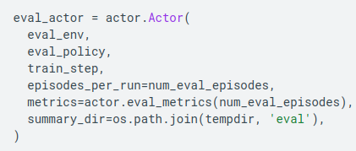
12.9 Actor
https://www.tensorflow.org/agents/tutorials/7_SAC_minitaur_tutorial
Actor
Create an Actor which will be used to evaluate the policy during training.
We pass in actor.eval_metrics(num_eval_episodes) to log metrics later.

Slide 32
12.10 Learner

Slide 33
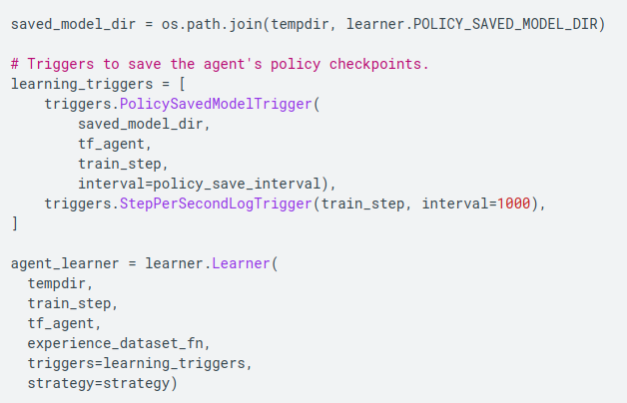
12.10 Learner
https://www.tensorflow.org/agents/tutorials/7_SAC_minitaur_tutorial
Learner
The Learner component contains the agent and performs gradient step updates to the policy variables using experience data from the replay buffer.
After one or more training steps, the Learner can push a new set of variable values to the variable container.

Slide 34
12.11 Metrics and Evaluation

Slide 35
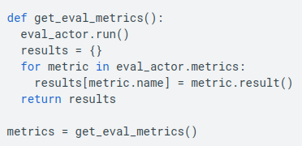
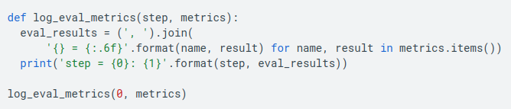
12.11 Metrics and Evaluation
https://www.tensorflow.org/agents/tutorials/7_SAC_minitaur_tutorial
Metrics and Evaluation
We instantiated the eval Actor with actor.eval_metrics above, which creates most commonly used metrics during policy evaluation:
  1. Average return. The return is the sum of rewards obtained while running a policy in an environment for an episode, and we usually average this over a few episodes.
  2. Average episode length.
We run the Actor to generate these metrics.

Slide 36
12.12 Train Agent

Slide 37
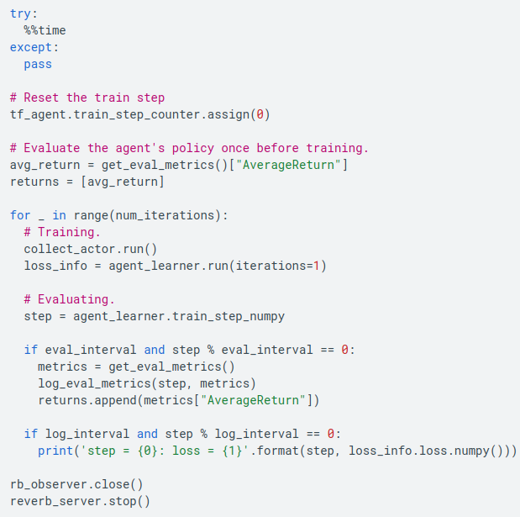
12.12 Train Agent
https://www.tensorflow.org/agents/tutorials/7_SAC_minitaur_tutorial
Train Agent
The training loop involves both collecting data from the environment and optimizing the agent's networks.
Along the way, we will occasionally evaluate the agent's policy to see how we are doing.

Slide 38
12.13 Visualization

Slide 39
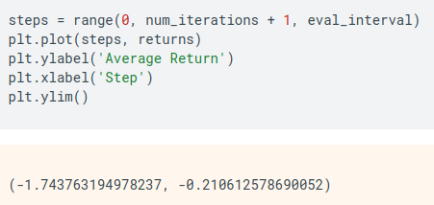
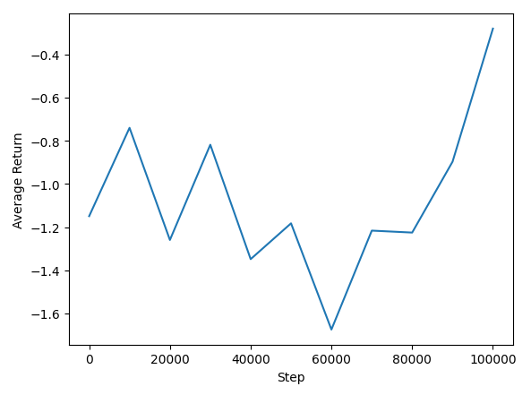
12.13 Visualization
https://www.tensorflow.org/agents/tutorials/7_SAC_minitaur_tutorial
Visualization
Plot
We can plot average return vs global steps to see the performance of our agent. In Minitaur, the reward function is based on how far the minitaur walks in 1000 steps and penalizes the energy expenditure.

Slide 40
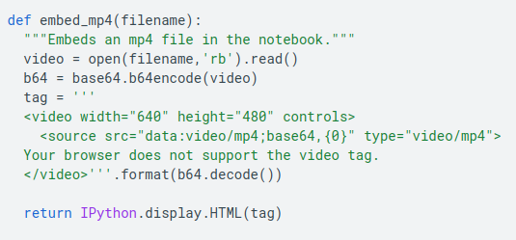
12.13 Visualization
https://www.tensorflow.org/agents/tutorials/7_SAC_minitaur_tutorial
Visualization
Video
It is helpful to visualize the performance of an agent by rendering the environment at each step.
Before we do that, let us first create a function to embed videos in this colab.

Slide 41
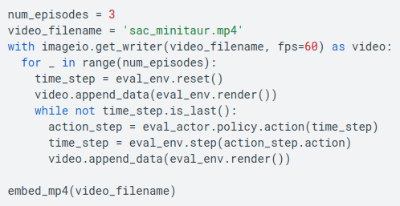
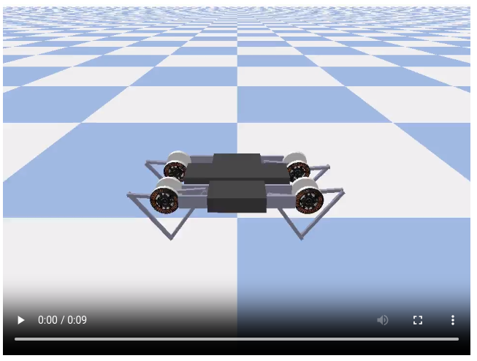
12.13 Visualization
https://www.tensorflow.org/agents/tutorials/7_SAC_minitaur_tutorial
Visualization
The following code visualizes the agent's policy for a few episodes:

Slide 42
End

