Slide 1

1.8 DQL Code
Peter H. Chen

Slide 2
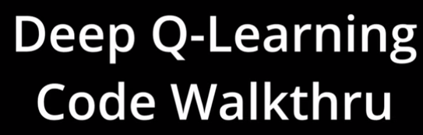
1.8 DQL Code
https://www.youtube.com/watch?v=EUrWGTCGzlA&list=PL58zEckBH8fCt_lYkmayZoR9XfDCW9hte&index=1
DQL Code (16:03-16:10/34:04)
We walk through the DQL (Deep Q-Leaning) Code.

Slide 3
1.8.0 Install Conda

Slide 4
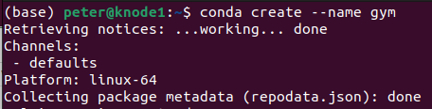
1.8.0 Install Conda/Gym Environment
https://www.youtube.com/watch?v=EUrWGTCGzlA&list=PL58zEckBH8fCt_lYkmayZoR9XfDCW9hte&index=1
Install Conda/Gym Environment (16:11-16:12/34:04)
We need to install Gymnasium on Ubuntu.
1. Create gym environment
> conda create –name gym
2. activate gym environment
> conda activate gym
1
2

Slide 5
1.8.0 Install Conda

Slide 6
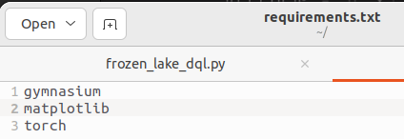
1.8.1 Install Libraries
https://www.youtube.com/watch?v=EUrWGTCGzlA&list=PL58zEckBH8fCt_lYkmayZoR9XfDCW9hte&index=1
Install Libraries (16:13-16:30/34:04)
In the requirements.txt:
1. gymnasium: OpenAI Gym Library is forked and maintained by Farama foundation.
2. matplotlib: Plot library
# collections: Python collections of pre-build module, no need to install.
# random: standard python library, no need to install
3. torch: Meta Neural Network library
https://gymnasium.farama.org/index.html

Slide 7
1.8.2 Import Library

Slide 8
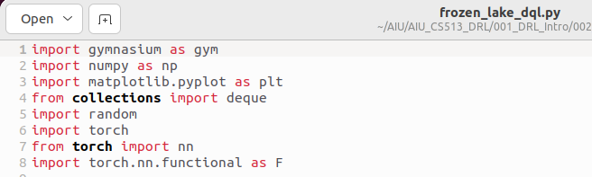
1.8.2 Import Library
https://www.youtube.com/watch?v=EUrWGTCGzlA&list=PL58zEckBH8fCt_lYkmayZoR9XfDCW9hte&index=1
Import Library (16:31-16:50/34:04)
In the 01_frozen_lake_dql.py, we import below libraries:

Slide 9
1.8.3 PyTorch Class DQN

Slide 10
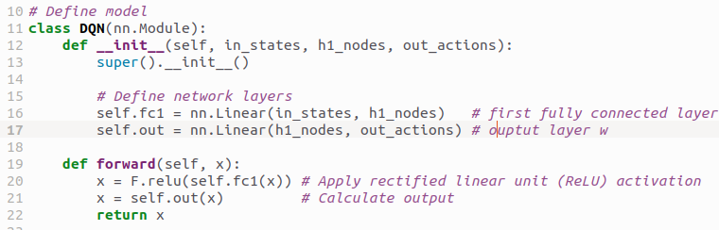
1.8.3 PyTorch Class DQN
https://www.youtube.com/watch?v=EUrWGTCGzlA&list=PL58zEckBH8fCt_lYkmayZoR9XfDCW9hte&index=1
PyTorch Class DQN (16:31-17:20/34:04)
We define PyTorch class DQN.
1. __init__(): defined fc1() and out(), we passed in the input layer, hidden layer, and output layer.
  fc1(), first fully connected layer: transform in_states (input states) into h1_nodes (first hidden nodes).
  out(), output layer: transform h1_nodes into output actions.
2. forward():
  Add ReLU (Linear Rectifier) activation function after fc1().
  Output with defined out()

Slide 11
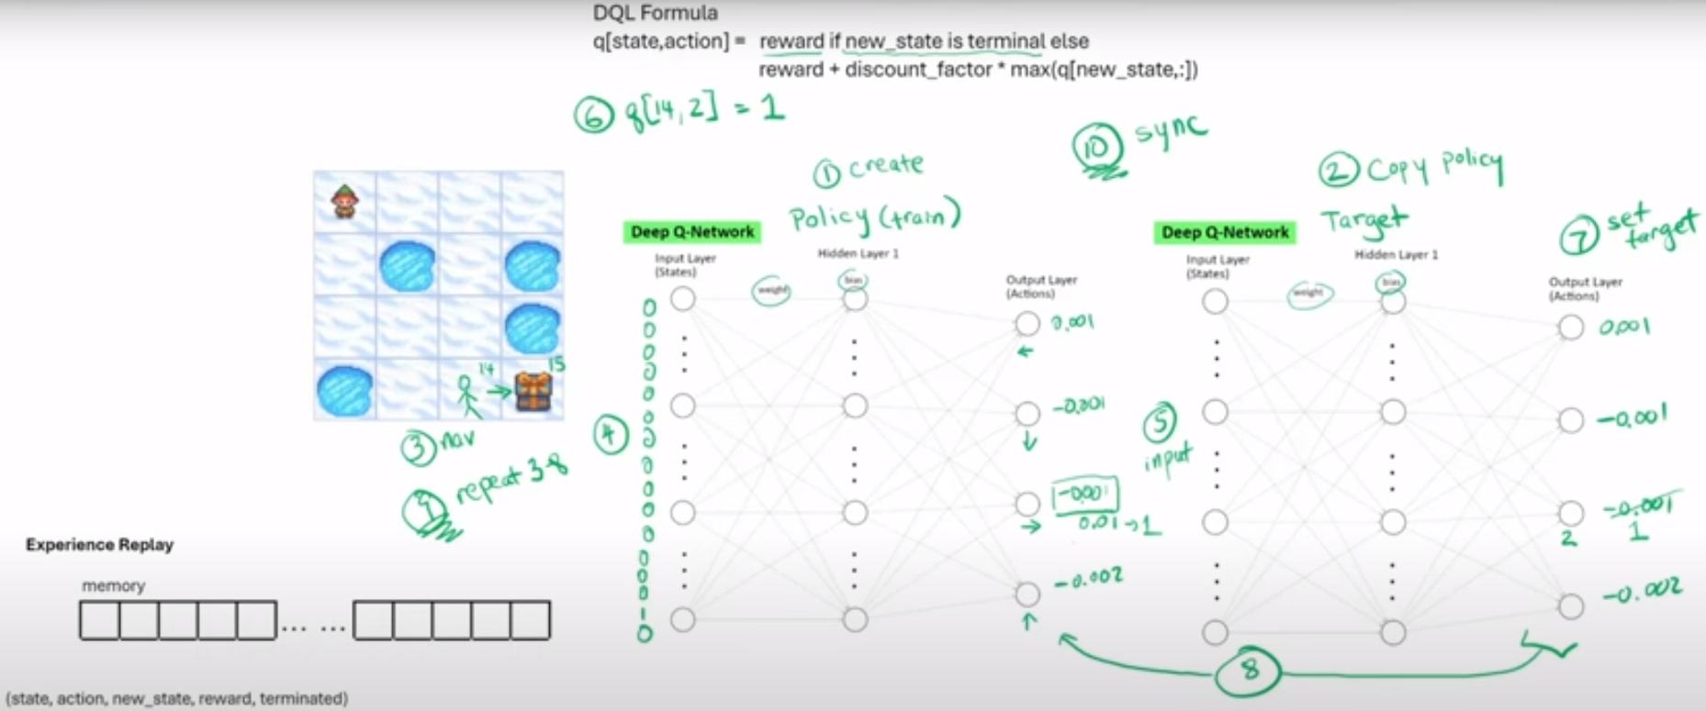
1.8.3 PyTorch Class DQN
https://www.youtube.com/watch?v=EUrWGTCGzlA&list=PL58zEckBH8fCt_lYkmayZoR9XfDCW9hte&index=1
PyTorch Class DQN (17:21-17:30/34:04)
In the diagram, as we mentioned before, we are going to have
1. 16 input states for input layer.
2. 16 nodes for hidden layer that you can adjust yourself.
3. one output layer with four nodes.
Experience Replay
memory
...
...
(states, action, new_state, reward, terminated)
Purged
3a: Maximize Experience
3b: Replay

Slide 12
1.8.3 PyTorch Class DQN
https://www.youtube.com/watch?v=EUrWGTCGzlA&list=PL58zEckBH8fCt_lYkmayZoR9XfDCW9hte&index=1
PyTorch Class DQN (17:21-18:00/34:04)
We declare
1. input layer with 16 inputs
2. hidden layer with 16 nodes
3. output layer with 4 output actions.
The Linear () function is used to connected inputs, hidden nodes, and output actions

Slide 13
1.8.4 Replay Memory

Slide 14
1.8.4 Replay Memory
https://www.youtube.com/watch?v=EUrWGTCGzlA&list=PL58zEckBH8fCt_lYkmayZoR9XfDCW9hte&index=1
Replay Memory (18:01-18:05/34:04)
Now, we implement the replay memory.
Experience Replay
memory
...
...
(states, action, new_state, reward, terminated)
Purged
3a: Maximize Experience
3b: Replay

Slide 15
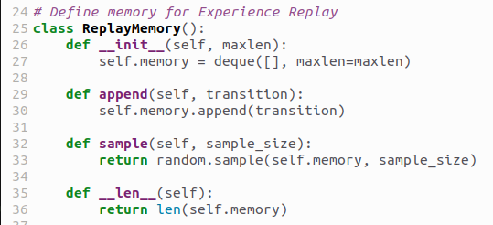
1.8.4 Replay Memory
https://www.youtube.com/watch?v=EUrWGTCGzlA&list=PL58zEckBH8fCt_lYkmayZoR9XfDCW9hte&index=1
Replay Memory (18:06-18:40/34:04)
1. In the class ReplayMemory(), we define the following function for Experience Replay
2. __init__(): We pass in the maxlen and create python queue.
3. append(): In the transition, we append the transition into the queue.
The transition contains the tuple: (states, action, new_state, reward, terminated) which we are going to append and delete from the queue.
4. sample(): the sample function will return random sample of the whatever the size you want in the memory.
5. __len__(): return the length of memory.
Experience Replay
deque
memory
...
...
(states, action, new_state, reward, terminated)
Purged
3a: Maximize Experience
3b: Replay

Slide 16
1.8.5 Setup Hyperparameter

Slide 17
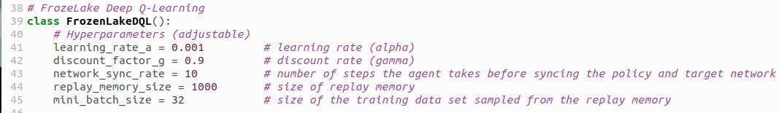
1.8.5 Setup Hyperparameter
https://www.youtube.com/watch?v=EUrWGTCGzlA&list=PL58zEckBH8fCt_lYkmayZoR9XfDCW9hte&index=1
Setup Hyperparameter (18:41-19:05/34:04)
The class FrozenLakeDQL() is the class we are going to do our training.
1. Set learning Rate
2. Set Discount factor for Deep Q Learning formula

Slide 18
1.8.5 Setup Hyperparameter
https://www.youtube.com/watch?v=EUrWGTCGzlA&list=PL58zEckBH8fCt_lYkmayZoR9XfDCW9hte&index=1
Setup Hyperparameter (19:06-19:15/34:04)
Network Sync Rate: The number of steps the agent takes between the syncing of policy and target network. That is the setup of step 10 where we sync the policy and target network.
Experience Replay
memory
...
...
(states, action, new_state, reward, terminated)
Purged
3a: Maximize Experience
3b: Replay

Slide 19
1.8.5 Setup Hyperparameter
https://www.youtube.com/watch?v=EUrWGTCGzlA&list=PL58zEckBH8fCt_lYkmayZoR9XfDCW9hte&index=1
Setup Hyperparameter (19:16-19:15/34:04)
The replay memory size is 1000.
The replay memory sample size is 32. This is also the numbers that you can play around with.

Slide 20
1.8.6 Setup Neural Network

Slide 21
1.8.6 Setup Neural Network
https://www.youtube.com/watch?v=EUrWGTCGzlA&list=PL58zEckBH8fCt_lYkmayZoR9XfDCW9hte&index=1
Setup Neural Network (19:16-19:40/34:04)
Next is loss function and the optimizer.
These two are PyTorch variables for loss function which we use MSELoss (mean square function).
For optimizer, we initialize that later on.

Slide 22
1.8.6 Setup Neural Network
https://www.youtube.com/watch?v=EUrWGTCGzlA&list=PL58zEckBH8fCt_lYkmayZoR9XfDCW9hte&index=1
Setup Neural Network (19:51-19:50/34:04)
Next, we setup the action letters into numbers.

Slide 23
1.8.7 Train Function

Slide 24
1.8.7 Train Function
https://www.youtube.com/watch?v=EUrWGTCGzlA&list=PL58zEckBH8fCt_lYkmayZoR9XfDCW9hte&index=1
Train Function (19:51-20:06/34:04)
In the training function, we can specify
1. How many episodes we want to train the agent.
2. Whether we want to render (redraw) the map on screen.
3. Whether we want to turn on the slipper flag on ice.
Question:
What is difference between the episode and epoch?
Answer:
a. one episode = one a sequence of states, actions and rewards, which ends with terminal state. For example, playing an entire game can be considered as one episode, the terminal state being reached when one player loses/wins/draws. Sometime, one may prefer to define one episode as several games (example: "each episode is a few dozen games, because the games go up to score of 21 for either player").
b. one epoch = one forward pass and one backward pass of all the training examples, in the neural network terminology.
https://stats.stackexchange.com/questions/250943/what-is-the-difference-between-episode-and-epoch-in-deep-q-learning

Slide 25
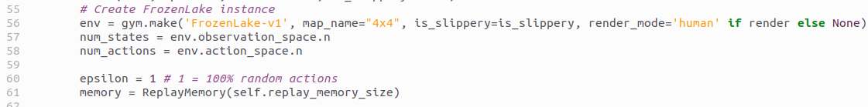
1.8.7 Train Function
https://www.youtube.com/watch?v=EUrWGTCGzlA&list=PL58zEckBH8fCt_lYkmayZoR9XfDCW9hte&index=1
Train Function (20:07-20:20/34:04)
1. We instantiate the frozen lake environment.
2. Create a variable to store the number of state. The number of state = 16.
3. Store the number of action = 4.
4. initialize epsilon = 1
5. instantiate the replay memory with relay_memory_size = 1000

Slide 26
1.9.1 Step 1: Create Policy DQN

Slide 27
1.9.1 Step 1: Create Policy DQN
https://www.youtube.com/watch?v=EUrWGTCGzlA&list=PL58zEckBH8fCt_lYkmayZoR9XfDCW9hte&index=1
Step 1: Create Policy DQN (20:21-20:30/34:04)
Now, we create the Policy DQN (Deep-Q Network).
This is the step 1: Create the Policy Network and also create Target network.
Experience Replay
memory
...
...
(states, action, new_state, reward, terminated)
Purged
3a: Maximize Experience
3b: Replay

Slide 28
1.9.2 Step 2: Copy Target Network

Slide 29
1.9.2 Step 2: Copy Target Network
https://www.youtube.com/watch?v=EUrWGTCGzlA&list=PL58zEckBH8fCt_lYkmayZoR9XfDCW9hte&index=1
Step 2: Copy Target Network (20:31-20:55/34:04)
We copy the the weights and biases from policy network to the target network.
Make the target network and policy network identical.
Experience Replay
memory
...
...
(states, action, new_state, reward, terminated)
Purged
3a: Maximize Experience
3b: Replay

Slide 30
1.9.2 Step 2: Copy Target Network
https://www.youtube.com/watch?v=EUrWGTCGzlA&list=PL58zEckBH8fCt_lYkmayZoR9XfDCW9hte&index=1
Step 2: Copy Target Network (20:56-21:00/34:04)
Before we do the training, we print out the policy network. Just to compare it to the end result.
Experience Replay
memory
...
...
(states, action, new_state, reward, terminated)
Purged
3a: Maximize Experience
3b: Replay

Slide 31
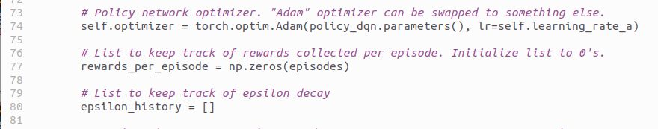
1.9.2 Step 2: Copy Target Network
https://www.youtube.com/watch?v=EUrWGTCGzlA&list=PL58zEckBH8fCt_lYkmayZoR9XfDCW9hte&index=1
Step 2: Copy Target Network (21:01-21:20/34:04)
1. We initialize the optimizer as we declared earlier. We use Adam optimizer, passed in the learning rate.
2. We create a list to keep track of rewards collected per episode.
3. We also keep track of history of epsilon decay.
1
2
3

Slide 32
1.9.3 Step 3: Navigation

Slide 33
1.9.3 Step 3: Navigation
https://www.youtube.com/watch?v=EUrWGTCGzlA&list=PL58zEckBH8fCt_lYkmayZoR9XfDCW9hte&index=1
Step 3: Navigation (21:21-21:45/34:04)
We count the number of steps taken. This is used to when to sync the policy and target network again. That is for step 10.
Experience Replay
memory
...
...
(states, action, new_state, reward, terminated)
Purged
3a: Maximize Experience
3b: Replay

Slide 34

1.9.3 Step 3: Navigation
https://www.youtube.com/watch?v=EUrWGTCGzlA&list=PL58zEckBH8fCt_lYkmayZoR9XfDCW9hte&index=1
Step 3: Navigation (21:46-22:10/34:04)
1. Next, we will loop through the number of episodes that we specified.
2. When calling the train function, we will initialize the map so the agent start at state 0.
3. We will initialize the terminated flag and truncated flag.
Terminated is when the agent fall into the hole or the agent reaches the goal.
We initialize the truncated flag. Truncated is when the agent takes more than 200 actions. For such a small map 4 x 4, the number of actions should never going to over than 200.
1
2
3

Slide 35
1.9.3 Step 3: Navigation
https://www.youtube.com/watch?v=EUrWGTCGzlA&list=PL58zEckBH8fCt_lYkmayZoR9XfDCW9hte&index=1
Step 4: Repeat Navigation (22:11-22:20/34:04)
We navigate the map until the agent falls into hole/reaches the goal (terminated) or agent ha more than 200 actions (truncated).
Experience Replay
memory
...
...
(states, action, new_state, reward, terminated)
Purged
3a: Maximize Experience
3b: Replay

Slide 36
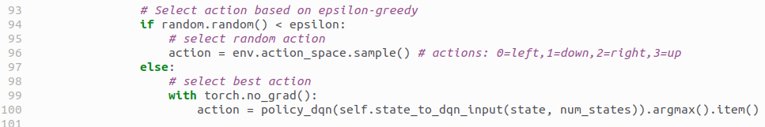
1.9.3 Step 3: Navigation
https://www.youtube.com/watch?v=EUrWGTCGzlA&list=PL58zEckBH8fCt_lYkmayZoR9XfDCW9hte&index=1
Step 3: Navigation (22:11-22:40/34:04)
Select the action based on
1. If random number is less than epsilon, select the random action
2. If random number is greater then epsilon, select the best action from the policy network. We calculate the set of Q-values. Take the maximum of that and extract that item. That going to be the best action.
1
2

Slide 37
1.9.4 Step 4: One-Hot-Encoding

Slide 38
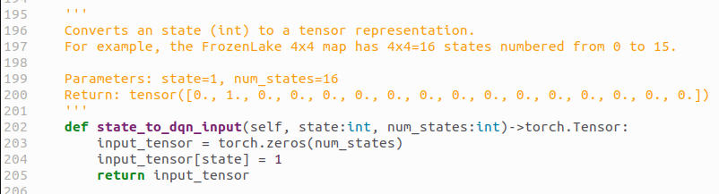
1.9.4 Step 4: One-Hot-Encoding
https://www.youtube.com/watch?v=EUrWGTCGzlA&list=PL58zEckBH8fCt_lYkmayZoR9XfDCW9hte&index=1
Step 4: One-Hot-Encoding (22:41-22:55/34:04)
We have function here called state_to_dqn_input() for One-Hot-Encoding.
We take the state 14 number and decode into one-hot-encoding tensor ([0, 0, 0, 0, 0, 0, 0, 0, 0, 0, 0, 0, 0, 0, 1, 0]).
Experience Replay
memory
...
...
(states, action, new_state, reward, terminated)
Purged
3a: Maximize Experience
3b: Replay

Slide 39
1.9.4 Step 4: One-Hot-Encoding
https://www.youtube.com/watch?v=EUrWGTCGzlA&list=PL58zEckBH8fCt_lYkmayZoR9XfDCW9hte&index=1
Step 4: One-Hot-Encoding (22:56-23:00/34:04)
Here, we use PyTorch to set the one-hot-encoding, input_tensor [state] = 1.

Slide 40
1.9.4 Step 4: One-Hot-Encoding
https://www.youtube.com/watch?v=EUrWGTCGzlA&list=PL58zEckBH8fCt_lYkmayZoR9XfDCW9hte&index=1
Step 4: One-Hot-Encoding (23:01-23:05/34:04)
We use torch.no_grad() to check whether we need to calculate the training or not.

Slide 41
1.9.5 Step 3a: Experience Replay

Slide 42
1.9.5 Step 3a: Experience Replay
https://www.youtube.com/watch?v=EUrWGTCGzlA&list=PL58zEckBH8fCt_lYkmayZoR9XfDCW9hte&index=1
Step 3a: Experience Replay (22:41-22:55/34:04)
Execute Action:
After set up the inputs, we call the step function to execute the action.
When we take that action, it going to return the new state whether there is a reward or not, wether there is a terminated state or we got truncated.

Slide 43
1.9.5 Step 3a: Experience Replay
https://www.youtube.com/watch?v=EUrWGTCGzlA&list=PL58zEckBH8fCt_lYkmayZoR9XfDCW9hte&index=1
Step 3a: Experience Replay (22:56-23:00/34:04)
Save Experience into Memory:
We take all that information and put it into our memory.
So, that is step 3a.
Experience Replay
memory
...
...
(states, action, new_state, reward, terminated)
Purged
3a: Maximize Experience
3b: Replay

Slide 44
1.9.5 Step 3a: Experience Replay
https://www.youtube.com/watch?v=EUrWGTCGzlA&list=PL58zEckBH8fCt_lYkmayZoR9XfDCW9hte&index=1
Step 3a: Experience Replay (23:01-23:30/34:04)
When we did the epsilon greedy.
That was the step 3.
Experience Replay
memory
...
...
(states, action, new_state, reward, terminated)
Purged
3a: Maximize Experience
3b: Replay

Slide 45
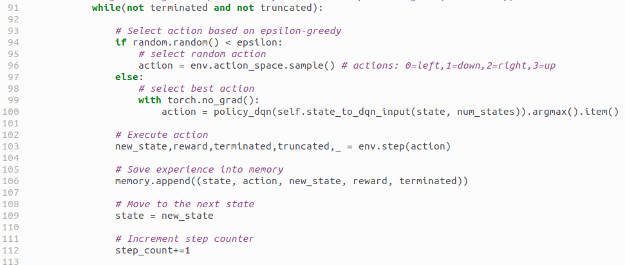
1.9.5 Step 3a: Experience Replay
https://www.youtube.com/watch?v=EUrWGTCGzlA&list=PL58zEckBH8fCt_lYkmayZoR9XfDCW9hte&index=1
Step 3a: Experience Replay (23:31-23:50/34:04)
1. Move to the next state:
After executing the action, we move to the next state.
We reset the state to the next state.
2. We increment our step counter.
1
2

Slide 46

1.9.5 Step 3a: Experience Replay
https://www.youtube.com/watch?v=EUrWGTCGzlA&list=PL58zEckBH8fCt_lYkmayZoR9XfDCW9hte&index=1
Step 3a: Experience Replay (23:51-24:00/34:04)
Keep track of rewards collected per episode:
We received an award and put it on our list.

Slide 47
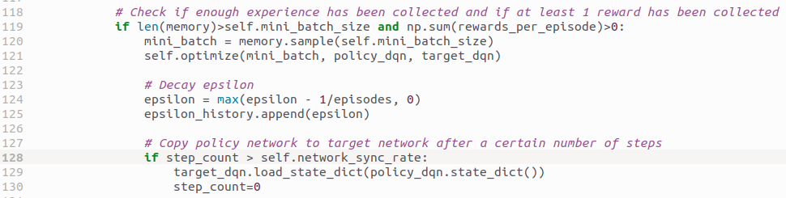
1.9.5 Step 3a: Experience Replay
https://www.youtube.com/watch?v=EUrWGTCGzlA&list=PL58zEckBH8fCt_lYkmayZoR9XfDCW9hte&index=1
Step 3a: Experience Replay (24:01-24:30/34:04)
Check if enough experience has been collected and at least 1 reward has been collected:
Now, we check the memory to see if we have enough training data to do optimization.
Also, we have to check if we have collected any reward. If we have not collected any rewards, there is really no point in optimizing the network.
1. If these conditions are met,
2. We use memory sample and pass in the mini_batch_size (= 32) and get the batch of training data (mini_batch) out of the memory.
3. We pass the training data into the optimize function along with the policy network and the target network.
1
2
3

Slide 48
1.9.6 Step 3b: Replay/Optimize

Slide 49
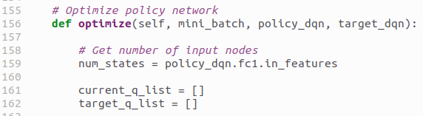
1.9.6 Step 3b: Replay/Optimize
https://www.youtube.com/watch?v=EUrWGTCGzlA&list=PL58zEckBH8fCt_lYkmayZoR9XfDCW9hte&index=1
Replay/Optimize (24:31-24:50/34:04)
Let’s jump over to the optimize function for step 3b.
1. The first line is to get the training data, get the policy network, and target network. We have 16 nodes in both networks.
2. Have have 16 states of current DQN and Target network.
3. We have current q list and target q list.
1
2
3
Experience Replay
memory
...
...
(states, action, new_state, reward, terminated)
Purged
3a: Maximize Experience
3b: Replay

Slide 50
1.9.6 Step 3b: Replay/Optimize
https://www.youtube.com/watch?v=EUrWGTCGzlA&list=PL58zEckBH8fCt_lYkmayZoR9XfDCW9hte&index=1
Replay/Optimize (24:51-25:00/34:04)
What we try to describe now is step 3b: Replay
Experience Replay
memory
...
...
(states, action, new_state, reward, terminated)
Purged
3a: Maximize Experience
3b: Replay

Slide 51
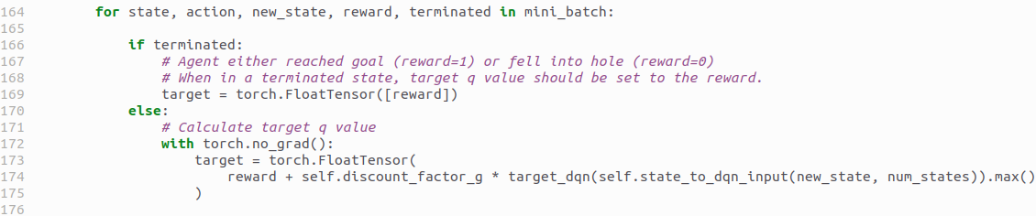
1.9.6 Step 3b: Replay/Optimize
https://www.youtube.com/watch?v=EUrWGTCGzlA&list=PL58zEckBH8fCt_lYkmayZoR9XfDCW9hte&index=1
Replay/Optimize (25:01-25:05/34:04)
In step 3b: Replay, we loop through the training data (min0_batch).
We skip the terminate section and look at later on.

Slide 52
1.9.7 Step 4: Policy Q-Value

Slide 53
1.9.7 Step 4: Policy Q-Value
https://www.youtube.com/watch?v=EUrWGTCGzlA&list=PL58zEckBH8fCt_lYkmayZoR9XfDCW9hte&index=1
Step 4: Policy Q-Value (25:06-25:10/34:04)
We are talking about the step 4: get the Q-values in Policy/Target Networks:
Experience Replay
memory
...
...
(states, action, new_state, reward, terminated)
Purged
3a: Maximize Experience
3b: Replay

Slide 54
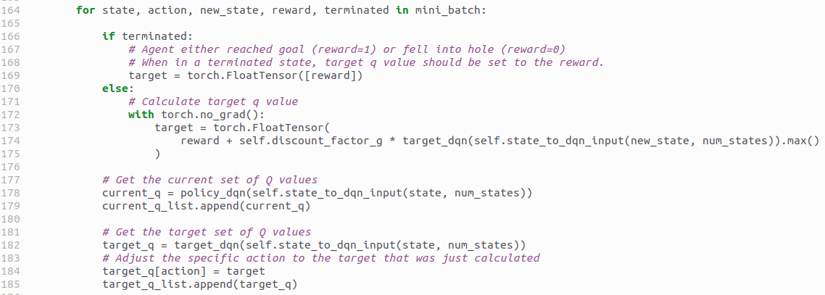
1.9.7 Step 4: Policy Q-Value
https://www.youtube.com/watch?v=EUrWGTCGzlA&list=PL58zEckBH8fCt_lYkmayZoR9XfDCW9hte&index=1
Step 4: Policy Q-Value (25:11-25:20/34:04)
In step 4, we get the current Q values from policy network.
Step 4

Slide 55
1.9.7 Step 4: Policy Q-Value
https://www.youtube.com/watch?v=EUrWGTCGzlA&list=PL58zEckBH8fCt_lYkmayZoR9XfDCW9hte&index=1
Step 4: Policy Q-Value (25:21-25:25/34:04)
In step 4, the output is the list of Q-Values of the Policy Network.
Experience Replay
memory
...
...
(states, action, new_state, reward, terminated)
Purged
3a: Maximize Experience
3b: Replay

Slide 56
1.9.8 Step 5: Target Q-Value

Slide 57
1.9.8 Step 5: Target Q-Value
https://www.youtube.com/watch?v=EUrWGTCGzlA&list=PL58zEckBH8fCt_lYkmayZoR9XfDCW9hte&index=1
Step 5: Target Q-Value (25:21-25:25/34:04)
In step 5,we pass same thing to the Target Network.
In step 5, we get the Q-values from the Target network.
It is same thing as step 4, get the Q-values from the policy network.
Experience Replay
memory
...
...
(states, action, new_state, reward, terminated)
Purged
3a: Maximize Experience
3b: Replay

Slide 58
1.9.8 Step 5: Target Q-Value
https://www.youtube.com/watch?v=EUrWGTCGzlA&list=PL58zEckBH8fCt_lYkmayZoR9XfDCW9hte&index=1
Step 5: Target Q-Value (25:16-25:30/34:04)
In step 5, we get the current Q values from target network.
Step 5

Slide 59
1.9.9 Step 6: Calculate Target Q-Value

Slide 60
1.9.9 Step 6: Calculate Target Q-Value
https://www.youtube.com/watch?v=EUrWGTCGzlA&list=PL58zEckBH8fCt_lYkmayZoR9XfDCW9hte&index=1
Step 6: Calculate Target Q-Value (25:31-25:40/34:04)
In step 6, the calculate formula as below.
Step 6
Experience Replay
memory
...
...
(states, action, new_state, reward, terminated)
Purged
3a: Maximize Experience
3b: Replay

Slide 61
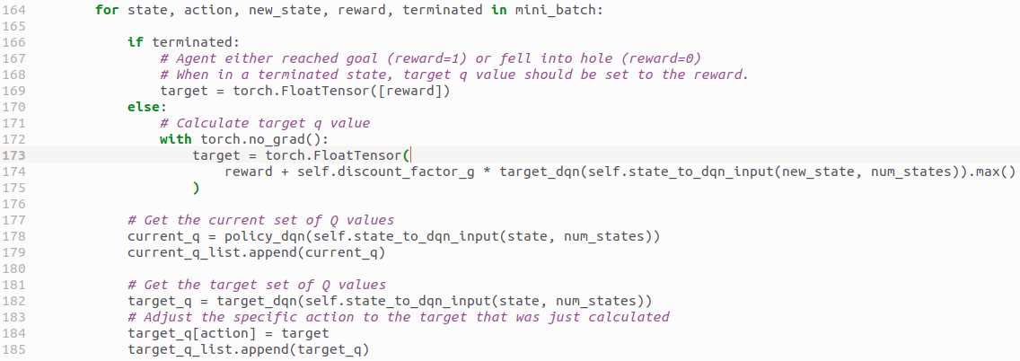
1.9.9 Step 6: Calculate Target Q-Value
https://www.youtube.com/watch?v=EUrWGTCGzlA&list=PL58zEckBH8fCt_lYkmayZoR9XfDCW9hte&index=1
Step 6: Calculate Target Q-Value (25:41-26:00/34:04)
If we get terminated (Reach the goal get into the holes), then we return the reward for Q-value.
Otherwise, we calculate the target Q-Value with reward and max Q-value.
Now, we have target for step 7.
Step 6

Slide 62
1.9.10 Step 7: Target Network Output

Slide 63
1.9.10 Step 7: Target Network Output
https://www.youtube.com/watch?v=EUrWGTCGzlA&list=PL58zEckBH8fCt_lYkmayZoR9XfDCW9hte&index=1
Step 7: Target Network Output (26:01-26:10/34:04)
In step 7, we set the output of Target Network.
We take output of step 6 and replace the with respective Q-Value.
Step 7
Experience Replay
memory
...
...
(states, action, new_state, reward, terminated)
Purged
3a: Maximize Experience
3b: Replay

Slide 64
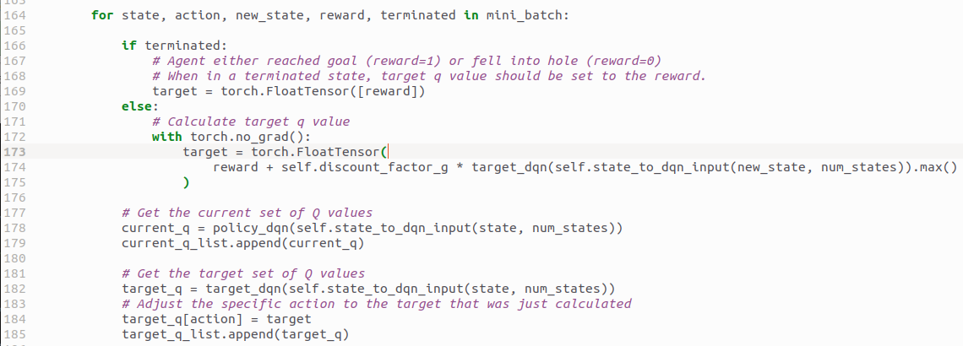
1.9.10 Step 7: Target Network Output
https://www.youtube.com/watch?v=EUrWGTCGzlA&list=PL58zEckBH8fCt_lYkmayZoR9XfDCW9hte&index=1
Step 7: Target Network Output (26:11-25:15/34:04)
We are replacing the Q-Value of that particular action.
Step 7

Slide 65
1.9.11 Step 8: Target to Policy Output

Slide 66
1.9.11 Step 8: Target to Policy Output
https://www.youtube.com/watch?v=EUrWGTCGzlA&list=PL58zEckBH8fCt_lYkmayZoR9XfDCW9hte&index=1
Step 8: Target to Policy Output (26:16-26:30/34:04)
In step 8, we return output of Target Network to Policy Network.
Experience Replay
memory
...
...
Step 8
(states, action, new_state, reward, terminated)
Purged
3a: Maximize Experience
3b: Replay

Slide 67
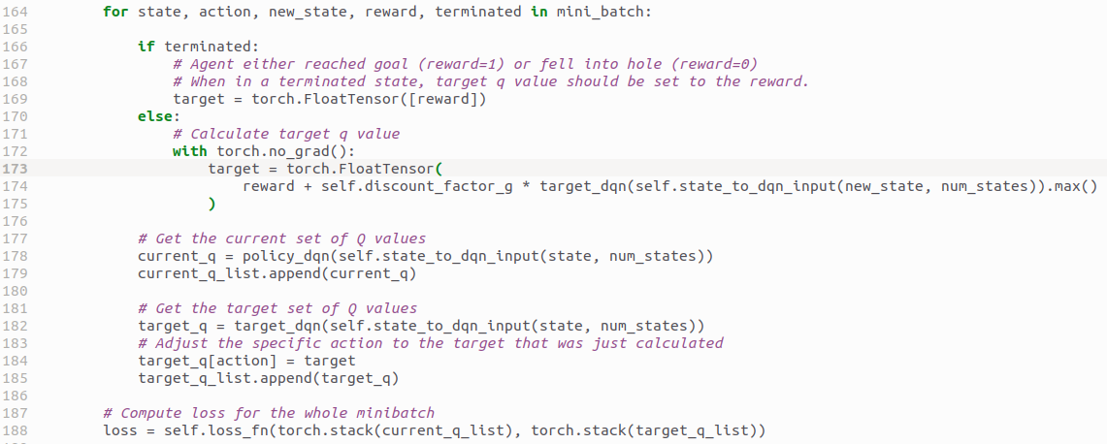
1.9.11 Step 8: Target to Policy Output
https://www.youtube.com/watch?v=EUrWGTCGzlA&list=PL58zEckBH8fCt_lYkmayZoR9XfDCW9hte&index=1
Step 8: Target to Policy Output (26:31-26:40/34:04)
We are update the output policy network with output of target network.
The loss function pass in the current q list and target q list.
This is the standard code to optimize the policy network.
Step 8

Slide 68
1.9.12 Step 9: Repeat 3 to 8

Slide 69
1.9.12 Step 9: Repeat 3 to 8
https://www.youtube.com/watch?v=EUrWGTCGzlA&list=PL58zEckBH8fCt_lYkmayZoR9XfDCW9hte&index=1
Step 9: Repeat 3 to 8 (26:41-26:50/34:04)
In step 9, we repeat the 3 to 8, starting from navigation to optimizing the network.
Step 9
Experience Replay
memory
...
...
(states, action, new_state, reward, terminated)
Purged
3a: Maximize Experience
3b: Replay

Slide 70
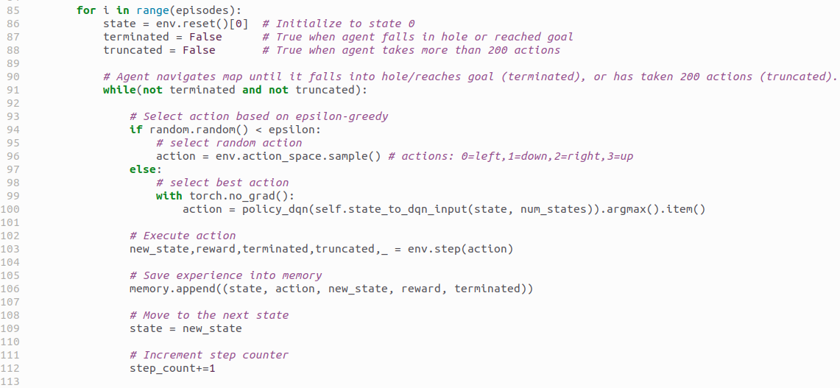
1.9.12 Step 9: Repeat 3 to 8
https://www.youtube.com/watch?v=EUrWGTCGzlA&list=PL58zEckBH8fCt_lYkmayZoR9XfDCW9hte&index=1
Step 9: Repeat 3 to 8 (26:51-27:10/34:04)
In step 9, we repeat the 3 to 8, starting from navigation to optimizing the network.
Step 9 contains two loops:
1. Outer Loop: is to loop through each episode.
2. Inner Loop: stepping through the states.
Step 9
1
2

Slide 71
1.9.13 Step 10: Sync Policy/Target Network

Slide 72
1.9.13 Step 10: Sync Policy/Target Network
https://www.youtube.com/watch?v=EUrWGTCGzlA&list=PL58zEckBH8fCt_lYkmayZoR9XfDCW9hte&index=1
Step 10: Sync Policy/Target Network (27:11-27:20/34:04)
In step 10, we sync the policy network and target network.
Step 10
Experience Replay
memory
...
...
(states, action, new_state, reward, terminated)
Purged
3a: Maximize Experience
3b: Replay

Slide 73
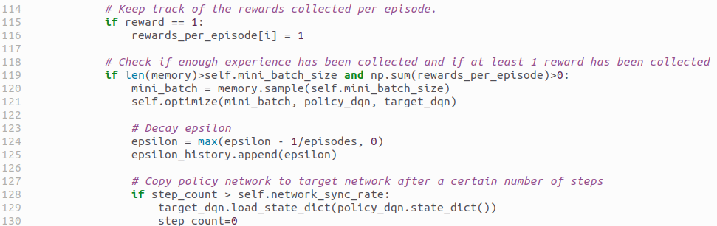
1.9.13 Step 10: Sync Policy/Target Network
https://www.youtube.com/watch?v=EUrWGTCGzlA&list=PL58zEckBH8fCt_lYkmayZoR9XfDCW9hte&index=1
Step 10: Sync Policy/Target Network (27:21-27:30/34:04)
In step 10, if the number of steps taken is greater than network sync rate that we set, then we copy the policy network into the target network.
Then, we reset the step counter.
After each episode, we should be decaying the epsilon value.
Step 10

Slide 74
1.9.13 Step 10: Sync Policy/Target Network
https://www.youtube.com/watch?v=EUrWGTCGzlA&list=PL58zEckBH8fCt_lYkmayZoR9XfDCW9hte&index=1
Step 10: Sync Policy/Target Network (27:31-27:45/34:04)
After syncing the network, we repeat step n again which is repeating the step 3 navigation to step 8 and training again.
Step 10
Experience Replay
memory
...
...
(states, action, new_state, reward, terminated)
Purged
3a: Maximize Experience
3b: Replay

Slide 75
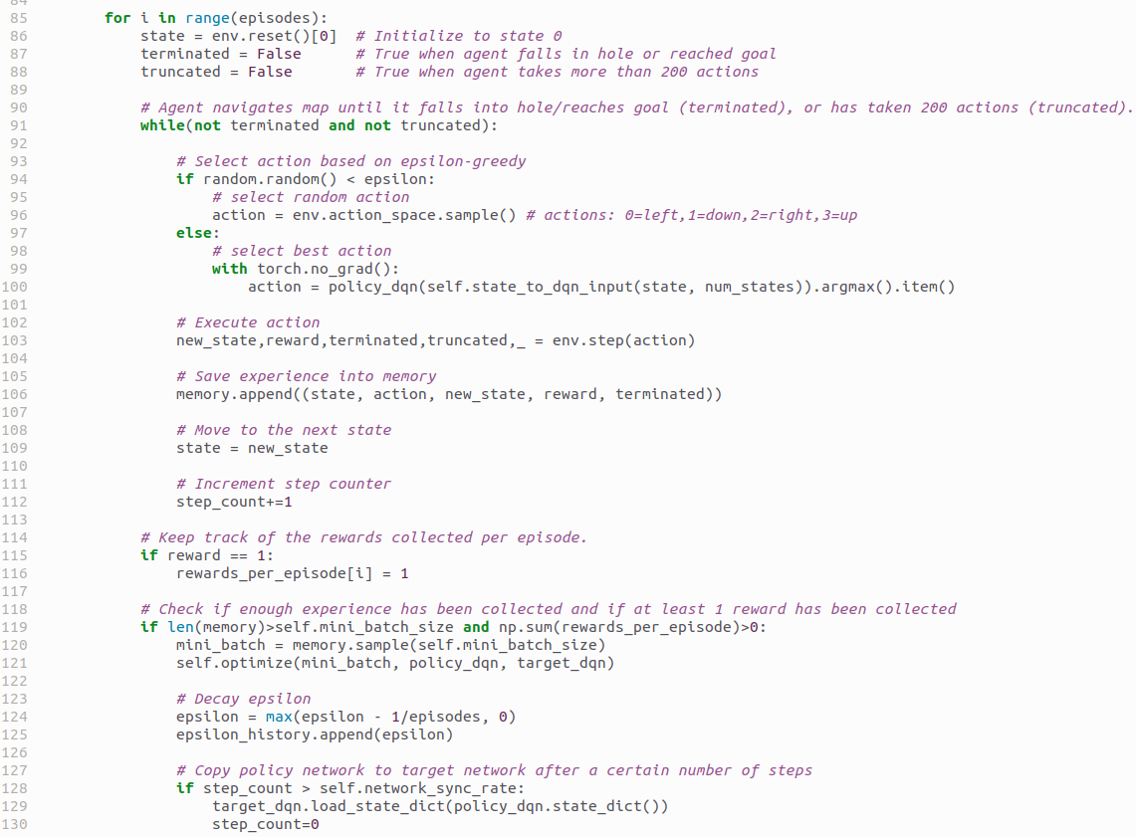
1.9.13 Step 10: Sync Policy/Target Network
https://www.youtube.com/watch?v=EUrWGTCGzlA&list=PL58zEckBH8fCt_lYkmayZoR9XfDCW9hte&index=1
Step 10: Sync Policy/Target Network (27:46-28:00/34:04)
That is basically go back to another episode here and repeat again.
All the ways until we finish all the numbers of episode.

Slide 76
1.9.14 Close Environment

Slide 77

1.9.14 Close Environment
https://www.youtube.com/watch?v=EUrWGTCGzlA&list=PL58zEckBH8fCt_lYkmayZoR9XfDCW9hte&index=1
Close Environment (28:01-28:02/34:04)
We close the environment after we finish all the numbers of episode.

Slide 78
1.9.15 Save Policy

Slide 79
1.9.15 Save Policy
https://www.youtube.com/watch?v=EUrWGTCGzlA&list=PL58zEckBH8fCt_lYkmayZoR9XfDCW9hte&index=1
Save Policy (28:03-28:05/34:04)
We save all the values of weights and bias of policy network into a file.
We hard-coded here with “frozen_lake_dql.pt”. We can change to non-hard-coded

Slide 80
1.9.16 Save Plot

Slide 81
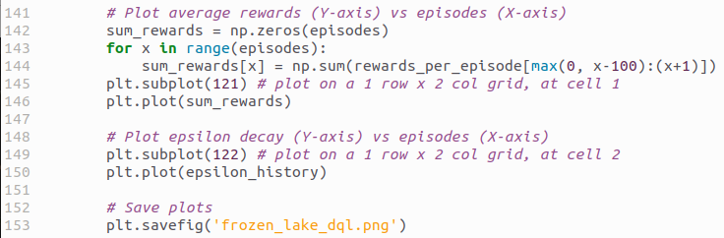
1.9.16 Save Plot
https://www.youtube.com/watch?v=EUrWGTCGzlA&list=PL58zEckBH8fCt_lYkmayZoR9XfDCW9hte&index=1
Save Plot (28:06-28:30/34:04)
We save the data (reward and epsilon history) for plotting.

Slide 82
1.9.17 Test Function

Slide 83
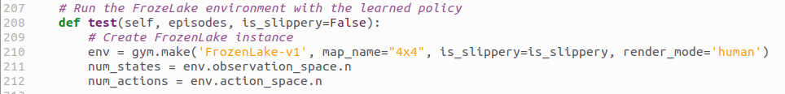
1.9.17 Test Function
https://www.youtube.com/watch?v=EUrWGTCGzlA&list=PL58zEckBH8fCt_lYkmayZoR9XfDCW9hte&index=1
Test Function (28:31-29:00/34:04)
In the test function, we are going to run Froze Lake environment with learned policy.
We pass in number of episodes and slippery flag.
The code is very similar to the train function.
We create
1. FrozenLake environment.
2. Number of states = 16
3. Number of actions = 4

Slide 84
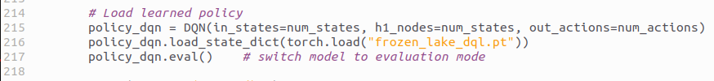
1.9.17 Test Function
https://www.youtube.com/watch?v=EUrWGTCGzlA&list=PL58zEckBH8fCt_lYkmayZoR9XfDCW9hte&index=1
Test Function (29:01-29:20/34:04)
Here, we
1. Declare the policy network.
2. Load the weights and bias of trained policy neural network from file
3. Switch the model to evaluate mode rather than training mode.

Slide 85
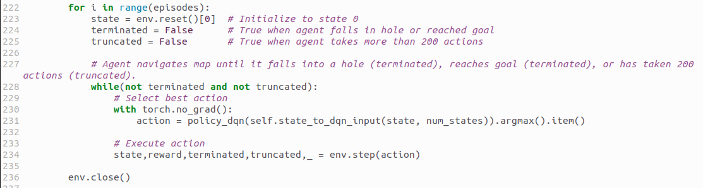
1.9.17 Test Function
https://www.youtube.com/watch?v=EUrWGTCGzlA&list=PL58zEckBH8fCt_lYkmayZoR9XfDCW9hte&index=1
Test Function (29:21-29:40/34:04)
Then, we loop through episodes.
We have agent on the top and navigate map until agent get terminated (Fall into hole/reach goal) or truncated (more than 200 actions).
Here, we
1. Select the best policy for action from our network and
2. Executing the action
3. When finished, we close the environment
1
2
3

Slide 86
1.9.17 Test Function
https://www.youtube.com/watch?v=EUrWGTCGzlA&list=PL58zEckBH8fCt_lYkmayZoR9XfDCW9hte&index=1
Test Function (29:31-29:50/34:04)
We will see the agent navigate the map and reach the goal.
However, if the slipper is on, then there is no guarantee that the agent will solve it in one try.
The agent may take several tries to solve the map.

Slide 87
End

