Slide 1

1.18 Run Training
Peter H. Chen

Slide 2

1.18 Run Training
https://www.youtube.com/watch?v=EUrWGTCGzlA&list=PL58zEckBH8fCt_lYkmayZoR9XfDCW9hte&index=1
Run Training (29:51-29:52/34:04)
Now, we run the training code.

Slide 3
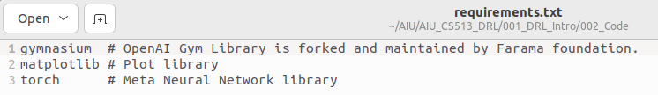
1.19 Run Train and Test
https://www.youtube.com/watch?v=EUrWGTCGzlA&list=PL58zEckBH8fCt_lYkmayZoR9XfDCW9hte&index=1
Run Train and Train (29:53-29:54/34:04)
1. Create/Activate conda environment
> conda create --name gym
> conda activate gym
2. Install requirements.txt
> conda install -r requirements.txt
1
2

Slide 4
1.19 Run Train and Test

Slide 5
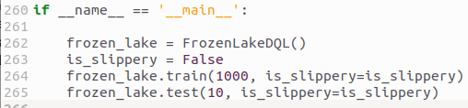
1.19 Run Train and Test
https://www.youtube.com/watch?v=EUrWGTCGzlA&list=PL58zEckBH8fCt_lYkmayZoR9XfDCW9hte&index=1
Run Training (29:55-29:56/34:04)
Check the code:
1. We have the main function which
2. We create frozen_lake instance of class FrozenLakeDQL().
3. First, we try non-slipper
4. We train for 1000 times (or 1000 episodes) and non-slippery
5. Then, we test 10 times with slippery. The map pops up and goes away when the agent gets to the goal.
We will run several times so that we see it on the screen.

Slide 6
1.19 Run Train and Test
https://www.youtube.com/watch?v=EUrWGTCGzlA&list=PL58zEckBH8fCt_lYkmayZoR9XfDCW9hte&index=1
Run Training (29:57-30:00/34:04)
Run application:
> python3 01_frozen_lake_dql.py

Slide 7

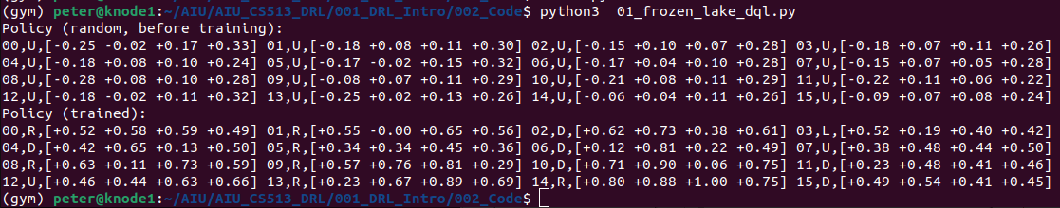
1.19 Run Train and Test
https://www.youtube.com/watch?v=EUrWGTCGzlA&list=PL58zEckBH8fCt_lYkmayZoR9XfDCW9hte&index=1
Run Train and Train (30:01-30:02/34:04)
A minute later...

Slide 8
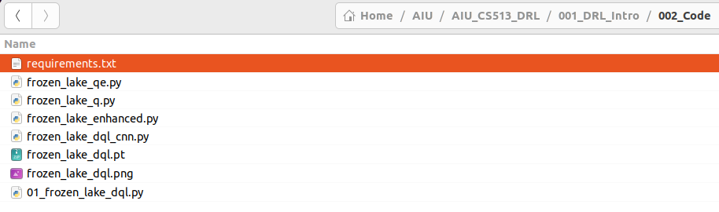
1.19 Run Train and Test
https://www.youtube.com/watch?v=EUrWGTCGzlA&list=PL58zEckBH8fCt_lYkmayZoR9XfDCW9hte&index=1
Run Train and Test (30:16-31:30/34:04)
A minute later…
After training, we have
1. file “frozen_lake_dqn.pt”
2. file “frozen_lake_dqn.png”

Slide 9
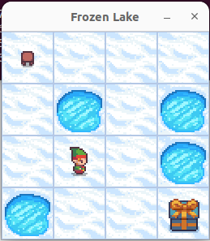
1.19 Run Train and Test
https://www.youtube.com/watch?v=EUrWGTCGzlA&list=PL58zEckBH8fCt_lYkmayZoR9XfDCW9hte&index=1
1
Run Train and Test (30:31-30:45/34:04)
We can see:
1. Pop up map
2. Print message
2

Slide 10
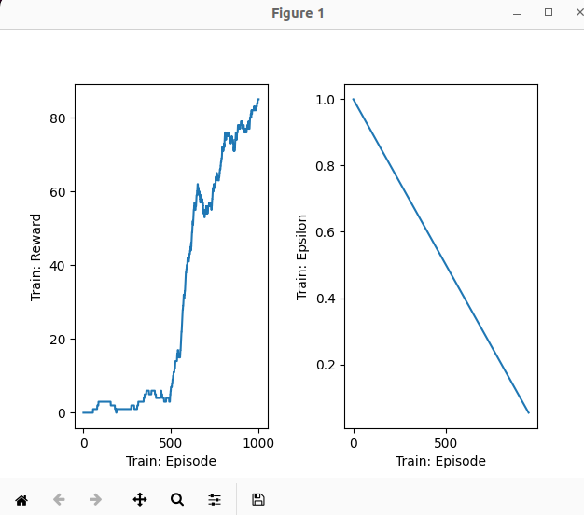
1.19 Run Train and Test
https://www.youtube.com/watch?v=EUrWGTCGzlA&list=PL58zEckBH8fCt_lYkmayZoR9XfDCW9hte&index=1
Run Train and Test (30:46-31:00/34:04)
Plot the reward and epsilon.
  On the left side, the rewards of collected 1000 episodes. We can see over the time, the reward is increasing at the end.
  On the right side, we can see epsilon is decaying from 1 to slowly down to 0.

Slide 11
1.20 Run Test Only

Slide 12
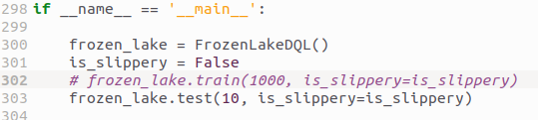
1.20 Run Test Only
https://www.youtube.com/watch?v=EUrWGTCGzlA&list=PL58zEckBH8fCt_lYkmayZoR9XfDCW9hte&index=1
Run Test Only (31:21-30:24/34:04)
If we want to play without the train, we can comment out the train() and just run the test() only.
We set 10 times (10 episodes)

Slide 13
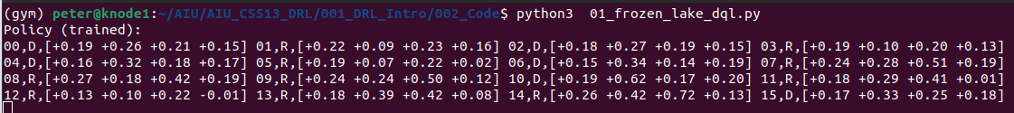
1.20 Run Test Only
https://www.youtube.com/watch?v=EUrWGTCGzlA&list=PL58zEckBH8fCt_lYkmayZoR9XfDCW9hte&index=1
1
Run Test Only (31:25-30:30/34:04)
1. We can see the agent solve the map immediately for 10 times (10 episodes) without wait for training for 1 minutes
2. We can see the agent learned with the printed it matched up with the map.
2

Slide 14
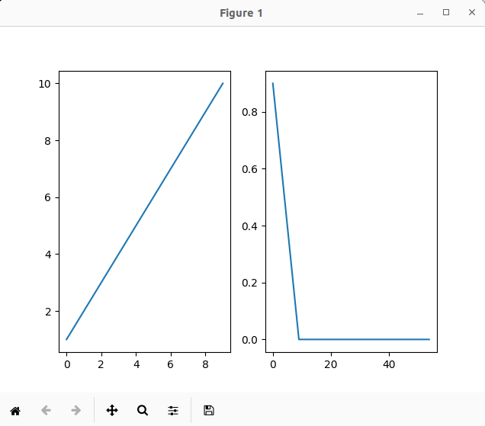
1.20 Run Test Only
https://www.youtube.com/watch?v=EUrWGTCGzlA&list=PL58zEckBH8fCt_lYkmayZoR9XfDCW9hte&index=1
Run Test Only (31:25-30:30/34:04)
Plot the reward and epsilon.
  On the left side, the rewards of collected 1000 episodes. We can see over the time, the reward is increasing at the end.
  On the right side, we can see epsilon is decaying from 1 to slowly down to 0.

Slide 15
1.21 Verify Printed Map

Slide 16
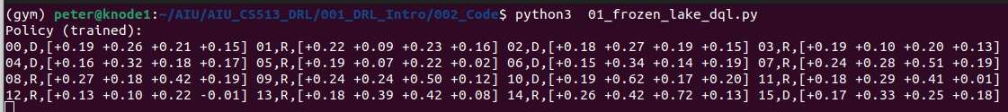
1.21 Verify Printed Map
https://www.youtube.com/watch?v=EUrWGTCGzlA&list=PL58zEckBH8fCt_lYkmayZoR9XfDCW9hte&index=1
Verify Printed Map (31:25-32:00/34:04)
At
1. State 0, the best action is to go right to state 1,
2. State 1, the best action is to go right.
3. State 2, the best action is to go down.
4. State 6, the best action is to go down
5. State 10, the best action is to go down.
6. State 14, the best action is to go right.

Slide 17
1.21 Verify Printed Map
https://www.youtube.com/watch?v=EUrWGTCGzlA&list=PL58zEckBH8fCt_lYkmayZoR9XfDCW9hte&index=1
Verify Printed Map (32:01-32:30/34:04)
We can see there are two possible paths:
1. Go right or Go down.
The epsilon greedy is randomly choose the path.
If we train again, the agent maybe pick up the second path to go down.
2
1

Slide 18
1.22 Run Test with Slippery Mode

Slide 19
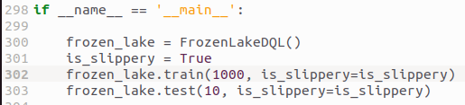
1.22 Run Test with Slippery Mode
https://www.youtube.com/watch?v=EUrWGTCGzlA&list=PL58zEckBH8fCt_lYkmayZoR9XfDCW9hte&index=1
Run Test with Slippery Mode (32:31-32:40/34:04)
Now, we
1. Change the slippery mode with is_slippery = True.
2. The agent will fall into hole often, we need to have more tries. Change try from 4 to 10.

Slide 20
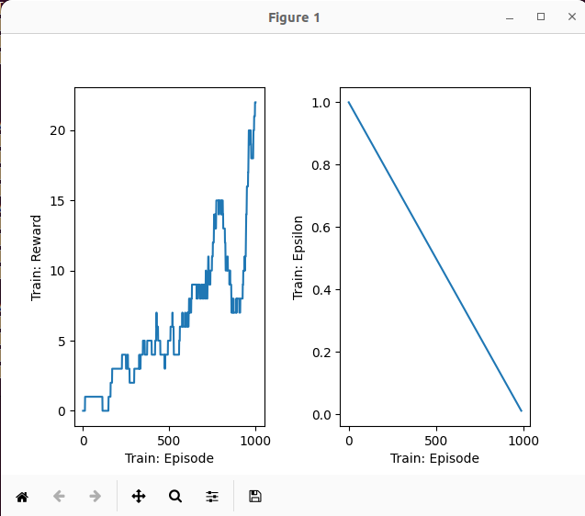
1.22 Run Test with Slippery Mode
https://www.youtube.com/watch?v=EUrWGTCGzlA&list=PL58zEckBH8fCt_lYkmayZoR9XfDCW9hte&index=1
Run Test with Slippery Mode (32:41-34:04/34:04)
Plot the rewards and epsilon.
Low reward, agent may drop into holes.

Slide 21
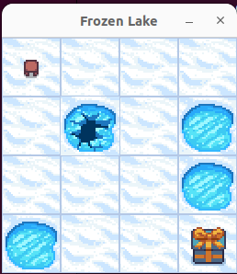
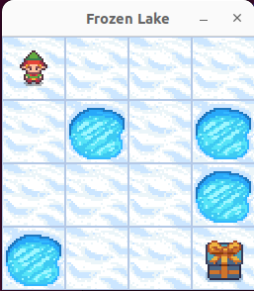
1.22 Run Test with Slippery Mode
https://www.youtube.com/watch?v=EUrWGTCGzlA&list=PL58zEckBH8fCt_lYkmayZoR9XfDCW9hte&index=1
Run Test with Slippery Mode (32:41-34:04/34:04)
We can see sometimes the agent
1. Fall into hole: Not able to complete because of slippery
2. Reach to goal.
1
2

Slide 22
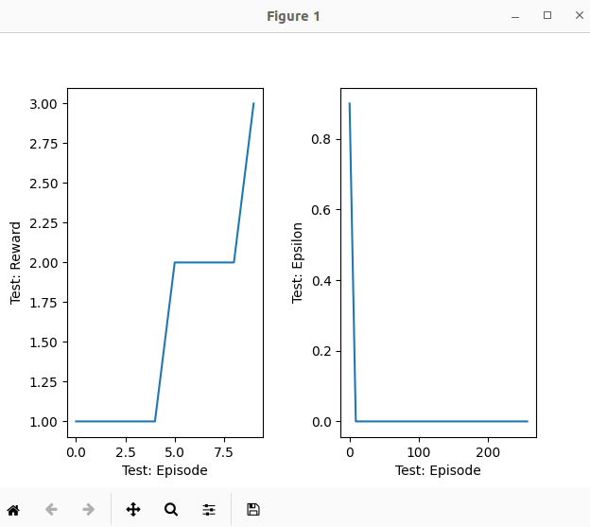
1.22 Run Test with Slippery Mode
https://www.youtube.com/watch?v=EUrWGTCGzlA&list=PL58zEckBH8fCt_lYkmayZoR9XfDCW9hte&index=1
Run Test with Slippery Mode (32:41-34:04/34:04)
We can see sometimes the agent
Plot the rewards and epsilon in test.

Slide 23
End

