Slide 1

9 Network
Peter H. Chen

Slide 2
9 Network
https://www.tensorflow.org/agents/tutorials/8_networks_tutorial
Network
We discuss how to define custom networks for your agents. The networks help us define the model that is trained by agents.
In TF-Agents you will find several different types of networks which are useful across agents:
Main Networks
  1. QNetwork: Used in Q-Learning for environments with discrete actions, this network maps an observation to value estimates for each possible action.
  2. CriticNetworks: Also referred to as ValueNetworks in literature, learns to estimate some version of a Value function mapping some state into an estimate for the expected return of a policy. These networks estimate how good the state the agent is currently in is.
  3. ActorNetworks: Learn a mapping from observations to actions. These networks are usually used by our policies to generate actions.
  4. ActorDistributionNetworks: Similar to ActorNetworks but these generate a distribution which a policy can then sample to generate actions.

Slide 3
9 Network
https://www.tensorflow.org/agents/tutorials/8_networks_tutorial
Network
Helper Networks
  1. EncodingNetwork: Allows users to easily define a mapping of pre-processing layers to apply to a network's input.
  2. DynamicUnrollLayer: Automatically resets the network's state on episode boundaries as it is applied over a time sequence.
  3. ProjectionNetwork: Networks like CategoricalProjectionNetwork or NormalProjectionNetwork take inputs and generate the required parameters to generate Categorical, or Normal distributions.
All examples in TF-Agents come with pre-configured networks.
However, these networks are not setup to handle complex observations.
If you have an environment which exposes more than one observation/action and you need to customize your networks then this dicsussion is for you.

Slide 4
9.1 Setup

Slide 5
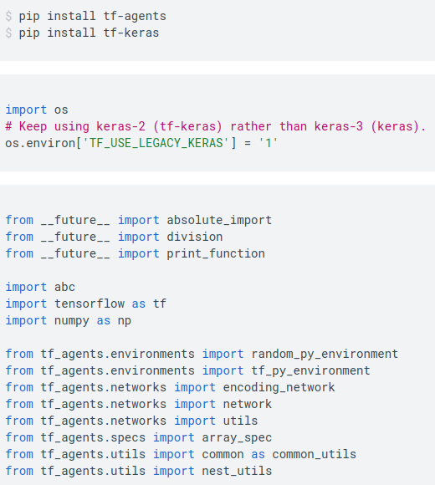
9.1 Setup
https://www.tensorflow.org/agents/tutorials/8_networks_tutorial
Setup
Install tf-agents and tf-keras:

Slide 6
9.2 Define Network

Slide 7
9.2 Define Network
https://www.tensorflow.org/agents/tutorials/8_networks_tutorial
Define Network
Network API
In TF-Agents we subclass from Keras Networks. With it we can:
  1. Simplify copy operations required when creating target networks.
  2. Perform automatic variable creation when calling network.variables().
  3. Validate inputs based on network input_specs.
EncodingNetwork
As mentioned above the EncodingNetwork allows us to easily define a mapping of pre-processing layers to apply to a network's input to generate some encoding.
The EncodingNetwork is composed of the following mostly optional layers:
  1. Preprocessing layers
  2. Preprocessing combiner
  3. Conv2D
  4. Flatten
  5. Dense
The special thing about encoding networks is that input preprocessing is applied. Input preprocessing is possible via preprocessing_layers and preprocessing_combiner layers.
Each of these can be specified as a nested structure.

Slide 8



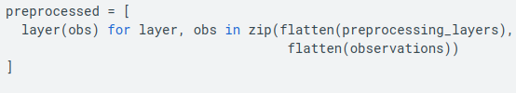
9.2 Define Network
https://www.tensorflow.org/agents/tutorials/8_networks_tutorial
Define Network
If the preprocessing_layers nest is shallower than input_tensor_spec, then the layers will get the subnests.
For example, if:
then preprocessing will call:
However if
then preprocessing will call:

Slide 9
9.3 Custom Network

Slide 10
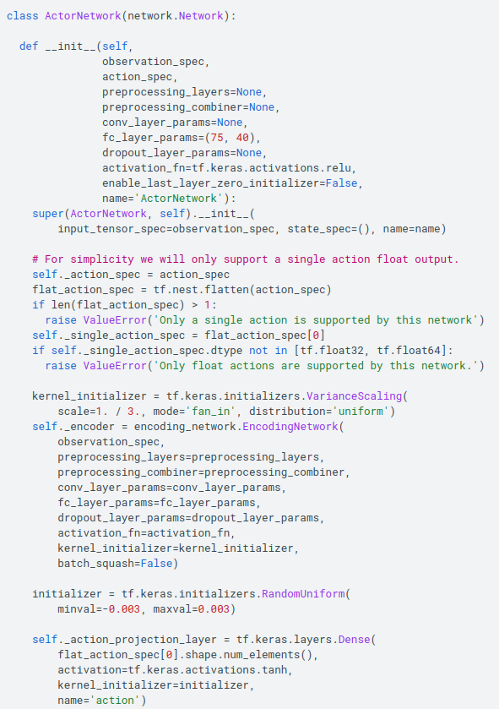
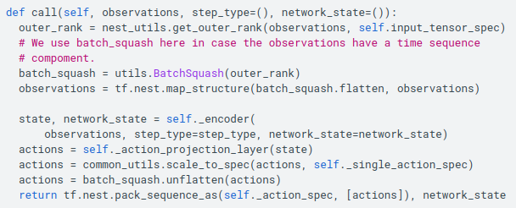
9.3 Custom Network
https://www.tensorflow.org/agents/tutorials/8_networks_tutorial
Custom Network
To create your own networks you will only have to override the __init__ and call methods.
Let's create a custom network using what we learned about EncodingNetworks to create an ActorNetwork that takes observations which contain an image and a vector.

Slide 11
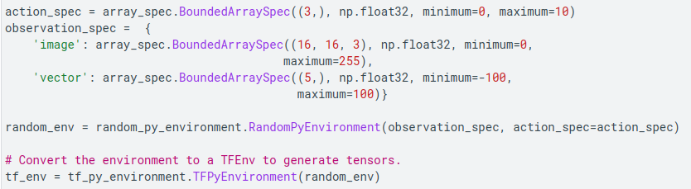
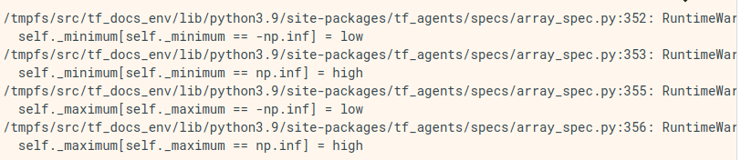
9.3 Custom Network
https://www.tensorflow.org/agents/tutorials/8_networks_tutorial
Custom Network
Let's create a RandomPyEnvironment to generate structured observations and validate our implementation.

Slide 12
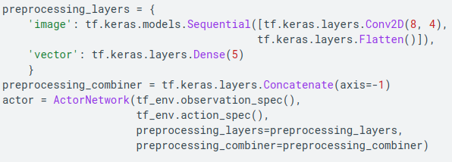
9.3 Custom Network
https://www.tensorflow.org/agents/tutorials/8_networks_tutorial
Custom Network
Since we've defined the observations to be a dict we need to create preprocessing layers to handle these.

Slide 13


9.3 Custom Network
https://www.tensorflow.org/agents/tutorials/8_networks_tutorial
Custom Network
Now that we have the actor network we can process observations from the environment.
This same strategy can be used to customize any of the main networks used by the agents.
You can define whatever preprocessing and connect it to the rest of the network.
As you define your own custom make sure the output layer definitions of the network match.

Slide 14
End

