Slide 1

8 Replay Buffer
Peter H. Chen

Slide 2
8 Replay Buffer
https://www.tensorflow.org/agents/tutorials/5_replay_buffers_tutorial
Replay Buffer
RL (Reinforcement Learning) algorithms use replay buffers to store trajectories of experience when executing a policy in an environment.
During training, replay buffers are queried for a subset of the trajectories (either a sequential subset or a sample) to "replay" the agent's experience.
In this discussion, we explore two types of replay buffers: python-backed and tensorflow-backed, sharing a common API.
In the following sections, we describe the API, each of the buffer implementations and how to use them during data collection training.

Slide 3
8.1 Setup

Slide 4
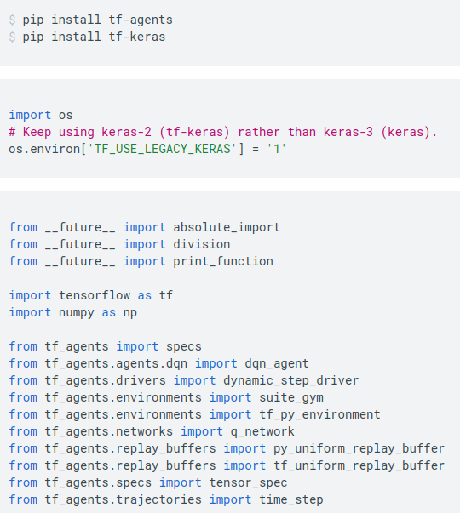
8.1 Setup
https://www.tensorflow.org/agents/tutorials/5_replay_buffers_tutorial
Setup
Install tf-agents and tf-keras, etc.

Slide 5
8.2 Replay Buffer API

Slide 6
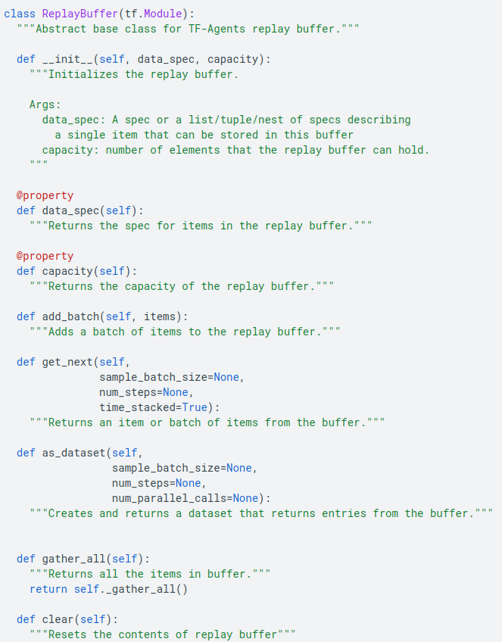
8.2 Replay Buffer API
https://www.tensorflow.org/agents/tutorials/5_replay_buffers_tutorial
Replay Buffer API
The Replay Buffer class are defined as follows:
Note:
When the replay buffer object is initialized, it requires the data_spec of the elements that it will store.
This spec corresponds to the TensorSpec of trajectory elements that will be added to the buffer.
This spec is usually acquired by looking at an agent's agent.collect_data_spec which defines
1. shapes,
2. types, and
3. structures
expected by the agent when training (more on that later).

Slide 7
8.3 TFUniformReplayBuffer

Slide 8
8.3 TFUniformReplayBuffer
https://www.tensorflow.org/agents/tutorials/5_replay_buffers_tutorial
TFUniformReplayBuffer
TFUniformReplayBuffer is the most commonly used replay buffer in TF-Agents, thus we will use it in our tutorial here.
In TFUniformReplayBuffer the backing buffer storage is done by tensorflow variables and thus is part of the compute graph.
The buffer stores batches of elements and has a maximum capacity max_length elements per batch segment.
Thus, the total buffer capacity is batch_size x max_length elements.
The elements stored in the buffer must all have a matching data spec.
When the replay buffer is used for data collection, the spec is the agent's collect data spec.

Slide 9
8.4 Create Buffer

Slide 10
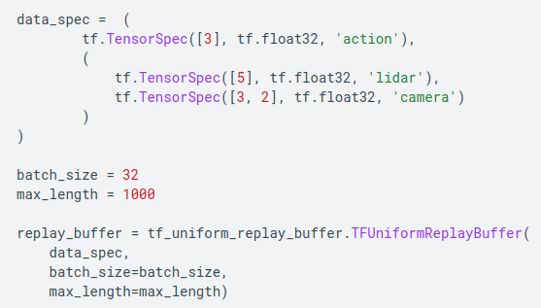
8.4 Create Buffer
https://www.tensorflow.org/agents/tutorials/5_replay_buffers_tutorial
Create Buffer
To create a TFUniformReplayBuffer we pass in:
1. the spec of the data elements that the buffer will store
2. the batch size corresponding to the batch size of the buffer
3. the max_length number of elements per batch segment
Below, is an example of creating a TFUniformReplayBuffer with sample data specs, batch_size 32 and max_length 1000.

Slide 11
8.5 Write Buffer

Slide 12
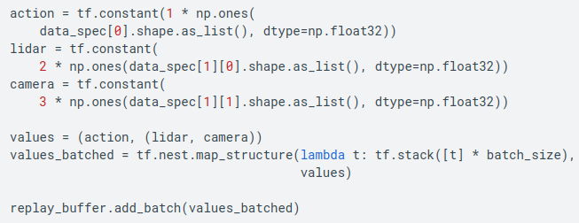
8.5 Write Buffer
https://www.tensorflow.org/agents/tutorials/5_replay_buffers_tutorial
Write Buffer
To add elements to the replay buffer, we use the add_batch(items) method where items is a list/tuple/nest of tensors representing the batch of items to be added to the buffer.
Each element of items must have an outer dimension equal batch_size and the remaining dimensions must adhere to the data spec of the item (same as the data specs passed to the replay buffer constructor).
Below is an example of adding a batch of items:

Slide 13
8.6 Read Buffer

Slide 14
8.6 Read Buffer
https://www.tensorflow.org/agents/tutorials/5_replay_buffers_tutorial
Read Buffer
There are three ways to read data from the TFUniformReplayBuffer:
1. get_next() - returns one sample from the buffer.
The sample batch size and number of timesteps returned can be specified via arguments to this method.
2. as_dataset() - returns the replay buffer as a tf.data.Dataset.
One can then create a dataset iterator and iterate through the samples of the items in the buffer.
3. gather_all() - returns all the items in the buffer as a Tensor with shape [batch, time, data_spec]

Slide 15
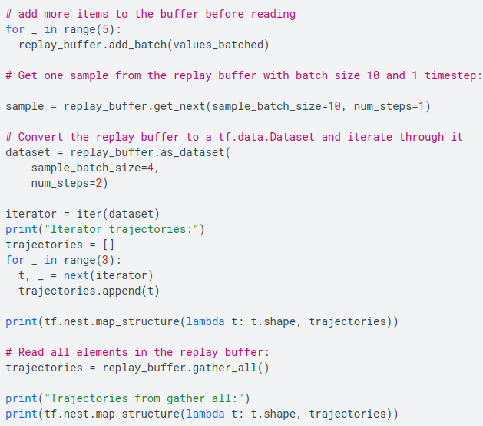
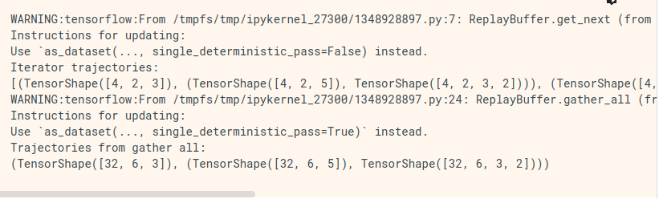
8.6 Read Buffer
https://www.tensorflow.org/agents/tutorials/5_replay_buffers_tutorial
Read Buffer
Below are examples of how to read from the replay buffer using each of these methods:

Slide 16
8.7 PyUniformReplayBuffer

Slide 17
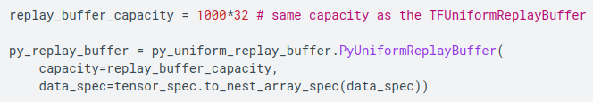
8.7 PyUniformReplayBuffer
https://www.tensorflow.org/agents/tutorials/5_replay_buffers_tutorial
PyUniformReplayBuffer
PyUniformReplayBuffer has the same functionality as the TFUniformReplayBuffer but instead of tf variables, its data is stored in numpy arrays.
This buffer can be used for out-of-graph data collection.
Having the backing storage in numpy may make it easier for some applications to do data manipulation (such as indexing for updating priorities) without using Tensorflow variables.
However, this implementation won't have the benefit of graph optimizations with Tensorflow.
Below is an example of instantiating a PyUniformReplayBuffer from the agent's policy trajectory specs:

Slide 18
8.8 Replay Buffer During Train

Slide 19
8.8 Replay Buffer During Train
https://www.tensorflow.org/agents/tutorials/5_replay_buffers_tutorial
Replay Buffer During Train
Now that we know how to create a replay buffer, write items to it and read from it, we can use it to store trajectories during training of our agents.

Slide 20
8.9 Data Collection

Slide 21
8.9 Data Collection
https://www.tensorflow.org/agents/tutorials/5_replay_buffers_tutorial
Data Collection
First, let's look at how to use the replay buffer during data collection.
In TF-Agents we use a Driver (see the Driver tutorial for more details) to collect experience in an environment.
To use a Driver, we specify an Observer that is a function for the Driver to execute when it receives a trajectory.
Thus, to add trajectory elements to the replay buffer, we add an observer that calls add_batch(items) to add a batch of items on the replay buffer.

Slide 22
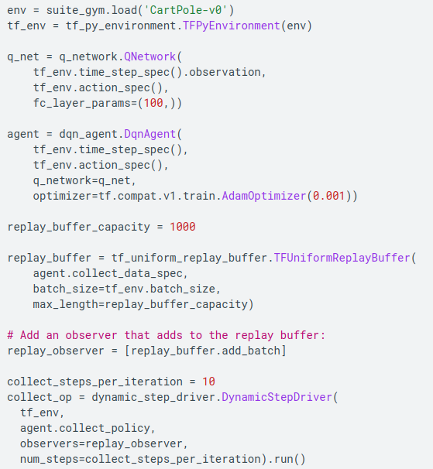
8.9 Data Collection
https://www.tensorflow.org/agents/tutorials/5_replay_buffers_tutorial
Data Collection
Here is an example of this with TFUniformReplayBuffer.
We first create an environment, a network and an agent.
Then we create a TFUniformReplayBuffer.
Note:
The specs of the trajectory elements in the replay buffer are equal to the agent's collect data spec.
We then set its add_batch method as the observer for the driver that will do the data collect during our training:

Slide 23
8.10 Read Data from Train Step

Slide 24
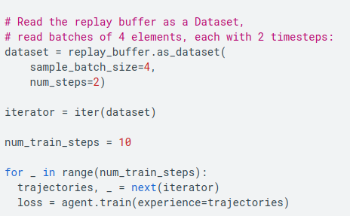
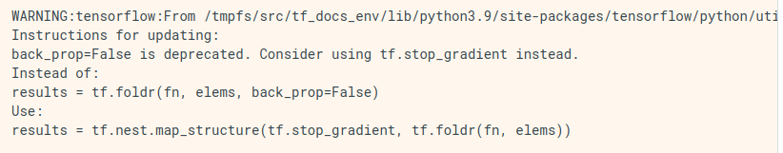
8.10 Read Data from Train Step
https://www.tensorflow.org/agents/tutorials/5_replay_buffers_tutorial
Read Data from Train Step
After adding trajectory elements to the replay buffer, we can read batches of trajectories from the replay buffer to use as input data for a train step.
Here is an example of how to train on trajectories from the replay buffer in a training loop:

Slide 25
End

