Slide 1

11 REINFORCE Agent
Peter H. Chen

Slide 2
11 REINFORCE Agent
https://www.tensorflow.org/agents/tutorials/6_reinforce_tutorial
REINFORCE Agent
What is tf REINFORCE Agent?
The REINFORCE agent is an algorithm in TensorFlow Agents (TF-Agents) that solves RL (Reinforcement Learning) problems.
To create a REINFORCE agent, you need the following components:
  1. Actor Network: Learns to predict actions based on observations from the environment
  2. Optimizer: Trains the network
  3. Train_step_counter: Keeps track of how many times the network has been updated

Slide 3
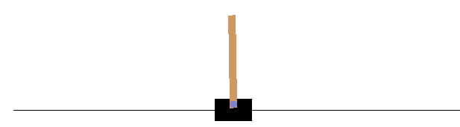
11 REINFORCE Agent
https://www.tensorflow.org/agents/tutorials/6_reinforce_tutorial
REINFORCE Agent
We discusses how to train a REINFORCE agent on the Cartpole environment using the TF-Agents library.
This is similar to the DQN discussion.
We will walk you through all the components in a RL (Reinforcement Learning) pipeline for training, evaluation and data collection.

Slide 4
11.1 Setup

Slide 5
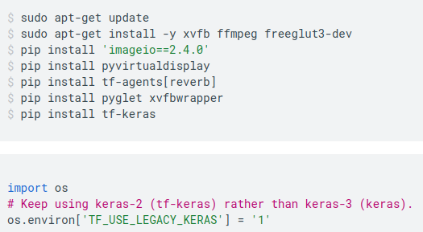
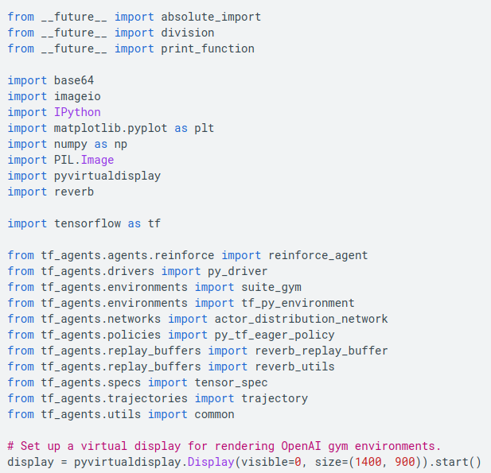
11.1 Setup
https://www.tensorflow.org/agents/tutorials/6_reinforce_tutorial
Setup
Install tf-agents and tf-keras.

Slide 6
11.2 Hyperparameter

Slide 7
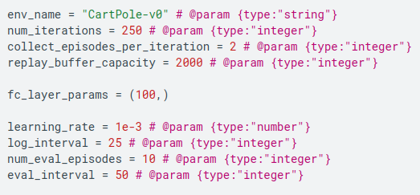
11.2 Hyperparameter
https://www.tensorflow.org/agents/tutorials/6_reinforce_tutorial
Hyperparameter

Slide 8
11.3 Environment

Slide 9


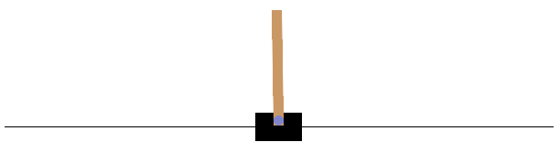
11.3 Environment
https://www.tensorflow.org/agents/tutorials/6_reinforce_tutorial
Environment
Environments in RL represent the task or problem that we are trying to solve.
Standard environments can be easily created in TF-Agents using suites. We have different suites for loading environments from sources such as the OpenAI Gym, Atari, DM Control, etc., given a string environment name.
Now let us load the CartPole environment from the OpenAI Gym suite.
We can render this environment to see how it looks.
A free-swinging pole is attached to a cart.
The goal is to move the cart right or left in order to keep the pole pointing up.

Slide 10


11.3 Environment
https://www.tensorflow.org/agents/tutorials/6_reinforce_tutorial
Environment
The time_step = environment.step(action) statement takes action in the environment.
The TimeStep tuple returned contains the environment's next observation and reward for that action.
The time_step_spec() and action_spec() methods in the environment return the specifications (types, shapes, bounds) of the time_step and action, respectively.
So, we see that observation is an array of 4 floats: the position and velocity of the cart, and the angular position and velocity of the pole.
Since only two actions are possible (move left or move right), the action_spec is a scalar where 0 means "move left" and 1 means "move right."

Slide 11
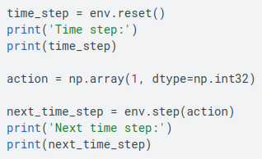
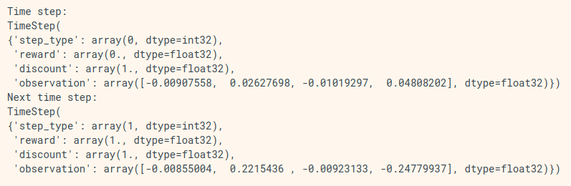
11.3 Environment
https://www.tensorflow.org/agents/tutorials/6_reinforce_tutorial
Environment
Time step and next time step.

Slide 12
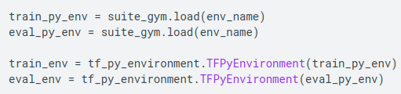
11.3 Environment
https://www.tensorflow.org/agents/tutorials/6_reinforce_tutorial
Environment
Usually, we create two environments: one for training and one for evaluation.
Most environments are written in pure python, but they can be easily converted to TensorFlow using the TFPyEnvironment wrapper.
The original environment's API uses numpy arrays, the TFPyEnvironment converts these to/from Tensors for you to more easily interact with TensorFlow policies and agents.

Slide 13
11.4 Agent

Slide 14

11.4 Agent
https://www.tensorflow.org/agents/tutorials/6_reinforce_tutorial
Agent
The algorithm that we use to solve an RL problem is represented as an Agent.
In addition to the REINFORCE agent, TF-Agents provides standard implementations of a variety of Agents, such as, REINFORCE, DQN, DDPG, TD3, PPO and SAC.
To create a REINFORCE Agent, we first need an Actor Network that can learn to predict the action given an observation from the environment.
We can easily create an Actor Network using the specs of the observations and actions.
We can specify the layers in the network which, in this example, is the fc_layer_params argument set to a tuple of ints representing the sizes of each hidden layer (see the Hyperparameters section above).

Slide 15
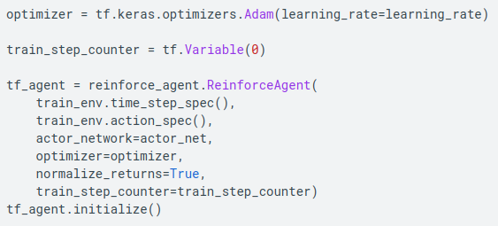
11.4 Agent
https://www.tensorflow.org/agents/tutorials/6_reinforce_tutorial
Agent
We also need an optimizer to train the network we just created, and a train_step_counter variable to keep track of how many times the network was updated.

Slide 16
11.5 Policy

Slide 17

11.5 Policy
https://www.tensorflow.org/agents/tutorials/6_reinforce_tutorial
Policy
In TF-Agents, policies represent the standard notion of policies in RL: given a time_step produce an action or a distribution over actions.
The main method is policy_step = policy.action(time_step) where policy_step is a named tuple PolicyStep(action, state, info).
The policy_step.action is the action to be applied to the environment, state represents the state for stateful (RNN) policies and info may contain auxiliary information such as log probabilities of the actions.
Agents contain two policies: the main policy that is used for evaluation/deployment (agent.policy) and another policy that is used for data collection (agent.collect_policy).

Slide 18
11.6 Metrics and Evaluation

Slide 19
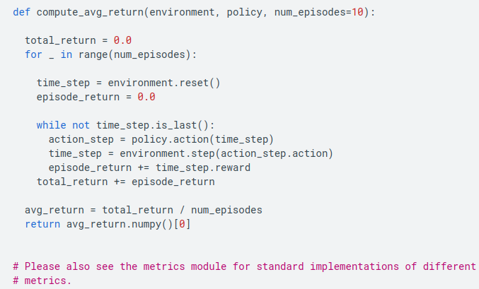
11.6 Metrics and Evaluation
https://www.tensorflow.org/agents/tutorials/6_reinforce_tutorial
Metrics and Evaluation
The most common metric used to evaluate a policy is the average return.
The return is the sum of rewards obtained while running a policy in an environment for an episode, and we usually average this over a few episodes.
We can compute the average return metric as follows.

Slide 20
11.7 Replay Buffer

Slide 21
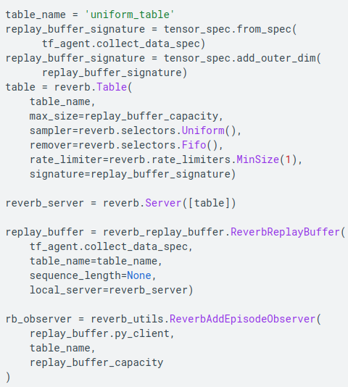
11.7 Replay Buffer
https://www.tensorflow.org/agents/tutorials/6_reinforce_tutorial
Replay Buffer
In order to keep track of the data collected from the environment, we will use Reverb (Reverberation), an efficient, extensible, and easy-to-use replay system by Deepmind.
It stores experience data when we collect trajectories and is consumed during training.
This replay buffer is constructed using specs describing the tensors that are to be stored, which can be obtained from the agent using tf_agent.collect_data_spec.
For most agents, the collect_data_spec is a Trajectory named tuple containing the observation, action, reward etc.

Slide 22
11.8 Data Collection

Slide 23
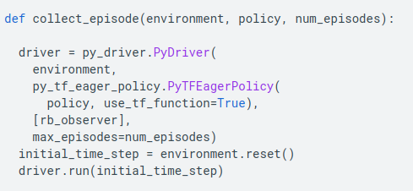
11.8 Data Collection
https://www.tensorflow.org/agents/tutorials/6_reinforce_tutorial
Data Collection
As REINFORCE learns from whole episodes, we define a function to collect an episode using the given data collection policy and save the data (observations, actions, rewards etc.) as trajectories in the replay buffer.
Here we are using 'PyDriver' to run the experience collecting loop. You can learn more about TF Agents driver in our drivers tutorial.

Slide 24
11.9 Train Agent

Slide 25
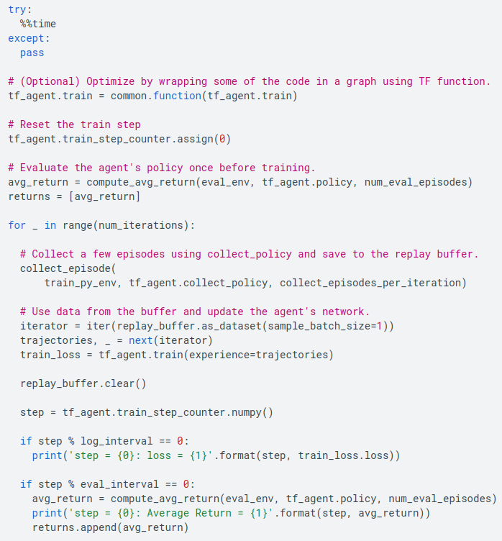
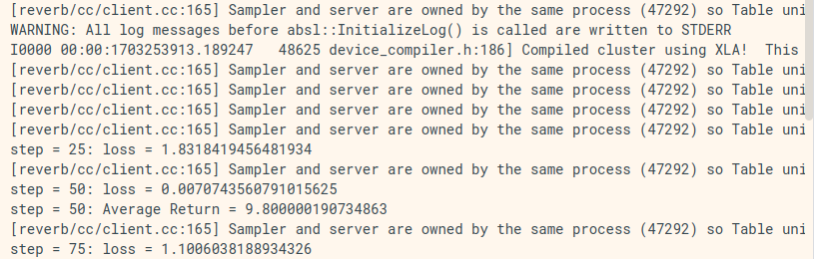
11.9 Train Agent
https://www.tensorflow.org/agents/tutorials/6_reinforce_tutorial
Train Agent
The training loop involves both collecting data from the environment and optimizing the agent's networks.
Along the way, we will occasionally evaluate the agent's policy to see how we are doing.
The following will take ~3 minutes to run.

Slide 26
11.10 Visualization: Plot

Slide 27
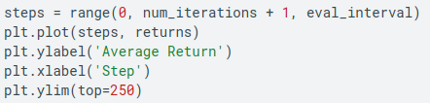
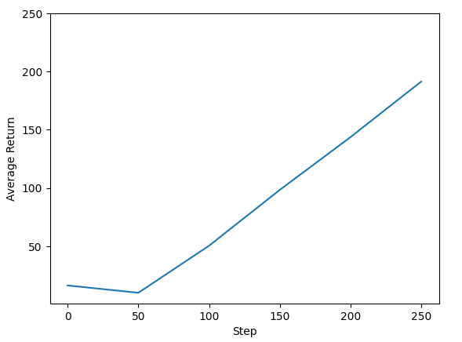
11.10 Visualization: Plot
https://www.tensorflow.org/agents/tutorials/6_reinforce_tutorial
Visualization: Plot
We can plot return vs global steps to see the performance of our agent.
In Cartpole-v0, the environment gives a reward of +1 for every time step the pole stays up, and since the maximum number of steps is 200, the maximum possible return is also 200.

Slide 28
11.11 Visualization: Video

Slide 29
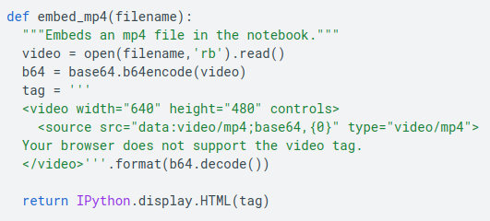
11.11 Visualization: Video
https://www.tensorflow.org/agents/tutorials/6_reinforce_tutorial
Visualization: Video
It is helpful to visualize the performance of an agent by rendering the environment at each step.
Before we do that, let us first create a function to embed videos in this colab.

Slide 30
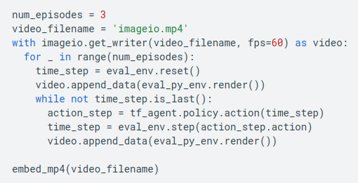
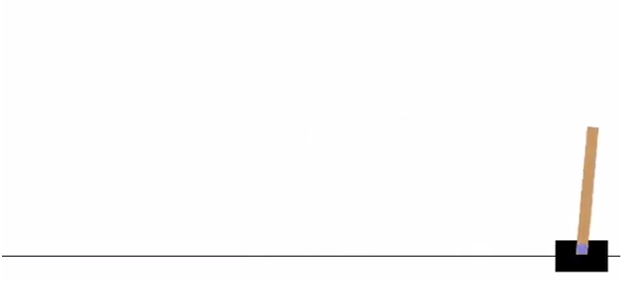
11.11 Visualization: Video
https://www.tensorflow.org/agents/tutorials/6_reinforce_tutorial
Visualization: Video
The following code visualizes the agent's policy for a few episodes:

Slide 31
End

