Slide 1

16 MAB per Arm
Peter H. Chen

Slide 2
16 MAB per Arm
https://www.tensorflow.org/agents/tutorials/per_arm_bandits_tutorial
MAB per Arm
We discuss MAB per Arm.
We use the TF-Agents library for contextual bandits problems.
The actions (arms) have their own features, such as, a list of movies represented by features (genre, year of release, ...).
Before we discuss, we need the knowledge of the Bandit library of TF-Agents, Bandits in TF-Agents.

Slide 3
16.1 TF-Agents per-Arm Bandit

Slide 4
16.1 TF-Agents per-Arm Bandit
https://www.tensorflow.org/agents/tutorials/per_arm_bandits_tutorial
TF-Agents per-Arm Bandit
In the "classic" Contextual Multi-Armed Bandits setting, an agent receives a context vector (i.e., observation) at every time step and has to choose from a finite set of numbered actions (arms) so as to maximize its cumulative reward.
Now, consider the scenario where an agent recommends to a user the next movie to watch.
Every time a decision has to be made, the agent receives as context some information about the user (watch history, genre preference, etc…) and the list of movies to choose from.
We could try to formulate this problem by having the user information as the context and the arms would be movie_1, movie_2, …, movie_K, but this approach has multiple shortcomings:
  1. The number of actions would have to be all the movies in the system and it is cumbersome to add a new movie.
  2. The agent has to learn a model for every single movie.
  3. Similarity between movies is not taken into account.

Slide 5
16.1 TF-Agents per-Arm Bandit
https://www.tensorflow.org/agents/tutorials/per_arm_bandits_tutorial
TF-Agents per-Arm Bandit
Instead of numbering the movies, we can do something more intuitive: we can represent movies with a set of features including genre, length, cast, rating, year, etc. The advantages of this approach are manifold:
  1. Generalization across movies.
  2. The agent learns just one reward function that models reward with user and movie features.
  3. Easy to remove from, or introduce new movies to the system.
In this new setting, the number of actions does not even have to be the same in every time step.
The TF-Agents Bandit suite is developed so that one can use it for the per-arm case as well.
There are per-arm environments, and also most of the policies and agents can operate in per-arm mode.
Before we dive into coding an example, we need the necessary imports.

Slide 6
16.2 Install Library

Slide 7
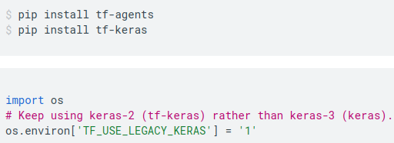
16.2 Install Library
https://www.tensorflow.org/agents/tutorials/per_arm_bandits_tutorial
Install Library
Install tf-agents and tf-keras

Slide 8
16.2 Install Library

Slide 9
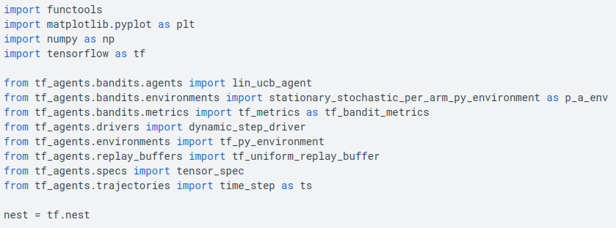
16.3 Import Library
https://www.tensorflow.org/agents/tutorials/per_arm_bandits_tutorial
Import Library

Slide 10
16.4 Hyperparameter

Slide 11
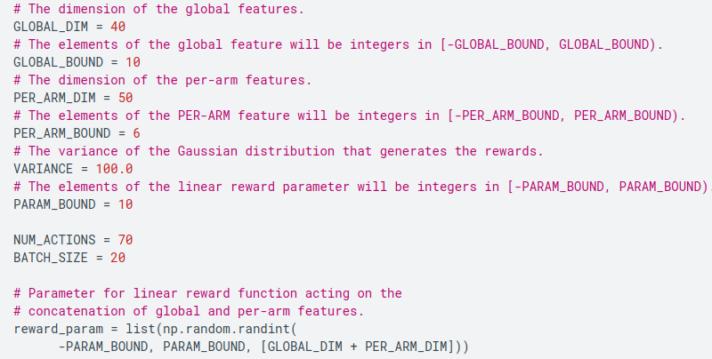
16.4 Hyperparameter
https://www.tensorflow.org/agents/tutorials/per_arm_bandits_tutorial
Hyperparameter

Slide 12
16.5 Environment

Slide 13
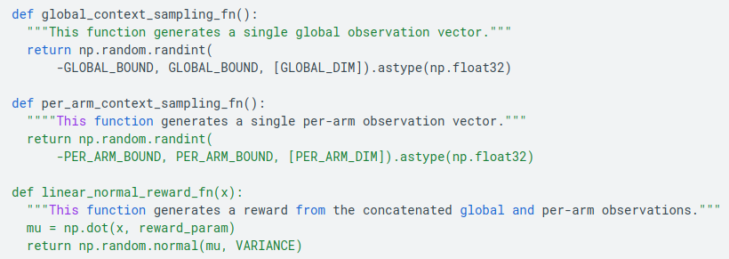
16.5 Environment
https://www.tensorflow.org/agents/tutorials/per_arm_bandits_tutorial
Environment
The stationary stochastic environment, has a per-arm counterpart.
To initialize the per-arm environment, one has to define functions that generate
  1. global and per-arm features: These functions have no input parameters and generate a single (global or per-arm) feature vector when called.
  2. rewards: This function takes as parameter the concatenation of a global and a per-arm feature vector, and generates a reward. Basically this is the function that the agent will have to "guess". It is worth noting here that in the per-arm case the reward function is identical for every arm. This is a fundamental difference from the classic bandit case, where the agent has to estimate reward functions for each arm independently.

Slide 14
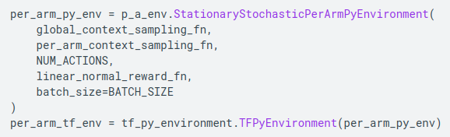
16.5 Environment
https://www.tensorflow.org/agents/tutorials/per_arm_bandits_tutorial
Environment
Now, initialize our environment.

Slide 15
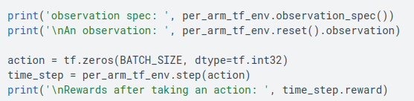
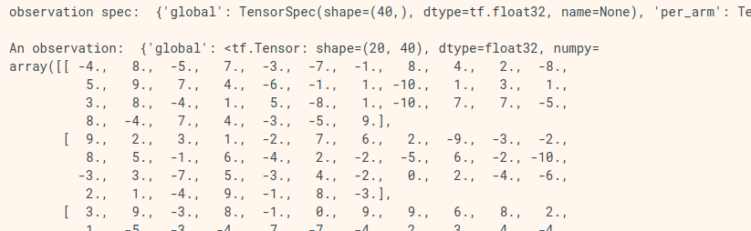
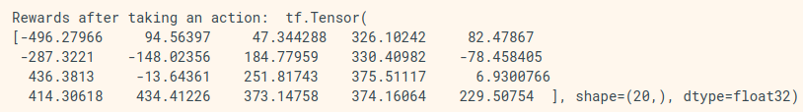
16.5 Environment
https://www.tensorflow.org/agents/tutorials/per_arm_bandits_tutorial
Environment
Below we can check what this environment produces.

Slide 16
16.5 Environment
https://www.tensorflow.org/agents/tutorials/per_arm_bandits_tutorial
Environment
We see that the observation spec is a dictionary with two elements:
  1. One with key 'global': this is the global context part, with shape matching the parameter GLOBAL_DIM.
  2. One with key 'per_arm': this is the per-arm context, and its shape is [NUM_ACTIONS, PER_ARM_DIM]. This part is the placeholder for the arm features for every arm in a time step.

Slide 17
16.6 LinUCB Agent

Slide 18
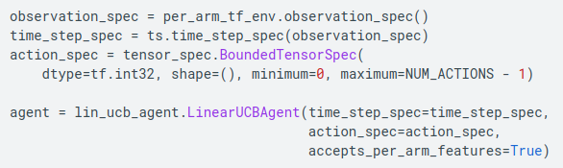
16.6 LinUCB Agent
https://www.tensorflow.org/agents/tutorials/per_arm_bandits_tutorial
LinUCB Agent
The LinUCB agent implements the identically named Bandit algorithm, which estimates the parameter of the linear reward function while also maintains a confidence ellipsoid around the estimate. The agent chooses the arm that has the highest estimated expected reward, assuming that the parameter lies within the confidence ellipsoid.
Creating an agent requires the knowledge of the observation and the action specification. When defining the agent, we set the boolean parameter accepts_per_arm_features set to True.

Slide 19
16.7 Flow of Train Data

Slide 20
16.7 Flow of Train Data
https://www.tensorflow.org/agents/tutorials/per_arm_bandits_tutorial
Flow of Train Data
This section gives a sneak peek into the mechanics of how per-arm features go from the policy to training. Feel free to jump to the next section (Defining the Regret Metric) and come back here later if interested.
First, let us have a look at the data specification in the agent. The training_data_spec attribute of the agent specifies what elements and structure the training data should have.
training data spec: Trajectory(
{'step_type': TensorSpec(shape=(), dtype=tf.int32, name='step_type'),
'observation': {'global': TensorSpec(shape=(40,), dtype=tf.float32, name=None)},
'action': BoundedTensorSpec(shape=(), dtype=tf.int32, name=None, minimum=array(0, dtype=int32), maximum=array(69, dtype=int32)),
'policy_info': PerArmPolicyInfo(log_probability=(), predicted_rewards_mean=(), multiobjective_scalarized_predicted_rewards_mean=(), predicted_rewards_optimistic=(), predicted_rewards_sampled=(), bandit_policy_type=(), chosen_arm_features=TensorSpec(shape=(50,), dtype=tf.float32, name=None)),
'next_step_type': TensorSpec(shape=(), dtype=tf.int32, name='step_type'),
'reward': TensorSpec(shape=(), dtype=tf.float32, name='reward'),
'discount': BoundedTensorSpec(shape=(), dtype=tf.float32, name='discount', minimum=array(0., dtype=float32), maximum=array(1., dtype=float32))})

Slide 21
16.7 Flow of Train Data
https://www.tensorflow.org/agents/tutorials/per_arm_bandits_tutorial
Flow of Train Data
If we have a closer look to the observation part of the spec, we see that it does not contain per-arm features!

Slide 22
16.7 Flow of Train Data
https://www.tensorflow.org/agents/tutorials/per_arm_bandits_tutorial
Flow of Train Data
What happened to the per-arm features? To answer this question, first we note that when the LinUCB agent trains, it does not need the per-arm features of all arms, it only needs those of the chosen arm.
Hence, it makes sense to drop the tensor of shape [BATCH_SIZE, NUM_ACTIONS, PER_ARM_DIM], as it is very wasteful, especially if the number of actions is large.
But still, the per-arm features of the chosen arm must be somewhere! To this end, we make sure that the LinUCB policy stores the features of the chosen arm within the policy_info field of the training data
We see from the shape that the chosen_arm_features field has only the feature vector of one arm, and that will be the chosen arm.
Note that the policy_info, and with it the chosen_arm_features, is part of the training data, as we saw from inspecting the training data spec, and thus it is available at training time.

Slide 23
16.8 Define Regret Metric

Slide 24
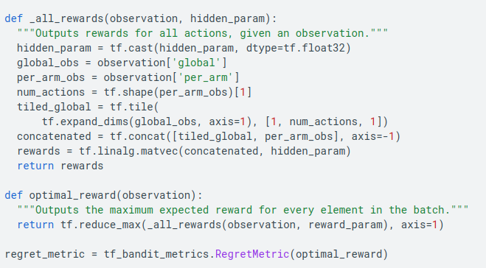
16.8 Define Regret Metric
https://www.tensorflow.org/agents/tutorials/per_arm_bandits_tutorial
Define Regret Metric
Before starting the training loop, we define some utility functions that help calculate the regret of our agent.
These functions help determining the optimal expected reward given the set of actions (given by their arm features) and the linear parameter that is hidden from the agent.

Slide 25
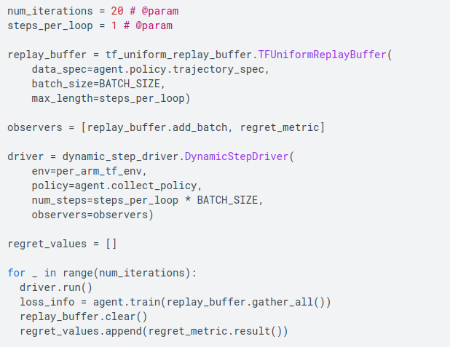
16.8 Define Regret Metric
https://www.tensorflow.org/agents/tutorials/per_arm_bandits_tutorial
Define Regret Metric
Now we are all set for starting our bandit training loop.
The driver below takes care of choosing actions using the policy, storing rewards of chosen actions in the replay buffer, calculating the predefined regret metric, and executing the training step of the agent.

Slide 26
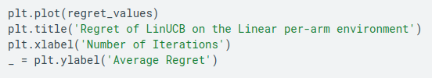
16.8 Define Regret Metric
https://www.tensorflow.org/agents/tutorials/per_arm_bandits_tutorial
Define Regret Metric
Now, let's see the result.
If we did everything right, the agent is able to estimate the linear reward function well, and thus the policy can pick actions whose expected reward is close to that of the optimal. This is indicated by our above defined regret metric, which goes down and approaches zero.

Slide 27
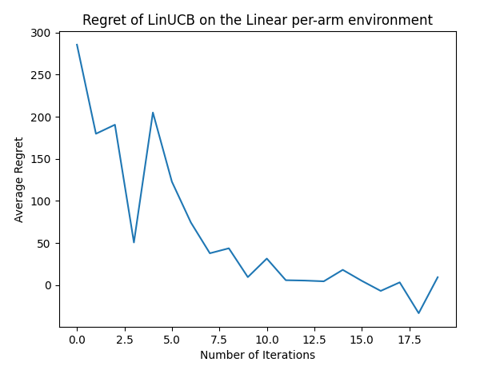
16.8 Define Regret Metric
https://www.tensorflow.org/agents/tutorials/per_arm_bandits_tutorial
Define Regret Metric

Slide 28
End

