Slide 1

2 Introduction to RL
Peter H. Chen

Slide 2
2 Introduction to RL
https://www.tensorflow.org/agents/tutorials/0_intro_rl
Introduction to RL
RL (Reinforcement learning) is a general framework where agents learn to perform actions in an environment so as to maximize a reward.
The two main components are
1. the environment, which represents the problem to be solved, and
2. the agent, which represents the learning algorithm.
The agent and environment continuously interact with each other.
At each time step, the agent
1. takes an action on the environment based on its policy π(at|st), where st is the current observation from the environment, and
2. receives a reward rt+1 and the next observation st+1 from the environment.
The goal is to improve the policy so as to maximize the sum of rewards (return).

Slide 3
2 Introduction to RL
https://www.tensorflow.org/agents/tutorials/0_intro_rl
Introduction to RL
Note:
1. Both are in the environment.
2. It is important to distinguish between the state and the observation.
3. Observation is the part of the state.
4. The agent can see observation but many not see all information of state.
5. In a poker game, the environment state consists of the cards belonging to all the players and the community cards,
6. The agent can observe only its own cards and a few community cards.
7. In most literature and document, the terms state and observation are used interchangeably and observation is also denoted as s.
.

Slide 4
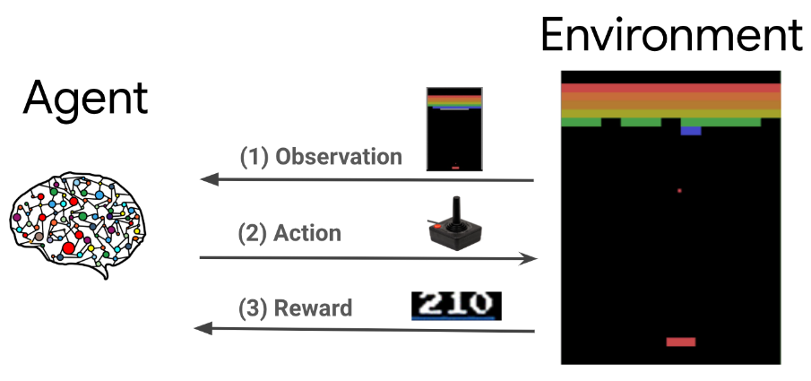
2 Introduction to RL
https://www.tensorflow.org/agents/tutorials/0_intro_rl
Introduction to RL
Below diagram is a general framework for most problems, such as games, robotics etc.

Slide 5
2.1 Cartpole Environment

Slide 6
2.1 Cartpole Environment
https://www.tensorflow.org/agents/tutorials/0_intro_rl
Cartpole Environment
The Cartpole environment is one of the most well known classic reinforcement learning problems ( the "Hello, World!" of RL).
A pole is attached to a cart, which can move along a frictionless track.
The pole starts upright and the goal is to prevent it from falling over by controlling the cart.
The observation from the environment st is a 4D vector representing
1. the position and
2. velocity of the cart, and
3. the angle and
4. angular velocity of the pole.

Slide 7
2.1 Cartpole Environment
https://www.tensorflow.org/agents/tutorials/0_intro_rl
Cartpole Environment
The agent can control the system by taking one of 2 actions at: push the cart right (+1) or left (-1).
A reward rt+1=1 is provided for every time-step that the pole remains upright.
The episode ends when one of the following is true:
1. the pole tips over some angle limit
2. the cart moves outside of the world edges
3. 200 time steps pass.

Slide 8
2.1 Cartpole Environment
https://www.tensorflow.org/agents/tutorials/0_intro_rl
Cartpole Environment
The goal of the agent is to learn a policy π(at | st) so as to maximize the sum of rewards in an episode ∑t=0 to T γ^{t} rt.
Here γ is a discount factor in [0,1] that discounts future rewards relative to immediate rewards.
This parameter helps us focus the policy, making it care more about obtaining rewards quickly.

Slide 9
2.2 DQN Agent

Slide 10
2.2 DQN Agent
https://www.tensorflow.org/agents/tutorials/0_intro_rl
DQN Agent
The DQN (Deep Q-Network) algorithm was developed by DeepMind in 2015.
It was able to solve a wide range of Atari games (some to superhuman level) by combining reinforcement learning and deep neural networks at scale.
The algorithm was developed by enhancing a classic RL algorithm called Q-Learning with deep neural networks and a technique called experience replay.

Slide 11
2.3 Q-Learning

Slide 12
2.3 Q-Learning
https://www.tensorflow.org/agents/tutorials/0_intro_rl
Q-Learning
Q-Learning is based on the notion of a Q-function.
The Q-function (a.k.a, the state-action value function) of a policy π, Q^{π} (s, a), measures the expected return or discounted sum of rewards obtained from state s by taking action a first and following policy π thereafter (After the event).
We define the optimal Q-function Q∗(s, a) as the maximum return that can be obtained starting from observation s, taking action a and following the optimal policy thereafter.
The optimal Q-function obeys the following Bellman optimality equation:
  Q∗(s, a)=E[r + γ × maxa′ ×Q∗(s′, a′)]
This means that the maximum return from state s and action a is the sum of the immediate reward r and the return (discounted by γ) obtained by following the optimal policy thereafter until the end of the episode, i.e., the maximum reward from the next state s′.
The expectation is computed both over the distribution of immediate rewards r and possible next states s′.

Slide 13
2.3 Q-Learning
https://www.tensorflow.org/agents/tutorials/0_intro_rl
Q-Learning
The basic idea behind Q-Learning is to use the Bellman optimality equation as an iterative update Qi+1(s, a) ← E[r + γ × maxa′ × Qi(s′,a′)], and
It can be shown that this converges to the optimal Q-function, i.e., Qi → Q∗ as i → ∞(see the DQN paper for details).

Slide 14
2.4 Deep Q-Learning

Slide 15
2.4 Deep Q-Learning
https://www.tensorflow.org/agents/tutorials/0_intro_rl
Deep Q-Learning
For most problems, it is impractical to represent the Q-function as a table containing values for each combination of s and a.
Instead, we train a function approximator, such as a neural network with parameters θ, to estimate the Q-values, i.e., Q(s, a; θ) ≈ Q∗(s, a).
This can done by minimizing the following loss at each step i:
  Li(θi)=Es,a,r,s′∼ρ(.) [(yi − Q(s, a; θi))²]
  where yi=r + γ × maxa′ × Q(s′, a′; θi−1)
  Here, yi is called the TD (temporal difference) target,
  and yi − Q is called the TD error.
  ρ represents the behavior distribution, the distribution over transitions {s, a, r, s′} collected from the environment.

Slide 16
2.4 Deep Q-Learning
https://www.tensorflow.org/agents/tutorials/0_intro_rl
Deep Q-Learning
Note:
1. The parameters from the previous iteration θi−1 are fixed and not updated.
2. In practice, we use a snapshot of the network parameters from a few iterations ago instead of the last iteration.
3. This copy is called the target network.
4. Q-Learning is an off-policy (Q-Learning is learn without any policy.) algorithm that learns about the greedy policy a = maxa Q(s, a; θ) while using a different behavior policy for acting in the environment/ collecting data.
5. The Q-Learning off-policy (Q-Learning is learn without any policy) is usually an ϵ-greedy policy that selects the greedy action with probability 1− ϵ and a random action with probability ϵ to ensure good coverage of the state-action space.

Slide 17
2.4 Deep Q-Learning
https://www.tensorflow.org/agents/tutorials/0_intro_rl
Deep Q-Learning
What is difference of Off-Policy and On-Policy?
1. In on-policy learning, the Q(s,a) function is learned from actions that we took using our current policy π(a|s).
2. In off-policy learning, the Q(s,a) function is learned from taking different actions (for example, random actions). Q-Learning is off-policy. We don't even need a policy at all!
This is the update function for the on-policy SARSA algorithm:
  Q(s,a) ← Q(s,a) + α (r + γ Q(s′,a′) − Q(s,a)), where a′ is the action, that was taken according to policy π.
Compare it with the update function for the off-policy Q-learning algorithm:
  Q(s,a) ← Q(s,a) + α (r+γ × maxa′ × Q(s′,a′) − Q(s,a)), where a′ are all actions, that were probed in state s′
https://stats.stackexchange.com/questions/184657/what-is-the-difference-between-off-policy-and-on-policy-learning

Slide 18
2.5 Experience Replay

Slide 19
2.5 Experience Replay
https://www.tensorflow.org/agents/tutorials/0_intro_rl
Experience Replay
To avoid computing the full expectation in the DQN loss, we can minimize it using stochastic gradient descent (Random select few samples to do gradient descent).
If the loss is computed using just the last transition {s, a, r, s′}, this reduces to standard Q-Learning.
The Atari DQN work introduced a technique called Experience Replay to make the network updates more stable.
At each time step of data collection, the transitions are added to a circular buffer called the replay buffer.
Then during training, instead of using just the latest transition to compute the loss and its gradient, we compute them using a mini-batch of transitions sampled from the replay buffer.
This has two advantages:
1. Better data efficiency by reusing each transition in many updates, and
2. Better stability using uncorrelated transitions in a batch.

Slide 20
2.6 DQN on Cartpole

Slide 21
2.6 DQN on Cartpole
https://www.tensorflow.org/agents/tutorials/0_intro_rl
DQN on Cartpole in TF-Agents
TF-Agents provides all the components necessary to train a DQN agent, such as,
  the agent itself,
  the environment,
  policies,
  networks,
  replay buffers,
  data collection loops, and
  metrics.
These components are implemented as:
1. Python functions or TensorFlow graph operations, and
2. We also have wrappers for converting between them.
3. TF-Agents supports TensorFlow 2.0 mode, which enables us to use TF in imperative (important) mode.

Slide 22
End

