Slide 1

7 QL: Frozen Lake
Peter H. Chen

Slide 2
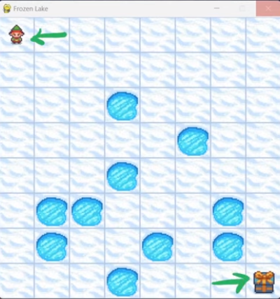
7 QL: Frozen Lake
https://www.youtube.com/watch?v=ZhoIgo3qqLU&list=PL58zEckBH8fCt_lYkmayZoR9XfDCW9hte&index=7
QL: Frozen Lake (00:00-00:05/11:41)
We discuss the Frozen Lake with Q-Learning (Q-Table).
Here, we use Q-Table for Q-Learning instead of DQN (Deep Q-Network) for Deep Q-Leaning.

Slide 3
7.1 Install Library

Slide 4

7.1 Install Library
https://www.youtube.com/watch?v=ZhoIgo3qqLU&list=PL58zEckBH8fCt_lYkmayZoR9XfDCW9hte&index=7
Install Library (00:06-00:10/11:41)
1. Create/Activate conda
> conda create –name gym
> conda activate gym
2. Install the required libraries
> pip install -r requirements.txt
1
2

Slide 5
7.2 Original Source Code

Slide 6
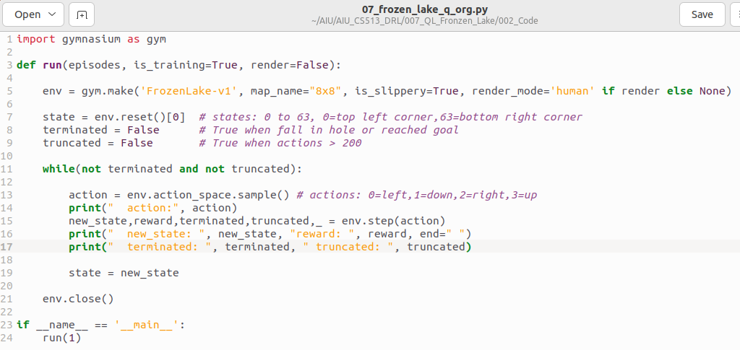
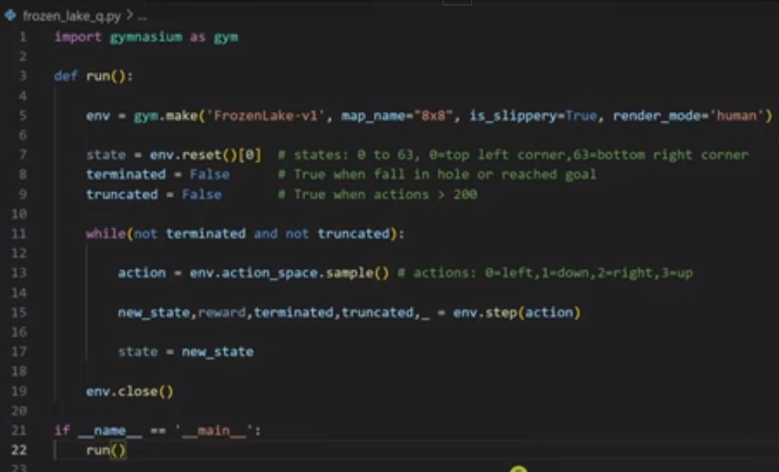
7.2 Original Source Code
https://www.youtube.com/watch?v=ZhoIgo3qqLU&list=PL58zEckBH8fCt_lYkmayZoR9XfDCW9hte&index=7
Original Source Code (00:11-01:30/11:41)
Below is the original source code of 01_frozen_lake_q_org.py
It does not train and run by random sample step.

Slide 7
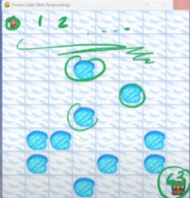
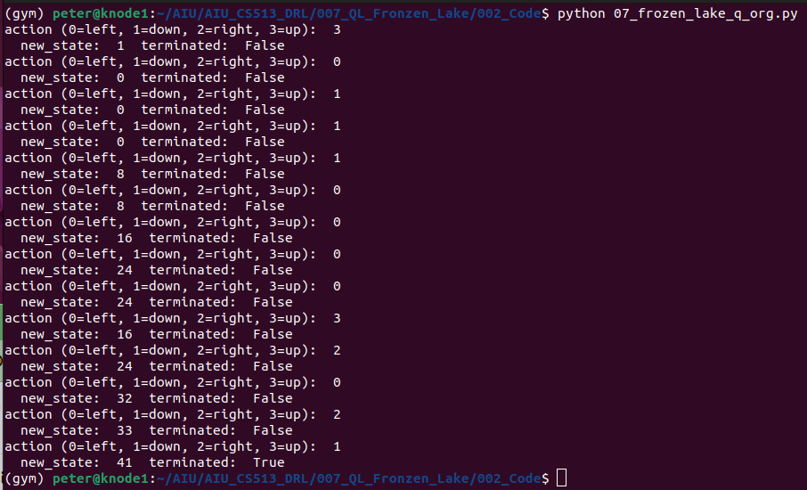
7.2 Original Source Code
https://www.youtube.com/watch?v=ZhoIgo3qqLU&list=PL58zEckBH8fCt_lYkmayZoR9XfDCW9hte&index=7
Original Source Code (01:31-02:40/11:41)
We run for 1 episode: 0: left, 1: up, 2: down, 3: right
> python 01_frozen_lake_q_org.py
Note that the action is getting from random sample. The next state is decided by both action and max reward, not action only.

Slide 8
7.3 Q-Learning

Slide 9
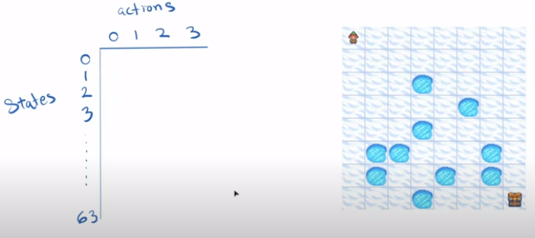
7.3 Q-Learning
https://www.youtube.com/watch?v=ZhoIgo3qqLU&list=PL58zEckBH8fCt_lYkmayZoR9XfDCW9hte&index=7
Q-Learning (02:41-03:20/11:41)
Now, we talk Q-Learning.
We have Q-table with 8 x 8 = 64 states and 4 actions.

Slide 10
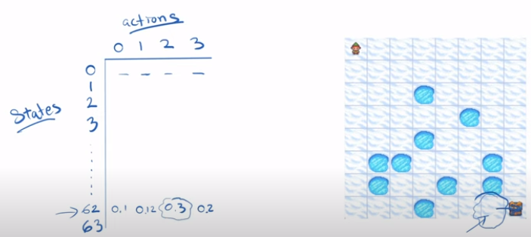
7.3 Q-Learning
https://www.youtube.com/watch?v=ZhoIgo3qqLU&list=PL58zEckBH8fCt_lYkmayZoR9XfDCW9hte&index=7
Q-Learning (03:21-03:30/11:41)
Assume we are in state 62. The agent come to the Q-table, find the biggest Q value.

Slide 11
7.4 Import Library

Slide 12
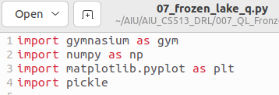
7.4 Import Library
https://www.youtube.com/watch?v=ZhoIgo3qqLU&list=PL58zEckBH8fCt_lYkmayZoR9XfDCW9hte&index=7
Import Library (03:31-03:40/11:41)
Import
1. gymnasium: Environment
2. numpy: Python Numerical
3. matplotlib: Python Plot library
4. Pickle: Python file Serialization/De-serialization read.

Slide 13
7.5 Create Environment

Slide 14
7.5 Create Environment
https://www.youtube.com/watch?v=ZhoIgo3qqLU&list=PL58zEckBH8fCt_lYkmayZoR9XfDCW9hte&index=7
Create Environment (03:31-03:40/11:41)

Slide 15
7.6 Initialize Q-Table

Slide 16
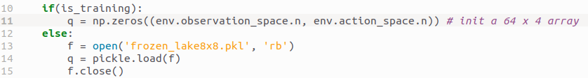
7.6 Initialize Q-Table
https://www.youtube.com/watch?v=ZhoIgo3qqLU&list=PL58zEckBH8fCt_lYkmayZoR9XfDCW9hte&index=7
Initialize Q-Table (03:41-03:50/11:41)
In Training mode, we create the Q-table with all zeros during the training.
In Play mode, we read the Q-Table data with Pickle (serialization/de-serialization).

Slide 17
7.7 Hyperparameter

Slide 18

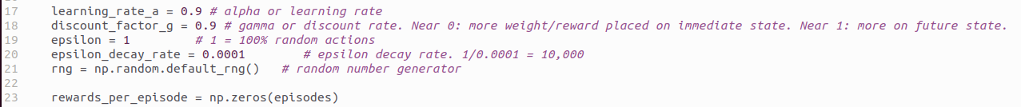
7.7 Hyperparameter
https://www.youtube.com/watch?v=ZhoIgo3qqLU&list=PL58zEckBH8fCt_lYkmayZoR9XfDCW9hte&index=7
Hyperparameter (03:41-03:50/11:41)
We setup hyperparameters.
1. learning_rate_a = 0.9: Alpha or learning rate for step size
2. discount_factor_g = 0.9: gamma or discount factor
3. epsilon =1: 1 = 100% random action
4. epsilon_decay_rate = 0.0001: decay rate = 1/0.0001 = 10,000
5. rng = np.random.dafault_rng(): random number generator
6. rewards_per_episode = zeros: rewards

Slide 19
7.8 Episode Loop

Slide 20

7.8 Episode Loop
https://www.youtube.com/watch?v=ZhoIgo3qqLU&list=PL58zEckBH8fCt_lYkmayZoR9XfDCW9hte&index=7
Episode Loop (03:51-03:55/11:41)
Loop for Episodes.
Get state 0.

Slide 21
7.9 Action

Slide 22

7.9 Action
https://www.youtube.com/watch?v=ZhoIgo3qqLU&list=PL58zEckBH8fCt_lYkmayZoR9XfDCW9hte&index=7
Action (03:56-04:00/11:41)
Generate the action

Slide 23
7.10 Update Q-Table

Slide 24
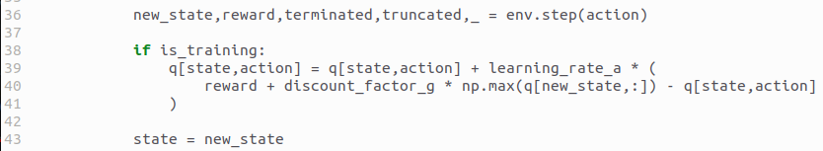
7.10 Update Q-Table
https://www.youtube.com/watch?v=ZhoIgo3qqLU&list=PL58zEckBH8fCt_lYkmayZoR9XfDCW9hte&index=7
Update Q-Table (03:56-04:00/11:41)
1. Get the next state: based on Action and max reward
2. update Q-Table.

Slide 25
7.11 Epsilon-Greedy Algorithm

Slide 26

7.11 Epsilon-Greedy Algorithm
https://www.youtube.com/watch?v=ZhoIgo3qqLU&list=PL58zEckBH8fCt_lYkmayZoR9XfDCW9hte&index=7
Epsilon-Greedy Algorithm (04:01-04:10/11:41)

Slide 27
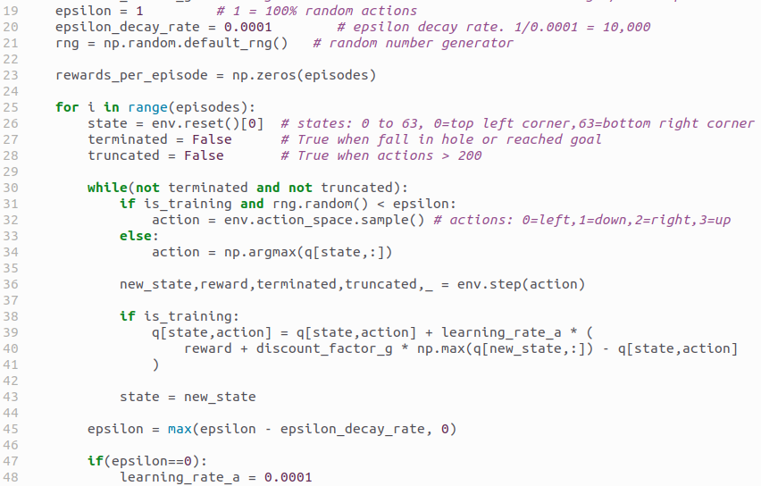
7.11 Epsilon-Greedy Algorithm
https://www.youtube.com/watch?v=ZhoIgo3qqLU&list=PL58zEckBH8fCt_lYkmayZoR9XfDCW9hte&index=7
Epsilon-Greedy Algorithm (04:01-05:40/11:41)
1. Epsilon decay with random number generator.
2. Epsilon decay in each episode. Epsilon has minimum = 0.0001
1
2

Slide 28
7.12 Reward Calculation

Slide 29
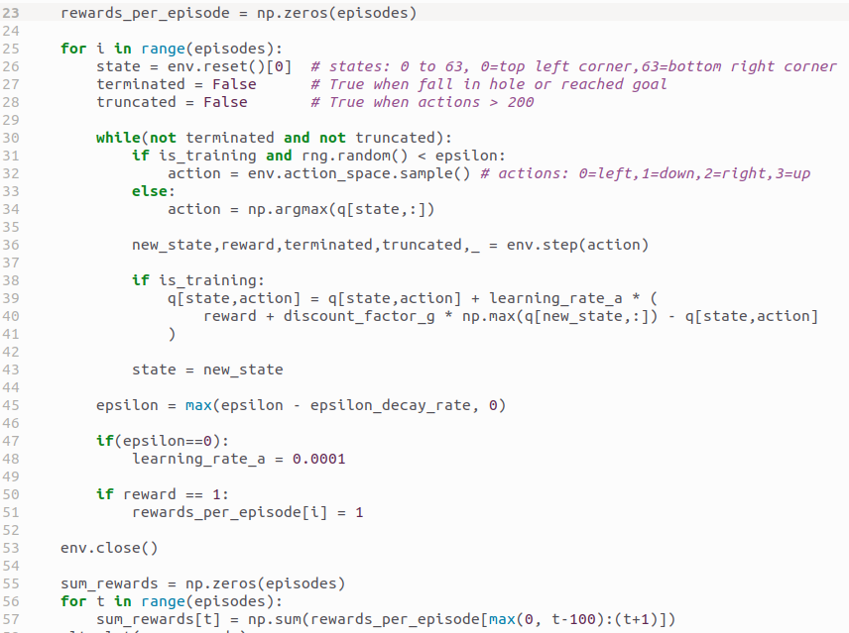
7.12 Reward Calculation
https://www.youtube.com/watch?v=ZhoIgo3qqLU&list=PL58zEckBH8fCt_lYkmayZoR9XfDCW9hte&index=7
Reward Calculation (04:01-04:30/11:41)
1
2
3

Slide 30
7.13 Plot/Save Reward

Slide 31
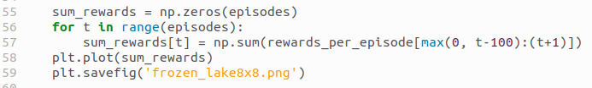
7.13 Plot/Save Reward
https://www.youtube.com/watch?v=ZhoIgo3qqLU&list=PL58zEckBH8fCt_lYkmayZoR9XfDCW9hte&index=7
Plot/Save Reward (04:31-06:20/11:41)

Slide 32
7.14 Save Q-Table

Slide 33

7.14 Save Q-Table
https://www.youtube.com/watch?v=ZhoIgo3qqLU&list=PL58zEckBH8fCt_lYkmayZoR9XfDCW9hte&index=7
Save Q-Table (06:21-07:00/11:41)

Slide 34
7.15 Train without Slippery

Slide 35
7.15 Train without Slippery
https://www.youtube.com/watch?v=ZhoIgo3qqLU&list=PL58zEckBH8fCt_lYkmayZoR9XfDCW9hte&index=7
Train Without Slippery (07:01-08:30/11:41)

Slide 36
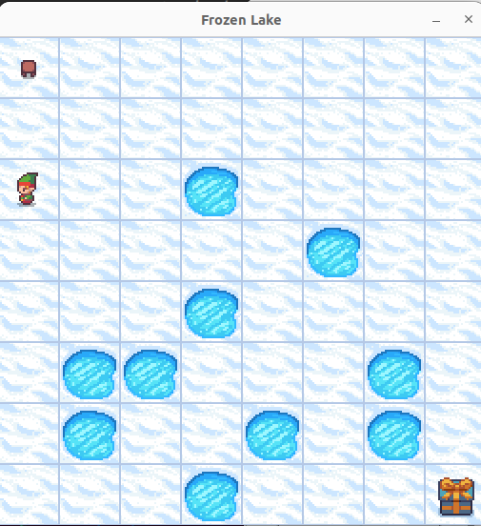
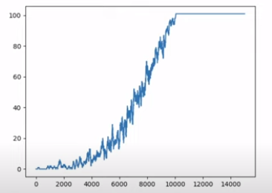
7.15 Train without Slippery
https://www.youtube.com/watch?v=ZhoIgo3qqLU&list=PL58zEckBH8fCt_lYkmayZoR9XfDCW9hte&index=7
Train Without Slippery (08:31-09:30/11:41)
At very beginning, the agent always trapped into the holes.
After 2000 episodes, the agent start to get the positive award.
After 10000 episodes of training, the agent learn how to achieve he goal with positive reward.

Slide 37
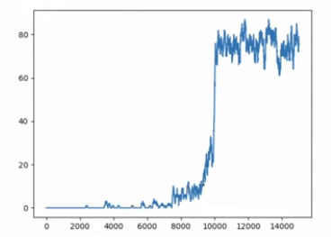
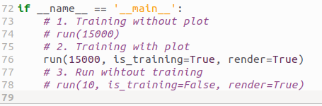
7.16 Train without Slippery
https://www.youtube.com/watch?v=ZhoIgo3qqLU&list=PL58zEckBH8fCt_lYkmayZoR9XfDCW9hte&index=7
Training Without Slippery (09:31-10:30/11:41)
We turn off the display for faster training.
Run (1000, is_training=False, render=False)
> python 17_frozen_lake_q.py
After 10,000 time, the agent get the positive award.

Slide 38
7.16 Run without Train

Slide 39
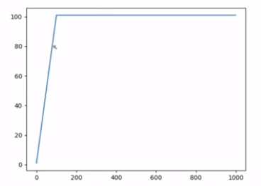
7.16 Run without Train
https://www.youtube.com/watch?v=ZhoIgo3qqLU&list=PL58zEckBH8fCt_lYkmayZoR9XfDCW9hte&index=7
Training Without Train (10:31-11:41/11:41)
After training, we can run without training.
We use Q-Table.
Run (1000, is_training=False, render=True)
> python 17_frozen_lake_q.py

Slide 40
End

