Slide 1

2.00 QL: Continuous Space
Peter H. Chen

Slide 2
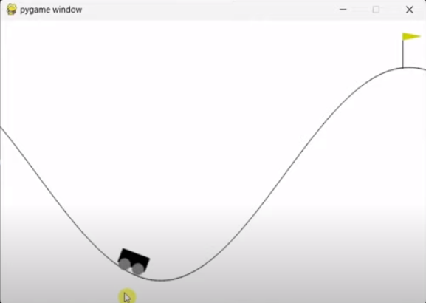
2.00 QL: Continuous Space
https://www.youtube.com/watch?v=_SWnNhM5w-g
QL: Continuous Space (00:00-00:30/8:30)
We discuss Q-Learning to train Gymnasium Mountain Car in Continuous Observation Space

Slide 3
End

