Slide 1

2.B DQL: Mountain Car
Peter H. Chen

Slide 2

2.B DQL: Mountain Car
https://www.youtube.com/watch?v=oceguqZxjn4&list=PL58zEckBH8fCt_lYkmayZoR9XfDCW9hte&index=2
DQL: Mountain Car (00:00-00:30/8:32)
We have discussed QL (Q-Learning) to Mountain Car.
In this discussion, we discuss DQL (Deep Q-Learning) to Mountain Car.
Before we start, we know the facts:
1. The Mountain Car states (stay position and driving velocity) is the Continuous Observation Space.
2. Both QL (Q-Learning) and DQL (Deep Q-Learning) cannot handle the Continuous Observation Space.

Slide 3
2.B.1 DQL of Mountain Car

Slide 4
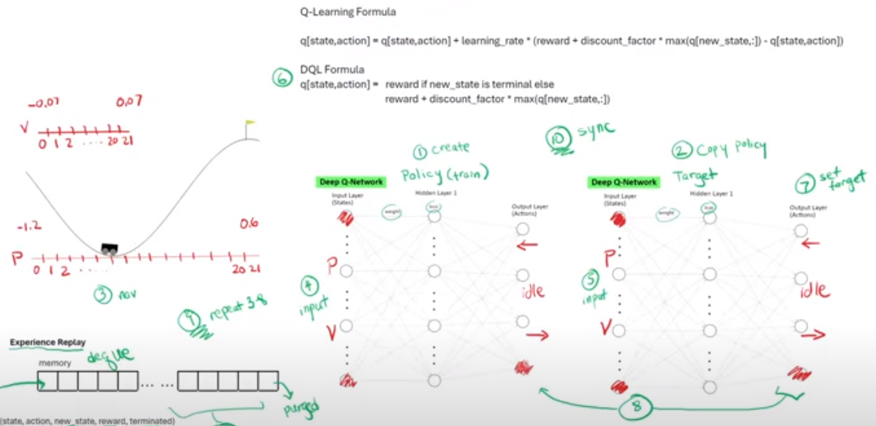
2.B.1 DQL of Mountain Car
https://www.youtube.com/watch?v=oceguqZxjn4&list=PL58zEckBH8fCt_lYkmayZoR9XfDCW9hte&index=2
DQL of Mountain Car (00:31-01:00/8:32)
Below is the Deep Q-Learning (with Two Deep Q-Networks) for Mountain Car. We are give two information:
1. Position of the car along with X-axis: The value is between -1.2 and +0.6
2. Velocity of the car: The value is between -0.07 and +0.07. That is the car can take, either accelerate to the left, accelerate to the right, or do nothing.
Experience Replay
memory
dequeue
...
...
(states, action, new_state, reward, terminated)
Purged
3a: Maximize Experience
3b: Replay

Slide 5
2.B.1 DQL of Mountain Car
https://www.youtube.com/watch?v=oceguqZxjn4&list=PL58zEckBH8fCt_lYkmayZoR9XfDCW9hte&index=2
DQL of Mountain Car (01:01-01:20/8:32)
Let’s map the observation space to our Deep Q-Network. We start with the action space. The output of the network represents our action space.
Since there are three actions (Left, Right, Idle), the action is going to be three nodes.
For the input, we are given position and velocity. So, there are two nodes that we are going to use.
Experience Replay
memory
dequeue
...
...
(states, action, new_state, reward, terminated)
Purged
3a: Maximize Experience
3b: Replay

Slide 6
2.B.1 DQL of Mountain Car
https://www.youtube.com/watch?v=oceguqZxjn4&list=PL58zEckBH8fCt_lYkmayZoR9XfDCW9hte&index=2
DQL of Mountain Car (01:21-01:40/8:32)
As we mentioned earlier, both Q-Learning and Deep Q-Learning cannot handle continuous space.
The continuous space can have infinite number of states.
Before we start Deep Q-Learning of Mountain Car, we have to convert the continuous observation space into the discrete space.
Experience Replay
memory
dequeue
...
...
(states, action, new_state, reward, terminated)
Purged
3a: Maximize Experience
3b: Replay

Slide 7
2.B.1 DQL of Mountain Car
https://www.youtube.com/watch?v=oceguqZxjn4&list=PL58zEckBH8fCt_lYkmayZoR9XfDCW9hte&index=2
DQL of Mountain Car (01:41-02:20/8:32)
Below, we slice the range into 20 divisions between -1.2 to 0.6.
We then pass [P (Position), V (Velocity)] = [0, 1], [0, 2], …, etc. into the input of Policy Network.
Experience Replay
memory
dequeue
...
...
(states, action, new_state, reward, terminated)
Purged
3a: Maximize Experience
3b: Replay

Slide 8
2.B.2 Conda and Install Library

Slide 9
2.B.2 Conda and Install Library
https://www.youtube.com/watch?v=oceguqZxjn4&list=PL58zEckBH8fCt_lYkmayZoR9XfDCW9hte&index=2
Conda and Install Library (02:21-02:22/8:32)
Create/Activate Conda environment
> conda create --name gym
> conda activate gym

Slide 10
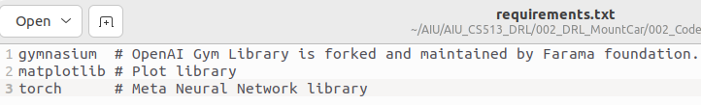
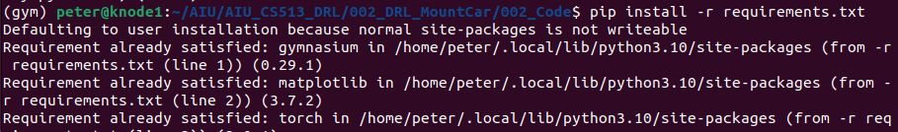
2.B.2 Conda and Install Library
https://www.youtube.com/watch?v=oceguqZxjn4&list=PL58zEckBH8fCt_lYkmayZoR9XfDCW9hte&index=2
Conda and Install Library (02:23-02:30/8:32)
Install Library:
> pip install -r requirements.txt

Slide 11
2.B.3 Compare Changes

Slide 12
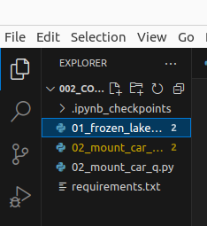
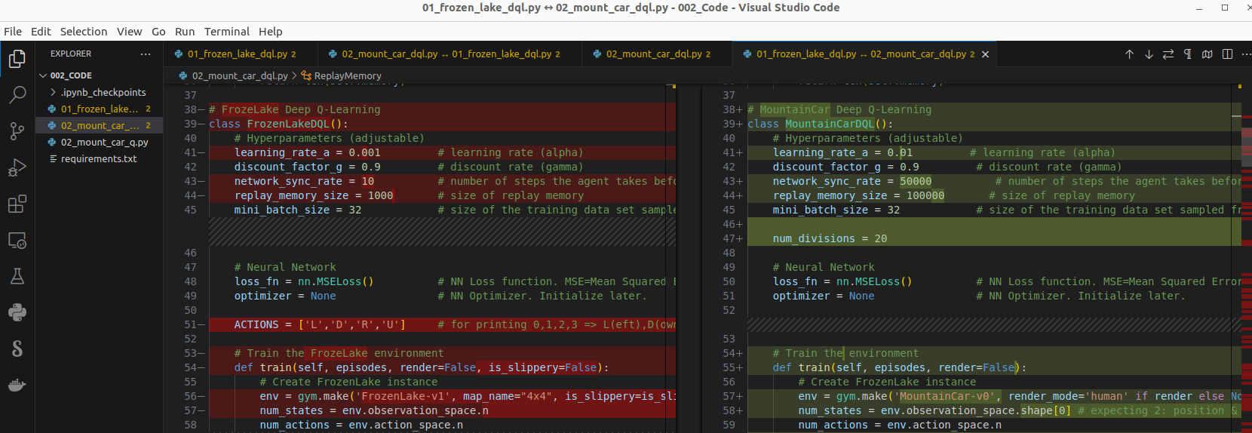
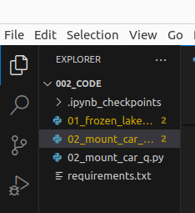
2.B.3 Compare Changes
https://www.youtube.com/watch?v=oceguqZxjn4&list=PL58zEckBH8fCt_lYkmayZoR9XfDCW9hte&index=2
Compare Changes (02:31-02:40/8:32)
1. Open file 01_frozen_lake_dql.py: RMB (Right Mouse Button) > Select to Compare
2. Open file 02_mount_car_dql.py: RMB > Compare with Selected
3. There are difference between 01
1
3
01_frozen_lake_dql.py
Select to Compare
02_mount_car_dql.py
Compare with Selected
2

Slide 13
2.B.4 No Change in Class DQN/ReplayMemory

Slide 14
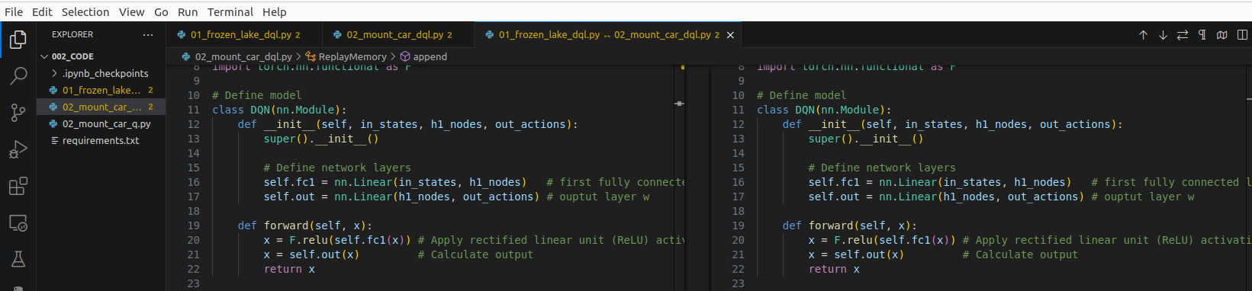
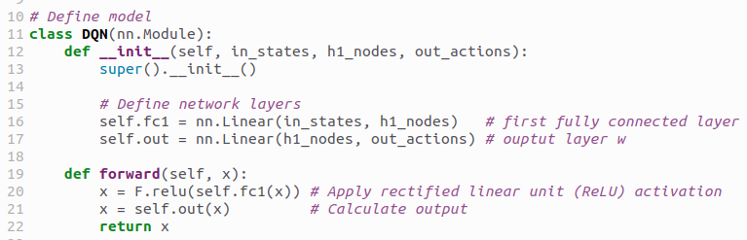
2.B.4 No Change in Class DQN/ReplayMemory
https://www.youtube.com/watch?v=oceguqZxjn4&list=PL58zEckBH8fCt_lYkmayZoR9XfDCW9hte&index=2
No Change in Class DQN/ReplayMemory (02:41-02:42/8:32)
There is no change in class DQN. We can ignore this.

Slide 15
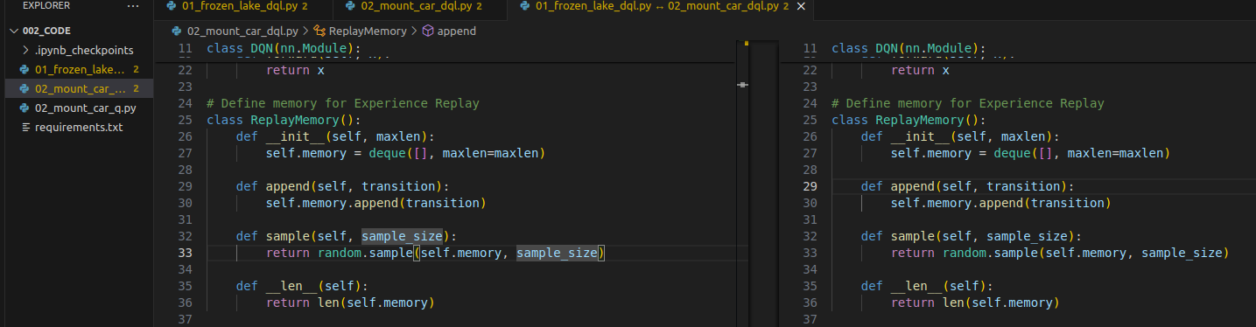
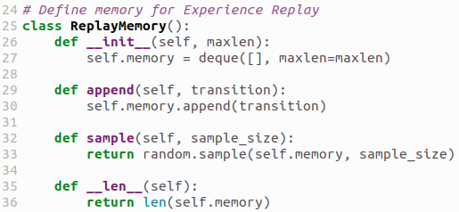
2.B.4 No Change in Class DQN/ReplayMemory
https://www.youtube.com/watch?v=oceguqZxjn4&list=PL58zEckBH8fCt_lYkmayZoR9XfDCW9hte&index=2
No Change in Class DQN/ReplayMemory (02:43-02:45/8:32)
We do not have changed in class ReplayMemory. Ignore class ReplayMemory.

Slide 16
2.B.5 Class MountainCarDQL

Slide 17
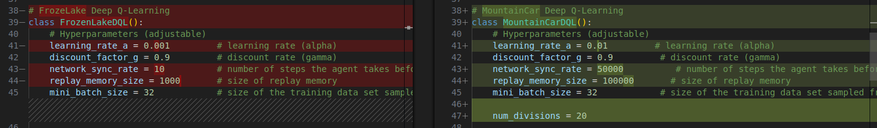
2.B.5 Class MountainCarDQL
https://www.youtube.com/watch?v=oceguqZxjn4&list=PL58zEckBH8fCt_lYkmayZoR9XfDCW9hte&index=2
Class MountainCarDQL (02:46-02:50/8:32)
There are changes between FrozenLakeDQL() and MountainCarDQL().
Here, we can see the code we change
a. learning_rate_a = 0.01
b. network_sync_rate = 50000
c. replay_memory_size = 100000

Slide 18
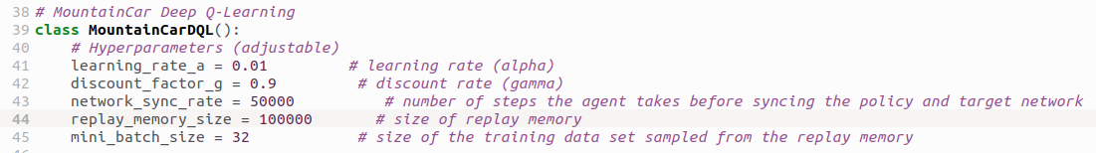
2.B.5 Class MountainCarDQL
https://www.youtube.com/watch?v=oceguqZxjn4&list=PL58zEckBH8fCt_lYkmayZoR9XfDCW9hte&index=2
Class MountainCarDQL (02:51-03:00/8:32)
In MountainCarDQL, we define Hyperparameter:
a. learning_rate_a = 0.01: Step size to find the optimization point.
We increase the learning rate to speed up the training.

Slide 19
2.B.5 Class MountainCarDQL
https://www.youtube.com/watch?v=oceguqZxjn4&list=PL58zEckBH8fCt_lYkmayZoR9XfDCW9hte&index=2
Class MountainCarDQL (03:01-03:10/8:32)
b. We define network_sync_rate = 50000: We sync the Policy Network and copy weights and bias to Target network in every 50000 steps (during the state increment). We increase network_sync_rate = 10 in Frozen lake to 50000 in Mountain Car because the mountain car needs a lot more number of actions.
Experience Replay
memory
dequeue
...
...
(states, action, new_state, reward, terminated)
Purged
3a: Maximize Experience
3b: Replay

Slide 20
2.B.5 Class MountainCarDQL
https://www.youtube.com/watch?v=oceguqZxjn4&list=PL58zEckBH8fCt_lYkmayZoR9XfDCW9hte&index=2
Class MountainCarDQL (02:51-03:15/8:32)
c. We define replay_memory_size = 10000: The same reason for replay memory size, we need a lot of more experiences to store in memory.
Experience Replay
memory
dequeue
...
...
(states, action, new_state, reward, terminated)
Purged
3a: Maximize Experience
3b: Replay

Slide 21
2.B.6 Train ()

Slide 22
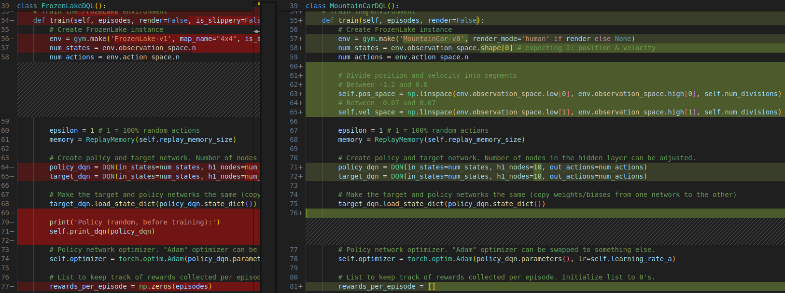
2.B.6 Train ()
https://www.youtube.com/watch?v=oceguqZxjn4&list=PL58zEckBH8fCt_lYkmayZoR9XfDCW9hte&index=2
Train Loop (03:16-03:20/8:32)
We have several codes changed in main training loop.

Slide 23
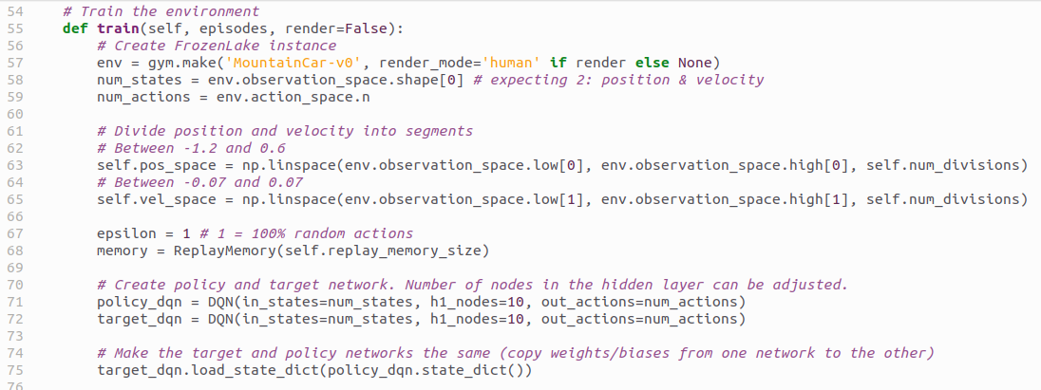
2.B.6 Train ()
https://www.youtube.com/watch?v=oceguqZxjn4&list=PL58zEckBH8fCt_lYkmayZoR9XfDCW9hte&index=2
Train () (03:21-03:30/8:32)
Below has almost no codes changed.
1. We create the mountain car environment and display in terminal for ‘human’ in each step and get num_states from observation space.
2. num_divisions = 20: Divide the position and velocity into segments.
3. We define the policy and target networks and sync weights/bias from policy to target.
1
2
3

Slide 24
2.B.6 Train()
https://www.youtube.com/watch?v=oceguqZxjn4&list=PL58zEckBH8fCt_lYkmayZoR9XfDCW9hte&index=2
Train() (03:31-03:40/8:32)
num_of_divisions = 20: We convert the infinite continuous observation space into the discrete space. We have number of segments to divide the position and velocity into 20 segments.
We can try this number bigger or smaller.
Experience Replay
memory
dequeue
...
...
(states, action, new_state, reward, terminated)
Purged
3a: Maximize Experience
3b: Replay

Slide 25
2.B.7 Training Loop

Slide 26
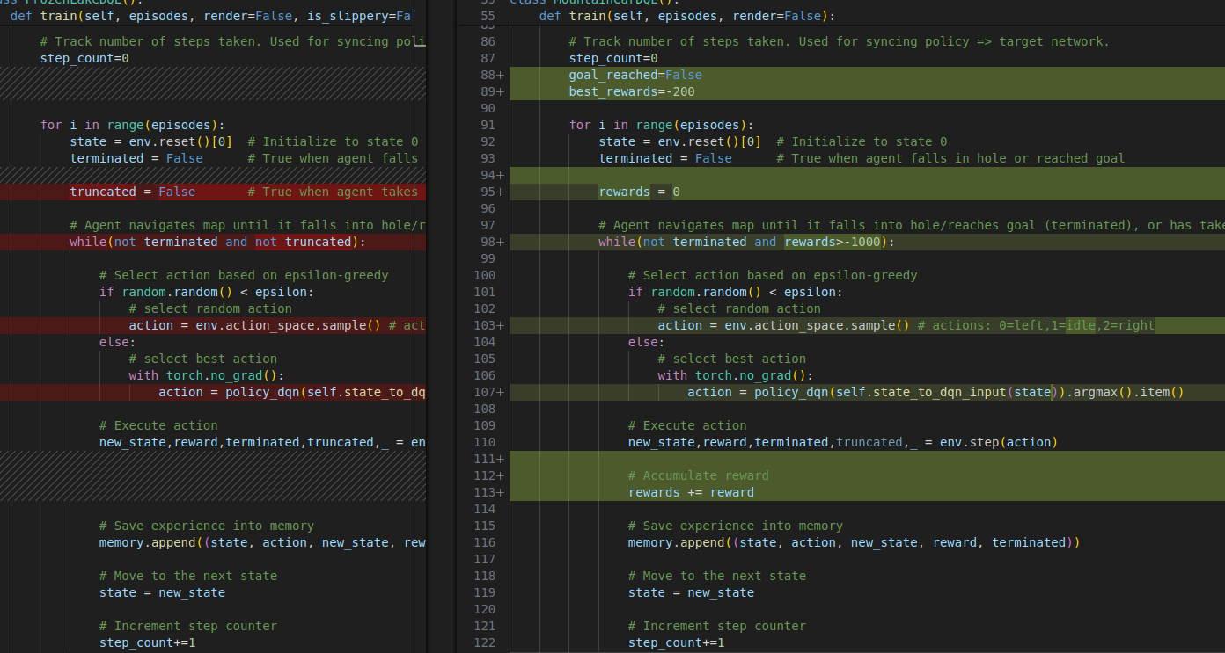
2.B.7 Training Loop
https://www.youtube.com/watch?v=oceguqZxjn4&list=PL58zEckBH8fCt_lYkmayZoR9XfDCW9hte&index=2
Training Loop (03:41-03:42/8:32)
> for i in range (episodes):
This is our main training loop.

Slide 27
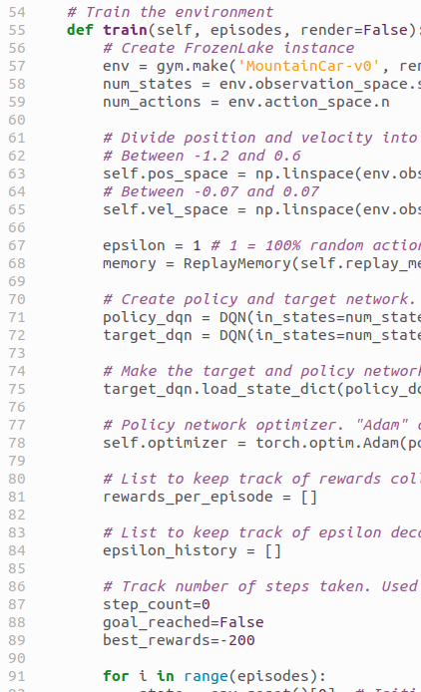
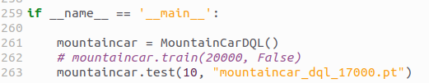
2.B.7 Training Loop
https://www.youtube.com/watch?v=oceguqZxjn4&list=PL58zEckBH8fCt_lYkmayZoR9XfDCW9hte&index=2
Training Loop (03:43-03:44/8:32)
> train (20000, ...)
This is our main training loop.
We go through number of episodes = 20000 during the training. Each trial and error is an episode.

Slide 28
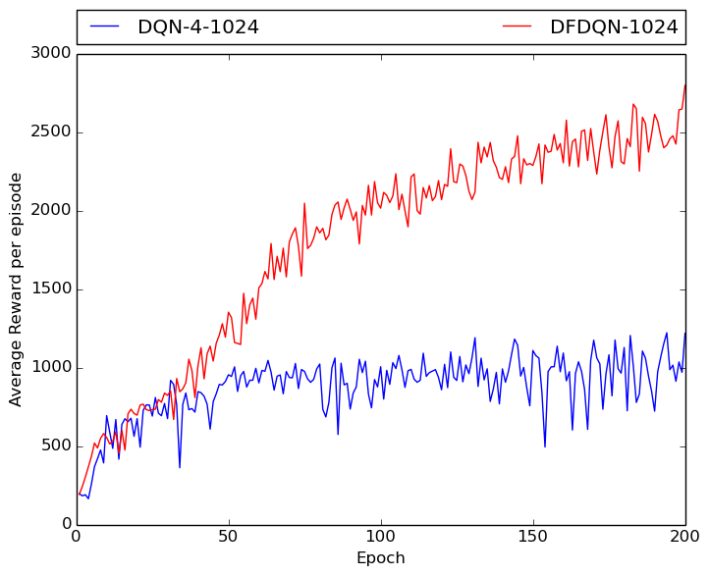
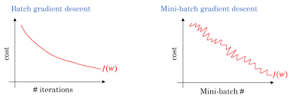
2.B.7 Training Loop
https://www.youtube.com/watch?v=oceguqZxjn4&list=PL58zEckBH8fCt_lYkmayZoR9XfDCW9hte&index=2
Training Loop (03:45-03:46/8:32)
What is difference in episode and epoch?
1. episode in RL (Reinforcement Learning): In reinforcement learning, the episode record actions, states, and reward that an agent performed from a start state to an end state. The agent try to get maximum reward in each episode.
2. epoch in DL (Deep Learning): An epoch is when all the training data is used at once and is defined as the total number of iterations to minimize the model error.
3. DRL (Deep Reinforcement Learning) use both episode in RL and epoch in DL.
Episode in RL
Epoch in DL

Slide 29
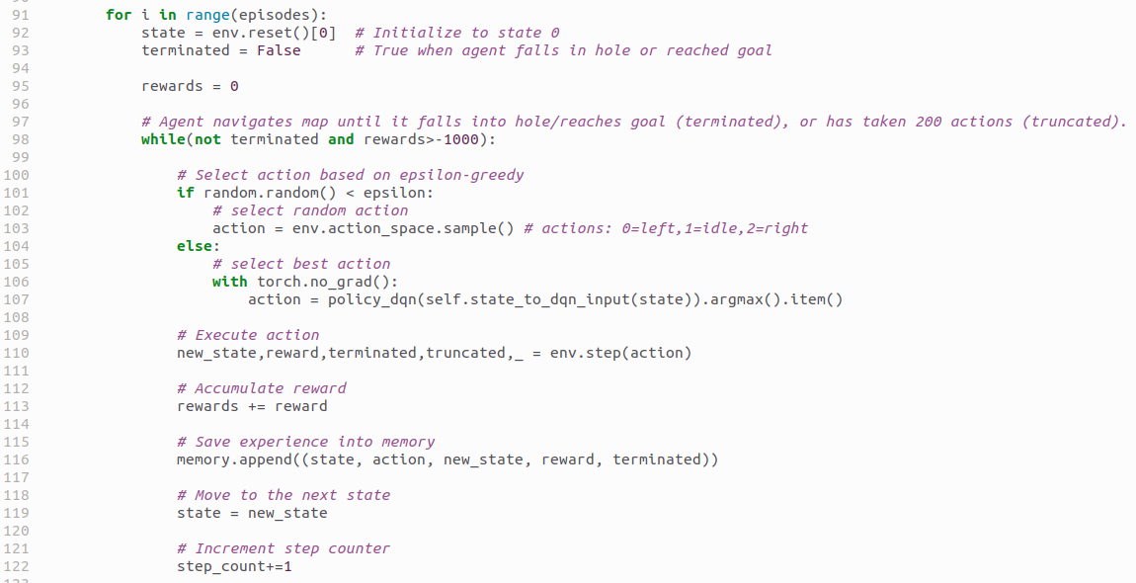
2.B.7 Training Loop
https://www.youtube.com/watch?v=oceguqZxjn4&list=PL58zEckBH8fCt_lYkmayZoR9XfDCW9hte&index=2
Training Loop (03:47-03:55/8:32)
Here, we check if not terminated (no change in code). We have 1000 steps for reward.
Each time we step with action, the reward will be automatically decreased from the environment.
policy_dqn() is the policy network which convert input state to the action.

Slide 30
2.B.8 State to DQN Input

Slide 31
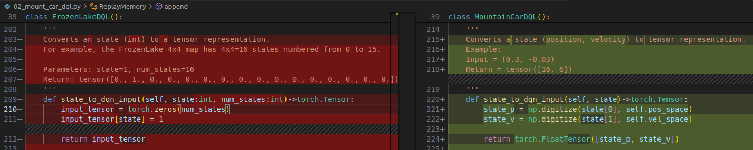
2.B.8 State to DQN Input
https://www.youtube.com/watch?v=oceguqZxjn4&list=PL58zEckBH8fCt_lYkmayZoR9XfDCW9hte&index=2
State to DQN Input (03:56-04:00/8:32)
Now, we look at function state_to_dqn_input ().

Slide 32
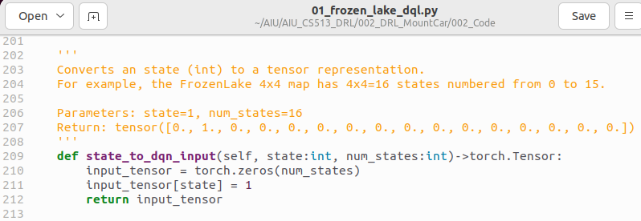
2.B.8 State to DQN Input
https://www.youtube.com/watch?v=oceguqZxjn4&list=PL58zEckBH8fCt_lYkmayZoR9XfDCW9hte&index=2
State to DQN Input (04:01-04:02/8:32)
In FrozenLakeDQL(), we use torch.Tensor to convert the state into one-hot-encoding.
1. torch.Tensor is similar to NumPy array but with GPU acceleration.
2. NumPy arrays are widely used in scientific computing and data analysis.
3. torch.Tensor are used in neural network.

Slide 33
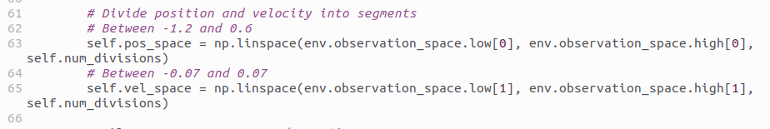
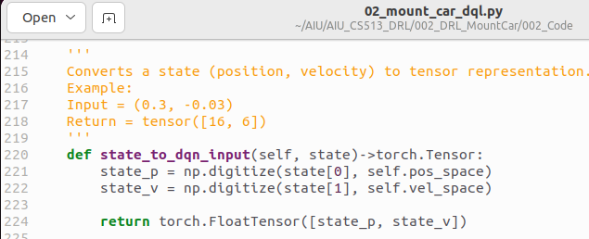
2.B.8 State to DQN Input
https://www.youtube.com/watch?v=oceguqZxjn4&list=PL58zEckBH8fCt_lYkmayZoR9XfDCW9hte&index=2
State to DQN Input (04:03-04:05/8:32)
In MountainCarDQL(), the position and velocity are infinity/continuous observation spaces.
We have pos_space and vel_space in linear space.
We digitize position and velocity into 20 discrete bins into Tensor with unique one-hot-encoding.
bins
Input data to be binned

Slide 34
2.B.8 State to DQN Input
https://www.youtube.com/watch?v=oceguqZxjn4&list=PL58zEckBH8fCt_lYkmayZoR9XfDCW9hte&index=2
State to DQN Input (04:06-04:10/8:32)
We convert the continuous observation spaces into discrete bins for the input of policy Network.
Experience Replay
memory
dequeue
...
...
(states, action, new_state, reward, terminated)
Purged
3a: Maximize Experience
3b: Replay

Slide 35
2.B.9 Plot Progress

Slide 36
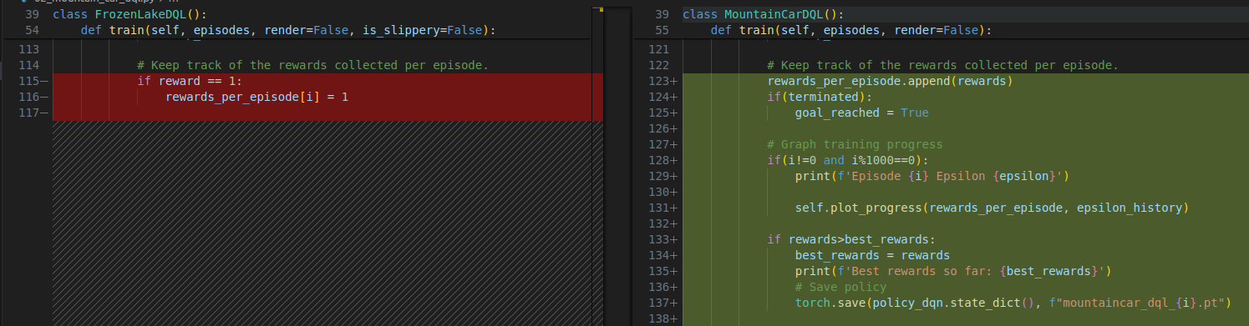
2.B.9 Plot Progress
https://www.youtube.com/watch?v=oceguqZxjn4&list=PL58zEckBH8fCt_lYkmayZoR9XfDCW9hte&index=2
Plot Progress (04:11-04:15/8:32)
We have another change in plot progress.
In Frozen Lake, we have 1,000 episodes. Training time is short, we do not plot the progress.
In Mountain Car, we have 20,000 episodes in training. It takes long time to train, we plot every 1,000 episodes.

Slide 37
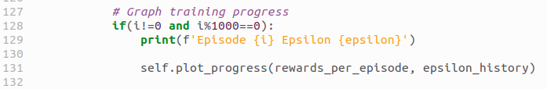
2.B.9 Plot Progress
https://www.youtube.com/watch?v=oceguqZxjn4&list=PL58zEckBH8fCt_lYkmayZoR9XfDCW9hte&index=2
Plot Progress (04:16-04:25/8:32)
Because we have a lot of episode (20,000), we only plot the progress in every 1000 episodes.

Slide 38
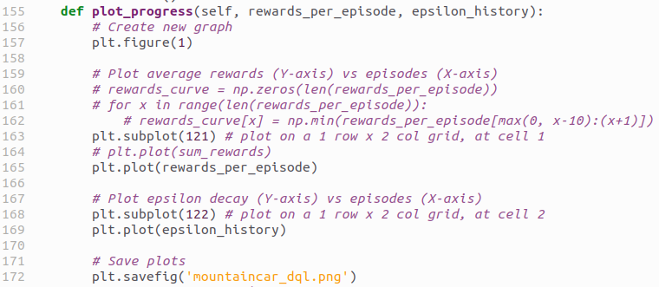
2.B.9 Plot Progress
https://www.youtube.com/watch?v=oceguqZxjn4&list=PL58zEckBH8fCt_lYkmayZoR9XfDCW9hte&index=2
Plot Progress (04:26-05:25/8:32)
Plot progress plot and reward and epsilon history of each episode.

Slide 39
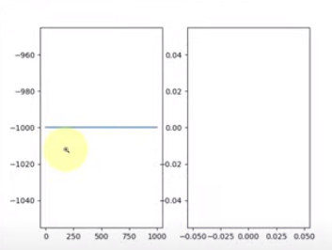
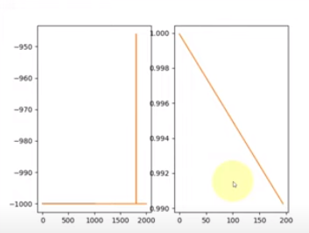
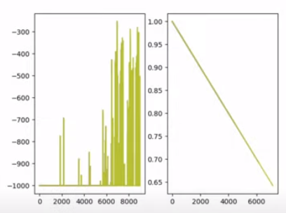
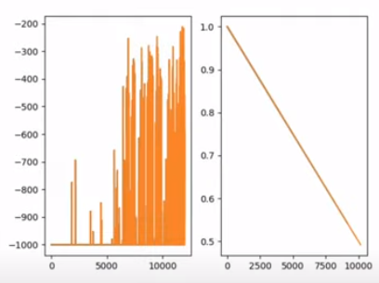
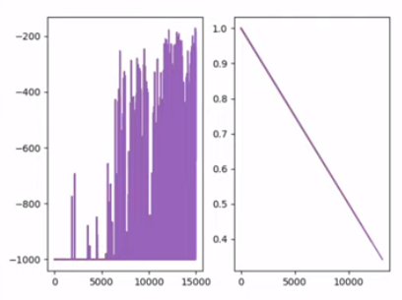
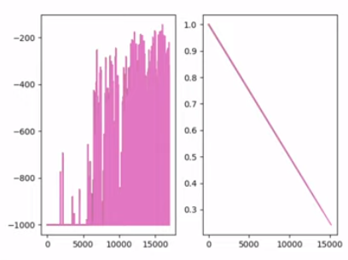
2.B.9 Plot Progress
https://www.youtube.com/watch?v=oceguqZxjn4&list=PL58zEckBH8fCt_lYkmayZoR9XfDCW9hte&index=2
Plot Progress (04:26-07:20/8:32)
1) 1,000; 2) 2,000; 3) 9,000; 4) 13,000; 5) 15,000; 6) 17,000 episode.
17,000 episode has the best solutions for weight and bias.
1
2
3
4
5
6

Slide 40
2.B.10 Test

Slide 41
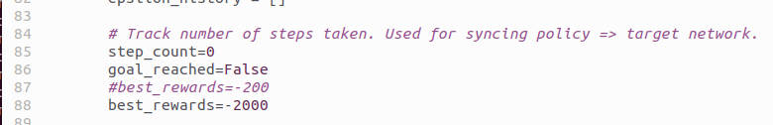
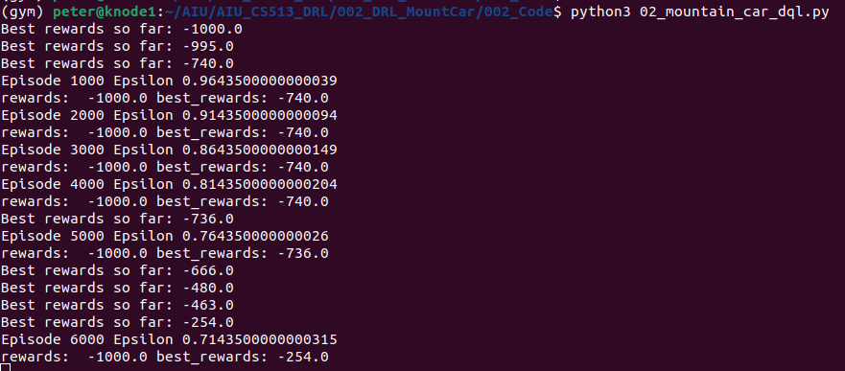
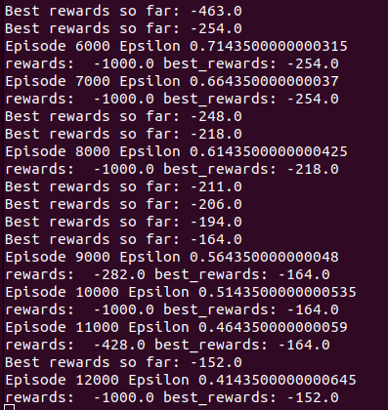
2.B.10 Test
https://www.youtube.com/watch?v=oceguqZxjn4&list=PL58zEckBH8fCt_lYkmayZoR9XfDCW9hte&index=2
Test (07:21-07:30/8:32)
Set the best reward = -2000. Whenever better than -2000, then save the “mountaincar_dql_nnn.pt” (nnn: episode count, pt: PyTorch extension).

Slide 42
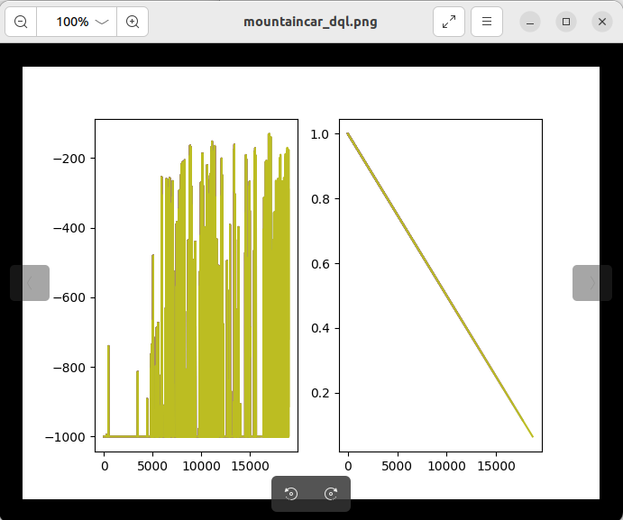
2.B.9 Plot Progress
https://www.youtube.com/watch?v=oceguqZxjn4&list=PL58zEckBH8fCt_lYkmayZoR9XfDCW9hte&index=2
Plot Progress (07:31-07:40/8:32)
We can see the best weight and bias at around episode 17nnn.

Slide 43
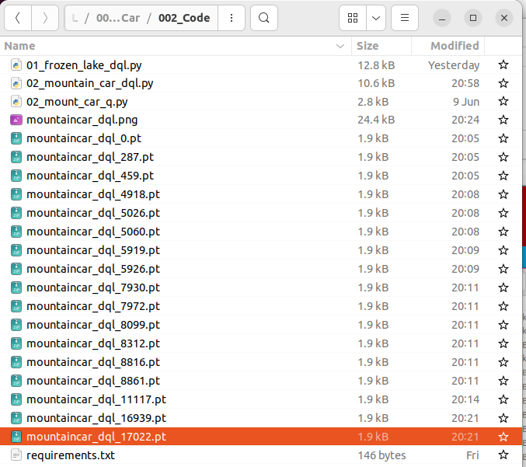
2.B.9 Plot Progress
https://www.youtube.com/watch?v=oceguqZxjn4&list=PL58zEckBH8fCt_lYkmayZoR9XfDCW9hte&index=2
Plot Progress (07:41-07:50/8:32)
We have the best weight and bias at episode 17002.

Slide 44
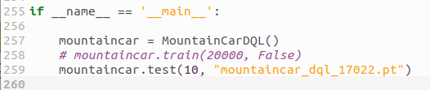
2.B.9 Plot Progress
https://www.youtube.com/watch?v=oceguqZxjn4&list=PL58zEckBH8fCt_lYkmayZoR9XfDCW9hte&index=2
Plot Progress (07:51-08:00/8:32)
1. We mark out tarin().
2. We test 10 times with “mountaincar_dql_17022.pt” (pt: PyTorch extension).

Slide 45
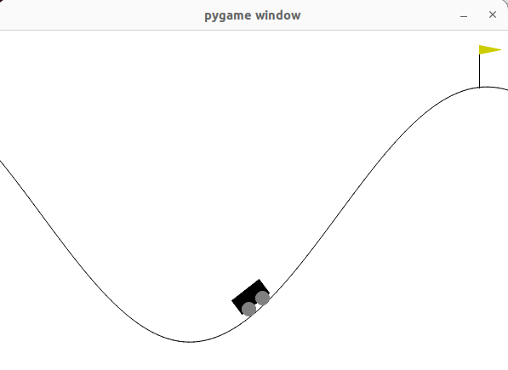
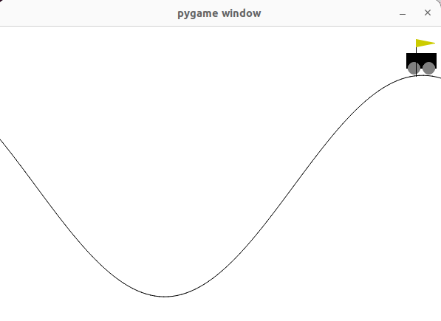
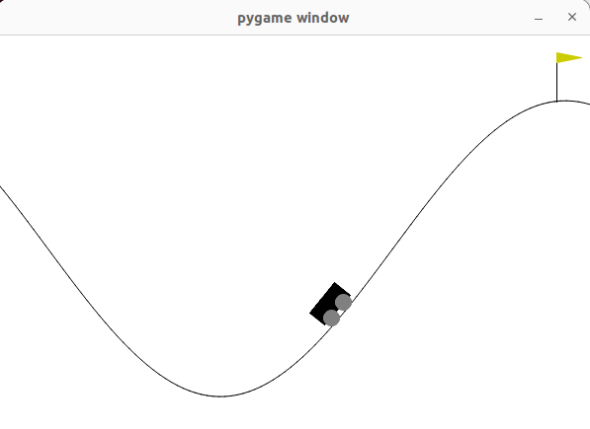

2.B.10 Test
https://www.youtube.com/watch?v=oceguqZxjn4&list=PL58zEckBH8fCt_lYkmayZoR9XfDCW9hte&index=2
Test (08:01-08:32/8:32)
Run again, with 17002 (best reward), in any position, the agent can easily reach the goal.
1
2

Slide 46
End

