Slide 1

13 Box2D
Peter H. Chen

Slide 2
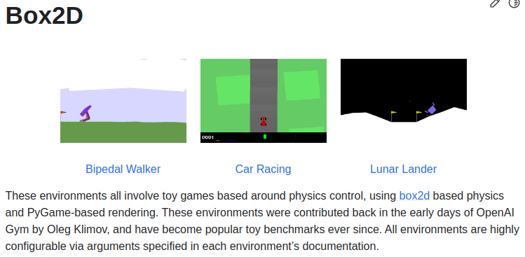
13 Box2D
https://www.youtube.com/watch?v=yxS5WErjYxc&list=PL58zEckBH8fCt_lYkmayZoR9XfDCW9hte&index=13
Box2D(00:00-03:00/8:04)
1. Unity Library provide 2D and 3D for video game developer.
2. Box2D uses Unity Library for 2D deterministic and random generation.
https://gymnasium.farama.org/environments/box2d/

Slide 3
13.1 Conda Environment

Slide 4
13.1 Conda Environment
https://www.youtube.com/watch?v=yxS5WErjYxc&list=PL58zEckBH8fCt_lYkmayZoR9XfDCW9hte&index=13
Conda Environment (03:01-04:00/8:04)
1. Create conda environment
>conda create --name gym
2. Activate conda environment
(base) > conda activate gym
(gym)

Slide 5
13.2 Install Box2D

Slide 6
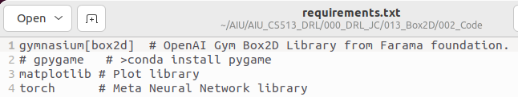
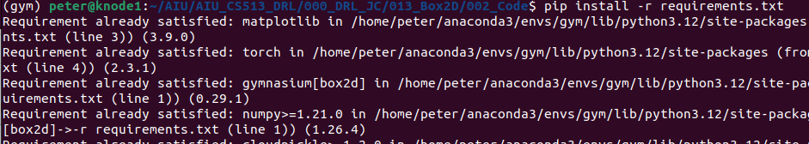
13.2 Install Box2D
https://www.youtube.com/watch?v=yxS5WErjYxc&list=PL58zEckBH8fCt_lYkmayZoR9XfDCW9hte&index=13
Install Box2D (04:01-05:00/8:04)
1. Command to Install Box2D
> pip install gymnasium[box2d]
2. Install requirements.txt
> pip install -r requirements.txt
https://gymnasium.farama.org/environments/box2d/

Slide 7
13.3 Bipedal Walker

Slide 8
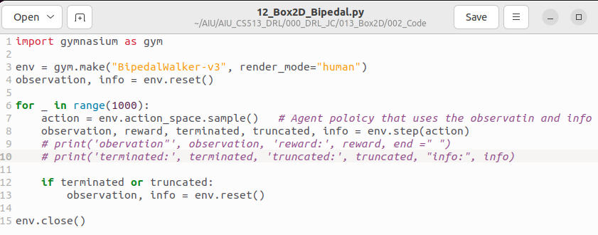
13.3 Bipedal Walker
https://www.youtube.com/watch?v=yxS5WErjYxc&list=PL58zEckBH8fCt_lYkmayZoR9XfDCW9hte&index=13
Bipedal Walker (04:01-05:00/8:04)
We
1. make environment for “BipefalWalker-v3” and render_mode=”human”)
2. Generate random walk.
https://www.gymlibrary.dev/environments/box2d/bipedal_walker/

Slide 9
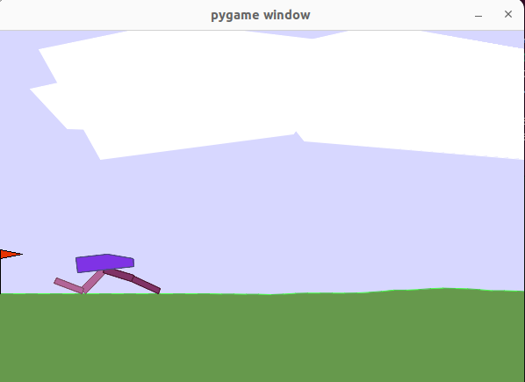
13.3 Bipedal Walker
https://www.youtube.com/watch?v=yxS5WErjYxc&list=PL58zEckBH8fCt_lYkmayZoR9XfDCW9hte&index=13
Bipedal Walker (05:01-05:30/8:04)
Run 12.01_BipedalWalker.py with environment render_mode=”human” will display for us.
> python 12.01_BipedalWalker.py
https://www.gymlibrary.dev/environments/box2d/bipedal_walker/

Slide 10
13.4 Car Racing

Slide 11
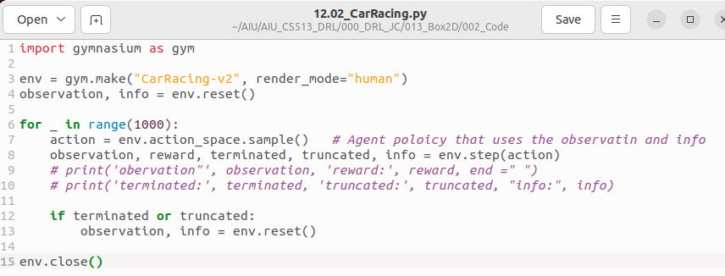
13.4 Car Racing
https://www.youtube.com/watch?v=yxS5WErjYxc&list=PL58zEckBH8fCt_lYkmayZoR9XfDCW9hte&index=13
Car Racing (05:31-06:00/8:04)
We
1. make environment for “CarRacing-v2” and render_mode=”human”)
2. generate random car motion.
https://www.gymlibrary.dev/environments/box2d/car_racing/

Slide 12
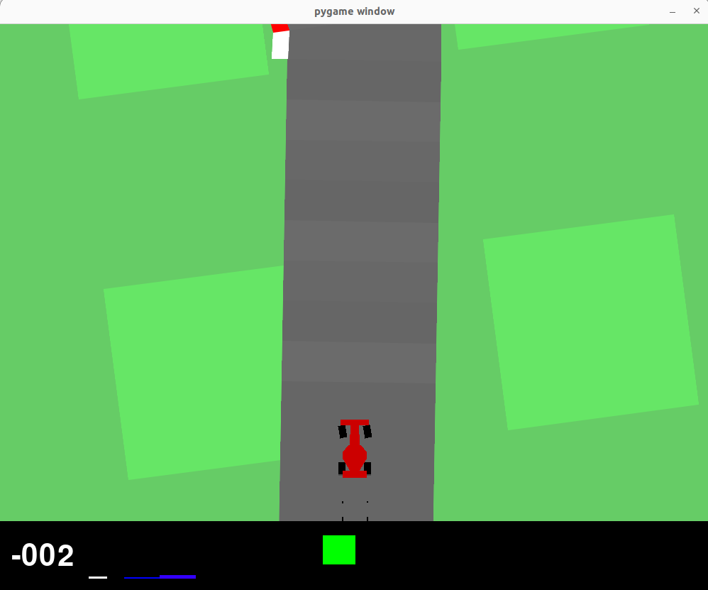
13.4 Car Racing
https://www.youtube.com/watch?v=yxS5WErjYxc&list=PL58zEckBH8fCt_lYkmayZoR9XfDCW9hte&index=13
Car Racing (06:01-07:00/8:04)
Run 12.02_CarRacing.py with environment render_mode=”human” will display for us.
> python 12.02_CarRacing.py
https://www.gymlibrary.dev/environments/box2d/car_racing/

Slide 13
13.5 Lunar Lander

Slide 14
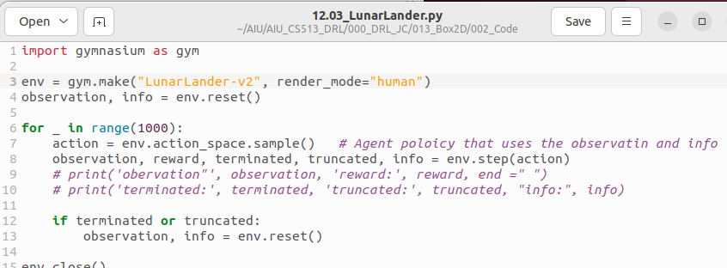
13.5 Lunar Lander
https://www.youtube.com/watch?v=yxS5WErjYxc&list=PL58zEckBH8fCt_lYkmayZoR9XfDCW9hte&index=13
Lunar Lander (07:01-07:30/8:04)
We
1. make environment for “LunarLander-v2” and render_mode=”human”)
2. generate random car motion.
https://www.gymlibrary.dev/envsironments/box2d/lunar_lander/

Slide 15
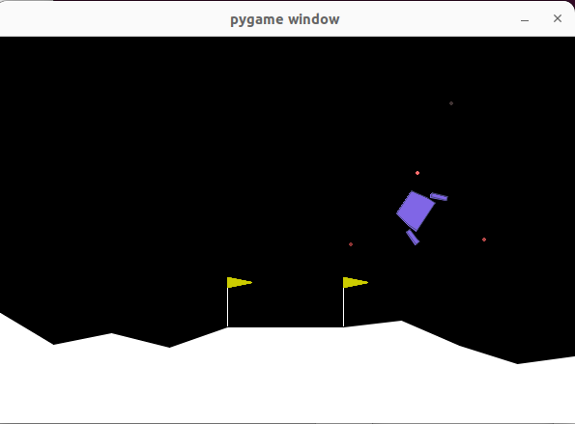
13.5 Lunar Lander
https://www.youtube.com/watch?v=yxS5WErjYxc&list=PL58zEckBH8fCt_lYkmayZoR9XfDCW9hte&index=13
Lunar Lander (07:31-08:04/8:04)
Run 12.03_LunarLander.py with environment render_mode=”human” will display for us.
> python 12.03_LunarLander.py
https://www.gymlibrary.dev/environments/box2d/lunar_lander/

Slide 16
End

