Slide 1

10 QL: Train MC
Peter H. Chen

Slide 2
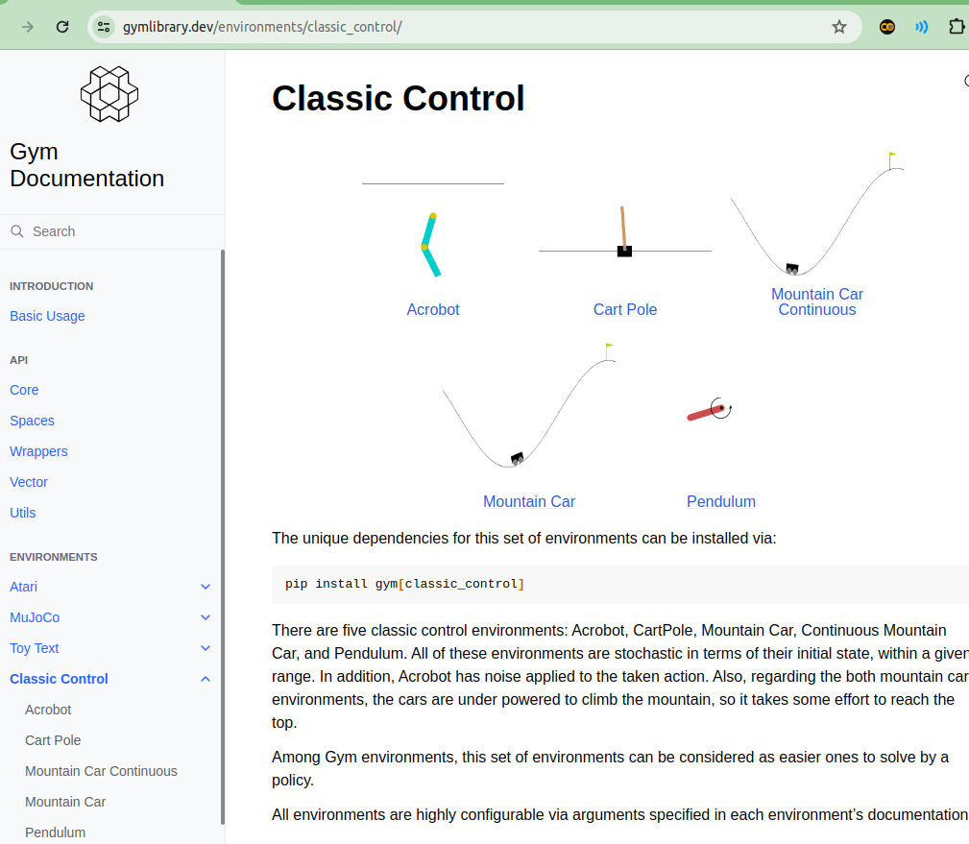
10 QL: Train MC
https://www.youtube.com/watch?v=_SWnNhM5w-g&list=PL58zEckBH8fCt_lYkmayZoR9XfDCW9hte&index=10
QL: Value Change (00:00-00:01/8:38)
We discuss the Q-Learning Training for Mountain Car.
> pip install gymansium[classic-control]
https://www.gymlibrary.dev/environments/classic_control/

Slide 3
10.1 Environment and Library

Slide 4
10.1 Environment and Library
https://www.youtube.com/watch?v=_SWnNhM5w-g&list=PL58zEckBH8fCt_lYkmayZoR9XfDCW9hte&index=10
Environment and Library (00:02-00:03/8:38)
1. Create/Activate conda environment
> create --name gym
(base) > conda activate gym
(gym)
https://www.gymlibrary.dev/environments/classic_control/

Slide 5
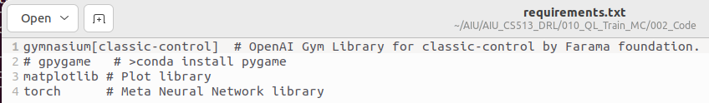

10.1 Environment and Library
https://www.youtube.com/watch?v=_SWnNhM5w-g&list=PL58zEckBH8fCt_lYkmayZoR9XfDCW9hte&index=10
Environment and Library (00:04-00:05/8:38)
Install “gymnasium [class-control]”:
> pip install gymansium[classic-control]
1. Add “gymnasium [class-control]”in the requirements.txt for below installation:
2. Install requiremenets.txt
> install -r requirements.txt
https://www.gymlibrary.dev/environments/classic_control/
1
2

Slide 6
10.2 Compare Code

Slide 7
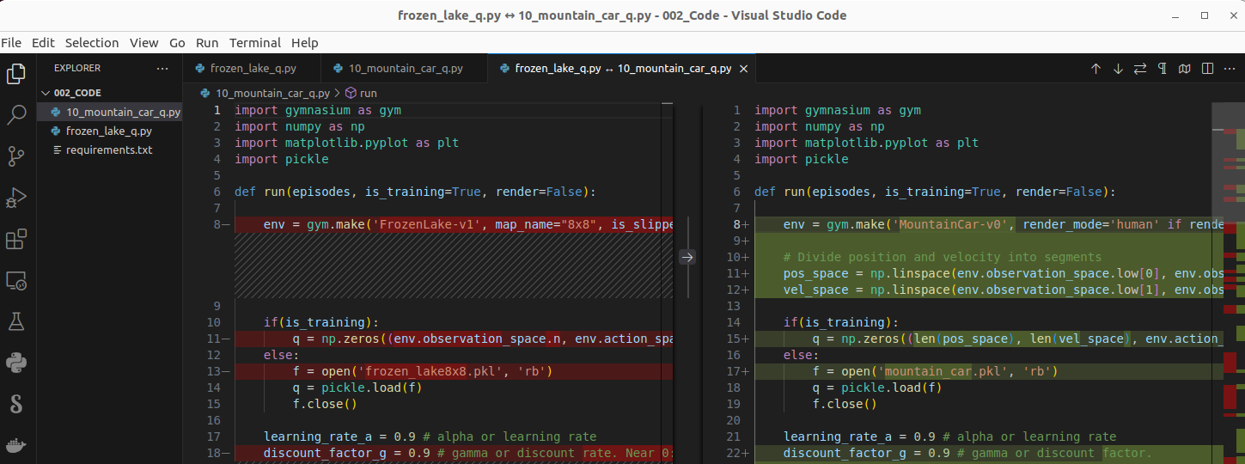
10.2 Compare Code
https://www.youtube.com/watch?v=_SWnNhM5w-g&list=PL58zEckBH8fCt_lYkmayZoR9XfDCW9hte&index=10
Compare Code (00:04-00:05/8:38)
We compare the code changes in frozen_lake_q.py and 10_mountain_car_q.py.
1. frozen_lake_q.py: Select to compare
2. 10_mountain_car_q.py: Compare with selected
https://www.gymlibrary.dev/environments/classic_control/

Slide 8
10.3 MC Basic Code

Slide 9
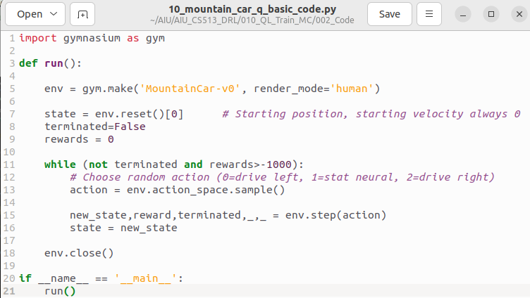
10.3 MC Basic Code
https://www.youtube.com/watch?v=_SWnNhM5w-g&list=PL58zEckBH8fCt_lYkmayZoR9XfDCW9hte&index=10
MC Basic Code (00:06-01:00/8:38)
Below is the Mountain Car basic code for training.
1. Create the mountain car environment
2. start with very low position 0 and velocity is 0.
3. Set terminated to false and reward to 0.
4. We randomly generate action (0: left, 1: neutral, 2: right)
5. Get the new state and reward from step function: The reward will minus 1 each time.
6. Update the state.

Slide 10
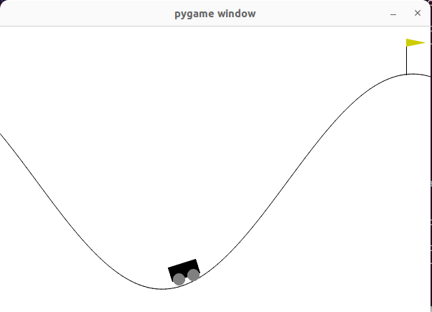
10.3 MC Basic Code
https://www.youtube.com/watch?v=_SWnNhM5w-g&list=PL58zEckBH8fCt_lYkmayZoR9XfDCW9hte&index=10
MC Basic Code (01:01-01:50/8:38)
After thousands of sampling tries, the mountain car can pass the goal.
https://www.gymlibrary.dev/environments/classic_control/

Slide 11
10.4 MC Q-Learning

Slide 12
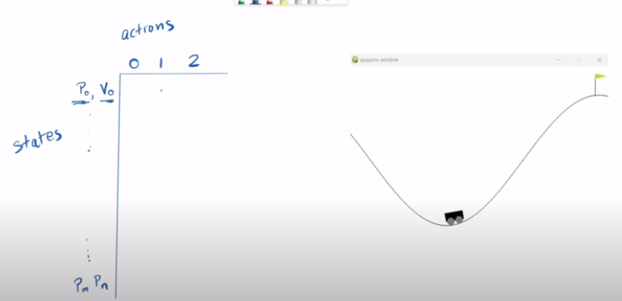
10.4 MC Q-Learning
https://www.youtube.com/watch?v=_SWnNhM5w-g&list=PL58zEckBH8fCt_lYkmayZoR9XfDCW9hte&index=10
MC Q-Learning (01:51-02:05/8:38)
Let’s talk about Q-Learning.
At the end of training of Q-Learning, we have a lookup table.
The agent can come and find its position,velocity and decide what action it can take the largest value in the table.

Slide 13
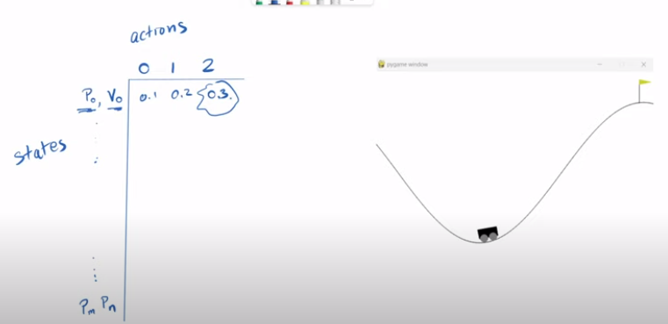
10.4 MC Q-Learning
https://www.youtube.com/watch?v=_SWnNhM5w-g&list=PL58zEckBH8fCt_lYkmayZoR9XfDCW9hte&index=10
MC Q-Learning (02:06-02:10/8:38)
If the prescribed values in table are 0.1, 0.2, and 0.3.
The agent will pick the 0.3 for the action 2(go right).

Slide 14
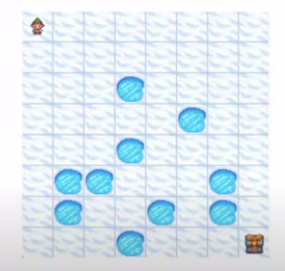
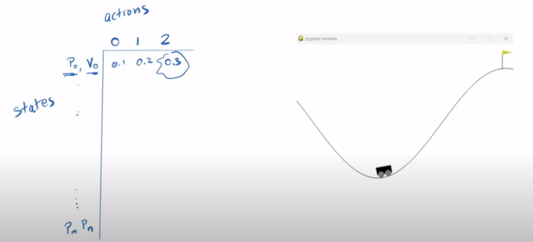
10.4 MC Q-Learning
https://www.youtube.com/watch?v=_SWnNhM5w-g&list=PL58zEckBH8fCt_lYkmayZoR9XfDCW9hte&index=10
MC Q-Learning (02:11-02:20/8:38)
1. In the Frozen Lake problem, the states are straightforward. The state and action are fixed.
2. In the mountain car problem, the states are not straightforward.
The states are infinity due to the combination of position and velocity.
The state will run out of spaces.
1
2

Slide 15
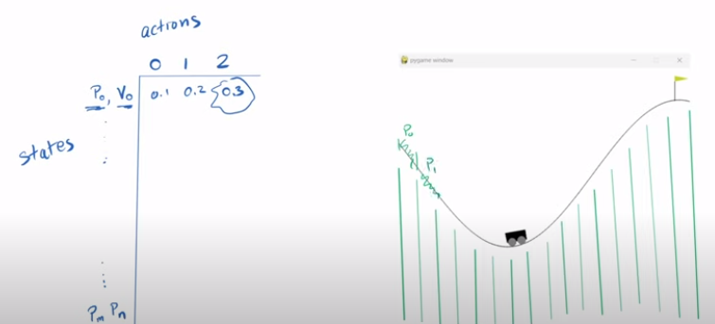
10.4 MC Q-Learning
https://www.youtube.com/watch?v=_SWnNhM5w-g&list=PL58zEckBH8fCt_lYkmayZoR9XfDCW9hte&index=10
MC Q-Learning (02:21-02:40/8:38)
The way we handle the infinity states is to divide the position into segments.
If the car is anywhere in the left. We say the position is P0.
If the car move a little bit, then we say the position P1.
We do the same thing for the velocity. We chop the velocity into the segments.

Slide 16
10.5 Discretize Position and Velocity

Slide 17
10.5 Discretize Position and Velocity
https://www.youtube.com/watch?v=_SWnNhM5w-g&list=PL58zEckBH8fCt_lYkmayZoR9XfDCW9hte&index=10
Discretize Position and Velocity (02:41-03:10/8:38)
Let’s look at code how to discretize the Position and Velocity.
1. The position can be anywhere between -1.2 and 0.6.
We use numpy linear space to divide this range into 20 segments.
2. We do the same thing for the velocity. The velocity is between -0.07 and 0.07.
The numpy library divide the velocity into 20 segments as well.
There have some problem in judgment, if we use too big of a number and the training time will take too long. In this case, we take 20 segments for both positions and velocity.

Slide 18
10.6 Initialize Q-Table

Slide 19
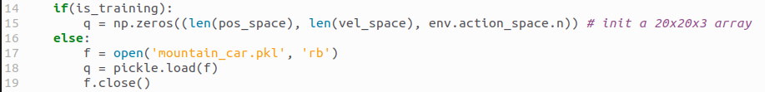
10.6 Initialize Q-Table
https://www.youtube.com/watch?v=_SWnNhM5w-g&list=PL58zEckBH8fCt_lYkmayZoR9XfDCW9hte&index=10
Initialize Q-Table (02:41-03:10/8:38)
We divide the Q-table into 20 (Position) x 20 (velocity) x 3 (action) because we have 20 actions and 20 velocity and 3 actions.

Slide 20
10.7 Calculate Q-Table

Slide 21
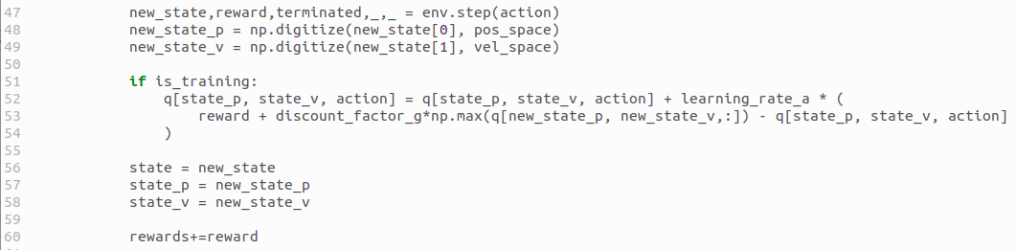
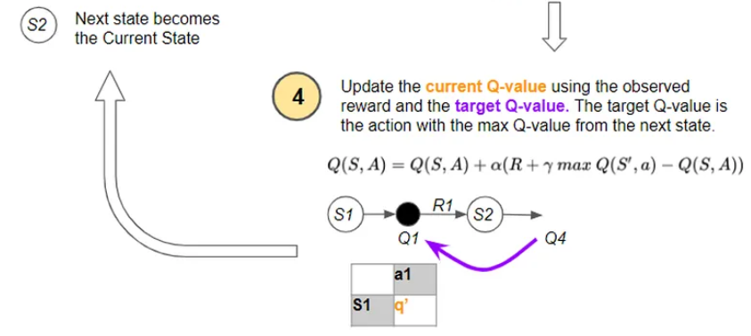
10.7 Calculate Q-Table
https://www.youtube.com/watch?v=_SWnNhM5w-g&list=PL58zEckBH8fCt_lYkmayZoR9XfDCW9hte&index=10
Calculate Q-Table (03:11-04:30/8:38)
1. After we get the new_state, we need to update to new_state_p and new_state_v.
2. Calculate/Update Q-Table:
q [state_p, state_v, action] = q [state_p, state_v, action] + learning_rate * (reward + discount_factor_g * np.max (q[new_state_q, new_state_v, :] - q[stat_p, state_v, action])
Here, “:” index from 0 to end. np.max find the max q-value from three actions (move left, no move, move right)
https://towardsdatascience.com/reinforcement-learning-explained-visually-part-4-q-learning-step-by-step-b65efb731d3e
1

Slide 22
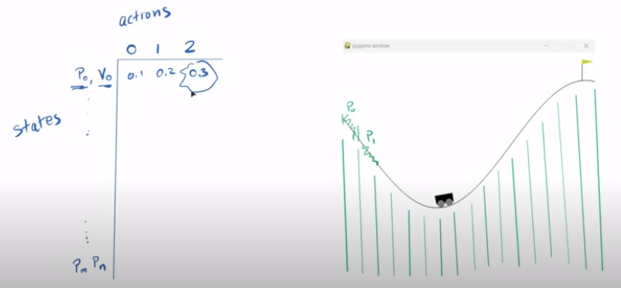
10.7 Calculate Q-Table
https://www.youtube.com/watch?v=_SWnNhM5w-g&list=PL58zEckBH8fCt_lYkmayZoR9XfDCW9hte&index=10
Calculate Q-Table (04:31-04:50/8:38)
This is the largest Q-value in the new state.
If we are in another state, we came into P0, V0. The largest Q-value 0.3 right now.
The mountain car is learning through random exploration. The mountain car needs to gradually start using what he learned.

Slide 23
10.8 Hyperparameter

Slide 24
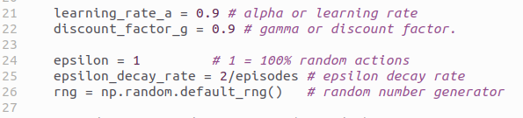
10.8 Hyperparameter
https://www.youtube.com/watch?v=_SWnNhM5w-g&list=PL58zEckBH8fCt_lYkmayZoR9XfDCW9hte&index=10
Hyperparameter (04:51-05:20/8:38)
We need to setup the hyperparameters.
1. learning rate: alpha
2. discount factor: gamma
3. epsilon: 1 = 100% random action
4. epsilon decay rate = 2 / episodes: epsilon decay with episodes
5. rng: random number generator
We start at epsilon = 1 which is 100% random action.
The randomness will decrease randomness gradually with time (episode).
The decrease rate = 2 / episodes. After episode = 50, the decrease rate will be closed to 0.

Slide 25
10.9 Exploration vs. Exploitation

Slide 26
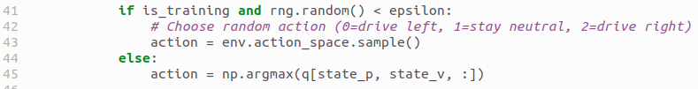
10.9 Exploration vs. Exploitation
https://www.youtube.com/watch?v=_SWnNhM5w-g&list=PL58zEckBH8fCt_lYkmayZoR9XfDCW9hte&index=10
Exploration vs. Exploitation (05:21-05:40/8:38)
1. Exploration:
If random number is smaller than epsilon, the agent will take the random action.
2. Exploitation:
Otherwise, the agent will take the Q-table to find the best action.
1
2

Slide 27
10.10 Decay Epsilon

Slide 28
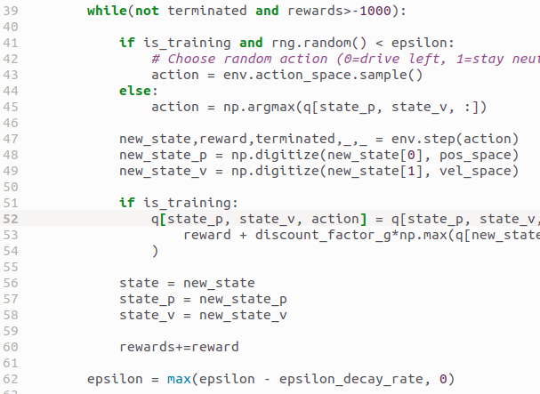
10.10 Decay Epsilon
https://www.youtube.com/watch?v=_SWnNhM5w-g&list=PL58zEckBH8fCt_lYkmayZoR9XfDCW9hte&index=10
Decay Epsilon (05:21-05:30/8:38)
After the episode, we decay the epsilon.

Slide 29
10.11 Track Reward

Slide 30
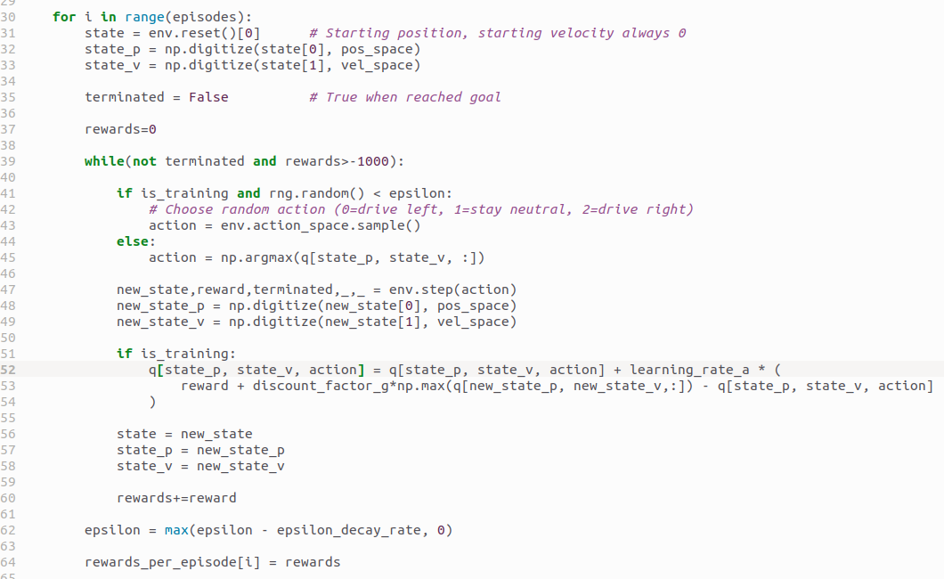
10.11 Track Reward
https://www.youtube.com/watch?v=_SWnNhM5w-g&list=PL58zEckBH8fCt_lYkmayZoR9XfDCW9hte&index=10
Track Reward (05:31-05:50/8:38)
1. Calculate the rewards in each episode and
2. Store in array for plot.
1
2

Slide 31
10.12 Save Q-Table

Slide 32
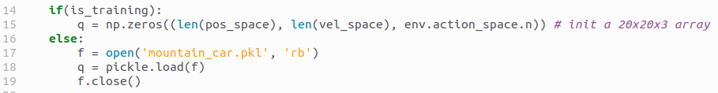
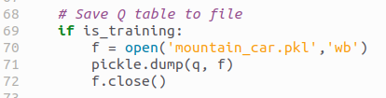
10.12 Save Q-Table
https://www.youtube.com/watch?v=_SWnNhM5w-g&list=PL58zEckBH8fCt_lYkmayZoR9XfDCW9hte&index=10
Save Q-Table (05:51-06:30/8:38)
1. Initialize Q-Table (or Load Q-table if in play mode)
2. Calculate Q-Table
3. Save Q-Table
1
2
3

Slide 33
10.13 Plot/Save Reward

Slide 34
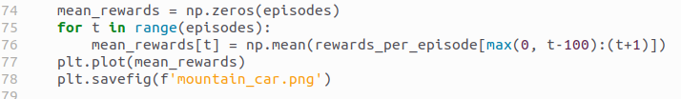
10.13 Plot/Save Reward
https://www.youtube.com/watch?v=_SWnNhM5w-g&list=PL58zEckBH8fCt_lYkmayZoR9XfDCW9hte&index=10
Plot/Save Reward (06:31-06:40/8:38)
Plot reward and save into file.

Slide 35
10.14 Main Program

Slide 36

10.14 Main Program
https://www.youtube.com/watch?v=_SWnNhM5w-g&list=PL58zEckBH8fCt_lYkmayZoR9XfDCW9hte&index=10
Main Program (06:41-07:00/8:38)
1. Run Training: 5000 times
2. run play: 10 times

Slide 37
10.15 Run Training

Slide 38
10.15 Run Training
https://www.youtube.com/watch?v=_SWnNhM5w-g&list=PL58zEckBH8fCt_lYkmayZoR9XfDCW9hte&index=10
Run Training (07:01-07:10/8:38)
1. Activate conda gym
> conda activate gym
2. run 10_mountain_car_q.py
> python 10_mountain_car_q.py

Slide 39
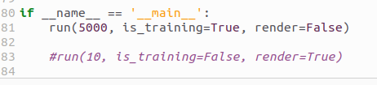
10.15 Run Training
https://www.youtube.com/watch?v=_SWnNhM5w-g&list=PL58zEckBH8fCt_lYkmayZoR9XfDCW9hte&index=10
Run Training (07:01-07:10/8:38)
We
1. Run 5000 times of training mode. We do not render the display to save time to speed up training.
2. Comment out the play mode
1
2

Slide 40
10.16 Check Reward

Slide 41
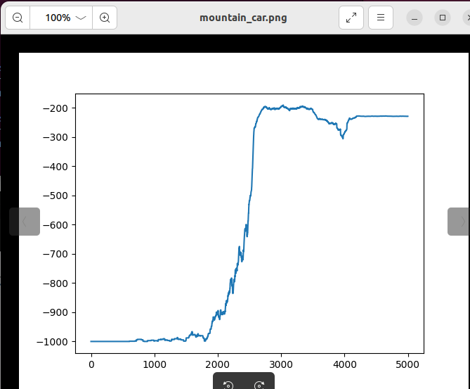
10.16 Check Reward
https://www.youtube.com/watch?v=_SWnNhM5w-g&list=PL58zEckBH8fCt_lYkmayZoR9XfDCW9hte&index=10
Check Reward (07:11-07:15/8:38)
Below x-axis is episodes, y-axis is reward of each episode.
At beginning, the reward start from 0 and decrease to -1000 due to 1000 times of tries.
After trained 2000 episodes, the agent learned and reward increase from -1000 to -200.
Then agent can play with the good reward in the Q-table

Slide 42
10.17 Run Play Mode

Slide 43

10.15 Run Training
https://www.youtube.com/watch?v=_SWnNhM5w-g&list=PL58zEckBH8fCt_lYkmayZoR9XfDCW9hte&index=10
Run Training (07:16-08:15/8:38)
1. Comment out the training mode since we already trained for 5000 times and save the Q-table.
2. run 10 times of play mode with highest rewards in Q-table.
1
2

Slide 44
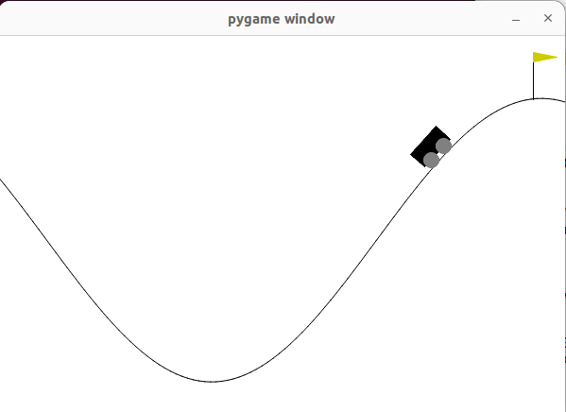
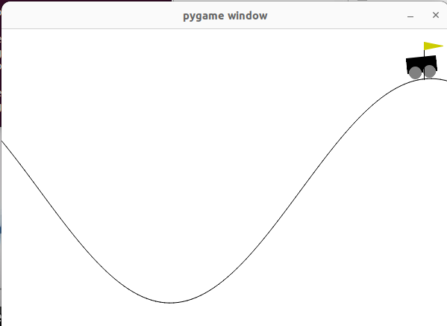
10.15 Run Training
https://www.youtube.com/watch?v=_SWnNhM5w-g&list=PL58zEckBH8fCt_lYkmayZoR9XfDCW9hte&index=10
Run Training (08:16-08:38/8:38)
Agent can always easily pass the target.

Slide 45
End

