Slide 1

36 LSTM
Peter H. Chen

Slide 2

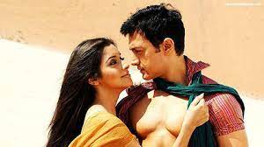

36 LSTM
https://www.youtube.com/watch?v=LfnrRPFhkuY&list=PLeo1K3hjS3uu7CxAacxVndI4bE_o3BDtO&index=36
LSTM (0:00-0:20/14:36)
There is a Bollywood (India Hollywood) movie (2008) called Ghajini (pronounced ‘ɡar-ji-ni’, 記憶拼圖 or 未知死亡).
Ghajini is name of the tenth-century Sultan (ruler) of Ghaznavid Empire (a southern India state). The movie use name “Ghajini” because Ghajini is famous for his persistence, despite of several failures.
Sanjay Singhania was hit by villain. His Fiancee Asin was killed. He suffered suffered memory Amnesia (健忘症). Sanjay only has 15 minutes short memory.
Sanjay uses Tatoo on his body, notes, and photos to to recover the past memory. He trains himself to become the strong man and revenge.
Memory Amnesia
recover memory
Train and revenge

Slide 3
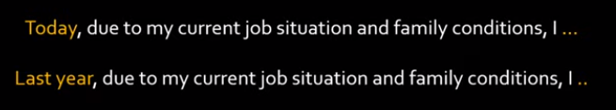
36 LSTM
https://www.youtube.com/watch?v=LfnrRPFhkuY&list=PLeo1K3hjS3uu7CxAacxVndI4bE_o3BDtO&index=36
LSTM (0:25-0:30/14:36)
RNN (Recurrent Neural Network) has suffered the same memory problem.
LSTM (Long Short Term Memory) is a special version of RNN to solve the short-term memory problem.
Let’s say we have NLP (Natural Language Processing) tasks to complete the sentence.
Predict with Recover memory
Short memory

Slide 4
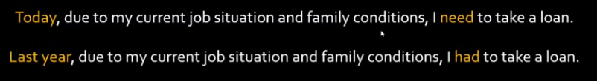
36 LSTM
https://www.youtube.com/watch?v=LfnrRPFhkuY&list=PLeo1K3hjS3uu7CxAacxVndI4bE_o3BDtO&index=36
LSTM (0:25-0:50/14:36)
For example, below two sentences is not complete, the prediction of the two sentences depends on the beginning of words.
Short memory
Predict with Recover memory

Slide 5
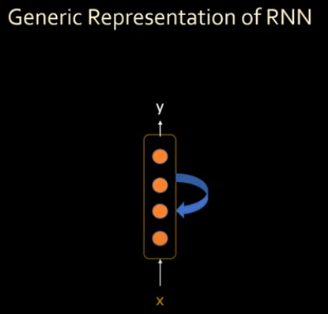
36 LSTM
https://www.youtube.com/watch?v=LfnrRPFhkuY&list=PLeo1K3hjS3uu7CxAacxVndI4bE_o3BDtO&index=36
LSTM (0:52-1:00/14:36)
In the tradition of RNN architecture.

Slide 6
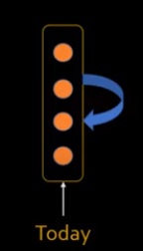
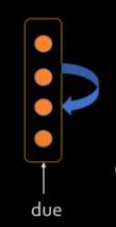
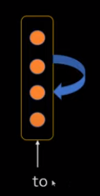
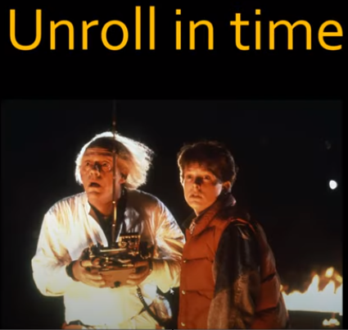
36 LSTM
https://www.youtube.com/watch?v=LfnrRPFhkuY&list=PLeo1K3hjS3uu7CxAacxVndI4bE_o3BDtO&index=36
LSTM (1:10-1:20/14:36)
Here, we feed in the sentence word by word: first word: “Today”, second word: “due”, third word: “to”.
These words are unroll in time.

Slide 7
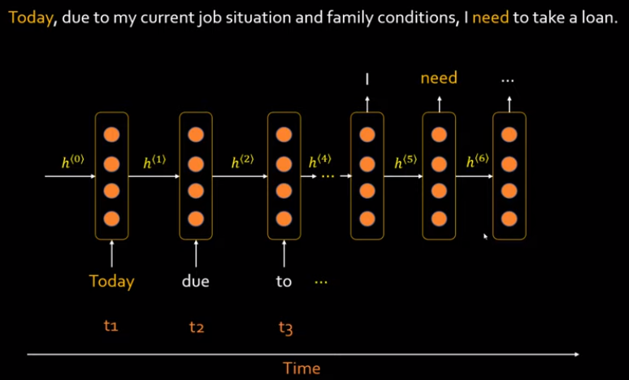
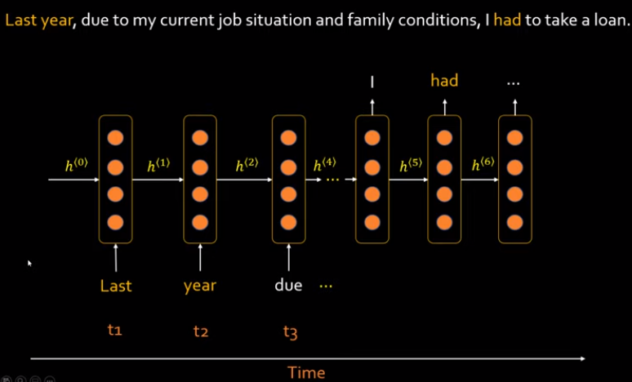
36 LSTM
https://www.youtube.com/watch?v=LfnrRPFhkuY&list=PLeo1K3hjS3uu7CxAacxVndI4bE_o3BDtO&index=36
LSTM (1:35-2:30/14:36)
These words are unroll in time and this is the architecture of RNN.
We have only one layer that come with time-series: t1, t2, t3, etc. This the the same layer that represented in different times. Because the RNN is short-time memory, RNN does not remember the beginning of words t1.
RNN just know very few words near by. To complete the sentence, RNN cannot do the job for sequence to sequence. Vanishing gradient is a common problem in RNN.
Similarly, this is the another sentence and have the same problem for RNN.

Slide 8
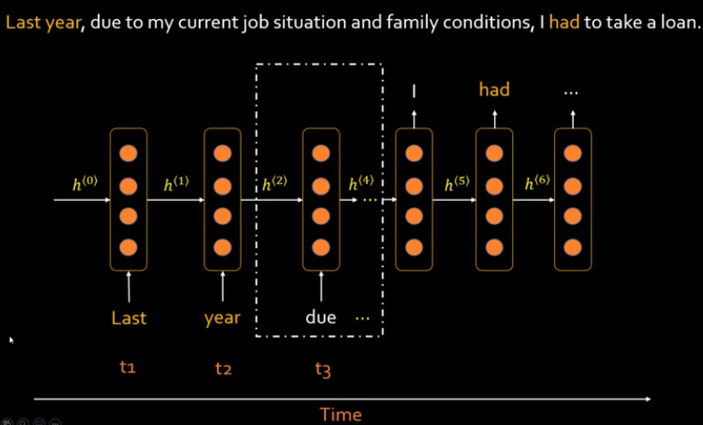
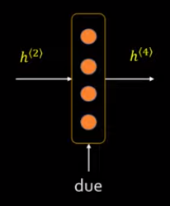
36 LSTM
https://www.youtube.com/watch?v=LfnrRPFhkuY&list=PLeo1K3hjS3uu7CxAacxVndI4bE_o3BDtO&index=36
LSTM (3:37-2:50/14:36)
Look at the below example, we spunk this to another picture.
RNN is a short term memory.

Slide 9
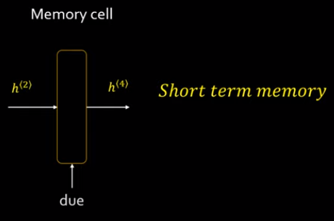
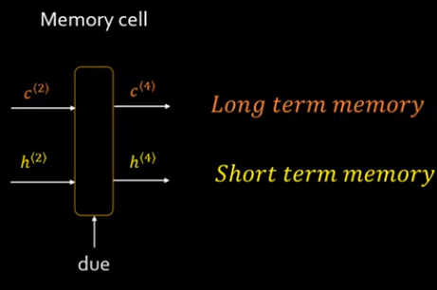
36 LSTM
https://www.youtube.com/watch?v=LfnrRPFhkuY&list=PLeo1K3hjS3uu7CxAacxVndI4bE_o3BDtO&index=36
LSTM (2:57-3:20/14:36)
We remove the neurons from the memory cell. These memory cell are short term memory.
If we want to have long term memory, we need to add new states c(2) and c(4).

Slide 10
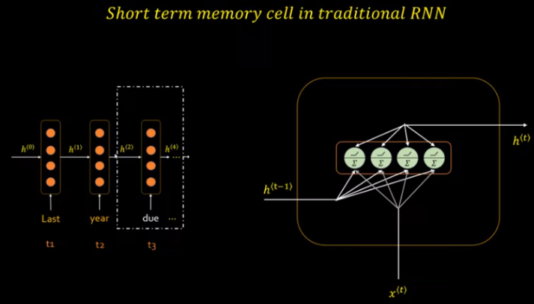
36 LSTM
https://www.youtube.com/watch?v=LfnrRPFhkuY&list=PLeo1K3hjS3uu7CxAacxVndI4bE_o3BDtO&index=36
LSTM (3:38-3:50/14:36)
For Short term memory cell in traditional RNN, we can draw horizontal a layer into several vectors.
When we have several input statements, we can expand a list of words (vectors) and a list of hidden states (as vectors).

Slide 11
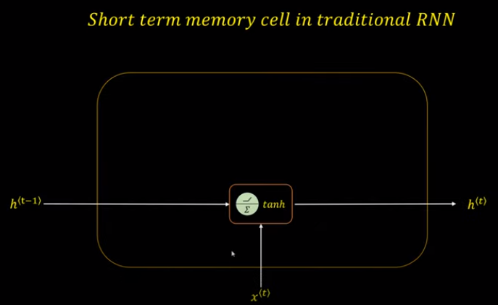
36 LSTM
https://www.youtube.com/watch?v=LfnrRPFhkuY&list=PLeo1K3hjS3uu7CxAacxVndI4bE_o3BDtO&index=36
LSTM (4:15-4:20/14:36)
We can simplified express the short term memory cell as below.

Slide 12
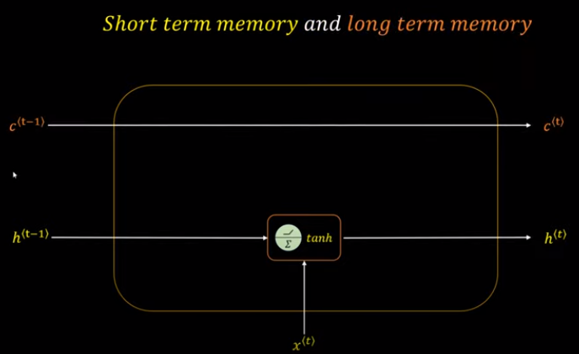
36 LSTM
https://www.youtube.com/watch?v=LfnrRPFhkuY&list=PLeo1K3hjS3uu7CxAacxVndI4bE_o3BDtO&index=36
LSTM (4:15-4:20/14:36)
Now, we add the long term memory cell for long term memory.
How short/long memory cell work?

Slide 13
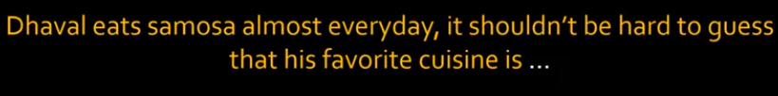
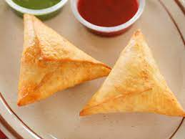
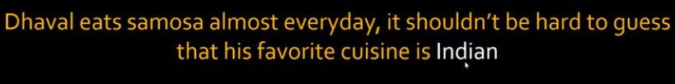
36 LSTM
https://www.youtube.com/watch?v=LfnrRPFhkuY&list=PLeo1K3hjS3uu7CxAacxVndI4bE_o3BDtO&index=36
LSTM (4:38-4:50/14:36)
Let’s look at the long term memory cell example.
Can you tell me what the “…” can be?
Answer should be “India Food”.
Samosa (咖哩角)

Slide 14
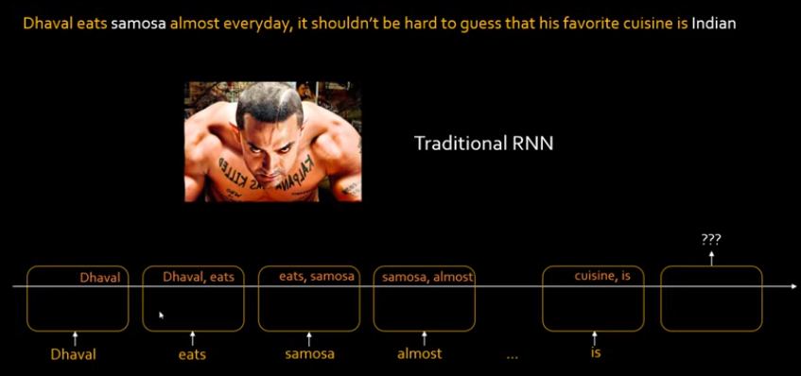
36 LSTM
https://www.youtube.com/watch?v=LfnrRPFhkuY&list=PLeo1K3hjS3uu7CxAacxVndI4bE_o3BDtO&index=36
LSTM (5:11-6:30/14:36)
If you are a human, which word tell you that the answer is “Indian Food”?
Answer is “Samosa (咖哩角)”. We are looking for the key word “Samosa” to get the output “Indian (Food)”.
In the traditional RNN, like Ghajini, we only short term memory, we can only look for before the current word or after the current keyword.
In this example, we are in the keyword “cuisine (美食)”, we do not have the key word “Samosa (咖哩角)”. For transitional RNN, it is difficult to predict the answer is “Indian Food”.

Slide 15
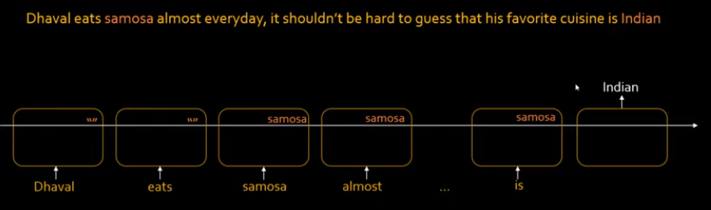
36 LSTM
https://www.youtube.com/watch?v=LfnrRPFhkuY&list=PLeo1K3hjS3uu7CxAacxVndI4bE_o3BDtO&index=36
LSTM (6:35-7:15/14:36)
If we have long term memory along with short-term memory, we store the meaningful key words into the long term memory.
When we find “eats”, “almost”, etc. will not store in the long term memory. Only the “samosa” is store in the long term memory.
Below, we can see empty list (“”) until we see the meaningful keyword (“samosa”), we put this keyword into the long term memory list.
When we have to make a prediction on “cuisine”, we have the memory of “samosa”, then we can have the answer “Indian (Food)”.

Slide 16
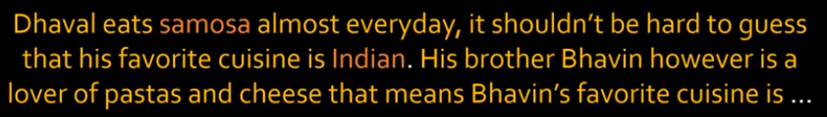
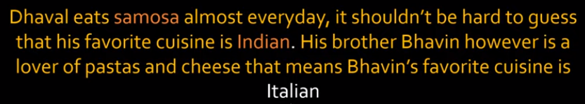
36 LSTM
https://www.youtube.com/watch?v=LfnrRPFhkuY&list=PLeo1K3hjS3uu7CxAacxVndI4bE_o3BDtO&index=36
LSTM (7:19-7:35/14:36)
Let’s look at more complicated example.
Dhaval brother Bhavin eat pastas and cheese, Bhavin favorite cuisine is …
Answer: Italian Food.

Slide 17
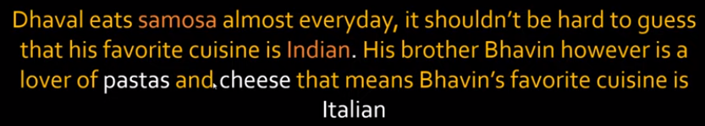
36 LSTM
https://www.youtube.com/watch?v=LfnrRPFhkuY&list=PLeo1K3hjS3uu7CxAacxVndI4bE_o3BDtO&index=36
LSTM (7:37-7:50/14:36)
We have this answer based on two keywords “pastas” and “cheese”.
Again, we scan the sentence and keep the keywords “pastas” and “cheese” in the memory and throw away all the other words.
The keyword “samosa” is important for Dhaval.
The keywords “pastas” and “cheese” are all important for Bhavin.

Slide 18
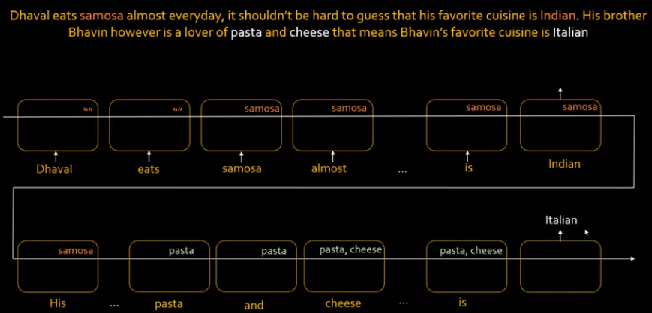
36 LSTM
https://www.youtube.com/watch?v=LfnrRPFhkuY&list=PLeo1K3hjS3uu7CxAacxVndI4bE_o3BDtO&index=36
LSTM (7:58-9:00/14:36)
Go back to RNN with Long-term memory.
When we encounter “samosa”, we store “samosa” in the long-term memory.
Then, we we scan to “Bhavin” and “pasta”, we throw away the keyword “samosa” and put “pasta” in the long-term memory. We continue to put “cheese” in the long-term memory list.
When we see “Bhavin cuisine”, we know the answer is “Italian (food)”.
Now, how do we know we should threw away the “samosa” and “Dhaval question”?
In the RNN, we already train the “Dhaval question” or “Bhavin question” for RNN.

Slide 19
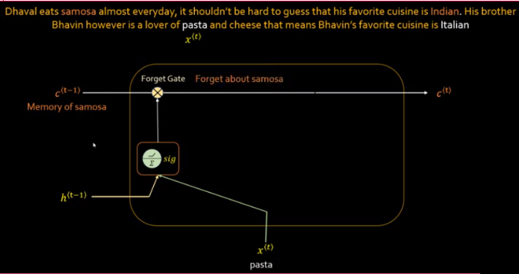
36 LSTM
https://www.youtube.com/watch?v=LfnrRPFhkuY&list=PLeo1K3hjS3uu7CxAacxVndI4bE_o3BDtO&index=36
LSTM (7:58-11:10/14:36)
LSTM is the long term memory cell for RNN. LSTM has three gates: Forget gate, Input Gate, and Output Gate.
The first LSTM gate is “forget gate”. When RNN is supervised trained with target, the RNN already known which keywords to keep and which keep word to discard. We process one word by another word x(t), t is the time-stamp.
When RNN see the pasta, RNN knows to discard “pasta”. The sigmoid function is 0 or 1. It will discard the “pasta”. The LSTM have “Forget Gate” to forget about “Samosa”. The memory cell will not store “pasta” in the memory cell.

Slide 20
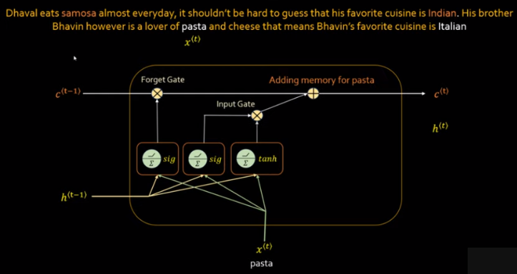
36 LSTM
https://www.youtube.com/watch?v=LfnrRPFhkuY&list=PLeo1K3hjS3uu7CxAacxVndI4bE_o3BDtO&index=36
LSTM (11:17-12:00/14:36)
The second LSTM gate is “Input Gate” which is used to store “pasta”, the LSTM will have “input gate” to store the “pasta”.
We use “sigmoid” and “tanh” to get the outputs. We multiply the output of sigmoid and tanh.
We add the memory cell for “pasta” for memory cell c(t) for “pasta” word.

Slide 21
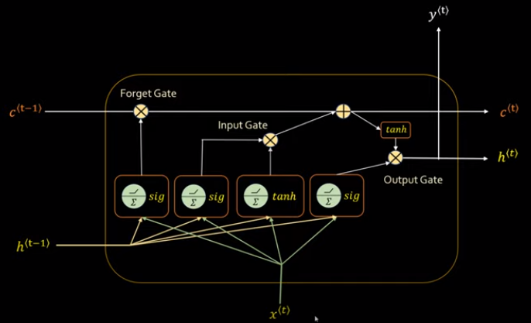
36 LSTM
https://www.youtube.com/watch?v=LfnrRPFhkuY&list=PLeo1K3hjS3uu7CxAacxVndI4bE_o3BDtO&index=36
LSTM (12:05-13:00/14:36)
The third LSTM gate is “Output Gate” which is used to predict the output.
We apply the long term memory to the output gate along with the input to sigmoid function.
We can get the output result is y(t) = h(t).

Slide 22
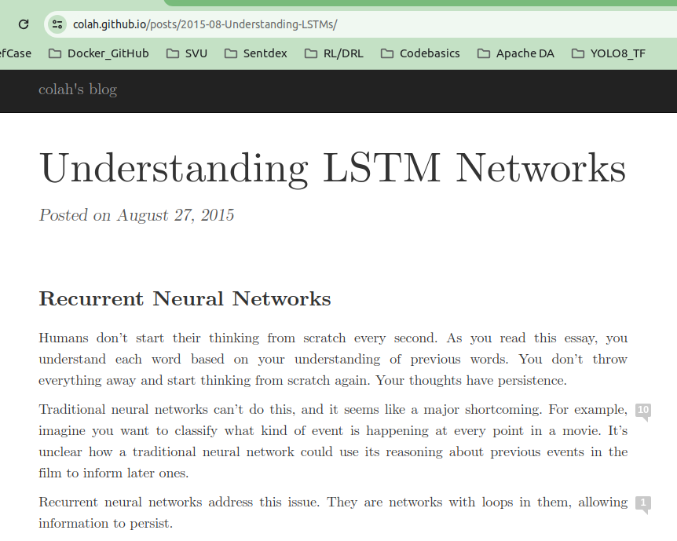
36 LSTM
https://www.youtube.com/watch?v=LfnrRPFhkuY&list=PLeo1K3hjS3uu7CxAacxVndI4bE_o3BDtO&index=36
LSTM (12:05-13:00/14:36)
Below link is “Understanding LSTM Networks”
https://colah.github.io/posts/2015-08-Understanding-LSTMs/

Slide 23
End

