Slide 1

1.02 Install and Setup
Peter H. Chen

Slide 2
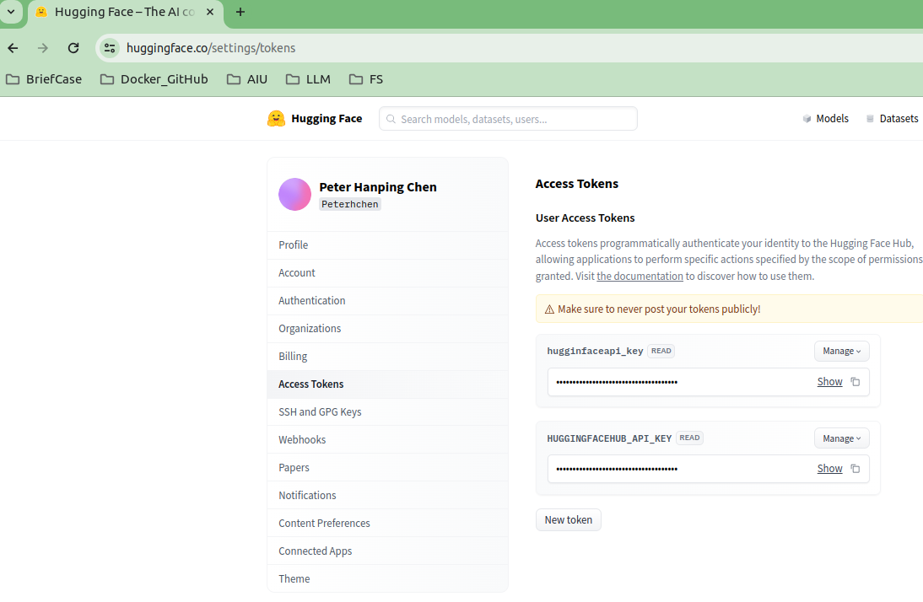
1.02 Install and Setup
https://www.youtube.com/watch?v=nAmC7SoVLd8&list=PLeo1K3hjS3uu0N_0W6giDXzZIcB07Ng_F&index=1
Setup API Key (04:34-04:50/46:07)
HuggingFace Store and Host LLM models. To use LangChain to access all the LLM Models and Tools, we need to create HuggingFace Token Key.

Slide 3
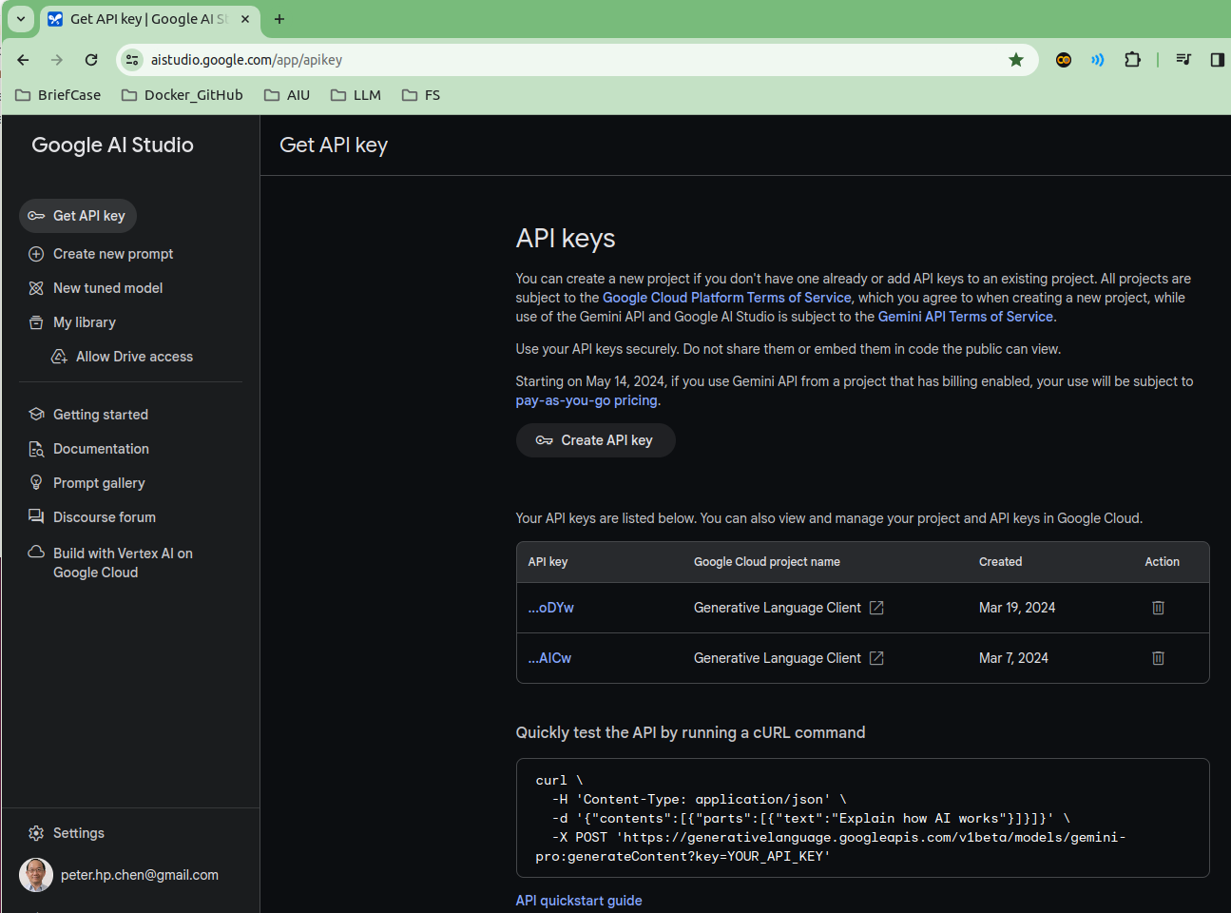
1.02 Install and Setup
https://www.youtube.com/watch?v=nAmC7SoVLd8&list=PLeo1K3hjS3uu0N_0W6giDXzZIcB07Ng_F&index=1
Setup API Key (04:51-05:00/46:07)
To use Google Gemini, we need to create Google API Key.

Slide 4

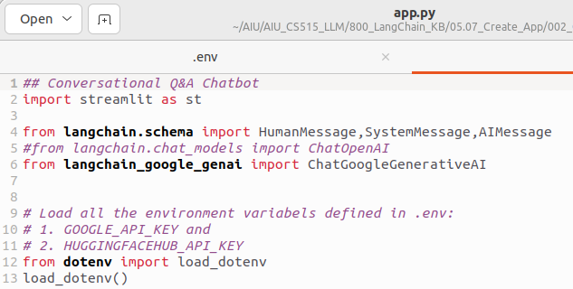
1.02 Install and Setup
https://www.youtube.com/watch?v=nAmC7SoVLd8&list=PLeo1K3hjS3uu0N_0W6giDXzZIcB07Ng_F&index=1
Setup API Key (05:01-05:02/46:07)
1. We copy and paste to the environment variables GOOGLE_API_KEY and HUGGINGFACEHUB_API_KEY, respectively, in the “.env” file.
2. In your application, we use load_dotenv() to load the defined environment variables, GOOGLE_API_KEY and HUGGINGFACEHUB_API_KEY, respectively.
1
2

Slide 5
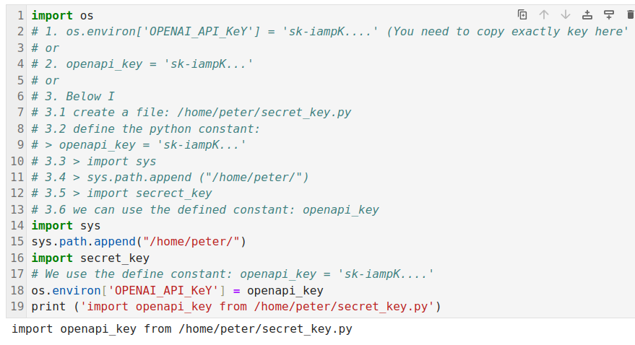
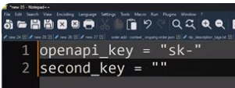
1.02 Install and Setup
https://www.youtube.com/watch?v=nAmC7SoVLd8&list=PLeo1K3hjS3uu0N_0W6giDXzZIcB07Ng_F&index=1
Setup API Key (05:03-05:04/46:07)
We also can create the key and copy and paste into your code as below.
Below, I define a constant
> secrete_key = ‘sk-….’ in the path ‘/home/peter/secret_key.py’
We can use the define openapi_key as below.

Slide 6
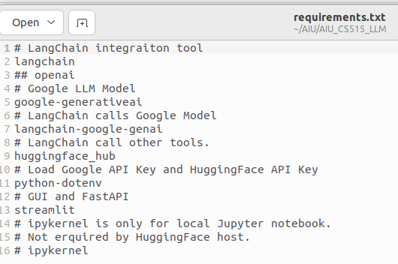
1.02 Install and Setup
https://www.youtube.com/watch?v=nAmC7SoVLd8&list=PLeo1K3hjS3uu0N_0W6giDXzZIcB07Ng_F&index=1
Install Requirements.txt (05:05-05:06/46:07)
Below are the requirements.txt
> pip install -r requirements.txt

Slide 7
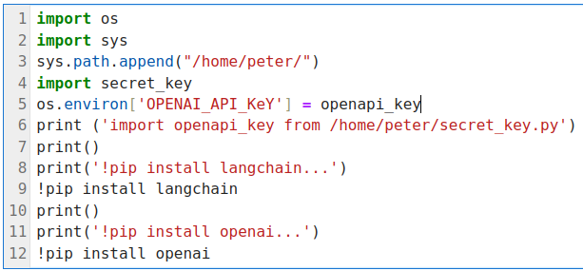
1.02 Install and Setup
https://www.youtube.com/watch?v=nAmC7SoVLd8&list=PLeo1K3hjS3uu0N_0W6giDXzZIcB07Ng_F&index=1
Install Requirements.txt (05:01-05:05/46:07)
We install
> pip install langchain
> pip install openai

Slide 8
End

