Slide 1

1.03 LLM and Prompt Template
Peter H. Chen

Slide 2
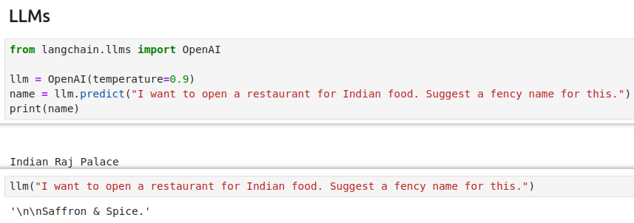
1.03 LLM and Prompt Template
https://www.youtube.com/watch?v=nAmC7SoVLd8&list=PLeo1K3hjS3uu0N_0W6giDXzZIcB07Ng_F&index=1
LLM (06:21-08:30/46:07)

Slide 3
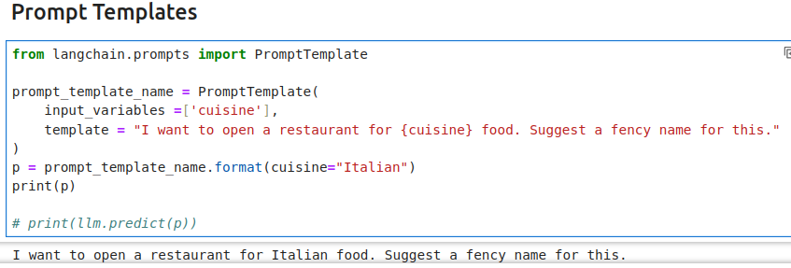
1.03 LLM and Prompt Template
https://www.youtube.com/watch?v=nAmC7SoVLd8&list=PLeo1K3hjS3uu0N_0W6giDXzZIcB07Ng_F&index=1
Prompt Template (08:31-10:10/46:07)

Slide 4
End

