Slide 1

1.04 Chain
Peter H. Chen

Slide 2
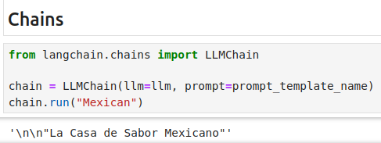
1.04 Chain
https://www.youtube.com/watch?v=nAmC7SoVLd8&list=PLeo1K3hjS3uu0N_0W6giDXzZIcB07Ng_F&index=1
Chain (10:11-11:20/46:07)

Slide 3
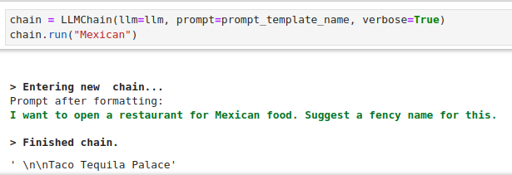
1.04 Chain
https://www.youtube.com/watch?v=nAmC7SoVLd8&list=PLeo1K3hjS3uu0N_0W6giDXzZIcB07Ng_F&index=1
Chain (11:21-11:50/46:07)

Slide 4
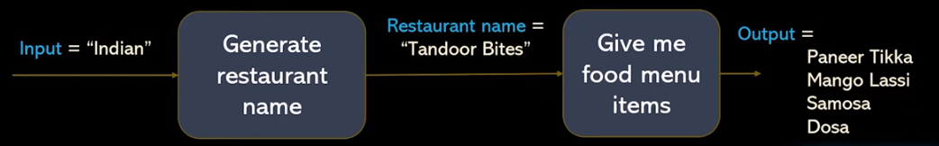
1.04 Chain
https://www.youtube.com/watch?v=nAmC7SoVLd8&list=PLeo1K3hjS3uu0N_0W6giDXzZIcB07Ng_F&index=1
Chain (11:21-11:50/46:07)
LangChain Concept
1. Schema: LangChain has several abstractions to make working with agents easy.
2. Agent:
2.1 Agent is the chain responsible for deciding what step to take next. This is usually powered by a language model, a prompt, and an output parser.
2.2 Different agents have different prompting styles for reasoning, different ways of encoding inputs, and different ways of parsing the output. For a full list of built-in agents see agent types. You can also easily build custom agents, should you need further control.
3. Tools:
3.1 Tools are functions that an agent can invoke. The Tool abstraction consists of two components:
3.2 The input schema for the tool. This tells the LLM what parameters are needed to call the tool. Without this, it will not know what the correct inputs are. These parameters should be sensibly named and described.
3.3 The function to run. This is generally just a Python function that is invoked.
https://python.langchain.com/v0.1/docs/modules/agents/concepts/#:~:text=Agent%E2%80%8B,ways%20of%20parsing%20the%20output.
Agent
(chain)
Tool
(Function)

Slide 5
End

