Slide 1

1.05 Simple Sequential Chain
Peter H. Chen

Slide 2

1.05 Simple Sequential Chain
https://www.youtube.com/watch?v=nAmC7SoVLd8&list=PLeo1K3hjS3uu0N_0W6giDXzZIcB07Ng_F&index=1
Simple Sequential Chain (11:51-11:55/46:07)
Simple Sequential Chain has only one input and one output at each tool.

Slide 3
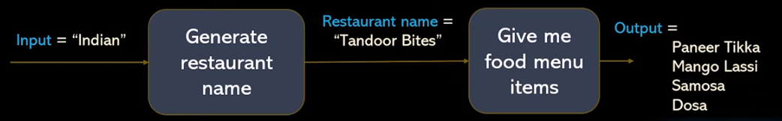
1.05 Simple Sequential Chain
https://www.youtube.com/watch?v=nAmC7SoVLd8&list=PLeo1K3hjS3uu0N_0W6giDXzZIcB07Ng_F&index=1
Simple Sequential Chain (11:56-12:30/46:07)
These are the sequences of chains:
1. Generate Restaurant Name: From input = “Indian” to output Restaurant name = “Tandoor Bites”,
2. Give me food menu items: Restaurant name = “Tandoor Bites” to output “Paneer Tikka, Mango Lassi, Samosa, Dosa”
This is called “Simple Sequential Chain”.

Slide 4
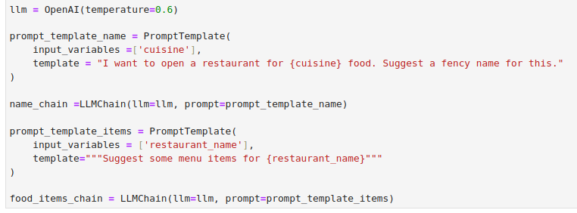
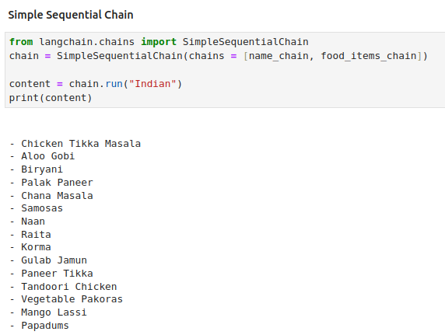
1.05 Simple Sequential Chain
https://www.youtube.com/watch?v=nAmC7SoVLd8&list=PLeo1K3hjS3uu0N_0W6giDXzZIcB07Ng_F&index=1
Simple Sequential Chain (12:31-15:20/46:07)
Previously, we have the two chains: name_chain and food_items_chain.
We use SimpleSequentialChain () to connect name_chain and food_items_chain together.

Slide 5
End

