Slide 1

1.06 Sequential Chain
Peter H. Chen

Slide 2

1.06 Sequential Chain
https://www.youtube.com/watch?v=nAmC7SoVLd8&list=PLeo1K3hjS3uu0N_0W6giDXzZIcB07Ng_F&index=1
Sequential Chain (15:31-15:40/46:07)
Sequential Chain can have multiple inputs (agents/chains) and multiple outputs (agents/chains).

Slide 3
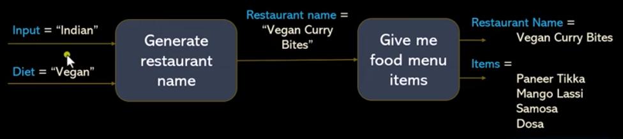

1.06 Sequential Chain
https://www.youtube.com/watch?v=nAmC7SoVLd8&list=PLeo1K3hjS3uu0N_0W6giDXzZIcB07Ng_F&index=1
Sequential Chain (15:21-15:40/46:07)
Sequential Chain can have multiple inputs (agents/chains) and multiple outputs (agents/chains).

Slide 4
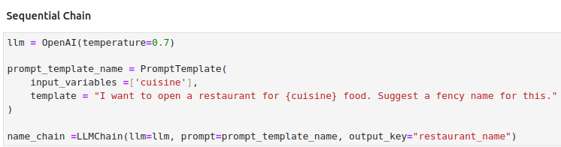
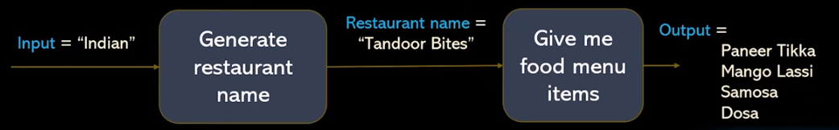
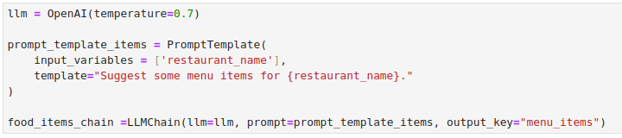
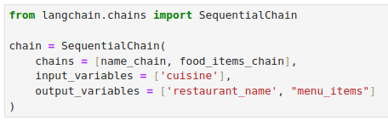
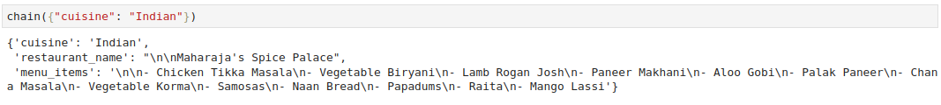
1.06 Sequential Chain
https://www.youtube.com/watch?v=nAmC7SoVLd8&list=PLeo1K3hjS3uu0N_0W6giDXzZIcB07Ng_F&index=1
Sequential Chain (15:41-18:00/46:07)

Slide 5
End

