Slide 1

1.07 Streamlit
Peter H. Chen

Slide 2
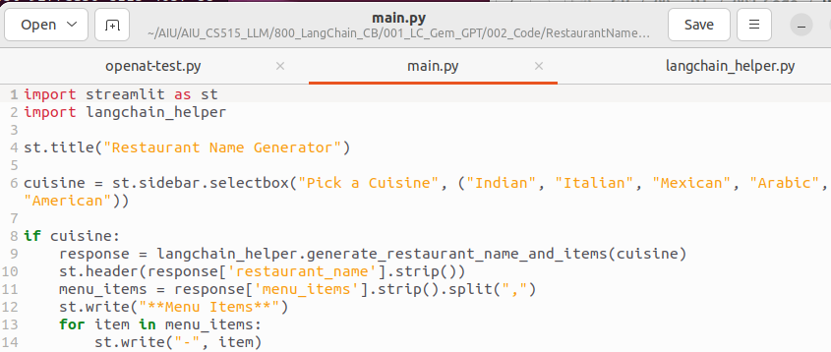
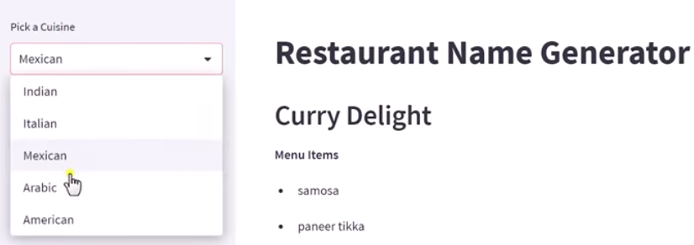
1.07 Streamlit
https://www.youtube.com/watch?v=nAmC7SoVLd8&list=PLeo1K3hjS3uu0N_0W6giDXzZIcB07Ng_F&index=1
Streamlit (18:01-24:00/46:07)

Slide 3
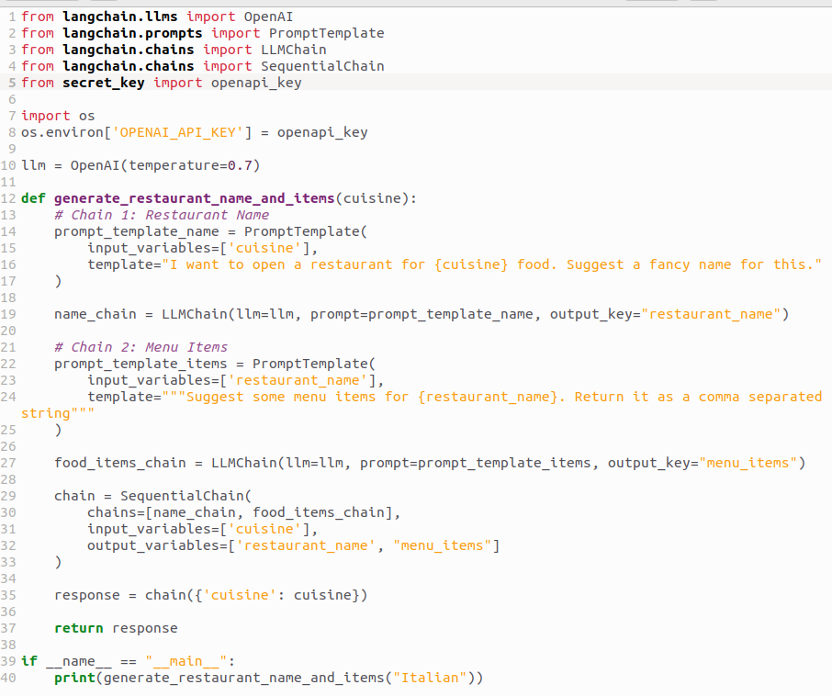
1.07 Streamlit
https://www.youtube.com/watch?v=nAmC7SoVLd8&list=PLeo1K3hjS3uu0N_0W6giDXzZIcB07Ng_F&index=1
Streamlit (24:01-26:30/46:07)
Copy code from Jupyter Notebook

Slide 4
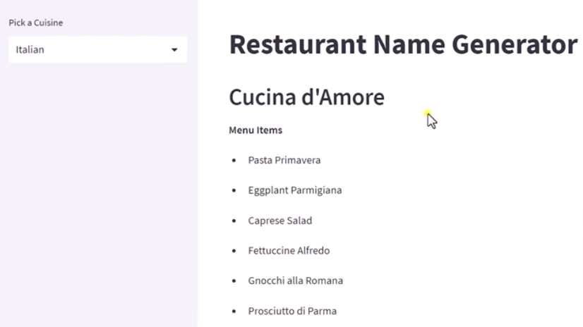
1.07 Streamlit
https://www.youtube.com/watch?v=nAmC7SoVLd8&list=PLeo1K3hjS3uu0N_0W6giDXzZIcB07Ng_F&index=1
Streamlit (26:31-27:00/46:07)
Copy code from Jupyter Notebook

Slide 5
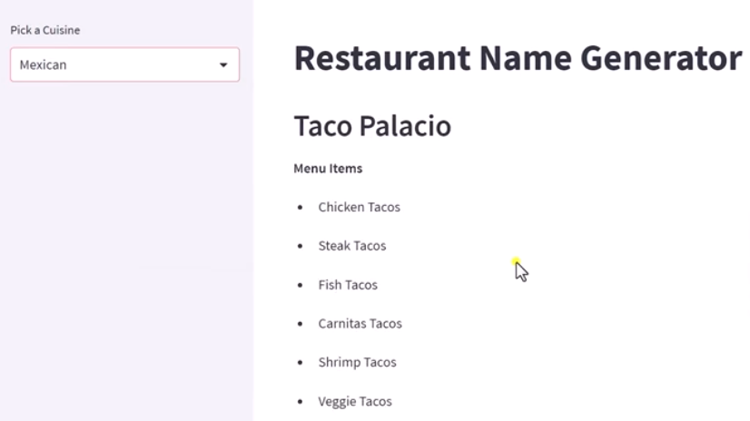
1.07 Streamlit
https://www.youtube.com/watch?v=nAmC7SoVLd8&list=PLeo1K3hjS3uu0N_0W6giDXzZIcB07Ng_F&index=1
Streamlit (27:01-27:30/46:07)
Select “Mexican”

Slide 6
End

