Slide 1

1.08 Agent
Peter H. Chen

Slide 2


1.08 Agent
https://www.youtube.com/watch?v=nAmC7SoVLd8&list=PLeo1K3hjS3uu0N_0W6giDXzZIcB07Ng_F&index=1
Agent (27:31-27:40/46:07)
Agent is very powerful concept in LangChain.

Slide 3
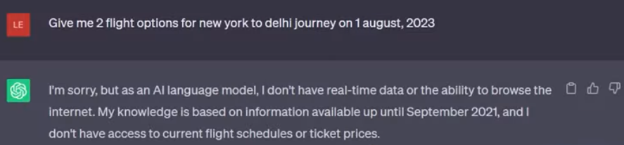
1.08 Agent
https://www.youtube.com/watch?v=nAmC7SoVLd8&list=PLeo1K3hjS3uu0N_0W6giDXzZIcB07Ng_F&index=1
Agent (27:47-28:40/46:07)
GPT does not have knowledge of september, 2021.

Slide 4


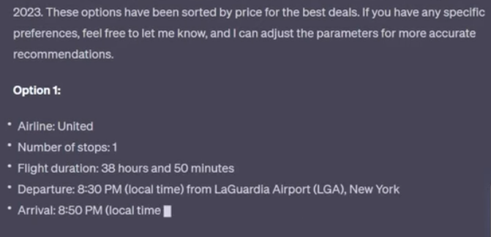
1.08 Agent
https://www.youtube.com/watch?v=nAmC7SoVLd8&list=PLeo1K3hjS3uu0N_0W6giDXzZIcB07Ng_F&index=1
Agent (28:41-28:50/46:07)
ChatGPT Plus has plugin.
You can easily plugin the knowledge after September, 2021.

Slide 5
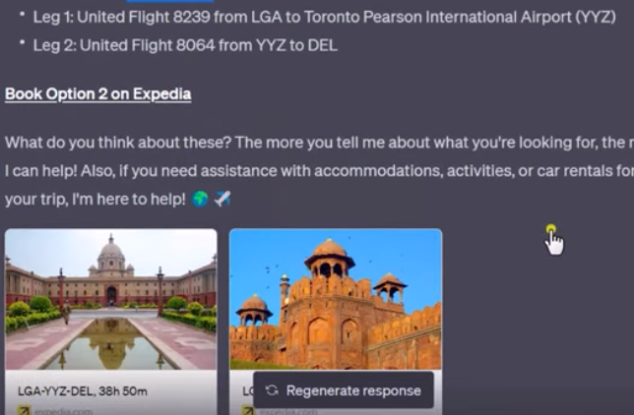
1.08 Agent
https://www.youtube.com/watch?v=nAmC7SoVLd8&list=PLeo1K3hjS3uu0N_0W6giDXzZIcB07Ng_F&index=1
Agent (28:51-29:05/46:07)
ChatGPT plus can acquire knowledge.

Slide 6
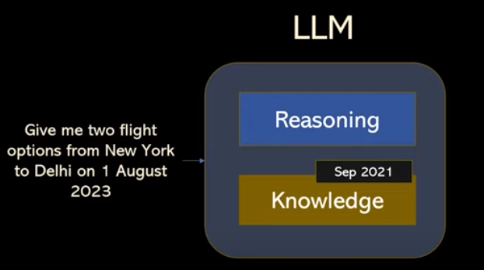
1.08 Agent
https://www.youtube.com/watch?v=nAmC7SoVLd8&list=PLeo1K3hjS3uu0N_0W6giDXzZIcB07Ng_F&index=1
Agent (28:51-29:50/46:07)
GPT Knowledge stops at September, 2021.
However, GPT has reasoning engine. The reasoning engine let GPT figure out the data after he is train. GOT has to go to Expedia to find out the answer of the trip.

Slide 7
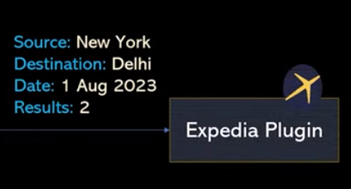
1.08 Agent
https://www.youtube.com/watch?v=nAmC7SoVLd8&list=PLeo1K3hjS3uu0N_0W6giDXzZIcB07Ng_F&index=1
Agent (29:54-30:10/46:07)
From the reasoning agent, GPT will figure it out the answer from Expedia.

Slide 8
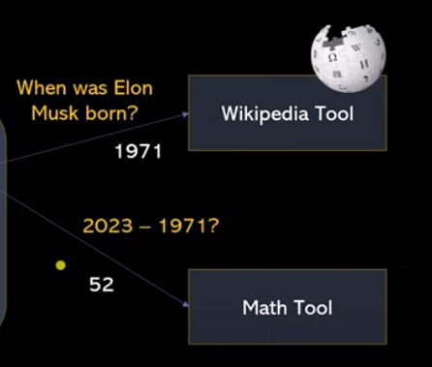
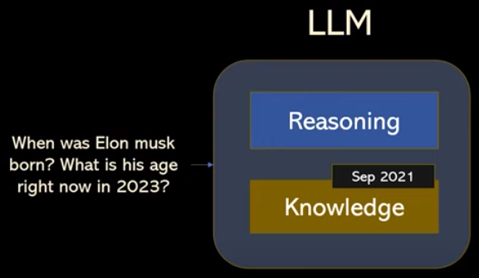
1.08 Agent
https://www.youtube.com/watch?v=nAmC7SoVLd8&list=PLeo1K3hjS3uu0N_0W6giDXzZIcB07Ng_F&index=1
Agent (29:54-31:10/46:07)
LLM does not have knowledge after September 2021.
1. GPT uses agent to help and fetch data from Wikipedia tool to find out the Elon Musk age. Elon Musk is born in 1971.
2. There is another math tool to calculate “2023 – 1971 = 52”
The agent will connect to external tool. GPT uses LLM reasoning capabilities to perform the give task.

Slide 9
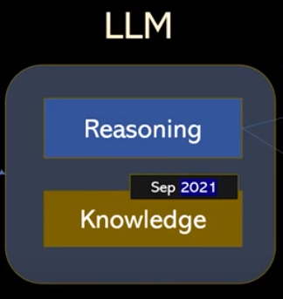
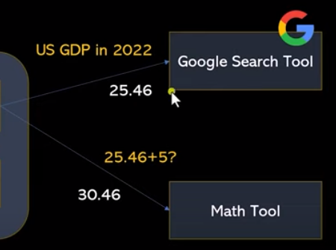

1.08 Agent
https://www.youtube.com/watch?v=nAmC7SoVLd8&list=PLeo1K3hjS3uu0N_0W6giDXzZIcB07Ng_F&index=1
Agent (31:11-31:50/46:07)
LLM does not have knowledge after September 2021.
1. GPT goes to google to find the answer (25.46).
2. Answer + 5 (= 30.46).
This google search tool is available in LangChain.
The LLM does not have answer. But agent can find the answer for us.

Slide 10
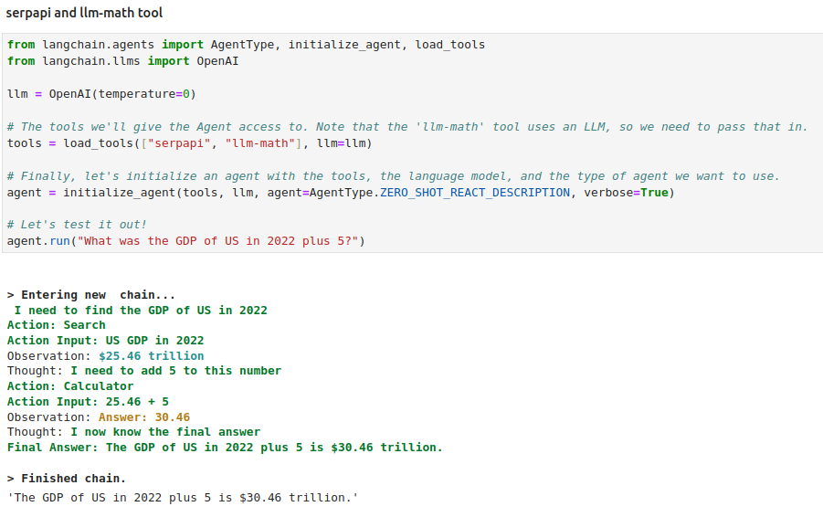
1.08 Agent
https://www.youtube.com/watch?v=nAmC7SoVLd8&list=PLeo1K3hjS3uu0N_0W6giDXzZIcB07Ng_F&index=1
Agent (31:11-33:30/46:07)
1. We import the agents tool
2. Initialize the agent
The agent will find the answer with google search and math engine.

Slide 11
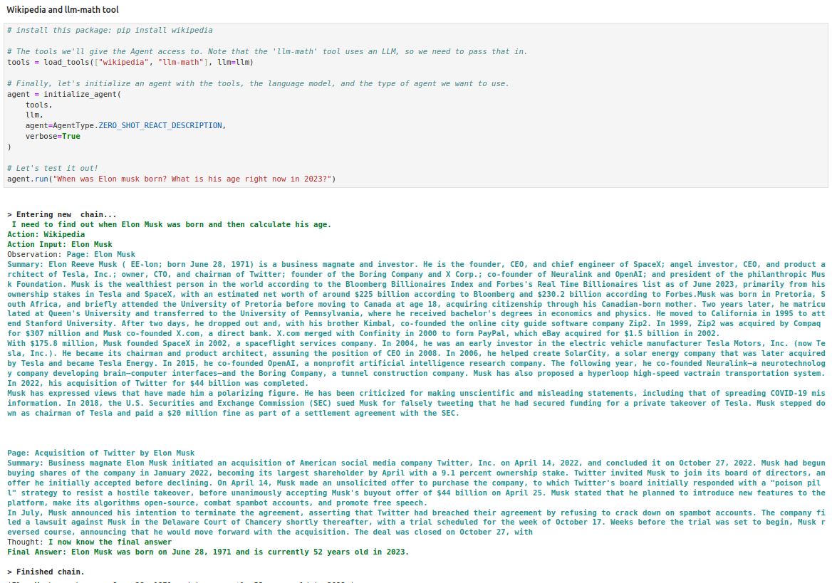
1.08 Agent
https://www.youtube.com/watch?v=nAmC7SoVLd8&list=PLeo1K3hjS3uu0N_0W6giDXzZIcB07Ng_F&index=1
Agent (33:31-35:20/46:07)
Find “Elon Musk Age” with Agent.

Slide 12
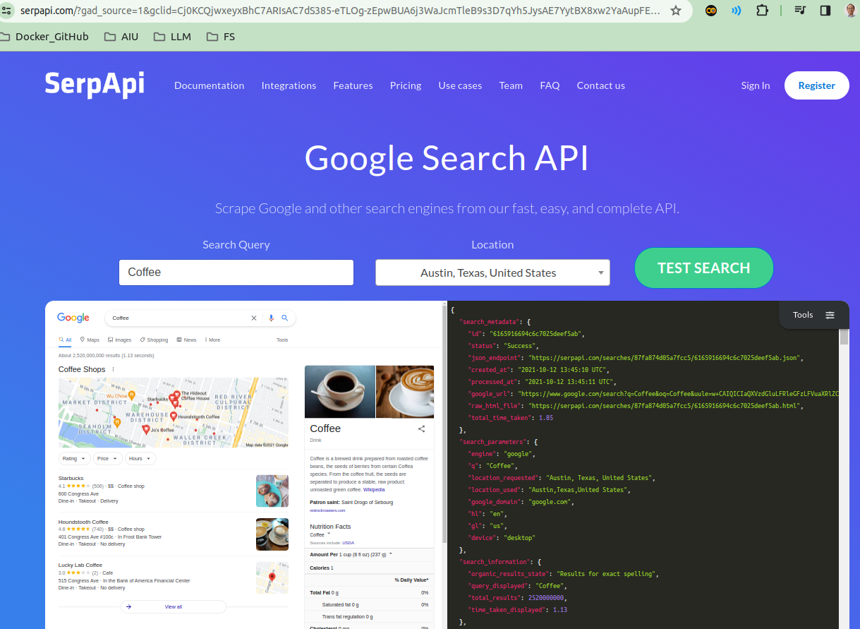
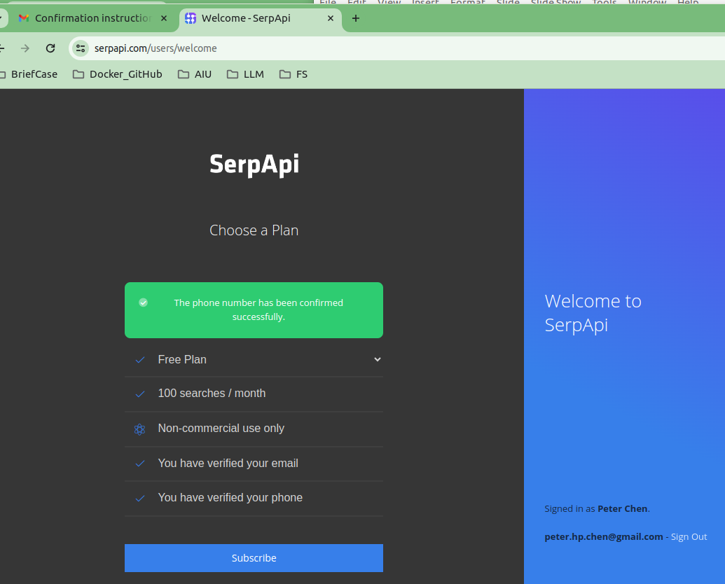
1.08 Agent
https://www.youtube.com/watch?v=nAmC7SoVLd8&list=PLeo1K3hjS3uu0N_0W6giDXzZIcB07Ng_F&index=1
Agent (35:21-35:30/46:07)
What is google SerpAPI?
You need to sign in google serpapi before you can use it.
1. Verify it with gmail and
2. Verify phone number.

Slide 13
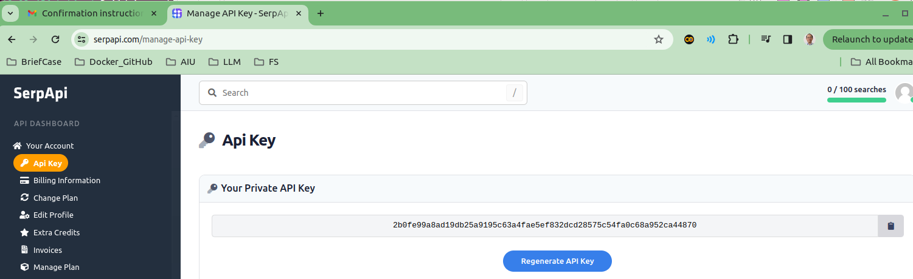
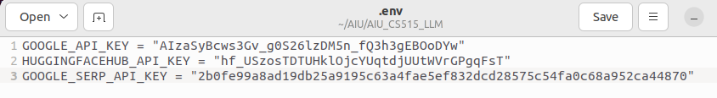
1.08 Agent
https://www.youtube.com/watch?v=nAmC7SoVLd8&list=PLeo1K3hjS3uu0N_0W6giDXzZIcB07Ng_F&index=1
Agent (35:31-36:20/46:07)
Generate Google serp API Key and put in GOOGLE_SERP_API_KEY the “env” file.

Slide 14
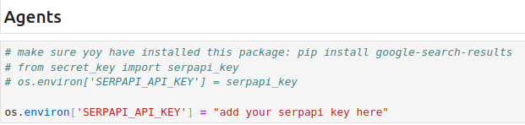
1.08 Agent
https://www.youtube.com/watch?v=nAmC7SoVLd8&list=PLeo1K3hjS3uu0N_0W6giDXzZIcB07Ng_F&index=1
Agent (36:21-36:30/46:07)
First, we need to get the Google Search API Key.

Slide 15
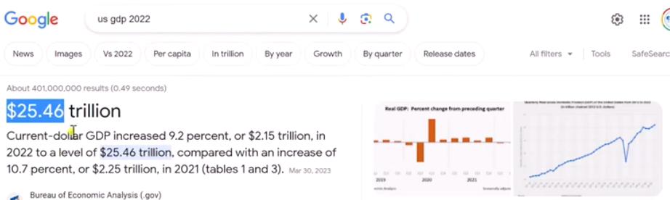
1.08 Agent
https://www.youtube.com/watch?v=nAmC7SoVLd8&list=PLeo1K3hjS3uu0N_0W6giDXzZIcB07Ng_F&index=1
Agent (36:31-36:40/46:07)
We google the answer.

Slide 16
1.08 Agent
https://www.youtube.com/watch?v=nAmC7SoVLd8&list=PLeo1K3hjS3uu0N_0W6giDXzZIcB07Ng_F&index=1
Agent (36:31-37:20/46:07)
We verify the GPT Agent answer get from Google Serp API.

Slide 17
End

