Slide 1

1.09 Memory
Peter H. Chen

Slide 2
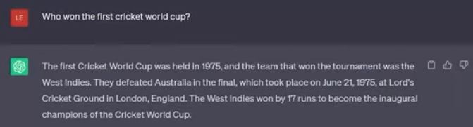
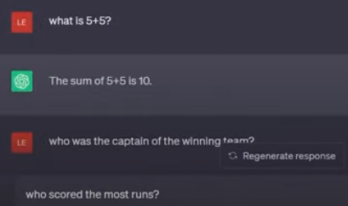
1.09 Memory
https://www.youtube.com/watch?v=nAmC7SoVLd8&list=PLeo1K3hjS3uu0N_0W6giDXzZIcB07Ng_F&index=1
Memory (37:21-38:00/46:07)
The LLM does not have memory.
They are stateless.

Slide 3
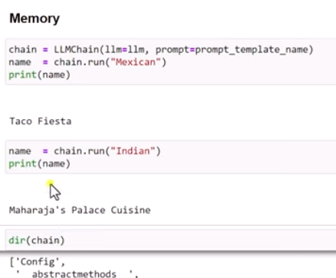
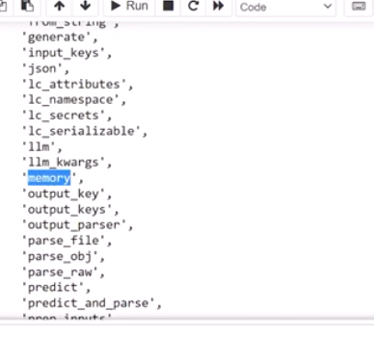
1.09 Memory
https://www.youtube.com/watch?v=nAmC7SoVLd8&list=PLeo1K3hjS3uu0N_0W6giDXzZIcB07Ng_F&index=1
Memory (38:01-38:10/46:07)
> dir (chain)
We can see an element called “memory”. The LangChain has the memory.

Slide 4
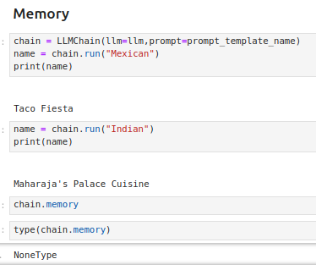
1.09 Memory
https://www.youtube.com/watch?v=nAmC7SoVLd8&list=PLeo1K3hjS3uu0N_0W6giDXzZIcB07Ng_F&index=1
Memory (38:11-38:20/46:07)
> chain.memory
Right now, the memory is “None”.

Slide 5
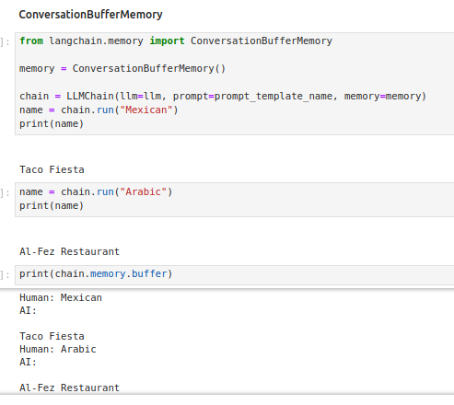
1.09 Memory
https://www.youtube.com/watch?v=nAmC7SoVLd8&list=PLeo1K3hjS3uu0N_0W6giDXzZIcB07Ng_F&index=1
Memory (38:21-38:30/46:07)
Conversation Buffer Memory: Now, LangChain has memory.

Slide 6
1.09 Memory
https://www.youtube.com/watch?v=nAmC7SoVLd8&list=PLeo1K3hjS3uu0N_0W6giDXzZIcB07Ng_F&index=1
Memory (38:31-34:00/46:07)
Conversation Buffer Memory: Now, LangChain has memory.

Slide 7
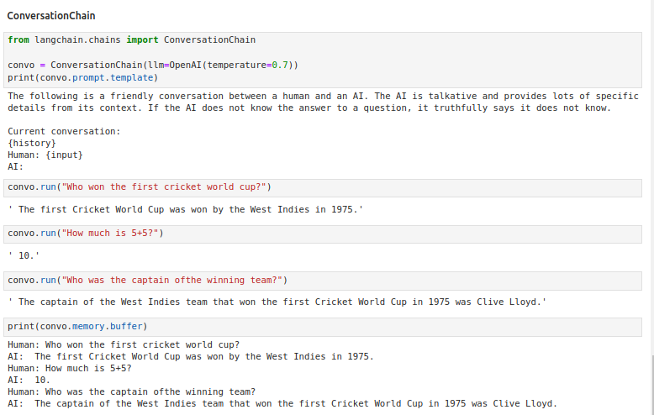
1.09 Memory
https://www.youtube.com/watch?v=nAmC7SoVLd8&list=PLeo1K3hjS3uu0N_0W6giDXzZIcB07Ng_F&index=1
Memory (34:01-43:50/46:07)
Conversation Chain memory buffer.

Slide 8
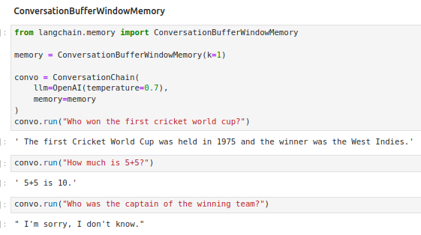
1.09 Memory
https://www.youtube.com/watch?v=nAmC7SoVLd8&list=PLeo1K3hjS3uu0N_0W6giDXzZIcB07Ng_F&index=1
Memory (43:51-46:07/46:07)
Conversation Buffer Window Memory.

Slide 9
End

