Slide 1

1.09 Memory
Peter H. Chen

Slide 2
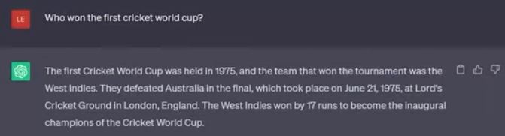
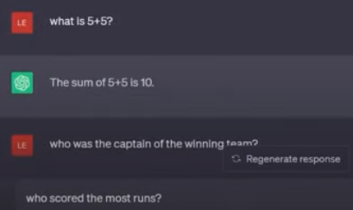
1.09 Memory
https://www.youtube.com/watch?v=nAmC7SoVLd8&list=PLeo1K3hjS3uu0N_0W6giDXzZIcB07Ng_F&index=1
Memory (37:21-38:00/46:07)
The LLM does not have memory.
They are stateless.

Slide 3
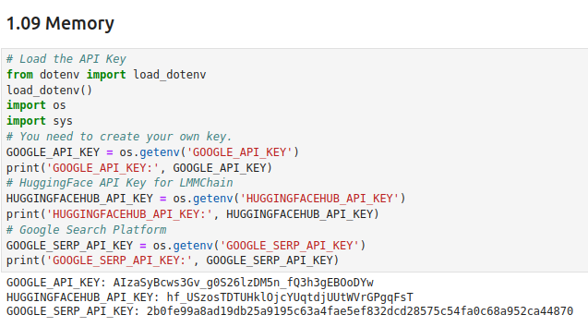
1.09 Memory
https://www.youtube.com/watch?v=nAmC7SoVLd8&list=PLeo1K3hjS3uu0N_0W6giDXzZIcB07Ng_F&index=1
Memory (38:01-38:10/46:07)
Get API Key:
1. Google API Key: Gemini
2. HuggingFace API Key: LangChain

Slide 4
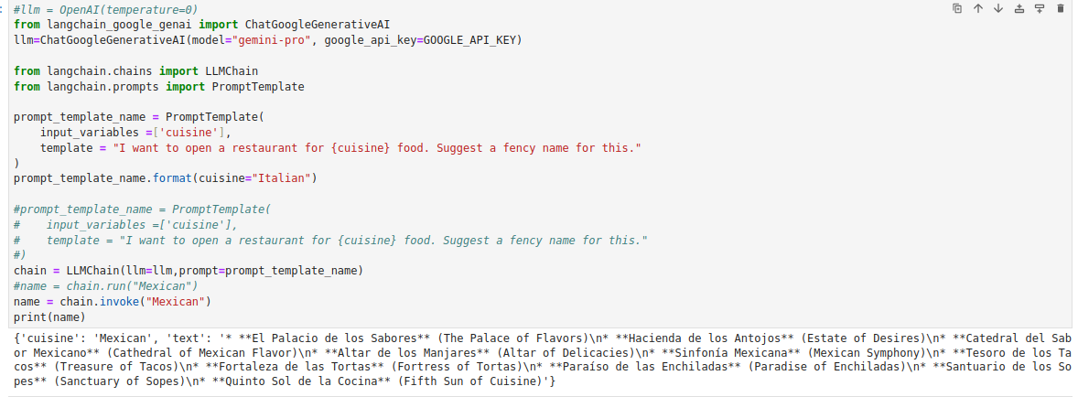
1.09 Memory
https://www.youtube.com/watch?v=nAmC7SoVLd8&list=PLeo1K3hjS3uu0N_0W6giDXzZIcB07Ng_F&index=1
Memory (38:03-38:04/46:07)
1. Create template for restaurant name.
2. LangChain create chain.
3. Print the chain response.

Slide 5
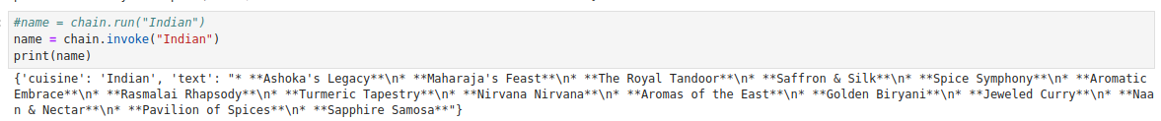
1.09 Memory
https://www.youtube.com/watch?v=nAmC7SoVLd8&list=PLeo1K3hjS3uu0N_0W6giDXzZIcB07Ng_F&index=1
Memory (38:03-38:04/46:07)
Ask another quesiton
> name = chain.invoke (“Indian”)

Slide 6
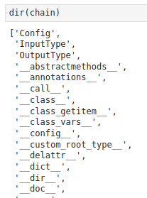
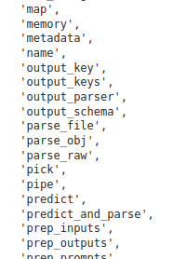
1.09 Memory
https://www.youtube.com/watch?v=nAmC7SoVLd8&list=PLeo1K3hjS3uu0N_0W6giDXzZIcB07Ng_F&index=1
Memory (38:04-38:05/46:07)
We use “dir (chain)” to see the attributes of the chain object. We can see chain has the memory attribute.
> dir (chain)
We scroll down and we can see an element called “memory”. The LangChain has the memory.
What is python dir()?
The dir() function in python is an in-built function used on an object to look at all the properties / attributes and methods of that object, without its values

Slide 7
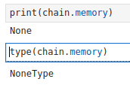
1.09 Memory
https://www.youtube.com/watch?v=nAmC7SoVLd8&list=PLeo1K3hjS3uu0N_0W6giDXzZIcB07Ng_F&index=1
Memory (38:06-38:07/46:07)
> chain.memory
> print(chain.memory)
>> None
Right now, The memory is “None.” The LLM Gemini itself does not have any memory.
We will use LangChain to create memory.

Slide 8
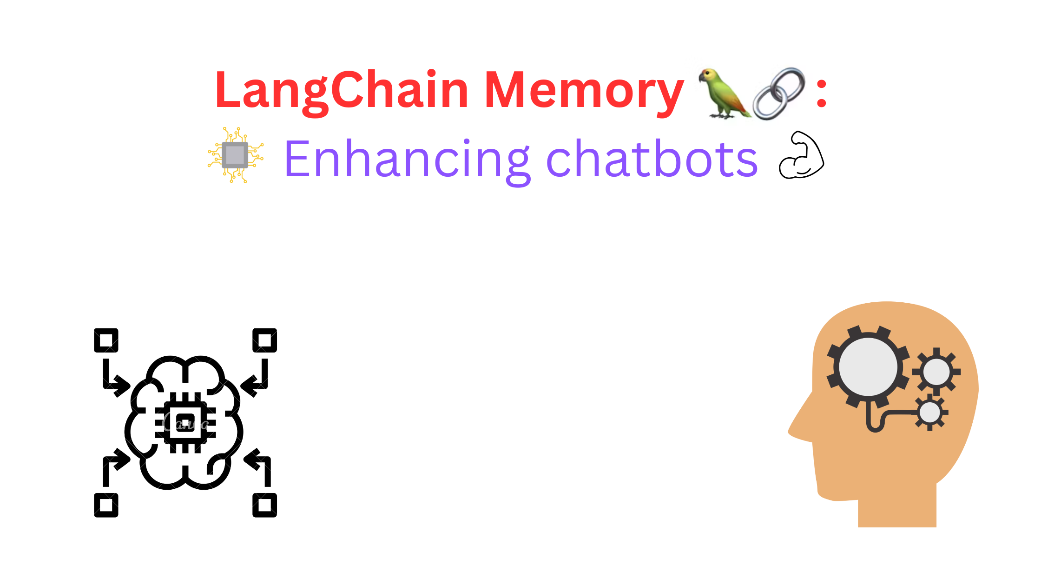
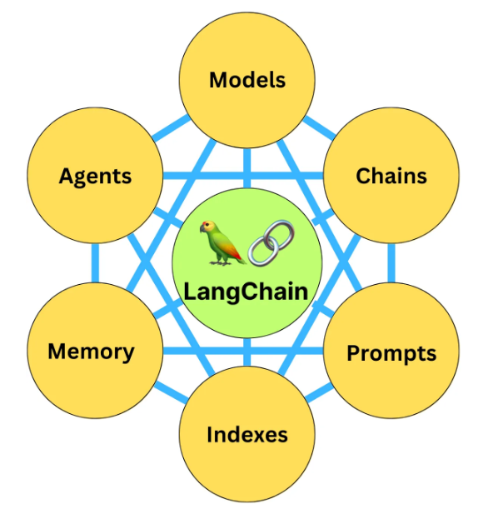
1.09 Memory
https://www.youtube.com/watch?v=nAmC7SoVLd8&list=PLeo1K3hjS3uu0N_0W6giDXzZIcB07Ng_F&index=1
Memory (38:08-38:09/46:07)
LangChain can create memory for LLM Gemini.
LangChain Provides three types of memory:
1. Conversation Buffer Memory: Buffer for Memory
2. Conversation Buffer Window Memory: Memory for with timing window.
3. Conversation Summary Memory: Memory for summary.

Slide 9
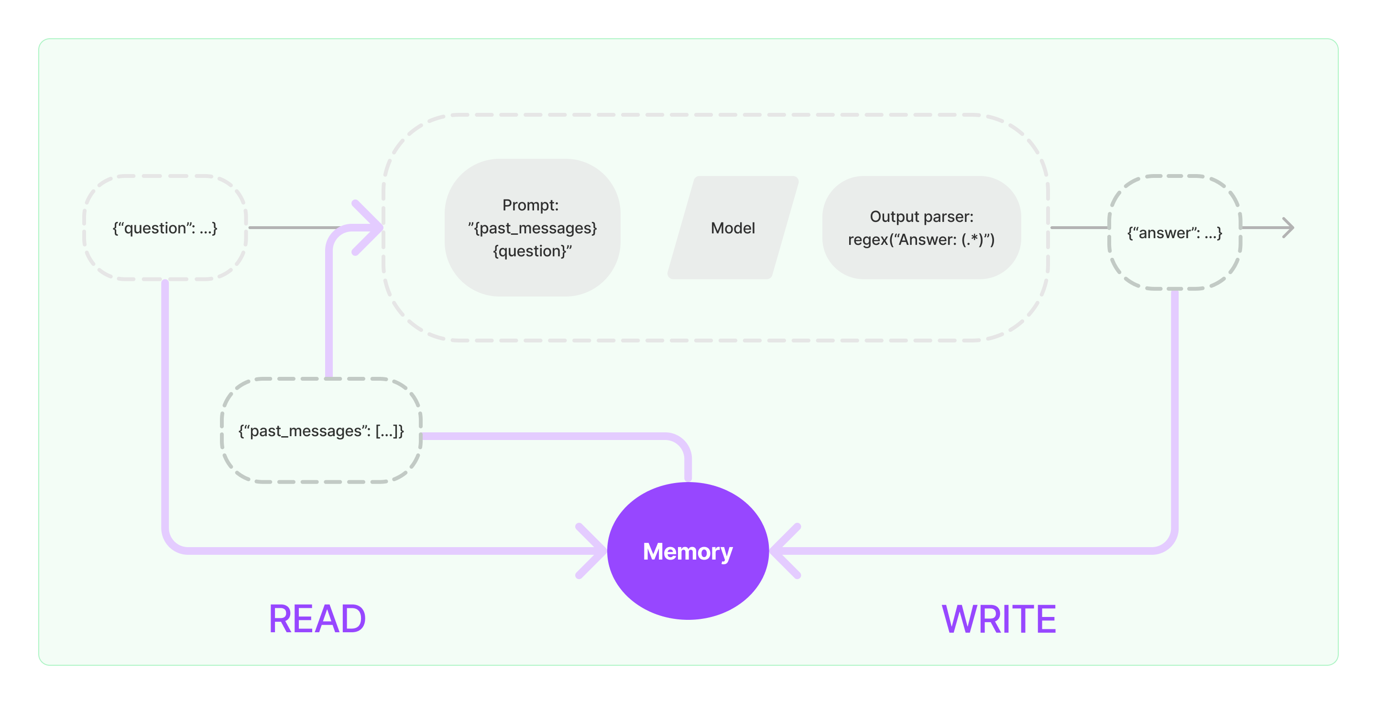
1.09 Memory
https://www.youtube.com/watch?v=nAmC7SoVLd8&list=PLeo1K3hjS3uu0N_0W6giDXzZIcB07Ng_F&index=1
Memory (38:10-38:15/46:07)
LangChain Write memory from output of LLM Gemini.
LangChain Read memory from previous LLM output.
https://python.langchain.com/v0.1/docs/modules/memory/

Slide 10
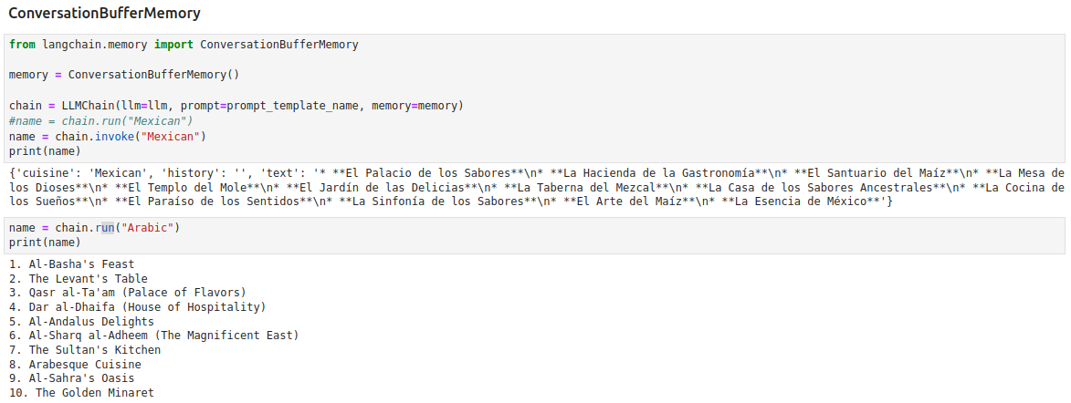
1.09 Memory
https://www.youtube.com/watch?v=nAmC7SoVLd8&list=PLeo1K3hjS3uu0N_0W6giDXzZIcB07Ng_F&index=1
Memory (38:16-38:20/46:07)
Here, we use “ConversationBufferMemory”
1. First, we ask “Mexican” Food
2. Second. We ask “Arabic” Food.

Slide 11
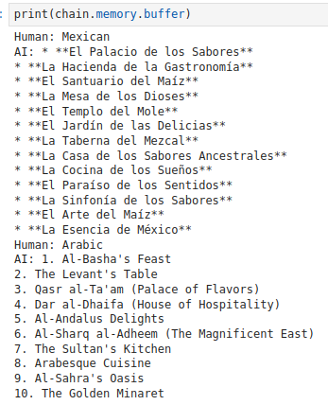
1.09 Memory
https://www.youtube.com/watch?v=nAmC7SoVLd8&list=PLeo1K3hjS3uu0N_0W6giDXzZIcB07Ng_F&index=1
Memory (38:21-38:30/46:07)
Now, we check what is the memory inside?
1. Human: Mexican, AI: Response ...
2. Human: Arabic, AI: Response ...

Slide 12
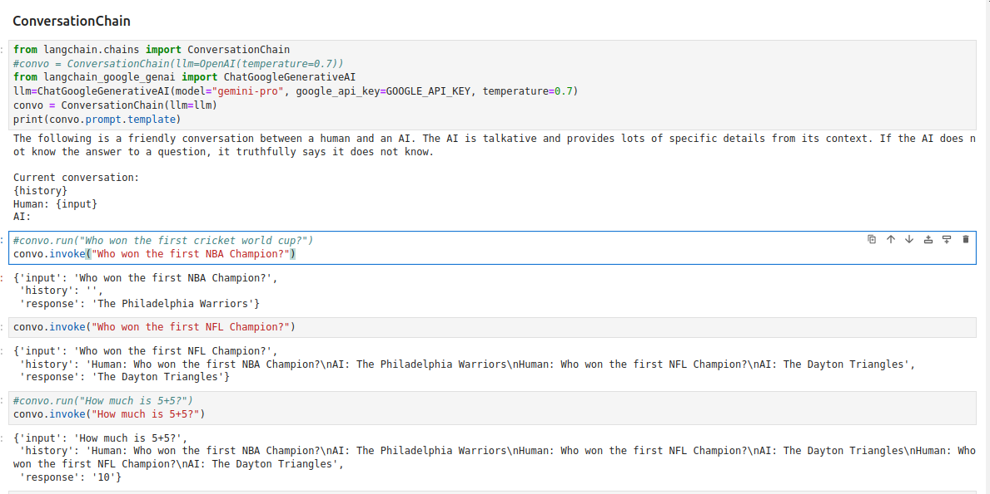
1.09 Memory
https://www.youtube.com/watch?v=nAmC7SoVLd8&list=PLeo1K3hjS3uu0N_0W6giDXzZIcB07Ng_F&index=1
Memory (38:31-43:50/46:07)
We ask a sequence of questions in the conversational chain.

Slide 13
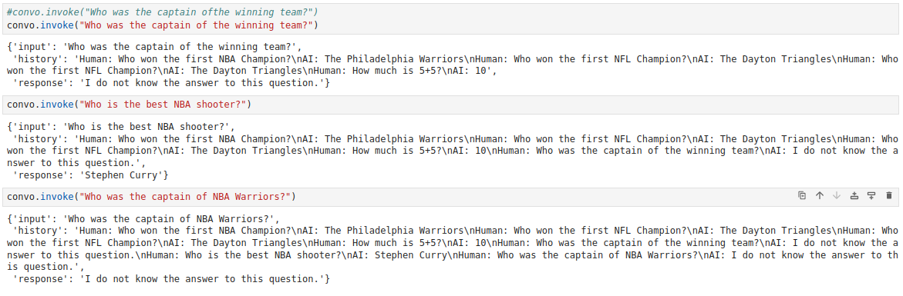

1.09 Memory
https://www.youtube.com/watch?v=nAmC7SoVLd8&list=PLeo1K3hjS3uu0N_0W6giDXzZIcB07Ng_F&index=1
Memory (43:51-44:00/46:07)
We ask a sequence of questions:
1. Who the best shooter in NBA?
2. Who is the captain of NBA Warrior?
We can see all the previous memories are kept.

Slide 14
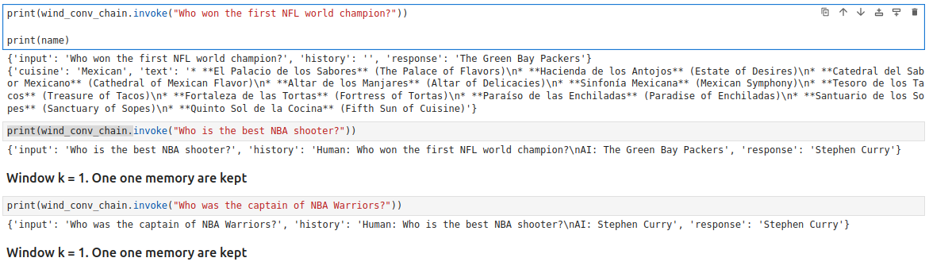
1.09 Memory
https://www.youtube.com/watch?v=nAmC7SoVLd8&list=PLeo1K3hjS3uu0N_0W6giDXzZIcB07Ng_F&index=1
Window Memory (45:01-46:07/46:07)
Below, we can see only one previous memory are kept.

Slide 15
End

