Slide 1

3 Gemini App
Peter H. Chen

Slide 2
3 Gemini App
https://www.youtube.com/watch?v=CC6qMpqgUMU&list=PLZoTAELRMXVNbDmGZlcgCA3a8mRQp5axb&index=3
Gemini App (00:00-01:50/26:27)
Gemini-pro API is open source and is free.
We already discussed gemini-pro basics which we used to create text summary, Text/Image Summary, Q & A, chat and chat history, etc.
In this discussion, we create the End-to-End LLM application with the help of Open Source Google Gemini Pro. It will be an LLM application with respect to various task. We will be using it for image applications.
We will do two projects in this discussion:
1. text inputs project:
2. Image input project:
As we know, gemini-pro is a multimodal which means it works for both text and images.
We will do the project for full stack: frontend, backend, etc.
Gemini-pro is comparable better to openAI chatGPT-4.0.

Slide 3
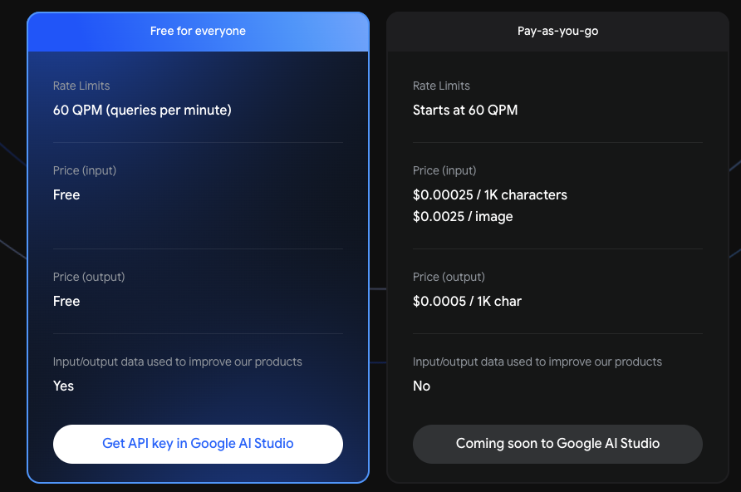
3 Gemini App
https://www.youtube.com/watch?v=CC6qMpqgUMU&list=PLZoTAELRMXVNbDmGZlcgCA3a8mRQp5axb&index=3
Gemini App (01:51-02:10/26:27)
As we know, Gemini-pro has its own free chatBot which we can download from iPhone store. We may ask for 60 QPM (Query Per Minute).
More than 60 QPM, Gemini will ask you for credit card and etc to pay. For inputs, gemini cost $0.00025/1K character and $0.0025/Image. For output, $0.0005/1 K character.
We will use Free open source Gemini-pro API to create our own specific application which is similar to Gemini-pro chatBot.

Slide 4
3.1 Setup Gemini API Key for Our Application

Slide 5
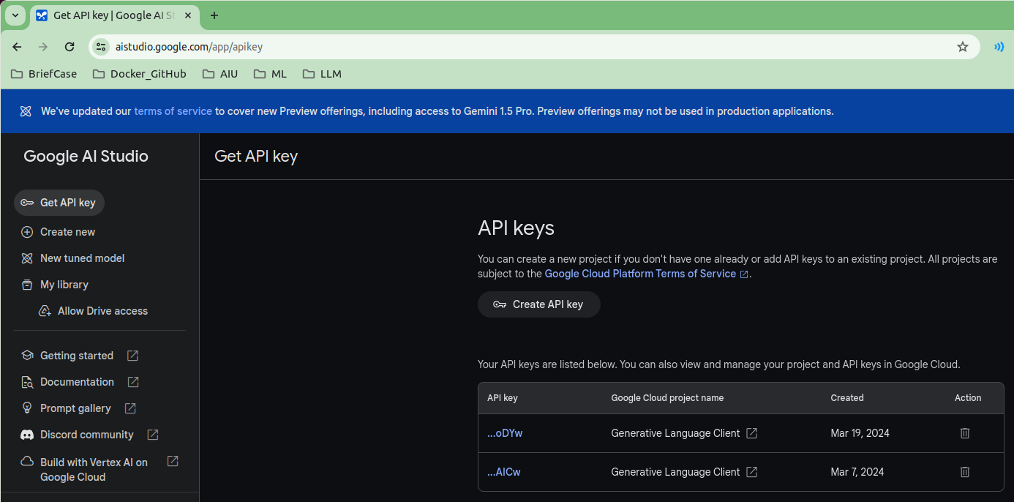
3.1 Setup Gemini API Key for Our Application
https://www.youtube.com/watch?v=CC6qMpqgUMU&list=PLZoTAELRMXVNbDmGZlcgCA3a8mRQp5axb&index=3
Setup Gemini API Key for Our Application (02:14-03:50/26:27)
We need to setup Gemini API Key.
Search for “create gemini api key”. You can create multiple API Key. You can use the same API key for different google projects.

Slide 6
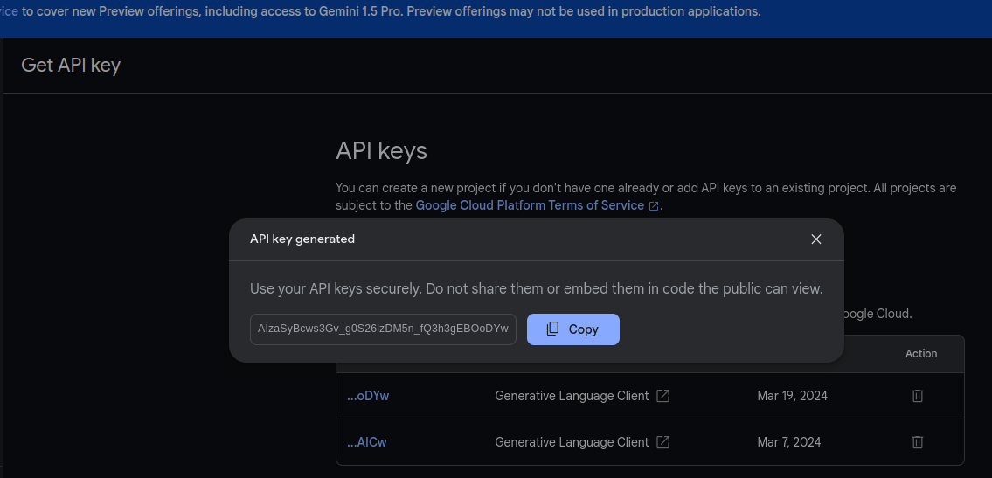
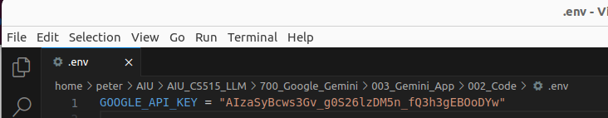
3.1 Setup Gemini API Key for Our Application
https://www.youtube.com/watch?v=CC6qMpqgUMU&list=PLZoTAELRMXVNbDmGZlcgCA3a8mRQp5axb&index=3
Setup Gemini API Key for Our Application (02:14-02:10/26:27)
1. Copy the API Key
2. Paste the API Key into hidden file “.env”
3. Save hidden file “.env”.

Slide 7
3.2 Install Environment

Slide 8
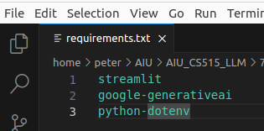
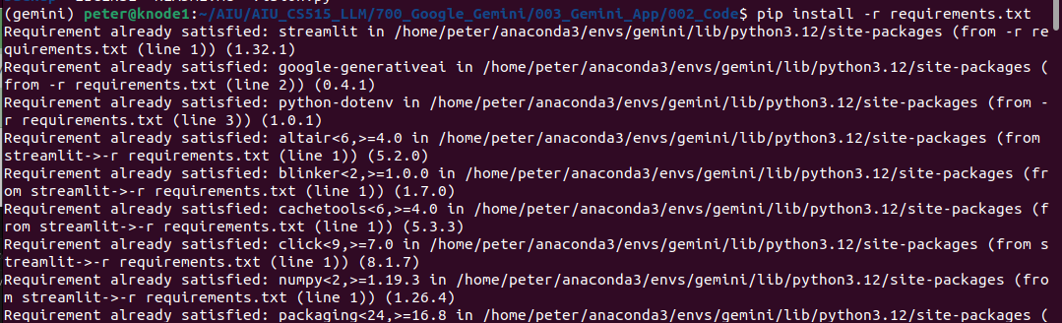
3.2 Install Environment
https://www.youtube.com/watch?v=CC6qMpqgUMU&list=PLZoTAELRMXVNbDmGZlcgCA3a8mRQp5axb&index=3
Install Environment (02:11-02:12/26:27)
We create the conda environment “gemini”
> conda create --name gemini
We activate the gemini environment.
> conda activate gemini
Install the requirements.txt
(gemini) > pip install -r requirements.txt
We need install the below Frameworks/Libraries:
1. streamlit: GUI
2. google-generativeai: Google Generative AI from gemini-pro.
3. python-dotenv: Read API Key from .env file.

Slide 9
End

