Slide 1

08 Gemini with SQL
Peter H. Chen

Slide 2
08 Gemini with SQL
https://www.youtube.com/watch?v=wFdFLWc-W4k&list=PLZoTAELRMXVNbDmGZlcgCA3a8mRQp5axb&index=8
Gemini with SQL (00:00-01:00/30:02)
We are going to
1. Convert the text into SQL query.
2. Retrieve data from SQL database.
There will a lot of discussion in this project. We will implement completely from scratch.
At the end, we can use different techniques to solve common problems in different domains.

Slide 3
08.01 Gemini with SQL Demo

Slide 4
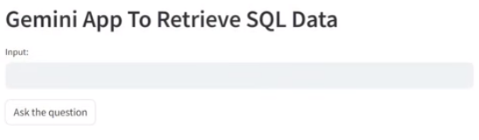
08.01 Gemini with SQL Demo
https://www.youtube.com/watch?v=wFdFLWc-W4k&list=PLZoTAELRMXVNbDmGZlcgCA3a8mRQp5axb&index=8
Gemini with SQL Demo (01:01-01:15/30:02)
We have a student database inside our application.

Slide 5
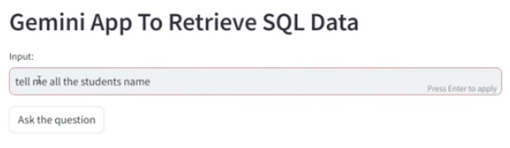
08.01 Gemini with SQL Demo
https://www.youtube.com/watch?v=wFdFLWc-W4k&list=PLZoTAELRMXVNbDmGZlcgCA3a8mRQp5axb&index=8
Gemini with SQL Demo (01:19-01:30/30:02)
Input: tell me all the students name
Click “Ask the question” button

Slide 6
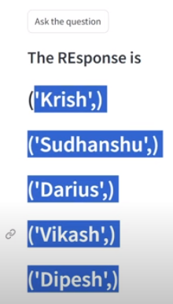
08.01 Gemini with SQL Demo
https://www.youtube.com/watch?v=wFdFLWc-W4k&list=PLZoTAELRMXVNbDmGZlcgCA3a8mRQp5axb&index=8
Gemini with SQL Demo (01:19-01:30/30:02)
Response: (‘Krish,’) …
These are all the students name in in all the classes in our databases.

Slide 7
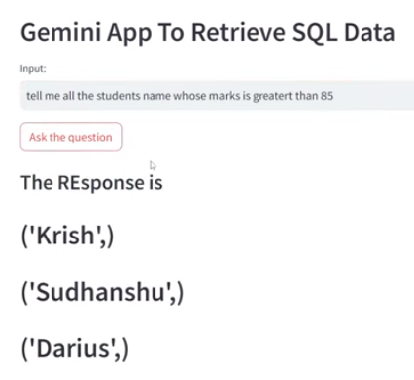
08.01 Gemini with SQL Demo
https://www.youtube.com/watch?v=wFdFLWc-W4k&list=PLZoTAELRMXVNbDmGZlcgCA3a8mRQp5axb&index=8
Gemini with SQL Demo (01:31-02:15/30:02)
Input: tell me all the students name whose marks is greater then 85.
Response: ...

Slide 8
End

