Slide 1

08.02 Create Conda Environment
Peter H. Chen

Slide 2

08.02 Create Conda Environment
https://www.youtube.com/watch?v=wFdFLWc-W4k&list=PLZoTAELRMXVNbDmGZlcgCA3a8mRQp5axb&index=8
Load API Key and Import Library (02:16-02:30/30:02)
1. First, we create our own conda environment:
> create conda --name gemini
2. We activate the conda environment:
(base) > conda activate gemini
(gemini) >

Slide 3
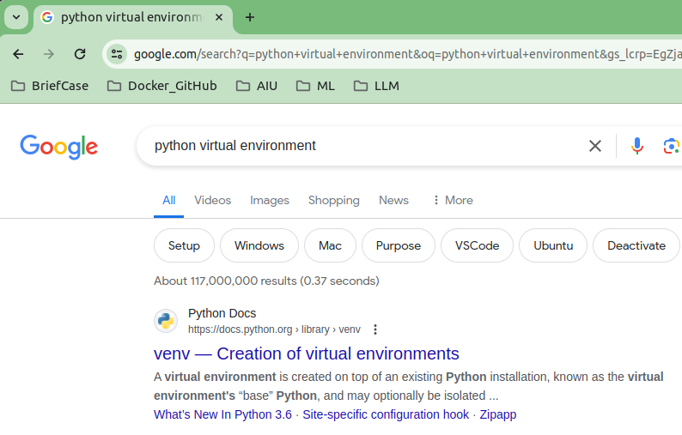
08.02 Create Conda Environment
https://www.youtube.com/watch?v=wFdFLWc-W4k&list=PLZoTAELRMXVNbDmGZlcgCA3a8mRQp5axb&index=8
Load API Key and Import Library (02:31-03:00/30:02)
Right, now. We use conda (anaconda) to create virtual environment.
We can also use Venv (python virtual env) as well.
1. What is the Key differences between conda and venv?
Package Management:
a. Venv does not handle package dependencies itself, whereas Conda excels in this area.
b. Installation:
b.1 Venv is part of Python
b.2 Conda requires a separate installation comes with Anaconda/Miniconda)
2. What is difference in Venv and Conda release date?
a. Conda first released 2012 (12 years ago).
b. Python virtual environment (venv) first release date: 02/20, 1992 (30 years ago).

Slide 4
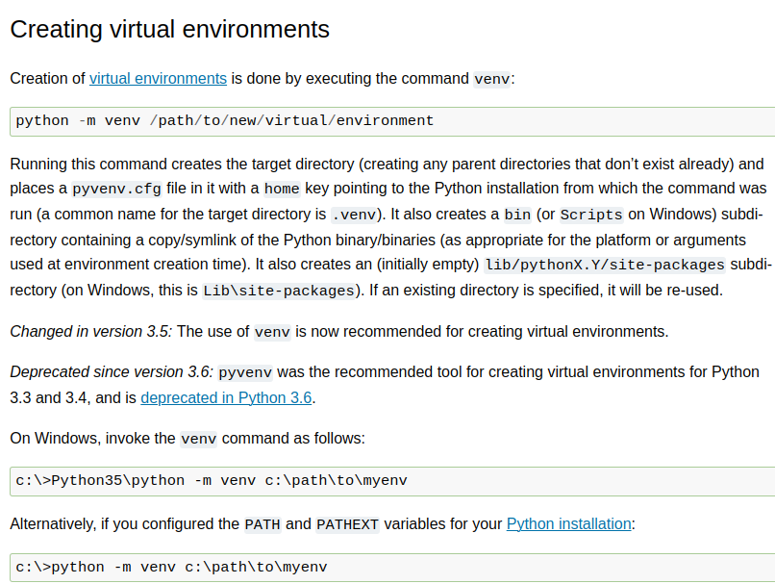
08.02 Create Conda Environment
https://www.youtube.com/watch?v=wFdFLWc-W4k&list=PLZoTAELRMXVNbDmGZlcgCA3a8mRQp5axb&index=8
Load API Key and Import Library (03:01-04:20/30:02)
How do create the venv (Python virtual environment)?
> python -m venv <path>
> venv activate
Question: How to activate different environment in venv?
> virtualenv -p /usr/bin/python3.5 p35-venv
> virtualenv -p /usr/bin/python2.7 p27-venv
Note:
1. Python venv configure environment in the script.
2. Conda is created through the shell commands.

Slide 5
08.03 Create API Key

Slide 6
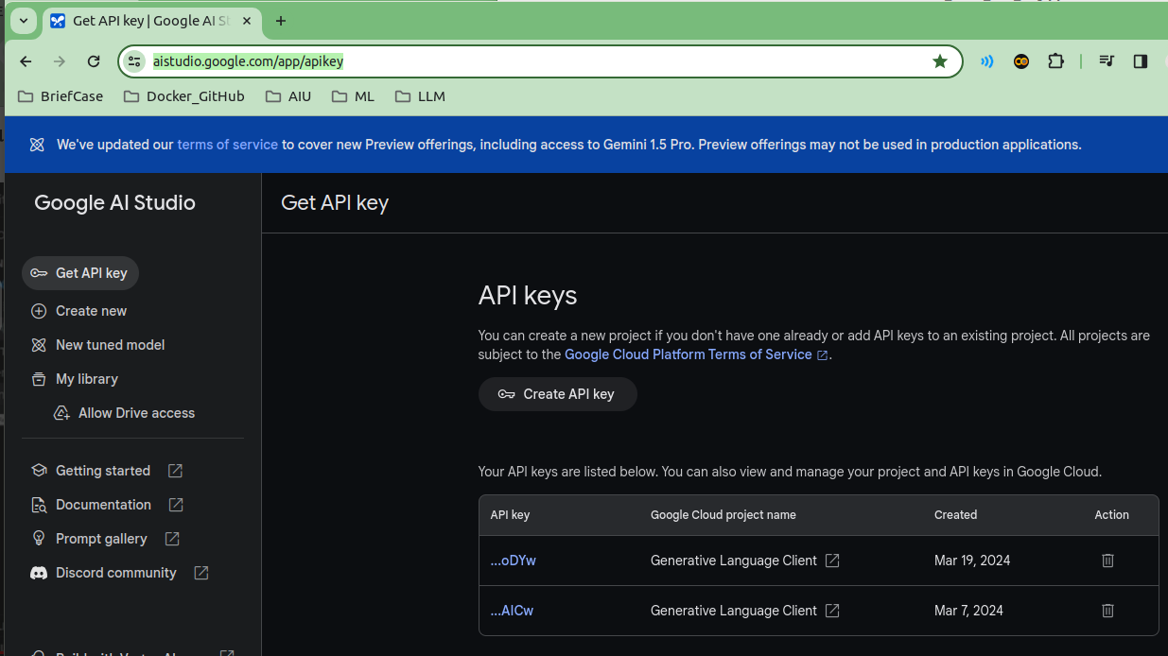
08.03 Create API Key
https://www.youtube.com/watch?v=wFdFLWc-W4k&list=PLZoTAELRMXVNbDmGZlcgCA3a8mRQp5axb&index=8
Create API Key (04:21-04:22/30:02)
1. Create Google API Key for Google ‘Gemini-pro’ Model. There is a default google API Key which google create for us. We can use that key for our application.
2. Copy the key ans paste into “.env” file in the current working directory.
https://aistudio.google.com/app/apikey

Slide 7
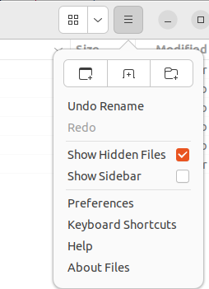
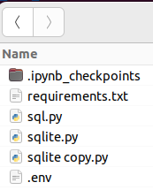
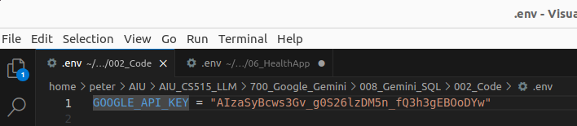
08.03 Create API Key
https://www.youtube.com/watch?v=wFdFLWc-W4k&list=PLZoTAELRMXVNbDmGZlcgCA3a8mRQp5axb&index=8
Create API Key (04:23-04:26/30:02)
To see the Ubuntu hidden file “.env”, we can
1. use the file browser and select “Show Hidden Files”.
2. use Linux command “ls -a” to see all the files (non-hidden and hidden files).

Slide 8
08.03 Create API Key
https://www.youtube.com/watch?v=wFdFLWc-W4k&list=PLZoTAELRMXVNbDmGZlcgCA3a8mRQp5axb&index=8
Create API Key (04:27-05:30/30:02)
1. Paste the Google API Key in the “env” file.
2. Save the “.env” file.
We need the GOOFLE_API_KEY to configure Google AI Model (“gemini-pro’).

Slide 9
08.04 Overall Flow and Implement
Peter H. Chen

Slide 10
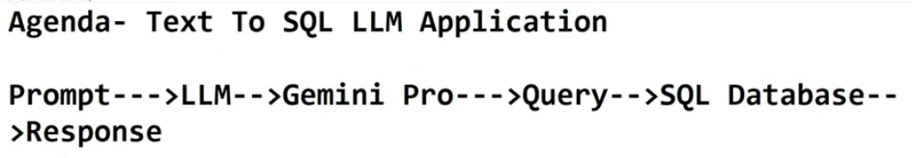
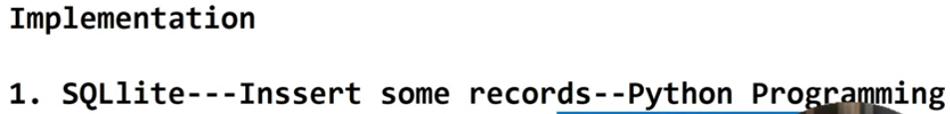
08.04 Overall Flow and Implement
https://www.youtube.com/watch?v=wFdFLWc-W4k&list=PLZoTAELRMXVNbDmGZlcgCA3a8mRQp5axb&index=8
Overall Flow and Implement (05:31-06:00/30:02)
Whenever we have “Natural Language Text to SQL”, that basically means “We will convert the Text to SQL Query and use SQL Query to hit our database and retrieve the results”.
Agenda: Text to SQL LLM Application
Below is the overflow flow of “Text to SQL LLM Application”.
Prompt --> LLM application --> Gemini-pro --> Query --> SQL Database --> Response
From the implementation point of view:
1. SQLite (pysqlite3) --- Insert some records -- Python Programming
2. LLM application --> Gemini-pro ---> SQL Database

Slide 11
08.04 Overall Flow and Implement
https://www.youtube.com/watch?v=wFdFLWc-W4k&list=PLZoTAELRMXVNbDmGZlcgCA3a8mRQp5axb&index=8
Overall Flow and Implement (06:01-06:30/30:02)
1. Below is the overflow flow of “Text to SQL LLM Application”.
First, we explain overall flow:
In Prompt, we create a prompt which is our own custom prompt. such as, “How may students are studying in this class”, or “tell me which student is first rank, second rank”, etc.
--> We are given the user prompt (question), the user prompt will go to the LLM application.
--> The LLM application will call gemini-pro Model.
--> The gemini-pro based on this user prompt (question).
--> The user prompt (question) will give us a Query, then
--> We can use this Query to hit the SQL database, and then
--> Finally, we will get the response.

Slide 12
08.04 Overall Flow and Implement
https://www.youtube.com/watch?v=wFdFLWc-W4k&list=PLZoTAELRMXVNbDmGZlcgCA3a8mRQp5axb&index=8
Overall Flow and Implement (06:31-07:30/30:02)
From the implementation point of view, two important things we need to implement. First,
1 We need to create a database to store the data.
We will use local database, such as, sqlite, in Python, we called pysqlite3.
We also can use MySQL, or any different types of database, such as, PostgreSQL, etc.
Just for quick example without much hassle (trouble).
We use pysqlite3 because we can actually do it in our local database.
So, that is the reason we use pysqlite3 for database.
-- In the local database, we insert some records. -- We insert the record entirely with Python Programming.
This is the first step of implementation.
2. The second step of implementation:
We will create our LLM application using --> Gemini-pro. The gemini pro is generating, it will go ahead and hit the SQL database --> SQL Database.

Slide 13
08.05 Install requirements.txt

Slide 14
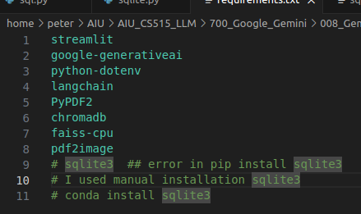
08.05 Install requirements.txt
https://www.youtube.com/watch?v=wFdFLWc-W4k&list=PLZoTAELRMXVNbDmGZlcgCA3a8mRQp5axb&index=8
Install requirements.txt (07:31-08:20/30:02)
We install the requirements.txt
1. streamlit: streamlit GUI
2. generative AI: Gemini-pro
3. python-dotenv: Load all environment variable in “.env” file
4. langchain: Integration tools
5. PyPDF2: Python PDF reader.
6. chromadb: database
7. faiss-cpu: Facebook AI similarity Search for embedding
8. pdf2image: Image
> pip install -r requirements
# 9. sqlite3: Python SQLite3 (small and fast) Database engine.
# Install by conda command as below.
> conda install sqlite3 #or pip install pysqlite3

Slide 15
End

