Slide 1

08.06 Create/Connect Database
Peter H. Chen

Slide 2
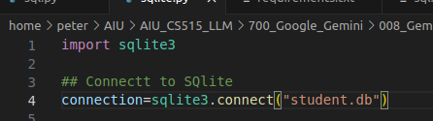
08.06 Create/Connect Database
https://www.youtube.com/watch?v=wFdFLWc-W4k&list=PLZoTAELRMXVNbDmGZlcgCA3a8mRQp5axb&index=8
Create/Connect Database (08:19-09:30/30:02)
1. Import sqlite3
2. sqlite3.connect(“student.db”):
2.1 If “student.db” does not existed, connect() automatically create a “student.db” database in the current working directory.
2.2 If “student.db” is existed, connect() make a connection to existed database.
> import pysqlite3
> connection = sqlite3.connect(“student.db”)
Question: In sqlite3.connect(), do we need to create database?
Answer: When you connect to an SQLite database file that does not exist, SQLite automatically creates the new database for you. To create a database, first, you have to create a Connection object that represents the database using the connect() function of the sqlite3 module.

Slide 3
08.07 Create Cursor

Slide 4

08.07 Create Cursor
https://www.youtube.com/watch?v=wFdFLWc-W4k&list=PLZoTAELRMXVNbDmGZlcgCA3a8mRQp5axb&index=8
Create Cursor (09:31-10:20/30:02)
Create a cursor object to insert record,create table
Question: What us cursor mean in database?
A database cursor is an identifier associated with a group of rows. A cursor is a pointer to the current row in a buffer.
You must use a cursor in the following cases:
1. Statements that return more than one row of data from the database server:
1.1 A SELECT statement requires a select cursor.
1.2 An EXECUTE FUNCTION statement requires a function cursor.
2. An INSERT statement that sends more than one row of data to the database server requires an insert cursor.

Slide 5
08.08 Table Creation and Column Creation Command

Slide 6
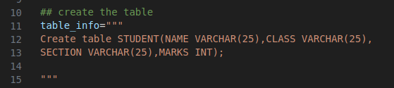
08.08 Table Creation and Column Creation Command
https://www.youtube.com/watch?v=wFdFLWc-W4k&list=PLZoTAELRMXVNbDmGZlcgCA3a8mRQp5axb&index=8
Table Creation and Column Creation Command (10:21-11:15/30:02)
We define the command to create a table and four columns.
The table name called “STUDENT” and the four columns store to student information.
In this table, the table name is “STUDENT”. The table is a simple SQL query table.
In the table, we have four columns:
a. Name (student name) VARCHAR (25)
b. Class (class name, alphabetical numeric): VARCHAR (25)
c. SECTION (section name, Spring, Summer, or Fall): VARCHAR (25)
d. MARKS (Student grade): integer

Slide 7
08.09 Create Table

Slide 8
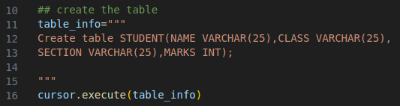
08.09 Create Table
https://www.youtube.com/watch?v=wFdFLWc-W4k&list=PLZoTAELRMXVNbDmGZlcgCA3a8mRQp5axb&index=8
Create Table (11:19-11:20/30:02)
We use cursor to execute table_info “Create table STUDENT (four columns...).
> cursor.execute (table_info)
To create four columns of ‘student’ table.

Slide 9
08.10 Insert Record

Slide 10
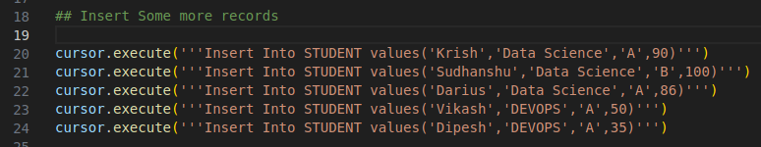
08.10 Insert Record
https://www.youtube.com/watch?v=wFdFLWc-W4k&list=PLZoTAELRMXVNbDmGZlcgCA3a8mRQp5axb&index=8
Insert Record (11:25-12:20/30:02)
Now, we insert the record.
> cursor.execute (‘’’Insert Into STUDENT values (…)’’’

Slide 11
08.11 Display Record

Slide 12
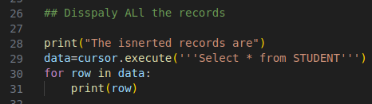
08.11 Display Record
https://www.youtube.com/watch?v=wFdFLWc-W4k&list=PLZoTAELRMXVNbDmGZlcgCA3a8mRQp5axb&index=8
Display Record (12:35-13:20/30:02)
> print (“Inserted record:”)
> data = cursor.execute (‘’’Select * From STUDENT ‘’’)
> for row in data:
> print (row)

Slide 13
08.12 Close Connection

Slide 14

08.12 Close Connection
https://www.youtube.com/watch?v=wFdFLWc-W4k&list=PLZoTAELRMXVNbDmGZlcgCA3a8mRQp5axb&index=8
Close Connection (13:21-14:10/30:02)
> connection.commit()
> connection.close()

Slide 15
08.13 Run sqlite.py

Slide 16
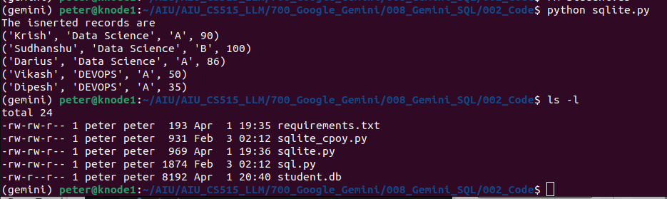
08.13 Run sqlite.py
https://www.youtube.com/watch?v=wFdFLWc-W4k&list=PLZoTAELRMXVNbDmGZlcgCA3a8mRQp5axb&index=8
Close Connection (14:11-14:45/30:02)
> python sqlite.py
>> display the record insertion
>> …
> ls -l
To re-create database “student.db”, we need to remove
> rm student.db
> python sqlite.py
>> display the record insertion
>> …

Slide 17
End

