Slide 1

08.14 Create LLM Application
Peter H. Chen

Slide 2
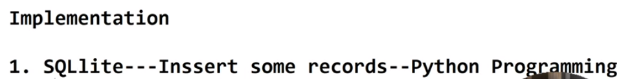
08.14 Create LLM Application
https://www.youtube.com/watch?v=wFdFLWc-W4k&list=PLZoTAELRMXVNbDmGZlcgCA3a8mRQp5axb&index=8
Create LLM Application (14:47-14:50/30:02)
We have done the first step
1. Create SQLite database.
Now, we are going to create
2. LLM Application --> Gemini-pro --->SQL Database

Slide 3
08.14 Create LLM Application
https://www.youtube.com/watch?v=wFdFLWc-W4k&list=PLZoTAELRMXVNbDmGZlcgCA3a8mRQp5axb&index=8
Create LLM Application (14:53-15:30/30:02)
Whenever we are given a prompt, we need to convert into a SQL Query and hit out of database.
> code sql.py

Slide 4
08.15 Load API Key

Slide 5
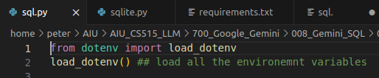
08.15 Load API Key
https://www.youtube.com/watch?v=wFdFLWc-W4k&list=PLZoTAELRMXVNbDmGZlcgCA3a8mRQp5axb&index=8
Load API Key (15:31-15:50/30:02)
Load the environment variable GOOGLE_API_KEY from “.env” file

Slide 6
08.16 Import Library and Configure Model

Slide 7
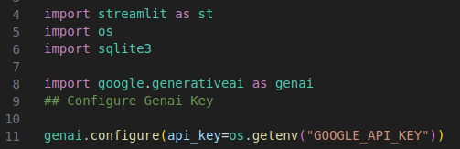
08.16 Import Library and Configure Model
https://www.youtube.com/watch?v=wFdFLWc-W4k&list=PLZoTAELRMXVNbDmGZlcgCA3a8mRQp5axb&index=8
Import Library and Configure Model (15:51-17:20/30:02)
Import the libraries:
1. streamlit: GUI
2. os: os.getenv(“GOOGLE_API_KEY”)
3. sqlite3: retrieve database
4. generative ai: gemini-pro model
5. Configure gemini-pro with google API Key.

Slide 8
08.17 Import Library and Configure Model

Slide 9
08.17 Import Library and Configure Model
https://www.youtube.com/watch?v=wFdFLWc-W4k&list=PLZoTAELRMXVNbDmGZlcgCA3a8mRQp5axb&index=8
Import Library and Configure Model (15:51-18:20/30:02)
Import the libraries:
1. streamlit: GUI
2. os: os.getenv(“GOOGLE_API_KEY”)
3. sqlite3: retrieve database
4. generative ai: gemini-pro model
5. Configure gemini-pro with google API Key.

Slide 10
08.18 Get Gemini Response

Slide 11
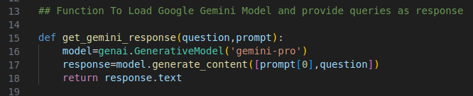
08.18 Get Gemini Response
https://www.youtube.com/watch?v=wFdFLWc-W4k&list=PLZoTAELRMXVNbDmGZlcgCA3a8mRQp5axb&index=8
Get Gemini Response (18:21-21:30/30:02)
1. Load Google Gemini-pro Model
2. Get SQL response.
3. return response.txt
What is prompt here?
Prompt is the user Input which guide the Gemini-pro what is the the user inputs and expectation.
Note:
Prompt is very import to guide the Gemini-pro Model.

Slide 12
08.19 Retrieve SQL Query

Slide 13
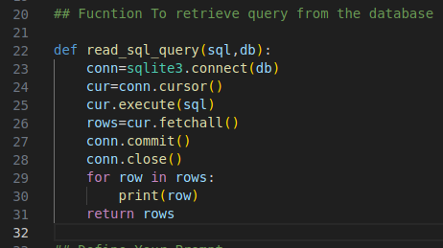
08.19 Retrieve SQL Query
https://www.youtube.com/watch?v=wFdFLWc-W4k&list=PLZoTAELRMXVNbDmGZlcgCA3a8mRQp5axb&index=8
Retrieve SQL Query (21:31-23:20/30:02)
Retrieve SQL Query from database:
1. Connect Database
2. Get Cursor
3. Execute cursor with SQL Query
4. Fetch all rows into local memory.
5. Close the database
6. Loop for rows in local memory
7. print all rows
8. return all rows

Slide 14
08.20 Define User Prompt

Slide 15
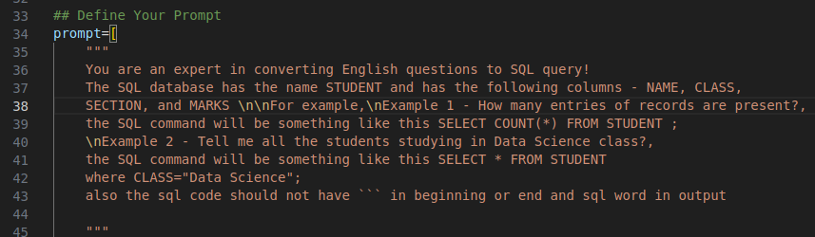
08.20 Define User Prompt
https://www.youtube.com/watch?v=wFdFLWc-W4k&list=PLZoTAELRMXVNbDmGZlcgCA3a8mRQp5axb&index=8
Define Our Prompt (23:21-24:20/30:02)
Now, define our prompt is the most important task here.
The prompt guide the LLM Model (Gemini-pro) what is the user question and excpected answer.
If wrong guide, then response may not get good response.
What is the use of prompt in LLM?
Prompt engineering is the practice of crafting input queries or instructions to elicit more accurate and desirable outputs from large language models (LLMs).
Prompt is a crucial skill for working with artificial intelligence (AI) applications, helping developers achieve better results from language models.

Slide 16
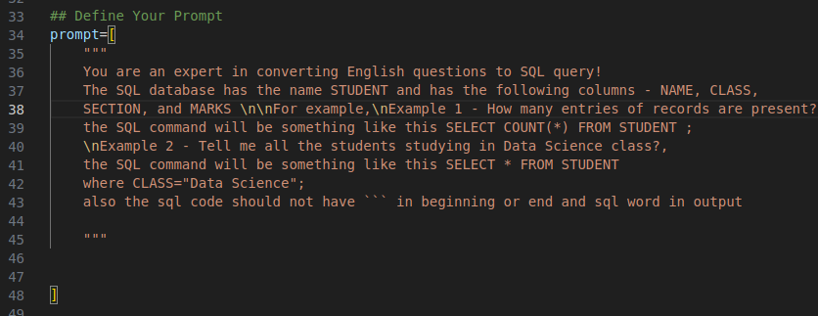

08.20 Define User Prompt
https://www.youtube.com/watch?v=wFdFLWc-W4k&list=PLZoTAELRMXVNbDmGZlcgCA3a8mRQp5axb&index=8
Define Our Prompt (24:21-24:30/30:02)
This prompt will be passed into the Gemini-pro Model.
We make the prompt[0] since we have only one prompt.

Slide 17
08.21 Create Streamlit GUI

Slide 18
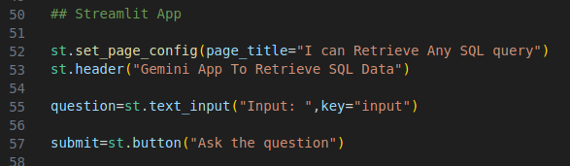
08.21 Create Streamlit GUI
https://www.youtube.com/watch?v=wFdFLWc-W4k&list=PLZoTAELRMXVNbDmGZlcgCA3a8mRQp5axb&index=8
Create Streamlit GUI (24:31-24:50/30:02)
1. Page Titile: Retrieve SQL Query
2. Header: Gemini App to retrieve SQL Data
3. Get Question
4. Create button: Ask the question

Slide 19
08.22 Process Submission

Slide 20
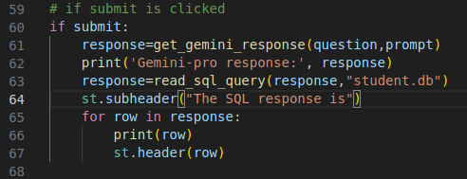
08.22 Process Submission
https://www.youtube.com/watch?v=wFdFLWc-W4k&list=PLZoTAELRMXVNbDmGZlcgCA3a8mRQp5axb&index=8
Process Submission (24:51-26:40/30:02)
If submit is clicked,
1. Input: 1. Quesiton 2. Prompt
2. Get the “Gemini-response” from Gemini-pro.
3. Print (“gemini-pro response, response)
4. Input the “Gemini-response” and “student.db” to read_sql_query (“Gemini-response”, “student.db”)
5. Get the SQL Query response: sql_response
6. print (“SQL response”, sql_response).

Slide 21
End

