Slide 1

08.23 Streamlit run SQL App
Peter H. Chen

Slide 2
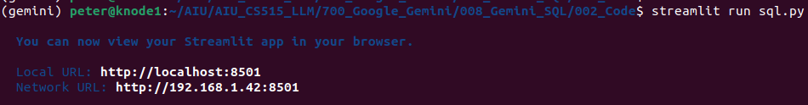
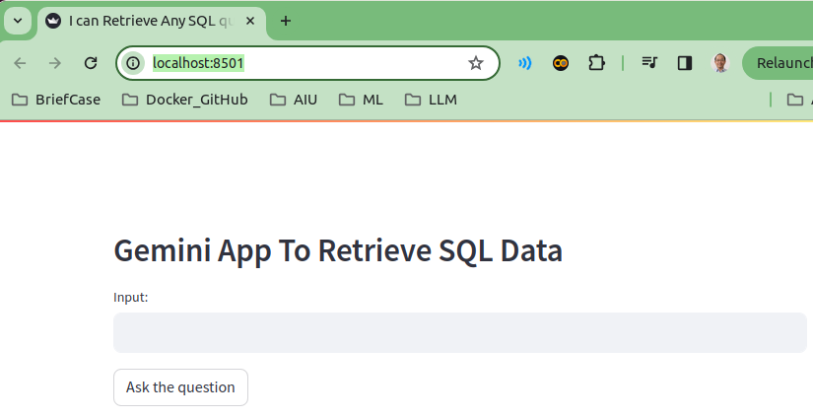
08.23 Streamlit run SQL App
https://www.youtube.com/watch?v=wFdFLWc-W4k&list=PLZoTAELRMXVNbDmGZlcgCA3a8mRQp5axb&index=8
Streamlit run SQL App (26:41-27:30/30:02)
> streamlit run sql.py

Slide 3
08.24 Test Average Grade

Slide 4
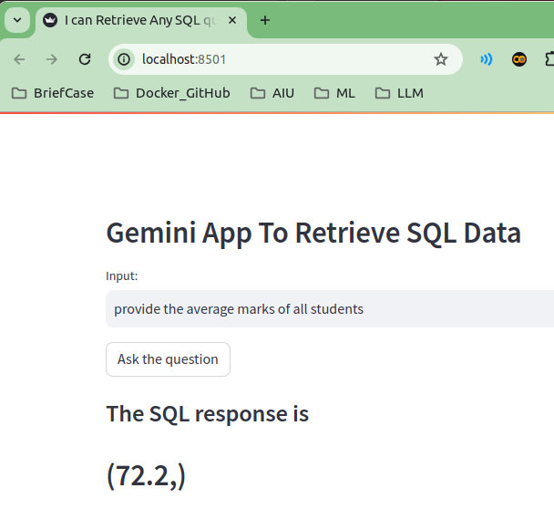
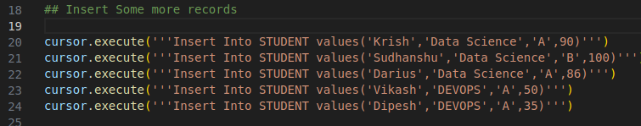
08.24 Test Average Grade
https://www.youtube.com/watch?v=wFdFLWc-W4k&list=PLZoTAELRMXVNbDmGZlcgCA3a8mRQp5axb&index=8
Test Average Grade (26:31-27:00/30:02)
Input: Provide the average marks of all students
Response: (90 + 100 + 86 + 50 + 30)/5 = 72.2

Slide 5
08.24 Test Average Grade
https://www.youtube.com/watch?v=wFdFLWc-W4k&list=PLZoTAELRMXVNbDmGZlcgCA3a8mRQp5axb&index=8
Test Average Grade (27:01-27:10/30:02)
Verify by sqlite3
Start “sqlite3 student.db”
> sqlite3 student.db
>> sqlite >

Slide 6
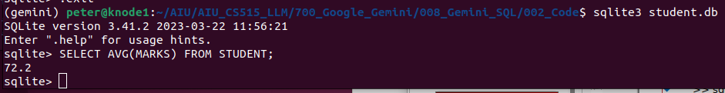
08.24 Test Average Grade
https://www.youtube.com/watch?v=wFdFLWc-W4k&list=PLZoTAELRMXVNbDmGZlcgCA3a8mRQp5axb&index=8
Test Average Grade (27:11-27:20/30:02)
Select average (marks) from table student.
> sqlite3 student.db
>> sqlite >SELECT AVG(MARKS) FROM STUDENTS;
>>72.2

Slide 7
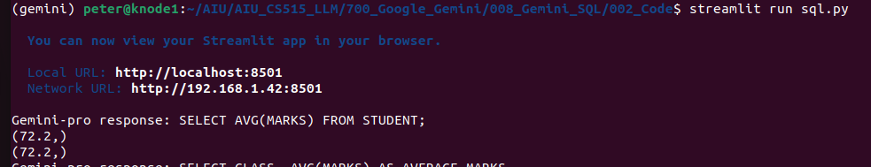
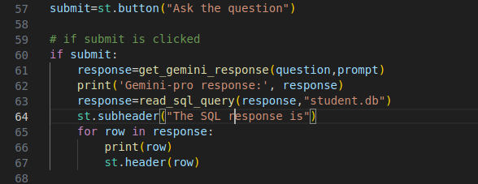
08.24 Test Average Grade
https://www.youtube.com/watch?v=wFdFLWc-W4k&list=PLZoTAELRMXVNbDmGZlcgCA3a8mRQp5axb&index=8
Test Average Grade (27:21-27:30/30:02)
Check the
1. Gemini-pro translation output and
2. SQL Query output.

Slide 8
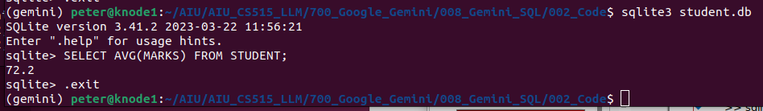
08.24 Test Average Grade
https://www.youtube.com/watch?v=wFdFLWc-W4k&list=PLZoTAELRMXVNbDmGZlcgCA3a8mRQp5axb&index=8
Test Average Grade (27:31-27:40/30:02)
Quit by .exit;
> sqlite3 student.db
>> sqlite >SELECT AVG(MARKS) FROM STUDENTS;
>>72.2
>> sqlite3> .exit

Slide 9
08.25 Test Average Grade Class Wise

Slide 10
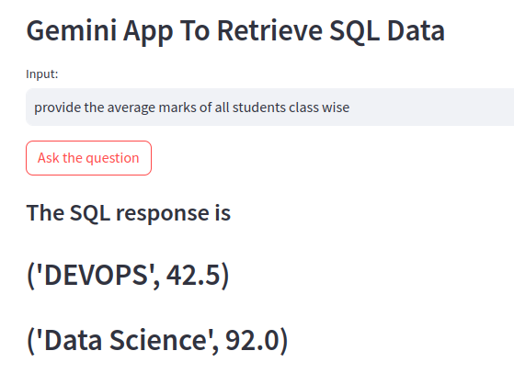
08.25 Test Average Grade Class Wise
https://www.youtube.com/watch?v=wFdFLWc-W4k&list=PLZoTAELRMXVNbDmGZlcgCA3a8mRQp5axb&index=8
Test Average Grade Class Wise (27:41-28:10/30:02)
Input: Provide the average marks of all students class wise
Response:
1. DEVOPS: (50+35)/2 = 42.5
2. Data Science: (90 + 100 + 86)/3 = 92.0

Slide 11
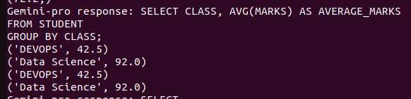
08.25 Test Average Grade Class Wise
https://www.youtube.com/watch?v=wFdFLWc-W4k&list=PLZoTAELRMXVNbDmGZlcgCA3a8mRQp5axb&index=8
Test Average Grade Class Wise (28:11-28:20/30:02)
Check the
1. Gemini-pro translation output and
2. sql result.

Slide 12
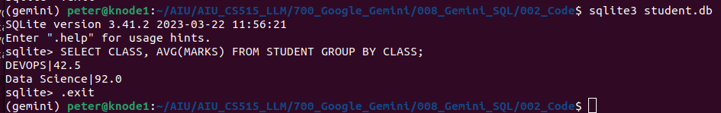
08.25 Test Average Grade Class Wise
https://www.youtube.com/watch?v=wFdFLWc-W4k&list=PLZoTAELRMXVNbDmGZlcgCA3a8mRQp5axb&index=8
Test Average Grade Class Wise (28:21-28:30/30:02)
> sqlite3 student.db
>> sqlite>SELECT CLASS, AVG(MARKS) FROM STUDENT GROUP BY CLASS:
>> DEVOPS|42.5
>> Data Science|92.0
>> sqlite>.exit

Slide 13
08.26 Test Second Highest Mark Class Wise

Slide 14
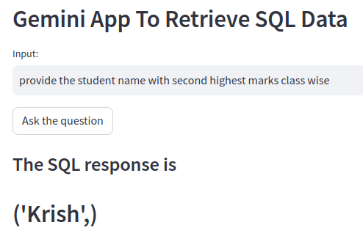
08.26 Test Second Highest Mark Class Wise
https://www.youtube.com/watch?v=wFdFLWc-W4k&list=PLZoTAELRMXVNbDmGZlcgCA3a8mRQp5axb&index=8
Test Second Highest Mark Class Wise (28:31-29:00/30:02)
Input: Provide the average marks of all students class wise
Response:
1. DEVOPS: (50+35)/2 = 42.5
2. Data Science: (90 + 100 + 86)/3 = 92.0

Slide 15
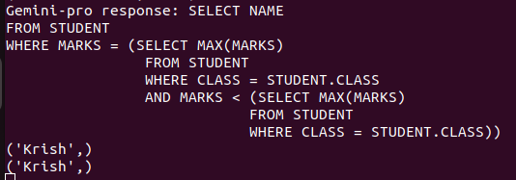
08.26 Test Second Highest Mark Class Wise
https://www.youtube.com/watch?v=wFdFLWc-W4k&list=PLZoTAELRMXVNbDmGZlcgCA3a8mRQp5axb&index=8
Test Second Highest Mark Class Wise (29:01-29:30/30:02)
Check the
1. Gemini-pro translation output
2. SQL Query result.

Slide 16
08.26 Test Second Highest Mark Class Wise
https://www.youtube.com/watch?v=wFdFLWc-W4k&list=PLZoTAELRMXVNbDmGZlcgCA3a8mRQp5axb&index=8
Test Second Highest Mark Class Wise (29:31-30:02/30:02)
Check with sqlite3
> sqlite3 student.db
>> sqlite>SELECT NAME FROM STUDENT WHERE MARKS = (SELECT MAX(MARKS) FROM STUDENT WHERE CLASS = STUDENT.CLASS AND MARKS < (SELECT MAX(MARKS) FROM STUDENT WHERE CLASS = STUDENT.CLASS));
>> Krish
>> sqlite>.exit

Slide 17
End

