Slide 1

4.07 Start QA ChatBot
Peter H. Chen

Slide 2
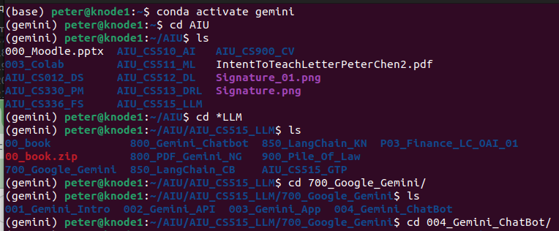
4.07 Start QA ChatBot
https://www.youtube.com/watch?v=o4ZhXSVuPyc&list=PLZoTAELRMXVNbDmGZlcgCA3a8mRQp5axb&index=4
Start QA ChatBot (11:31-12:20/14:32)
Open Terminal
> conda activate gemini
> cd <path>

Slide 3
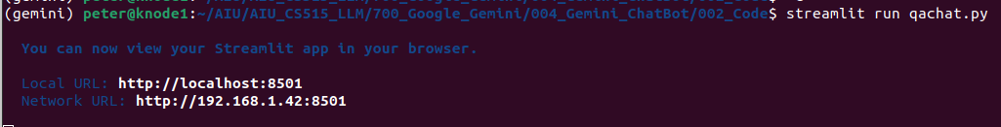
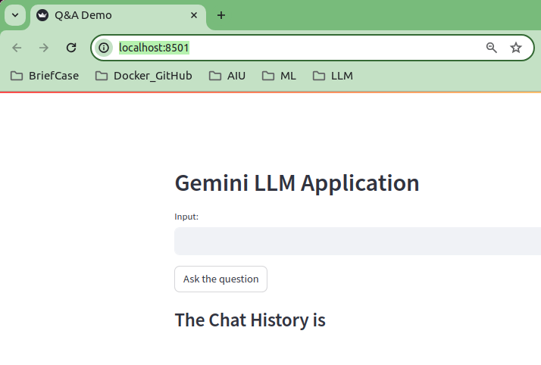
4.07 Start QA ChatBot
https://www.youtube.com/watch?v=o4ZhXSVuPyc&list=PLZoTAELRMXVNbDmGZlcgCA3a8mRQp5axb&index=4
Start QA ChatBot (12:21-13:00/14:32)
Start qachat.py
> streamlit rub qachat.py

Slide 4
4.08 Test QA ChatBot

Slide 5
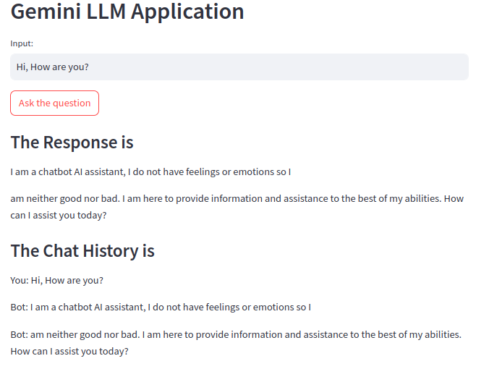
4.08 Test QA ChatBot
https://www.youtube.com/watch?v=o4ZhXSVuPyc&list=PLZoTAELRMXVNbDmGZlcgCA3a8mRQp5axb&index=4
Test QA ChatBot (13:01-13:30/14:32)
1. Input: “Hi, How are you?”
2. Response: “I am a chatbot AI assistant. ...”

Slide 6
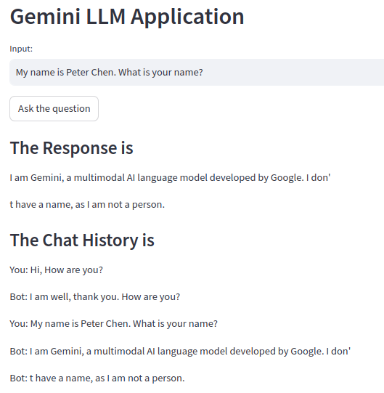
4.08 Test QA ChatBot
https://www.youtube.com/watch?v=o4ZhXSVuPyc&list=PLZoTAELRMXVNbDmGZlcgCA3a8mRQp5axb&index=4
Test QA ChatBot (13:31-14:30/14:32)
1. Input: “My Name is Peter Chen. What is your name?”.
2. Response: “I am a large language model, trained by Google. I do not have a name”

Slide 7
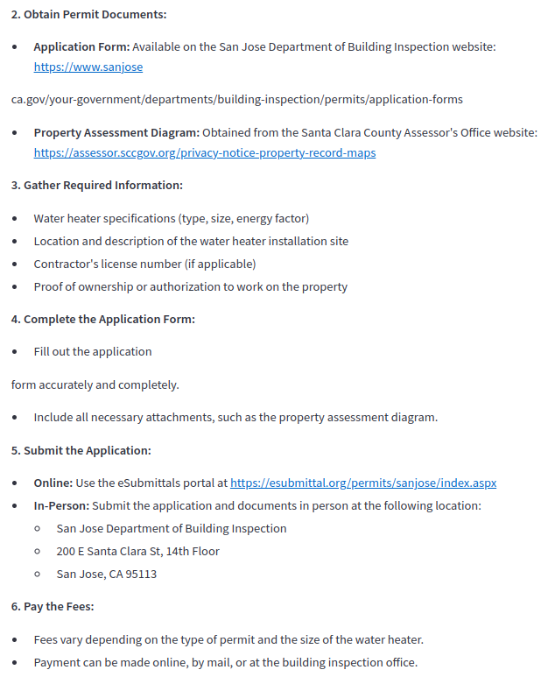
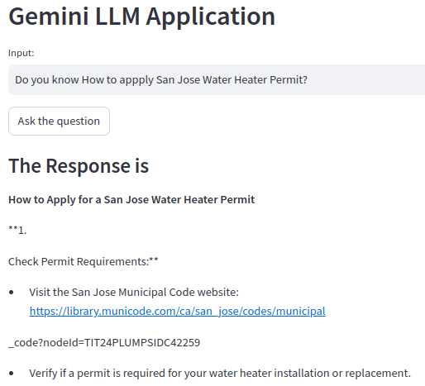
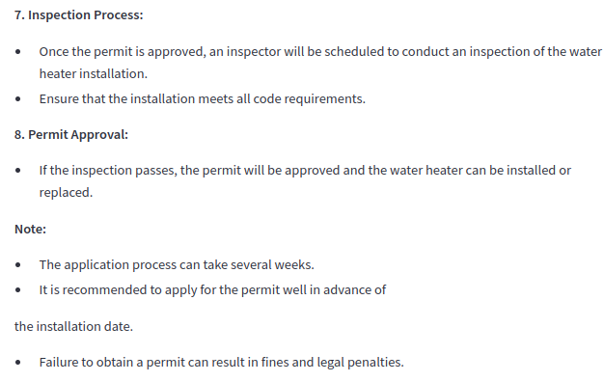
4.08 Test QA ChatBot
https://www.youtube.com/watch?v=o4ZhXSVuPyc&list=PLZoTAELRMXVNbDmGZlcgCA3a8mRQp5axb&index=4
Test QA ChatBot (13:31-14:00/14:32)
1. Input: “Do you know San Jose water heater permit?”
6. Response: “...”

Slide 8
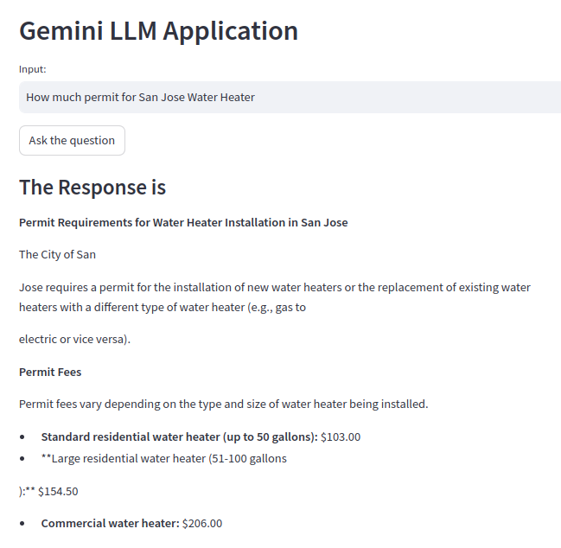
4.08 Test QA ChatBot
https://www.youtube.com/watch?v=o4ZhXSVuPyc&list=PLZoTAELRMXVNbDmGZlcgCA3a8mRQp5axb&index=4
Test QA ChatBot (14:01-14:30/14:32)
1. Input: “How much permit for San Jose Water Heater”
6. Response: “.$154.00”

Slide 9
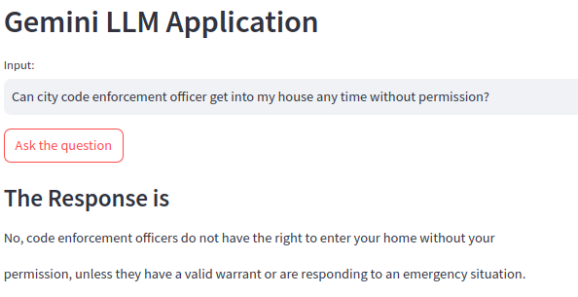
4.08 Test QA ChatBot
https://www.youtube.com/watch?v=o4ZhXSVuPyc&list=PLZoTAELRMXVNbDmGZlcgCA3a8mRQp5axb&index=4
Test QA ChatBot (14:31-14:32/14:32)
1. Input: “Can City code enforcement officer get into my house any time?”
6. Response: “No. … unless they have warrant”

Slide 10
End

