Slide 1

10.03 Prompt Template Text Summarization
Peter H. Chen

Slide 2
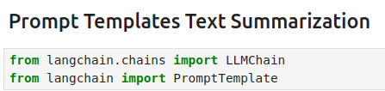
10.03 Prompt Template Text Summarization
https://www.youtube.com/watch?v=o11J4oO-P28&list=PLZoTAELRMXVORE4VF7WQ_fAl0L1Gljtar&index=10
Prompt Template Text Summarization (09:41-10:50/33:29)
Our second method is “Prompt Template Text Summarization”.
We create the custom prompt for particular purpose.
Whenever we create Prompt Template for LLM (Large Language Model), in LangChain, we called it LLMChain.
Because prompt template can have multiple prompts. In order to execute the multiple prompts, we need chains of LLMs. So that we can execute one-by-one in sequences and get the final output.
For this reason, we import LLMChain and promptTemplate.

Slide 3
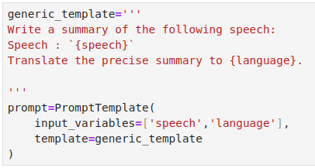
10.03 Prompt Template Text Summarization
https://www.youtube.com/watch?v=o11J4oO-P28&list=PLZoTAELRMXVORE4VF7WQ_fAl0L1Gljtar&index=10
Prompt Template Text Summarization (10:51-12:10/33:29)
With the help of promptTemplate, we will create our own custom prompt.
Below, we define
generic_template:
‘’’
Write a summary …
Speech: `{Speech}`
Translate summary into {language}
‘’’
Prompt = promptTemplate (
input_variables = {‘speech’, ‘language’}
Template = generic_template
}

Slide 4
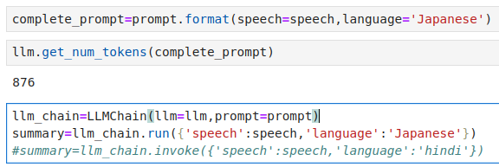
10.03 Prompt Template Text Summarization
https://www.youtube.com/watch?v=o11J4oO-P28&list=PLZoTAELRMXVORE4VF7WQ_fAl0L1Gljtar&index=10
Prompt Template Text Summarization (12:11-13:30/33:29)
1. We english format prompt: … Translate into speech into Japanese....
2. Count the prompt token: “Japanese”, “Chinese”, “Hindi” has a little bit difference.
3. Use LLMChain to translate and summarize

Slide 5
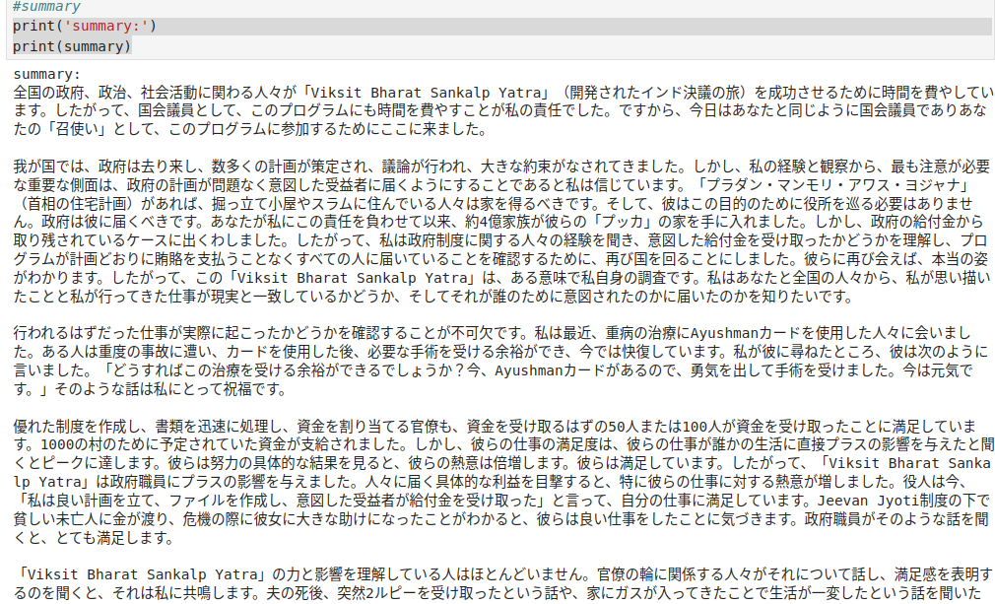
10.03 Prompt Template Text Summarization
https://www.youtube.com/watch?v=o11J4oO-P28&list=PLZoTAELRMXVORE4VF7WQ_fAl0L1Gljtar&index=10
Prompt Template Text Summarization (13:31-14:30/33:29)
Print the summary in Japanese.

Slide 6
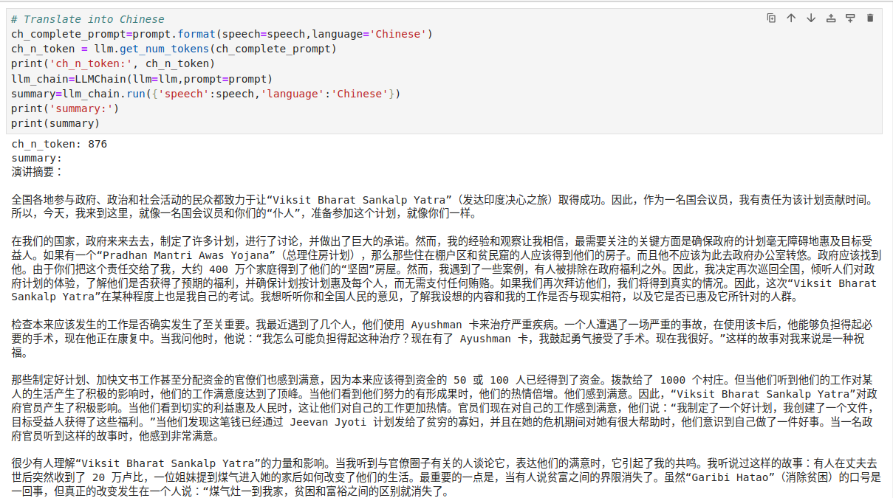
10.03 Prompt Template Text Summarization
https://www.youtube.com/watch?v=o11J4oO-P28&list=PLZoTAELRMXVORE4VF7WQ_fAl0L1Gljtar&index=10
Prompt Template Text Summarization (14:31-15:00/33:29)
We try other languages: Chinese.

Slide 7
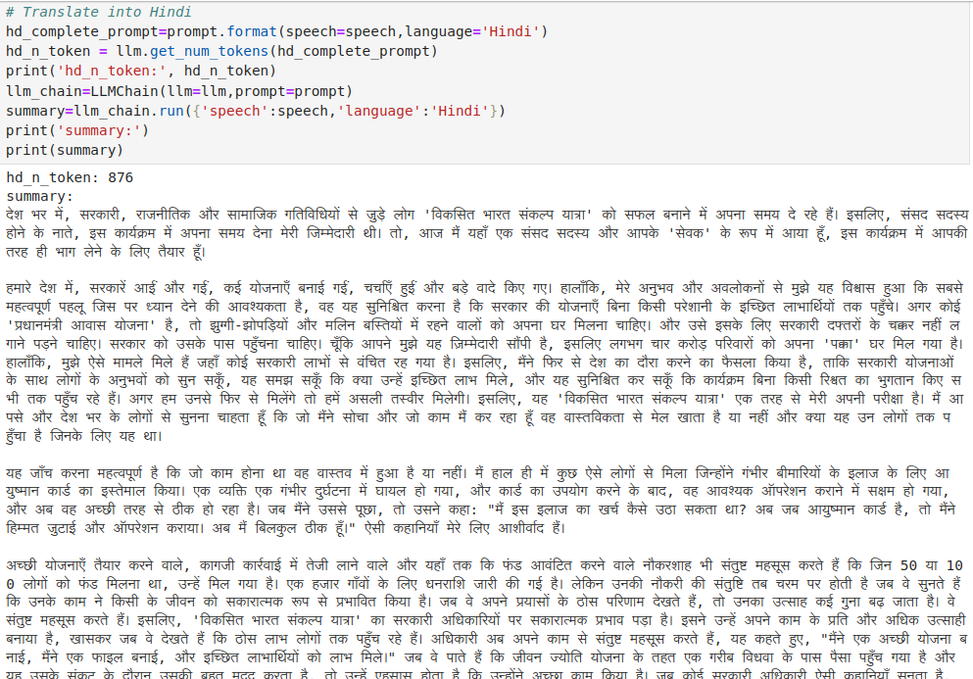
10.03 Prompt Template Text Summarization
https://www.youtube.com/watch?v=o11J4oO-P28&list=PLZoTAELRMXVORE4VF7WQ_fAl0L1Gljtar&index=10
Prompt Template Text Summarization (15:01-15:15/33:29)
We try other languages: Hindi.

Slide 8
End

