Slide 1

10.04 Stuff Doc Chain Text Summarization
Peter H. Chen

Slide 2
10.04 Stuff Doc Chain Text Summarization
https://www.youtube.com/watch?v=o11J4oO-P28&list=PLZoTAELRMXVORE4VF7WQ_fAl0L1Gljtar&index=10
PDF Doc Chain Text Summarization (15:16-19:00/33:29)
We already discussed two ways:
The first is generic way, and second one is prompt template. We see both text summarization.
The third method is called “Stuff Documentation Chain”.
Next one, is “map Reduce”.
The process is as below:
1. We read the PDF document into into text.
2. Send the text to LLM.
3. Get the summary of the document.
This “Stuff Document Chain” is only for small document.
At the end, we should only use “map reduce” which has more tokens length for long PDF document text summarization.

Slide 3
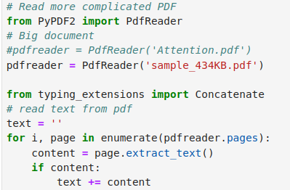
10.04 Stuff Doc Chain Text Summarization
https://www.youtube.com/watch?v=o11J4oO-P28&list=PLZoTAELRMXVORE4VF7WQ_fAl0L1Gljtar&index=10
PDF Doc Chain Text Summarization (19:01-20:30/33:29)
1. Read the PDF document
2. Read the document one page by another.
3. Put all the pages together.

Slide 4

10.04 Stuff Doc Chain Text Summarization
https://www.youtube.com/watch?v=o11J4oO-P28&list=PLZoTAELRMXVORE4VF7WQ_fAl0L1Gljtar&index=10
PDF Doc Chain Text Summarization (20:31-21:40/33:29)
Convert the text into document format.

Slide 5
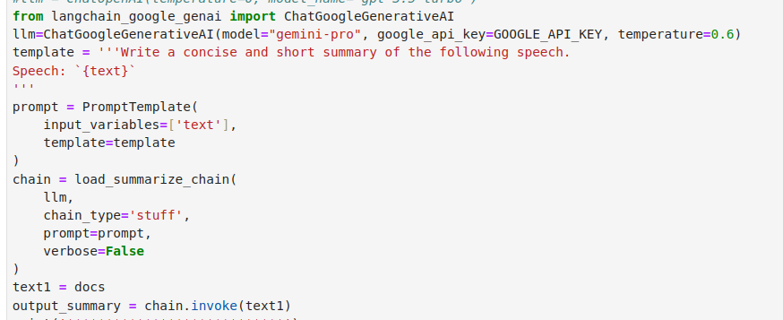
10.04 Stuff Doc Chain Text Summarization
https://www.youtube.com/watch?v=o11J4oO-P28&list=PLZoTAELRMXVORE4VF7WQ_fAl0L1Gljtar&index=10
PDF Doc Chain Text Summarization (21:41-22:30/33:29)
1. promptTemplate
2. use LLMChain to summarize the document.

Slide 6
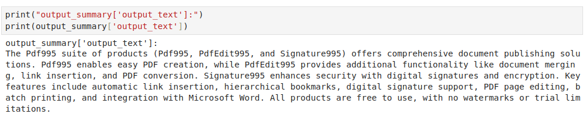
10.04 Stuff Doc Chain Text Summarization
https://www.youtube.com/watch?v=o11J4oO-P28&list=PLZoTAELRMXVORE4VF7WQ_fAl0L1Gljtar&index=10
PDF Doc Chain Text Summarization (22:31-25:00/33:29)
Summarize document.
This “Stuff Documentation Chain” is only for small document summarization. The token length is very small.
For large document, we need “Map Reduce” for text summarization.

Slide 7
End

