Slide 1

10.05 Map Reduce Text Summarization
Peter H. Chen

Slide 2
10.05 Map Reduce Text Summarization
https://www.youtube.com/watch?v=o11J4oO-P28&list=PLZoTAELRMXVORE4VF7WQ_fAl0L1Gljtar&index=10
Map Reduce Text Summarization (25:27-27:00/33:29)
The “Stuff Documentation Chain” is only for small document summarization. The token length is very small.
For large document, we need “Map Reduce” for text summarization.
1. The map reduce divide the large PDF into several chunks,
2. We give every chunks to the LLM model individually.
3. For every chunk, we get the summary. We have many summaries for many chunk.
4. LLM will take all the summaries, combine them.
5. Finally, LLM give the response.
Note:
My computer GPU is not big enough to handle big PDF.

Slide 3
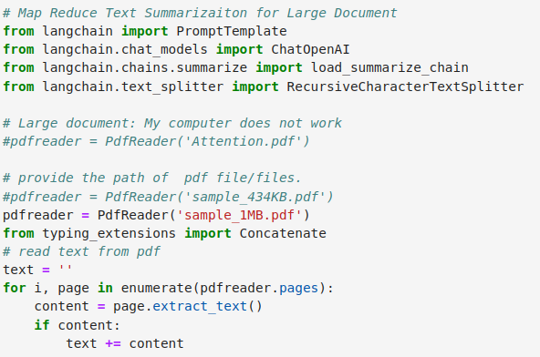
10.05 Map Reduce Text Summarization
https://www.youtube.com/watch?v=o11J4oO-P28&list=PLZoTAELRMXVORE4VF7WQ_fAl0L1Gljtar&index=10
Map Reduce Text Summarization (27:01-27:10/33:29)
We read the PDF into text.

Slide 4
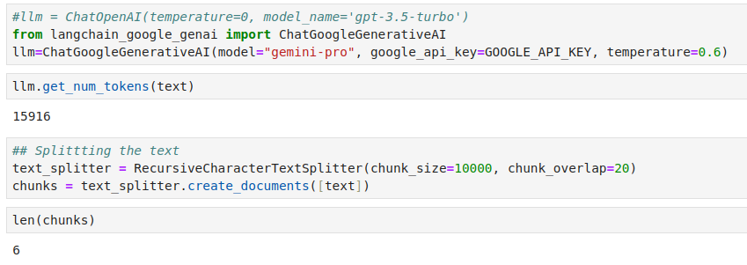
10.05 Map Reduce Text Summarization
https://www.youtube.com/watch?v=o11J4oO-P28&list=PLZoTAELRMXVORE4VF7WQ_fAl0L1Gljtar&index=10
Map Reduce Text Summarization (27:11-27:20/33:29)
1. We get the LLM Model
2. We split text into chunks.
3. We can see there is 6 chunks in the documents.

Slide 5
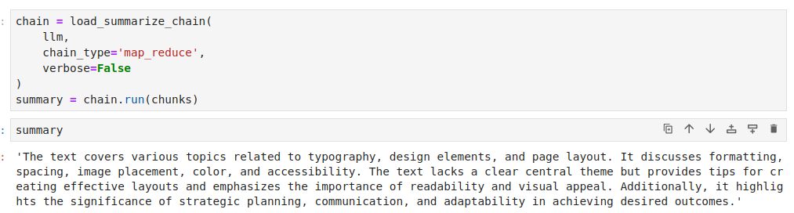
10.05 Map Reduce Text Summarization
https://www.youtube.com/watch?v=o11J4oO-P28&list=PLZoTAELRMXVORE4VF7WQ_fAl0L1Gljtar&index=10
Map Reduce Text Summarization (27:11-29:20/33:29)
1. Finally, we combine the chunks of result.
2. Text Summary results with Map Reduce.

Slide 6
End

