Slide 1

10.07 Refine Chain for Text Summarization
Peter H. Chen

Slide 2
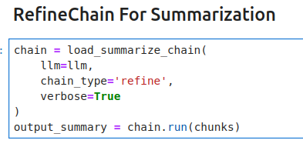
10.07 Refine Chain for Text Summarization
https://www.youtube.com/watch?v=o11J4oO-P28&list=PLZoTAELRMXVORE4VF7WQ_fAl0L1Gljtar&index=10
Refine Chain Text Summarization (31:31-32:30/33:29)
In the Refine Chain, we only change “map_reduce” to “refine”.
In refine, we give the document.
1. It return the summary from LLM of first chunk.
2. In the second chunk, we combine summary of chunk 1 and chunk 2 into one chunk and give to LLM model, and we get the summary.
3. In third chunk, we combine summary (output of chunk 1 and chunk 2) and chunk 3 into one and give to LLM Model.
4. Similarly, for all of the rest.
5. Then, finally, we get the summary of huge document.
Note: My computer RTX3050 with VRAM Size 8GB is too small to process “Attention.pdf”

Slide 3
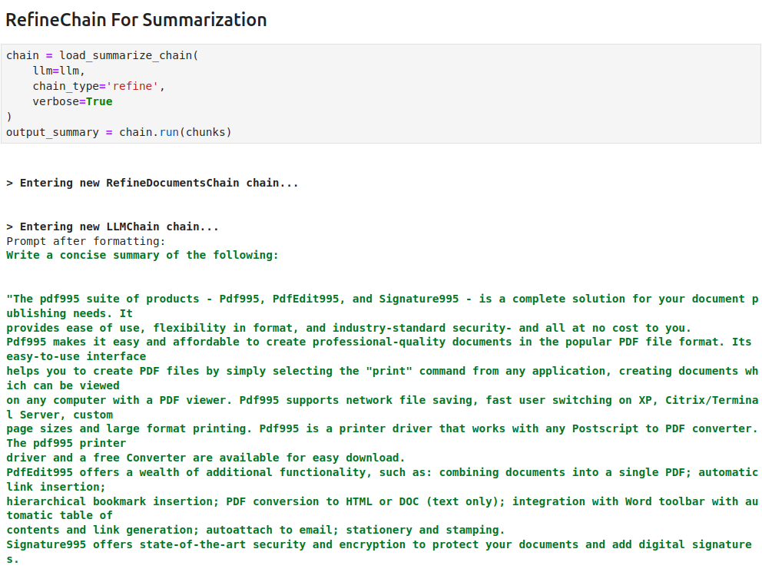
10.07 Refine Chain for Text Summarization
https://www.youtube.com/watch?v=o11J4oO-P28&list=PLZoTAELRMXVORE4VF7WQ_fAl0L1Gljtar&index=10
Refine Chain Text Summarization (31:31-32:30/33:29)
Result Summary of refine Chain

Slide 4
End

