Slide 1

16.02 Create Environment
Peter H. Chen

Slide 2
16.02 Create Environment
https://www.youtube.com/watch?v=VZOnp2YpY8Q&list=PLZoTAELRMXVNbDmGZlcgCA3a8mRQp5axb&index=10
Create Environment (02:30-03:20/18:07)
> conda create --name gemini # python==3.10 -y
(base) > conda activate gemini
(gemini) >

Slide 3
16.03 Install Requirements

Slide 4

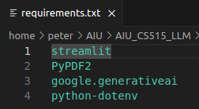
16.03 Install Requirements
https://www.youtube.com/watch?v=VZOnp2YpY8Q&list=PLZoTAELRMXVNbDmGZlcgCA3a8mRQp5axb&index=10
Install Requirements (03:21-02:30/18:07)
We change the “pdf2image” into “PyPDF2”
We can read the text directly from PDF into text instead of converting pdf into byte image and then convert into text.

Slide 5
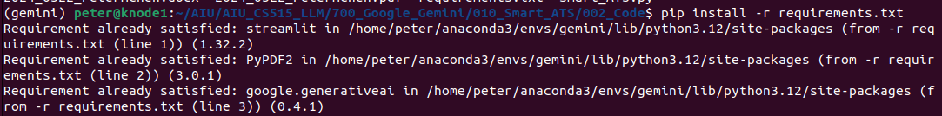
16.03 Install Requirements
https://www.youtube.com/watch?v=VZOnp2YpY8Q&list=PLZoTAELRMXVNbDmGZlcgCA3a8mRQp5axb&index=10
Install Requirements (02:31-04:20/18:07)
Install the requirements.
> pip install -r requirements.txt

Slide 6
16.04 Generate API Key

Slide 7
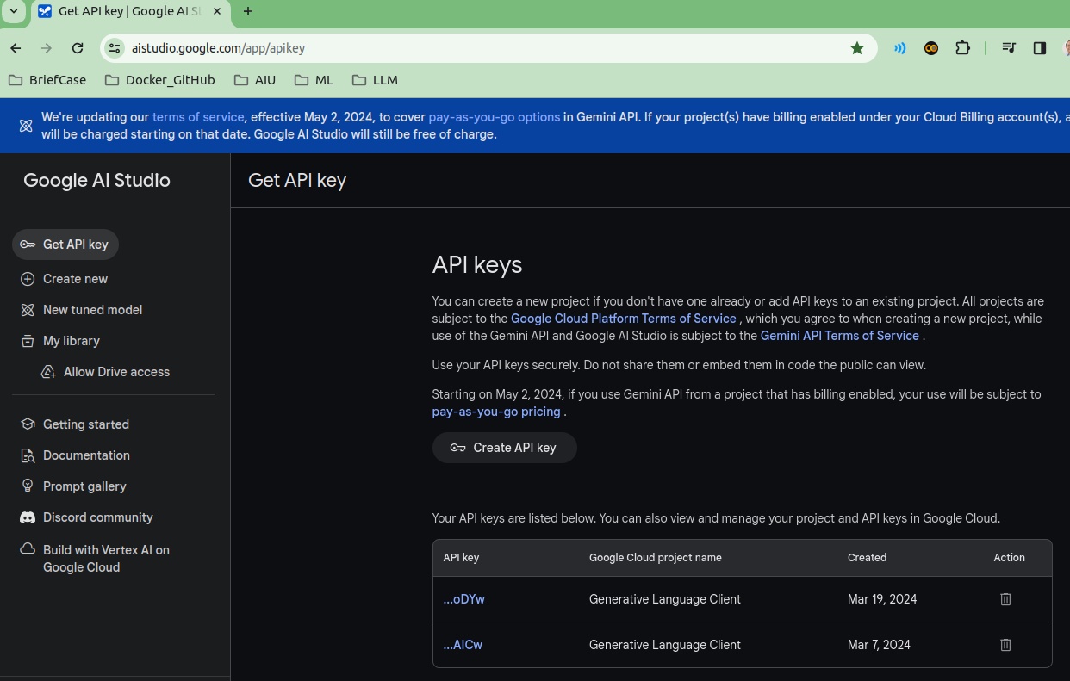
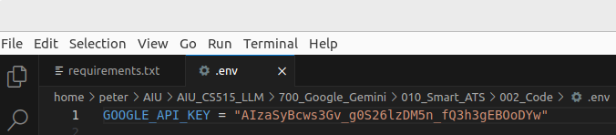
16.04 Generate API Key
https://www.youtube.com/watch?v=VZOnp2YpY8Q&list=PLZoTAELRMXVNbDmGZlcgCA3a8mRQp5axb&index=10
Generate API Key (03:01-03:30/18:07)
1. Generate API Key and
2. Copy and paste API Key into the “env” file.
https://aistudio.google.com/app/apikey
2
21\

Slide 8
End

