Slide 1

14.12 Create Conversational Chain
Peter H. Chen

Slide 2
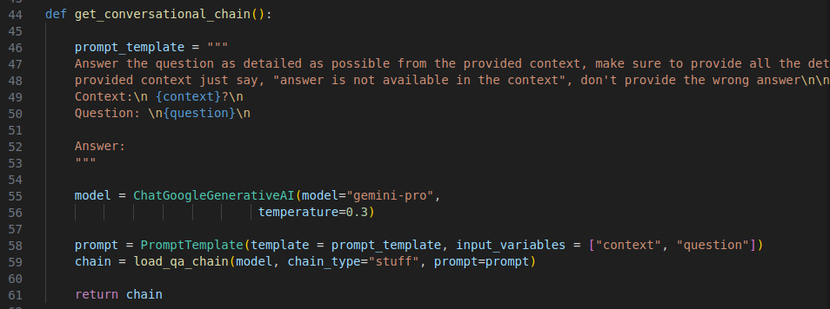
14.12 Create Conversational Chain
https://www.youtube.com/watch?v=uus5eLz6smA&list=PLZoTAELRMXVNbDmGZlcgCA3a8mRQp5axb&index=6
Create Conversational Chain (19:51-23:00/29:20)
We define conversational chain.
1. Prompt: Prompt the user with {context}, {question}, and answer.
2. Create model Gemini-pro
3. What is PromptTemplate () do?
Answer:
PromptTemplate to create a template for a string prompt (in Python string Format).
4. load_qa_chain() do?
Answer: load_qa_chain n() returns a chain that takes a list of documents and a question as input.
5. return chain

Slide 3
14.13 Find Answer for User Input

Slide 4
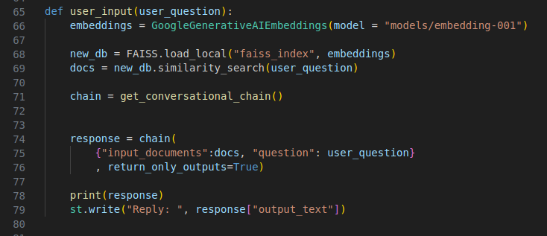
14.13 Find Answer for User Input
https://www.youtube.com/watch?v=uus5eLz6smA&list=PLZoTAELRMXVNbDmGZlcgCA3a8mRQp5axb&index=6
Find Answer for User Input (23:01-25:00/29:20)
Find answer for user input:
1. Get Gemini embedding model
2. Load PDF embedding model (faiss_index)
3. Base on user input, find answer from by similarity search in the PDF embedding model.
4. Get conversational chain in prompt format.
5. Get response from conversational chain
14. Display the response.

Slide 5
14.14 Main(): User Input

Slide 6
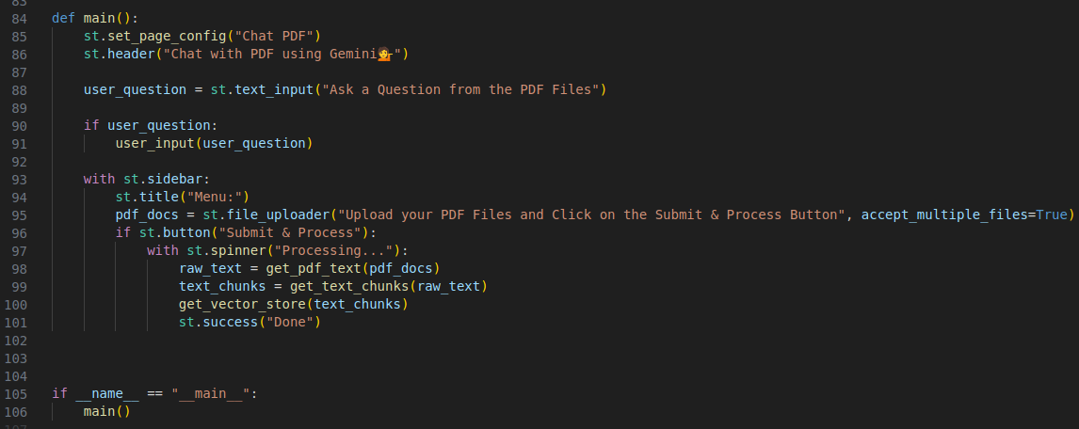
14.14 Main(): User Input
https://www.youtube.com/watch?v=uus5eLz6smA&list=PLZoTAELRMXVNbDmGZlcgCA3a8mRQp5axb&index=6
Main(): User Input (25:01-25:30/29:20)
1. Set Page: “Chat PDF”)
2. set header: “Chat with PDF using Gemini”
3. Get user input question
4. Convert user input into prompt chain
5. Side Bar Creation and Processing:

Slide 7
14.15 Main(): Side Bar

Slide 8
14.15 Main(): Side Bar
https://www.youtube.com/watch?v=uus5eLz6smA&list=PLZoTAELRMXVNbDmGZlcgCA3a8mRQp5axb&index=6
Main(): Side Bar (25:31-26:45/29:20)
Side Bar:
1. Set side bar title: “Menu”
2. file upload
3. Create button “Submit & Process”
4. Get PDF into text
5. Text into Chunk
14. Convert Text into number Embedding (one-hot encoding vector database) and store in “faiss_index) folder.

Slide 9
14.16 Main Program

Slide 10
14.16 Main Program
https://www.youtube.com/watch?v=uus5eLz6smA&list=PLZoTAELRMXVNbDmGZlcgCA3a8mRQp5axb&index=6
Main Program (26:46-26:50/29:20)
Call main()

Slide 11
End

