Slide 1

14.17 Test PDF to Gemini
Peter H. Chen

Slide 2
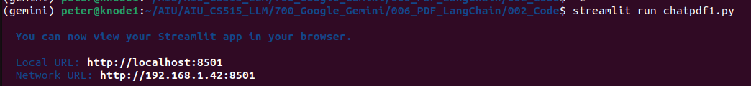
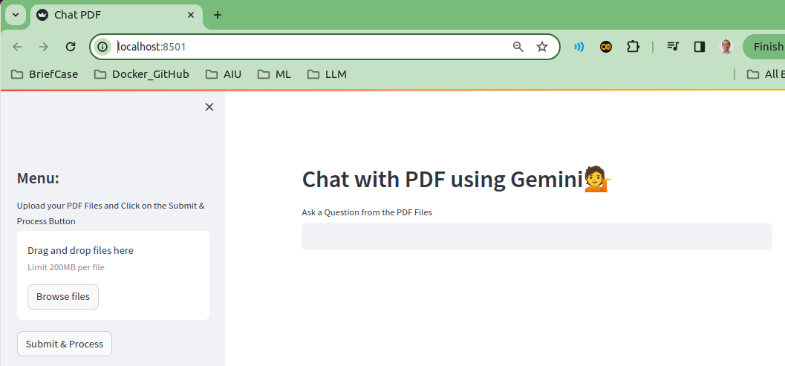
14.17 Test PDF to Gemini
https://www.youtube.com/watch?v=uus5eLz6smA&list=PLZoTAELRMXVNbDmGZlcgCA3a8mRQp5axb&index=6
Test PDF to Gemini (27:01-27:20/29:20)
> streamlit run chatpdf1.py

Slide 3
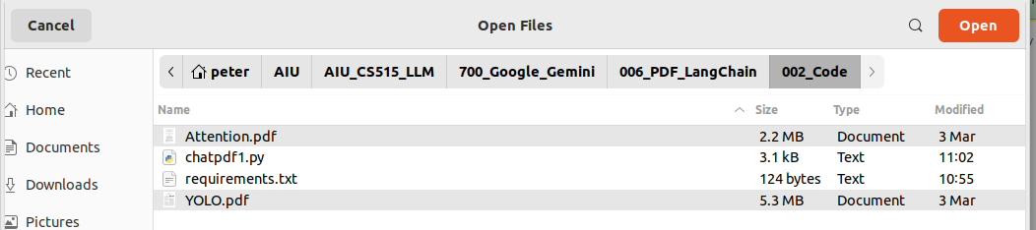
14.17 Test PDF to Gemini
)x=6
Test PDF to Gemini (27:21-27:30/29:20)
Click “Browse files” button to upload “Attention.pdf” (2.2 MB) and “YOLO.pdf” (5.3MB).
These two files are too big for my computer with 5 GB VRAM to handle. It will generate the unknown error message. The colab with bigger VRAM can do the job.

Slide 4
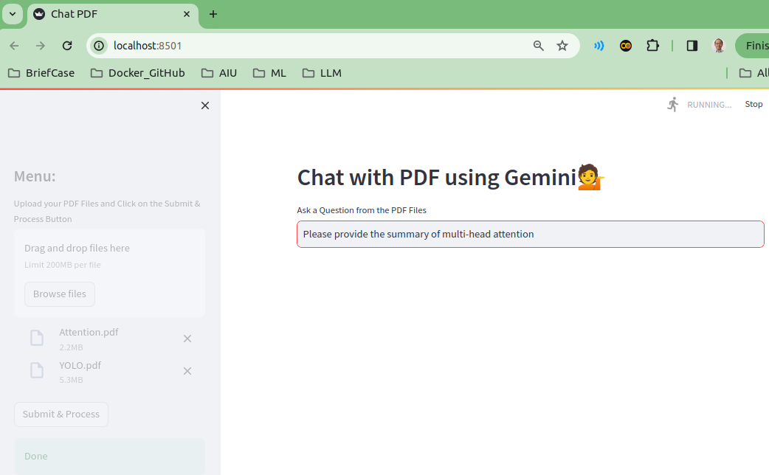
14.17 Test PDF to Gemini
https://www.youtube.com/watch?v=uus5eLz6smA&list=PLZoTAELRMXVNbDmGZlcgCA3a8mRQp5axb&index=6
Test PDF to Gemini (27:31-28:00/29:20)
Now, we open Attention.pdf and see which question (Multi-Head Attention) we are interested.
Quesiton: “Please provide the summary of multi-head attention”

Slide 5
14.18 Test Small PDF to Gemini

Slide 6
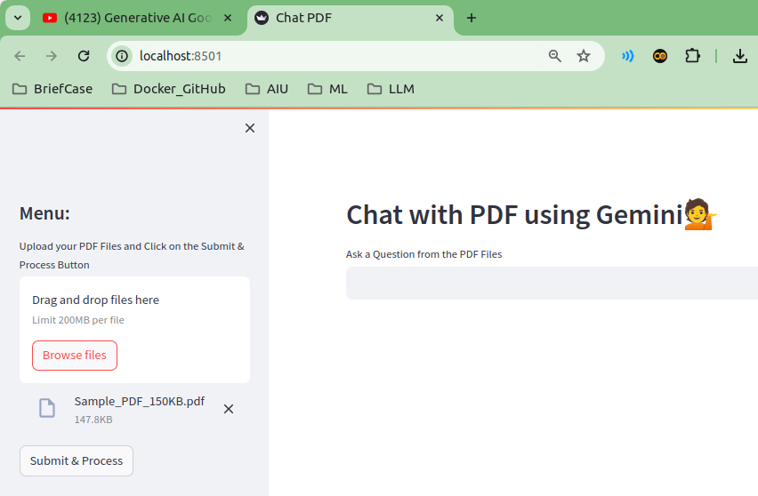
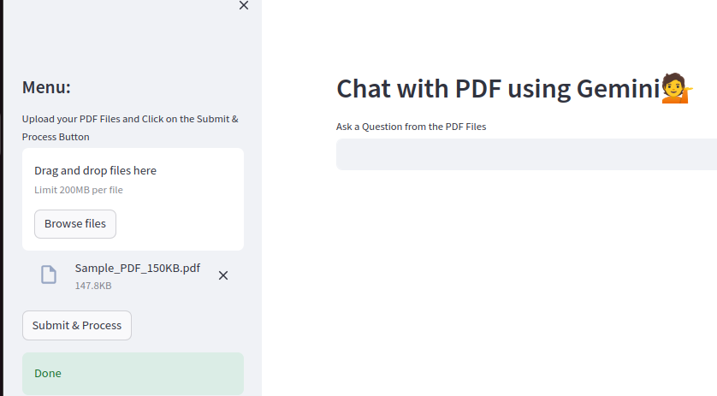
14.18 Test Small PDF to Gemini
https://www.youtube.com/watch?v=uus5eLz6smA&list=PLZoTAELRMXVNbDmGZlcgCA3a8mRQp5axb&index=6
Test Small PDF to Gemini (28:01-28:30/29:20)
I download the smaller pdf file (Sample_PDF_150KB.pdf). The title inside is “The Track”. We can ask Gemini to summarize for us.
1. Drag and Drop “Sample_PDF_150KB.pdf”.
2. Click “Submit & Process”
3. “Done” is displayed
1
2
3

Slide 7
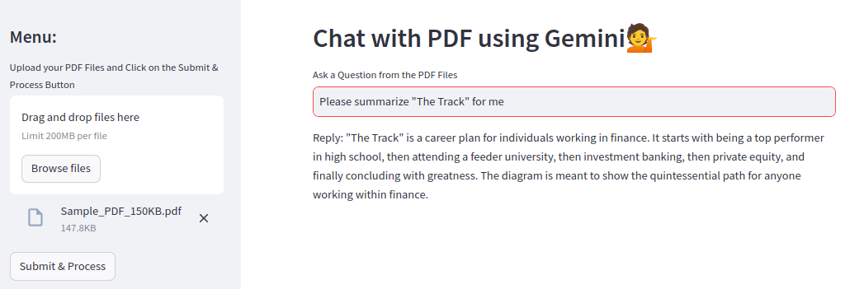
14.18 Test Small PDF to Gemini
https://www.youtube.com/watch?v=uus5eLz6smA&list=PLZoTAELRMXVNbDmGZlcgCA3a8mRQp5axb&index=6
Test Small PDF to Gemini (28:31-29:20/29:20)
Question: ‘Please Summarize “The Track” for me.
The PDF documents describes a person career plan in Finance.

Slide 8
End

