Slide 1

3.4 Text Splitter
Peter H. Chen

Slide 2

3.4 Text Splitter
https://www.youtube.com/watch?v=MoqgmWV1fm8&list=PLeo1K3hjS3uu0N_0W6giDXzZIcB07Ng_F&index=3
Text Splitter (21:31-21:40/1:14:33)
After the Text Loaders, we need to do the Text Splitting.
We recursively split the text into token.

Slide 3
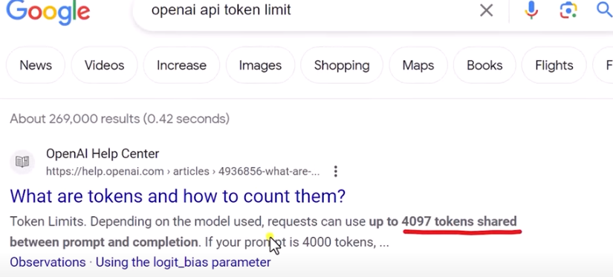
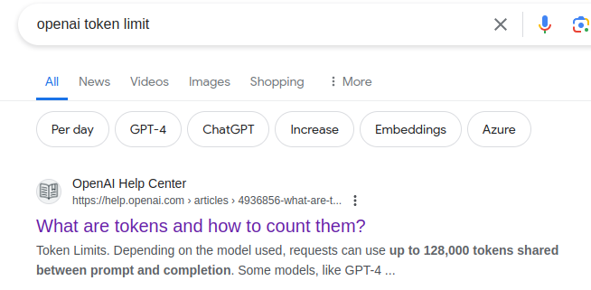
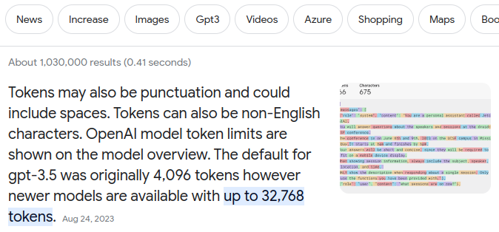
3.4 Text Splitter
https://www.youtube.com/watch?v=MoqgmWV1fm8&list=PLeo1K3hjS3uu0N_0W6giDXzZIcB07Ng_F&index=3
Text Splitter (21:41-21:50/1:14:33)
OpenAI GPT-3.5 LLM token limit 4097.
OpenAI GPT-4.0 LLM token limit 32,768. Maximum is 128,000 tokens.
https://help.openai.com/en/articles/4936856-what-are-tokens-and-how-to-count-them

Slide 4
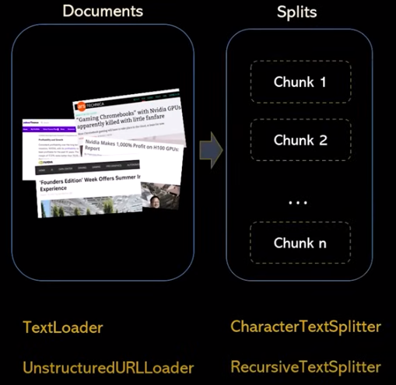
3.4 Text Splitter
https://www.youtube.com/watch?v=MoqgmWV1fm8&list=PLeo1K3hjS3uu0N_0W6giDXzZIcB07Ng_F&index=3
Text Splitter (21:51-22:00/1:14:33)
Why do we need to the Text Splitting?
1. When you want to deal with long pieces of text, it is necessary to split up that text into chunks.
2. Because LLM has limit of 4097, 32768, etc. The chunks used in LangChain may not be very big.

Slide 5
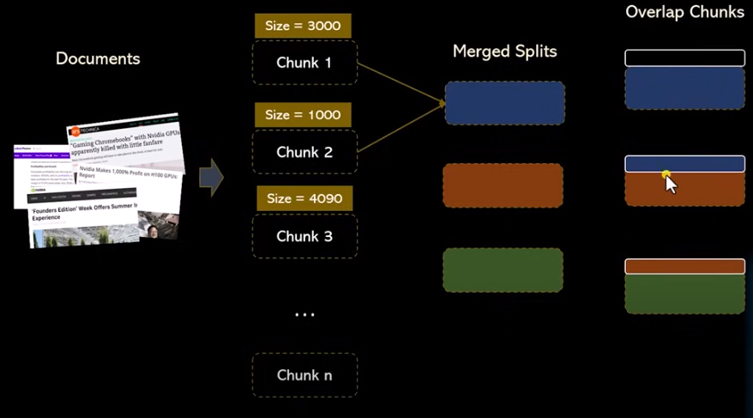
3.4 Text Splitter
https://www.youtube.com/watch?v=MoqgmWV1fm8&list=PLeo1K3hjS3uu0N_0W6giDXzZIcB07Ng_F&index=3
Text Splitter (22:11-23:20/1:14:33)
Why do we split into smaller chunk and then merge into bigger chunk?
Because too many small chunks take to many steps of LLM to process, we need to perform the merge to as close as to maximumum limit (e.g., 4097). In the below example,
1. The text is split into three groups of token (3000, 1000, and 4000). All group of tokens are smaller than maximum limit, e.g., 4097. Three groups of tokens need to request LLM three times.
2. We merge 3000 and 1000 into 4000 token. After merge, we have two groups of tokens (4000 and 4000). Three groups of token request LLM two times.
3. We have the overlap chunks in the merged tokens. We need to remove the overlap tokens.
1
1
2
3

Slide 6
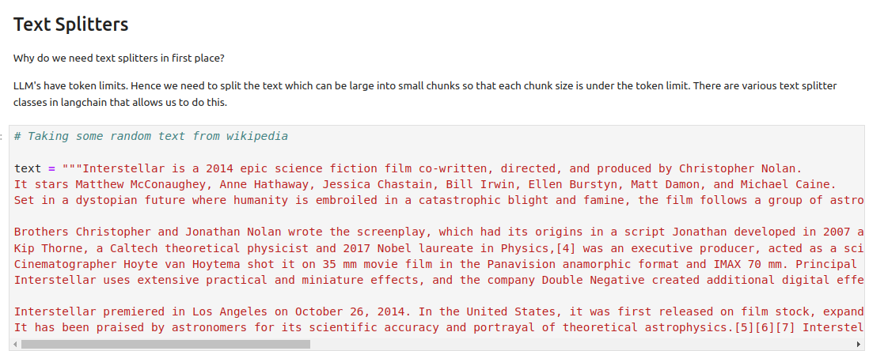
3.4 Text Splitter
https://www.youtube.com/watch?v=MoqgmWV1fm8&list=PLeo1K3hjS3uu0N_0W6giDXzZIcB07Ng_F&index=3
Text Splitter (23:21-23:50/1:14:33)
For example, we have texts taken from wikipedia.
Text Splitter can help us to split the text into token into chunks in the token limit.

Slide 7
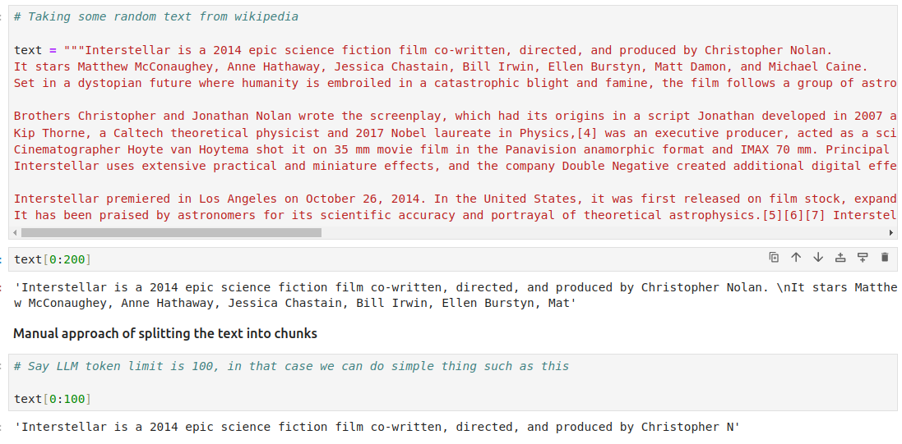
3.4 Text Splitter
https://www.youtube.com/watch?v=MoqgmWV1fm8&list=PLeo1K3hjS3uu0N_0W6giDXzZIcB07Ng_F&index=3
Text Splitter (23:51-24:00/1:14:33)
1. If we take text[0:200], the word “Matt Damon” are cut into “Mat”. LLM does not know who is “Mat” and will give us the wrong response.
2. If we take text[0:100], the “Christopher Nolan” is cut into “Christopher N”. LLM cannot understand “Christopher N” and give us the wrong answer.

Slide 8
3.4.1 Manual Split

Slide 9
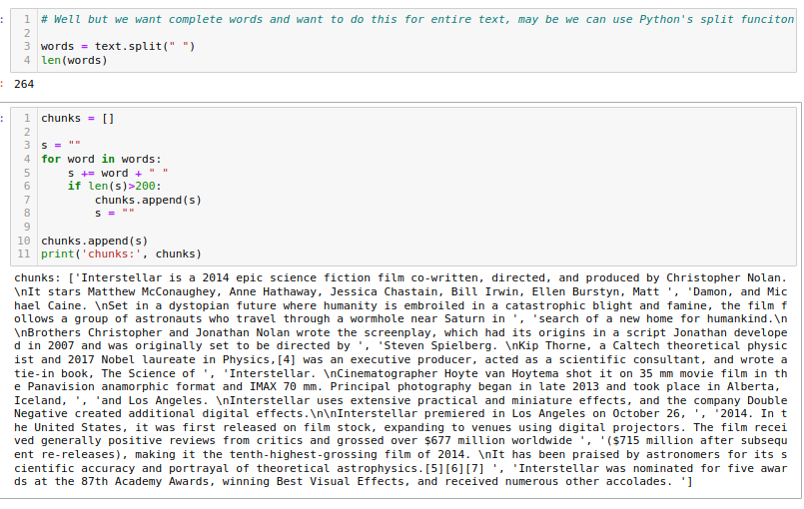
3.4.1 Manual Split
https://www.youtube.com/watch?v=MoqgmWV1fm8&list=PLeo1K3hjS3uu0N_0W6giDXzZIcB07Ng_F&index=3
Manual Split (24:01-25:00/1:14:33)
We split the text into words by “ “.
Then, we put words into into list chunk.
We keep add the string s, if string s is bigger than 200, then we append string into a new chunk.

Slide 10
3.4.2 Char Text Splitter

Slide 11
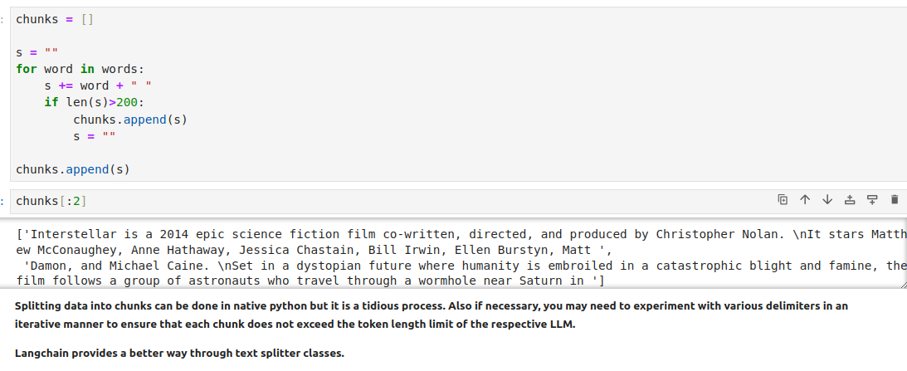
3.4.2 Char Text Splitter
https://www.youtube.com/watch?v=MoqgmWV1fm8&list=PLeo1K3hjS3uu0N_0W6giDXzZIcB07Ng_F&index=3
Char Text Splitter (25:01-25:10/1:14:33)
The sentences are too long.
We use text splitter to split with chunk size = 200.
All of the texts are less than 200.

Slide 12
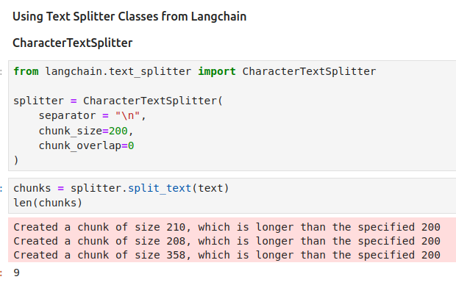
3.4.2 Character Text Splitter
https://www.youtube.com/watch?v=MoqgmWV1fm8&list=PLeo1K3hjS3uu0N_0W6giDXzZIcB07Ng_F&index=3
Character Text Splitter (25:11-25:30/1:14:33)
Use Text Splitter classes from LangChain to do the Character Text Split.

Slide 13
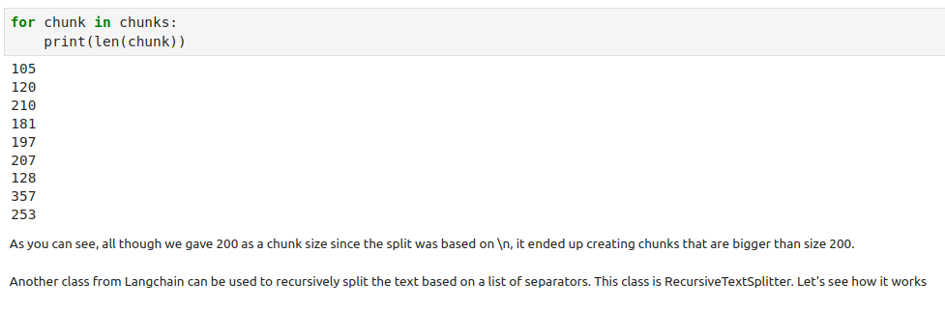
3.4.2 Character Text Splitter
https://www.youtube.com/watch?v=MoqgmWV1fm8&list=PLeo1K3hjS3uu0N_0W6giDXzZIcB07Ng_F&index=3
Character Text Splitter (25:31-30:00/1:14:33)
Use Text Splitter classes from LangChain to do the Character Text Split.

Slide 14
3.4.3 Recursive Text Splitter

Slide 15
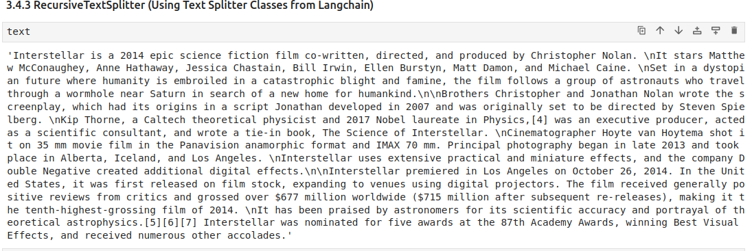
3.4.3 Recursive Text Splitter
https://www.youtube.com/watch?v=MoqgmWV1fm8&list=PLeo1K3hjS3uu0N_0W6giDXzZIcB07Ng_F&index=3
Recursive Text Splitter (30:01-31:30/1:14:33)
We will use recursive text splitter from LangChain.

Slide 16
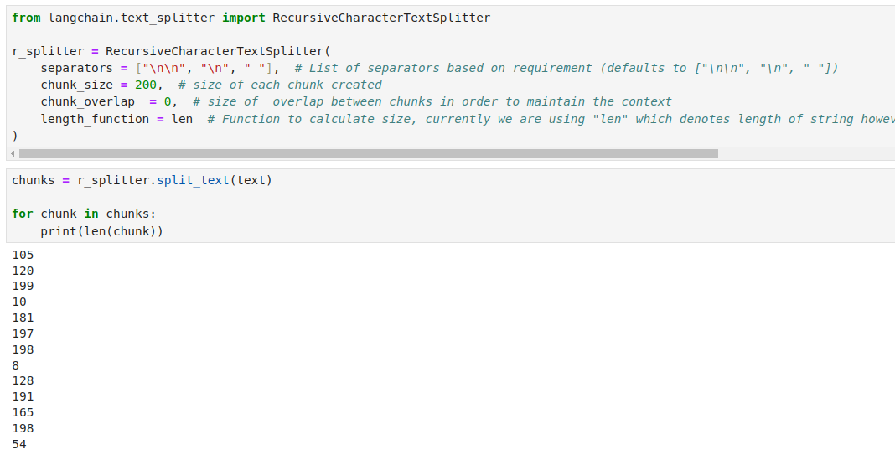
3.4.3 Recursive Text Splitter
https://www.youtube.com/watch?v=MoqgmWV1fm8&list=PLeo1K3hjS3uu0N_0W6giDXzZIcB07Ng_F&index=3
Recursive Text Splitter (31:31-32:30/1:14:33)
Recursively Text Splitter with “\n\n” and “\n”.

Slide 17
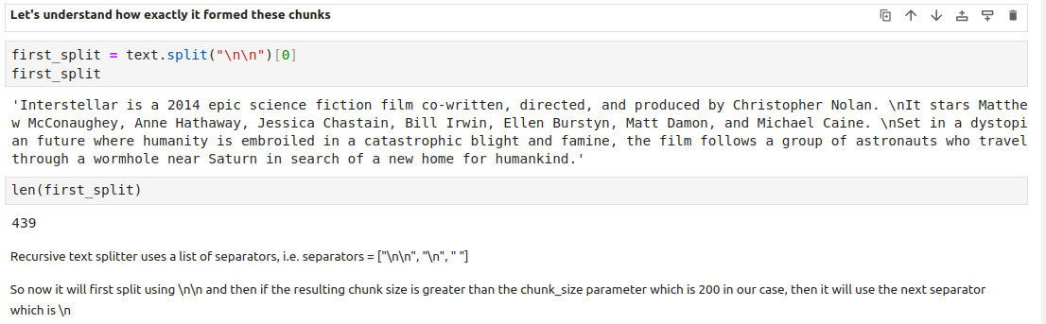
3.4.3 Recursive Text Splitter
https://www.youtube.com/watch?v=MoqgmWV1fm8&list=PLeo1K3hjS3uu0N_0W6giDXzZIcB07Ng_F&index=3
Recursive Text Splitter (32:31-33:00/1:14:33)
We can try to understand how “\n\n”. then “\n”, and “ ” work.
We can do:
1. Split with with “\n\n”.
2. Split with “\n”.
3. Split with “ “

Slide 18
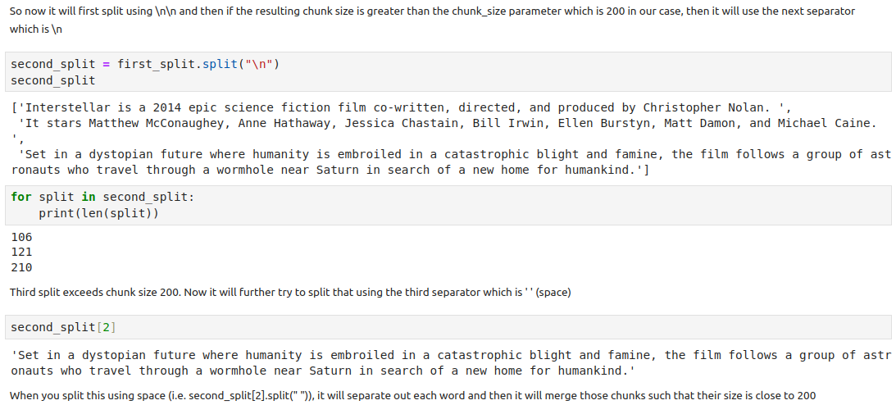
3.4.3 Recursive Text Splitter
https://www.youtube.com/watch?v=MoqgmWV1fm8&list=PLeo1K3hjS3uu0N_0W6giDXzZIcB07Ng_F&index=3
Recursive Text Splitter (33:01-33:20/1:14:33)
Recursively Text Splitter with “\n”.
Then, we can do text splitter with “ “ if we need.

Slide 19
End

