Slide 1

6.02 FAISS
Peter H. Chen

Slide 2
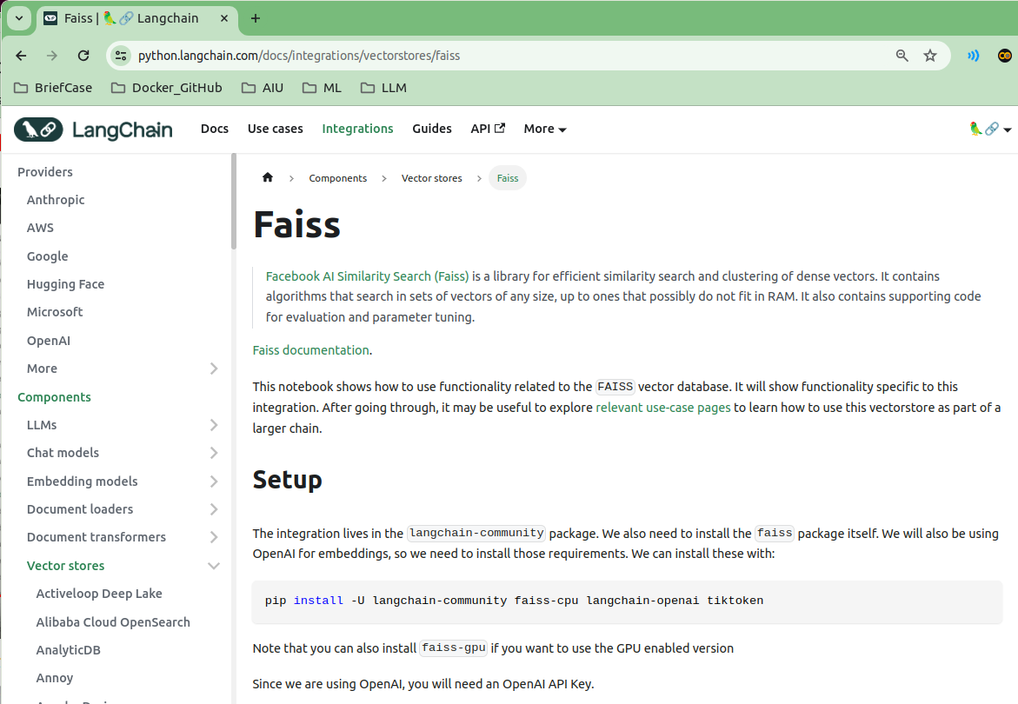
6.02 FAISS
https://www.youtube.com/watch?v=uus5eLz6smA&list=PLZoTAELRMXVNbDmGZlcgCA3a8mRQp5axb&index=6
FAISS (04:21-04:50/29:20)
We are going to to FAISS (Facebook AI Similarity Search). FAISS is the most popular library for Embedding Vector Database. FAISS also can be used in ChromaDB.
https://python.langchain.com/docs/integrations/vectorstores/faiss

Slide 3
6.03 Conda Environment

Slide 4
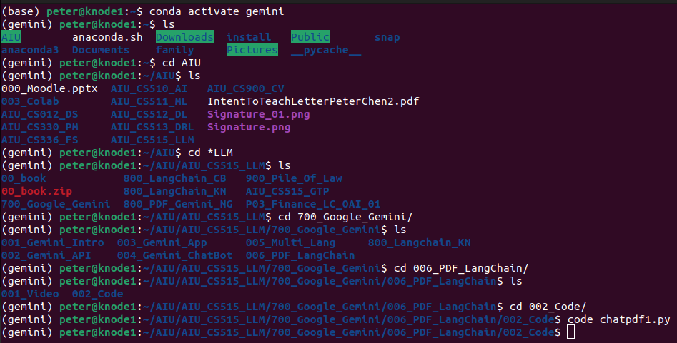
6.03 Conda Environment
https://www.youtube.com/watch?v=uus5eLz6smA&list=PLZoTAELRMXVNbDmGZlcgCA3a8mRQp5axb&index=6
Conda Environment (05:01-05:30/29:20)
Gemini framework work well with Python 3.9+.
> conda create -p venv python==3.9 # or python ==3.10
> conda activate venv
We already created below before:s
> conda create --name gemini
> conda activate gemini

Slide 5
6.04 Google API Key

Slide 6

6.04 Google API Key
https://www.youtube.com/watch?v=uus5eLz6smA&list=PLZoTAELRMXVNbDmGZlcgCA3a8mRQp5axb&index=6
Google API Key (05:01-05:30/29:20)
Here, we will develop application and see how to create the vector embedding and store in your local database or any database server.
Below is my GOOGLE_API_KEY. You should already created your GOOGLE_API_KEY for your project.

Slide 7
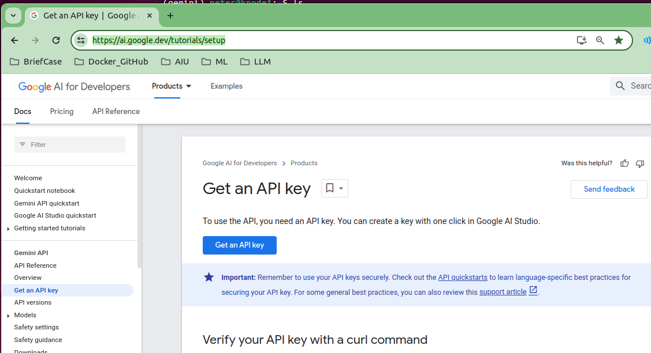
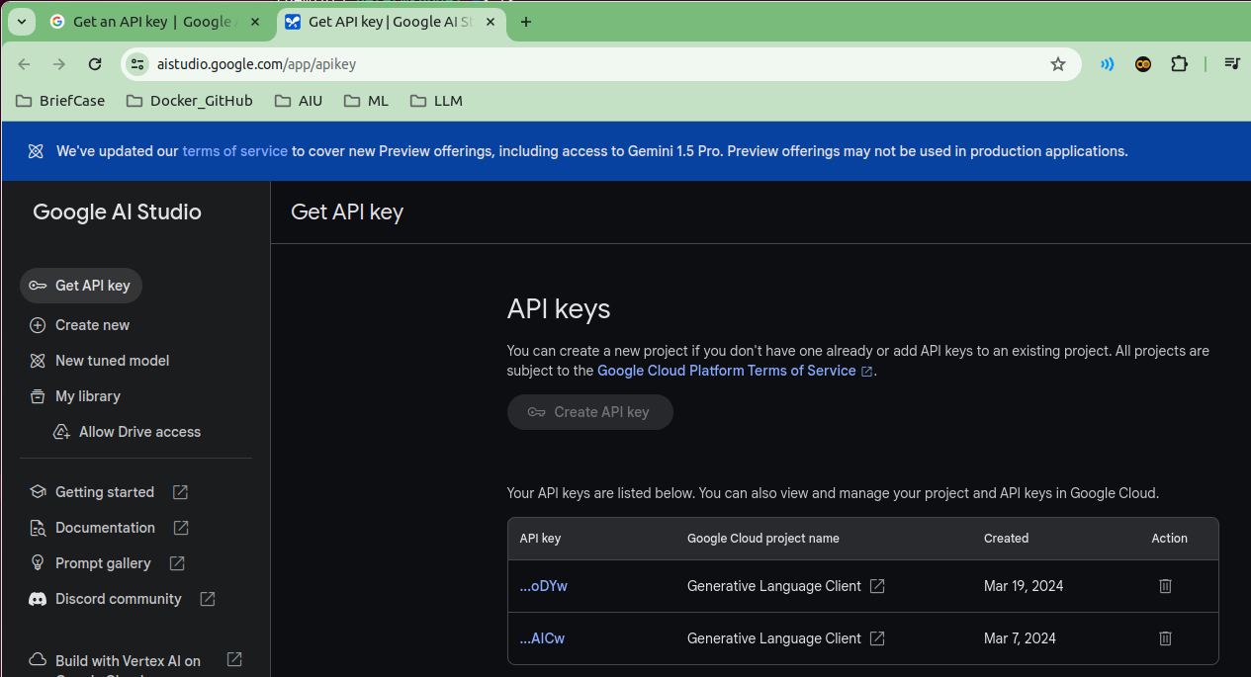
6.04 Google API Key
https://www.youtube.com/watch?v=uus5eLz6smA&list=PLZoTAELRMXVNbDmGZlcgCA3a8mRQp5axb&index=6
Google API Key (05:31-07:00/29:20)
If you do not have GOOGLE_API_KEY.
Below is the link show you how to create Google API Key.
https://ai.google.dev/tutorials/setup
I already created two Google API Key for two projects.

Slide 8
6.05 Libraries

Slide 9
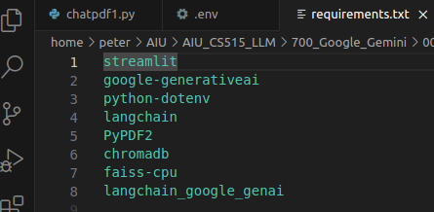
6.05 Libraries
https://www.youtube.com/watch?v=uus5eLz6smA&list=PLZoTAELRMXVNbDmGZlcgCA3a8mRQp5axb&index=6
Libraries (07:01-00:00/29:20)
What the libraries are required?
1. streamlit: GUI
2. google-generativeai: Google Gemini model
3. python-dotenv: Python load environment variables from .env
4. langchain: lang chain framework
5. PyPDF2: Python read PDF files
6. chromaDB: Database server
7. faiss-cpu: Facebook AI Similarity Search for Vector Embedding
8. langchain_google_genai: package for langchain google gemini model.

Slide 10
6.06 Install Requirements.txt

Slide 11
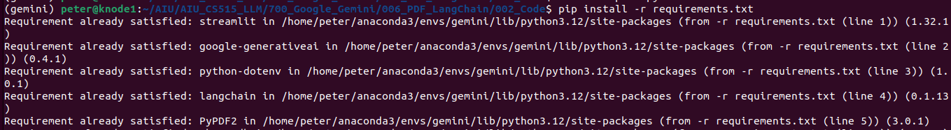
6.06 Install requirements.txt
https://www.youtube.com/watch?v=uus5eLz6smA&list=PLZoTAELRMXVNbDmGZlcgCA3a8mRQp5axb&index=6
Install requirements.txt (09:01-09:30/29:20)
> code requirements.txt
Install requirements.txt
> pip install -r requirements.txt

Slide 12
6.07 Import Library

Slide 13
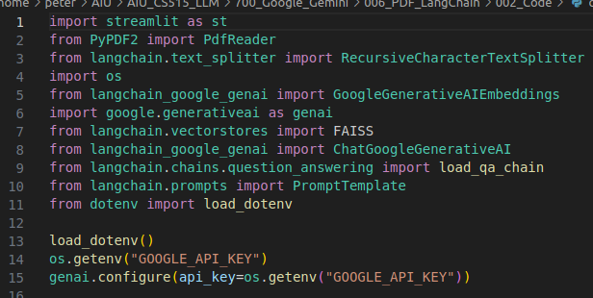
6.07 Import Library
https://www.youtube.com/watch?v=uus5eLz6smA&list=PLZoTAELRMXVNbDmGZlcgCA3a8mRQp5axb&index=6
Import Library (09:31-12:30/29:20)
We import all the below libraries.
1. Streamlit: GUI
2. PyPDF2: PDF reader
3. langchain: text splitter.
4. os: system call.
5. GoogleGenerativeAIEmbeddings: LangChain Embedding for Gemini Model.
6. Googlegenerativeai: Gemini Model
6. FAISS: Translate Words into Vector Database
7. ChatGoogleGenartiveAI: Langchain Chat for Generative AI
8. load_qa_chain: LangChain Question Answer Chain.
9. PromptTemplate: LangChain Prompt
10. load_dotenv: Load “.env”

Slide 14
6.08 Load Environment

Slide 15

6.08 Load Environment
https://www.youtube.com/watch?v=uus5eLz6smA&list=PLZoTAELRMXVNbDmGZlcgCA3a8mRQp5axb&index=6
Load Environment (12:31-13:00/29:20)
1. Load all the defined environment variables, such as, Google API Key.
2. Get Google API Key.
3. Configure generative AI with Google API Key.

Slide 16
6.09 PDF to Text

Slide 17
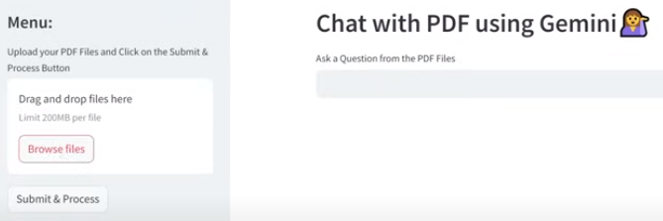
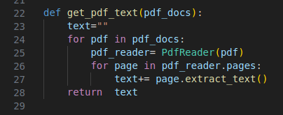
6.09 PDF to Text
https://www.youtube.com/watch?v=uus5eLz6smA&list=PLZoTAELRMXVNbDmGZlcgCA3a8mRQp5axb&index=6
PDF to Text (13:01-15:30/29:20)
In the left side of pane, we create the PDF to Text.
1. Input the pdf documents.
2. PDF reader read the pdf line by line.
3. for each PDF page, we extract the text.
4. Append the text to each page
5. Return text

Slide 18
6.10 Text to Chunk

Slide 19

6.10 Text to Chunk
https://www.youtube.com/watch?v=uus5eLz6smA&list=PLZoTAELRMXVNbDmGZlcgCA3a8mRQp5axb&index=6
Text to Chunk (15:31-17:00/29:20)
What is RecursiveCharacterTextSplitter (text) ?
Answer:
1. Takes a large text and splits it based on a specified chunk size.
2. Imagine a news article with a long, complex paragraph. A recursive character splitter might slice it into more manageable chunks based on thematic shifts, ensuring the retrieved information remains focused.
get_text_chunks (text):
1. input text
2. split the text into chunks. Each chunks contains chunk size = 10000 tokens and overlap = 1000 tokens.
3. return chunk

Slide 20
6.11 Text Chunk into Vector Database

Slide 21

6.11 Text Chunk into Vector Database
https://www.youtube.com/watch?v=uus5eLz6smA&list=PLZoTAELRMXVNbDmGZlcgCA3a8mRQp5axb&index=6
Text Chunk into Vector Database (17:01-19:50/29:20)
We convert the Text Chunks into Embedding (Vector Database)
1. What is GoogleGenerativeAIEmbeddings(model) do?
Answer:
Computer only understand number for operations. Text embeddings converts textual data into numerical vectors (one-hot encoding for set operations).
Here, we use model “embedding-001”.
2. What is FAISS.from_texts (text_chunks. embeddings)
Answer:
The FAISS.from_texts (texts, embeddings) method creates a FAISS vector Database (embeddings) from a list of documents (texts).
3. Save the FAISS Vector Database in local drive. The folder name is “faiss_index”.

Slide 22
End

