Slide 1

12.01 Create Environment
Peter H. Chen

Slide 2
12.01 Create Environment
https://www.youtube.com/watch?v=HFfXvfFe9F8&list=PLZoTAELRMXVNbDmGZlcgCA3a8mRQp5axb&index=12
Create Environment (01:21-01:30/26:14)
1. Conda create environment
> conda create --name gemini
(base) >
2. Conda activate Environment
(base) > conda activate gemini
(gemini) >
3. Conda deactivate Environment
(gemini) conda deactivate
(base)

Slide 3
12.01 Create Environment
https://www.youtube.com/watch?v=HFfXvfFe9F8&list=PLZoTAELRMXVNbDmGZlcgCA3a8mRQp5axb&index=12
Create Environment (01:31-01:50/26:14)
1. Conda create environment
> conda create --name gemini
(base) >
2. Conda activate Environment
(base) > conda activate gemini
(gemini) >
3. Conda deactivate Environment
(gemini) conda deactivate
(base)

Slide 4
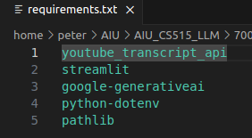
12.01 Create Environment
https://www.youtube.com/watch?v=HFfXvfFe9F8&list=PLZoTAELRMXVNbDmGZlcgCA3a8mRQp5axb&index=12
Create Environment (01:51-02:10/26:14)
Check requirements.txt
(gemini) > code requirements.txt
1. youtube_transcript_api: YouTube Transcribe
2. streamlit: GUI
3. google-generativeai: Gemini Model
4. python-dotenv: python read env variables.
5. pathlib: process path

Slide 5
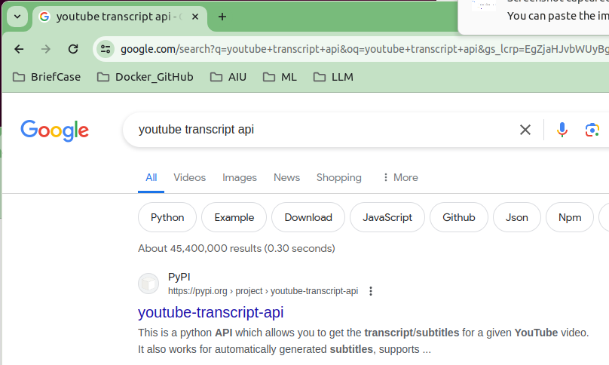
12.01 Create Environment
https://www.youtube.com/watch?v=HFfXvfFe9F8&list=PLZoTAELRMXVNbDmGZlcgCA3a8mRQp5axb&index=12
Create Environment (02:11-02:40/26:14)
Google search “YouTube Transcript API”
YouTube Transcript API extracts all the detail we need for video transcription.
1. We get the transcript/subtitles for a given YouTube video.
2. It automatically generated subtitles, supports translating subtitles
3. It does not need the browser (like selenium driver which crosses all the browser).

Slide 6
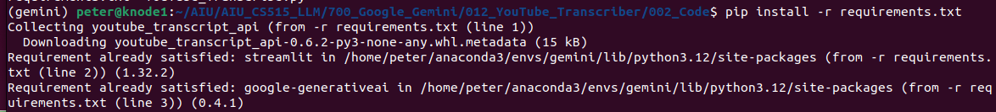
12.01 Create Environment
https://www.youtube.com/watch?v=HFfXvfFe9F8&list=PLZoTAELRMXVNbDmGZlcgCA3a8mRQp5axb&index=12
Create Environment (02:41-04:30/26:14)
Install environment
> pip install -r requirements.txt

Slide 7
12.02 API Key

Slide 8
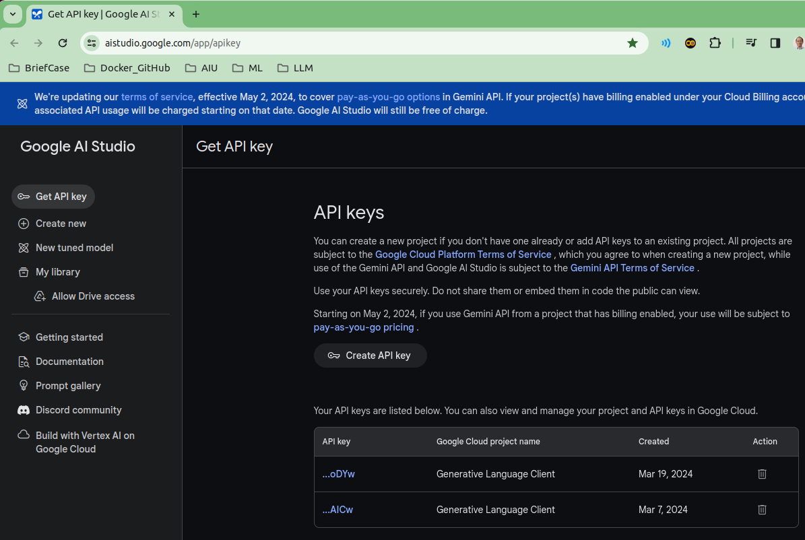
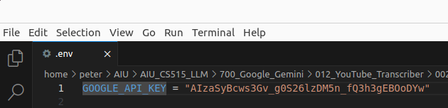
12.02 API Key
https://www.youtube.com/watch?v=HFfXvfFe9F8&list=PLZoTAELRMXVNbDmGZlcgCA3a8mRQp5axb&index=12
API Key (04:31-05:30/26:14)
1. Create the API Key
2. Store in the .env file
https://aistudio.google.com/app/apikey

Slide 9
End

