Slide 1

12.03 Load API Key
Peter H. Chen

Slide 2
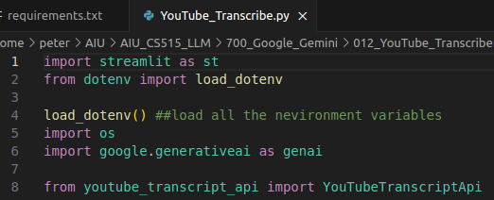
12.03 Load API Key
https://www.youtube.com/watch?v=HFfXvfFe9F8&list=PLZoTAELRMXVNbDmGZlcgCA3a8mRQp5axb&index=12
Load API Key (05:31-07:10/26:14)
1. Load API Key defined in environment variable.
2. Import library

Slide 3
12.04 Configure Gemini Model

Slide 4
12.04 Configure Gemini Model
https://www.youtube.com/watch?v=HFfXvfFe9F8&list=PLZoTAELRMXVNbDmGZlcgCA3a8mRQp5axb&index=12
Configure Gemini Model (07:11-07:50/26:14)
Configure Gemini Model with API Key.

Slide 5
12.05 Create Prompt

Slide 6
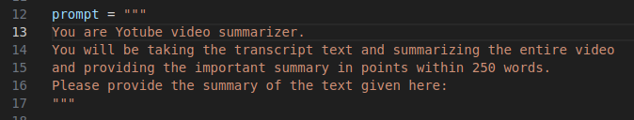
12.05 Create Prompt
https://www.youtube.com/watch?v=HFfXvfFe9F8&list=PLZoTAELRMXVNbDmGZlcgCA3a8mRQp5axb&index=12
Create Prompt (07:51-08:00/26:14)
Create Input Prompt

Slide 7
12.06 Video Transcript

Slide 8
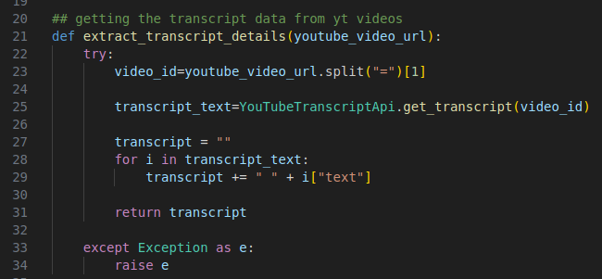
12.06 Video Transcript
https://www.youtube.com/watch?v=HFfXvfFe9F8&list=PLZoTAELRMXVNbDmGZlcgCA3a8mRQp5axb&index=12
Video Transcript (08:01-17:30/26:14)
We need to
1. Get the video ID to get the video text.
2. Append the text together.
3. return the complete text.
What is YouTube Video ID?
1. The Video Link “https://www.youtube.com/watch?v=aqz-KE-bpKQ”
2. Video ID is after “v=”
3. This video ID is “aqz-KE-bpKQ”.

Slide 9
12.07 Get Gemini Response

Slide 10
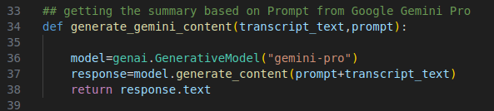
12.07 Get Gemini Response
https://www.youtube.com/watch?v=HFfXvfFe9F8&list=PLZoTAELRMXVNbDmGZlcgCA3a8mRQp5axb&index=12
Get Gemini Response (17:31-18:30/26:14)
Input transcript Text, and prompt
We prompt and transcript text together.
Get the response.

Slide 11
12.08 Streamlit GUI

Slide 12
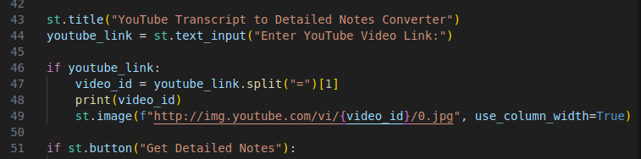
12.08 Streamlit GUI
https://www.youtube.com/watch?v=HFfXvfFe9F8&list=PLZoTAELRMXVNbDmGZlcgCA3a8mRQp5axb&index=12
Streamlit GUI (18:31-19:30/26:14)
1. Title: YouTube Transcript
2. Provide the YouTube Link.
2.1 Get YouTube ID and YouTube Video Image
2.2 Display YouTube ID and Display Video Image.
3. Create button: Get Detailed Notes.

Slide 13
12.09 Process Submission

Slide 14
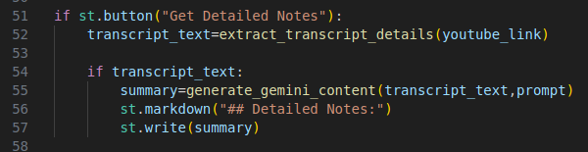
12.09 Process Submission
https://www.youtube.com/watch?v=HFfXvfFe9F8&list=PLZoTAELRMXVNbDmGZlcgCA3a8mRQp5axb&index=12
Process Submission (19:31-21:15/26:14)
1. Extract the transcript text from video.
2. Get Summary from transcript text and input prompt.
3. Display the Summary.

Slide 15
End

