Slide 1

12.10 Test YouTube Transcriber
Peter H. Chen

Slide 2
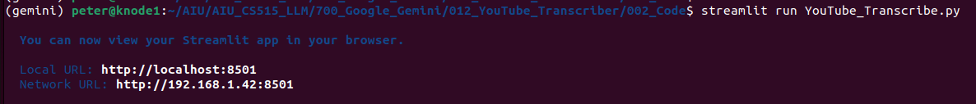
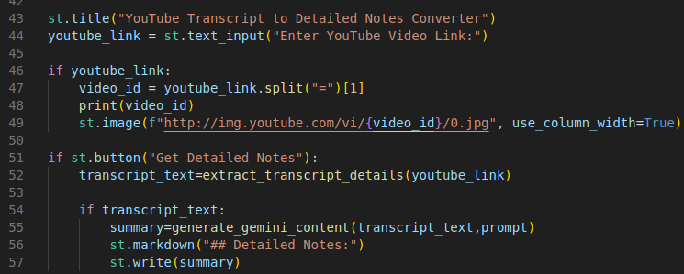
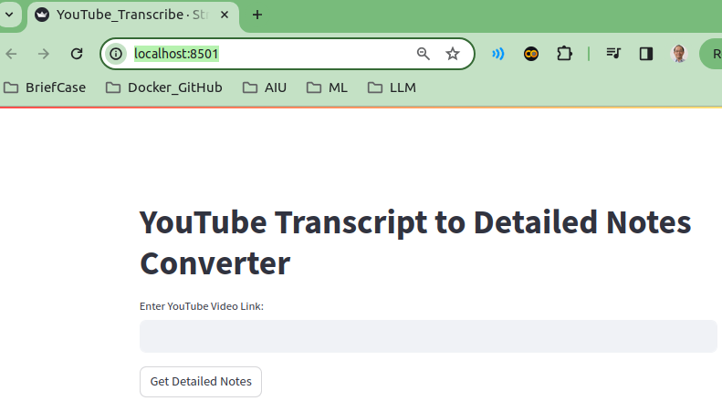
12.10 Test YouTube Transcriber
https://www.youtube.com/watch?v=HFfXvfFe9F8&list=PLZoTAELRMXVNbDmGZlcgCA3a8mRQp5axb&index=12
Test YouTube Transcriber (21:16-22:30/26:14)
>streamlit run YouTube_Transcribe.py

Slide 3
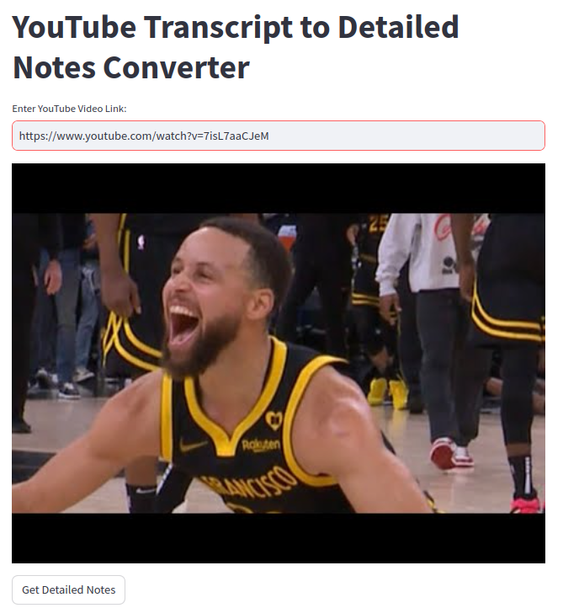
12.10 Test YouTube Transcriber
https://www.youtube.com/watch?v=HFfXvfFe9F8&list=PLZoTAELRMXVNbDmGZlcgCA3a8mRQp5axb&index=12
Test YouTube Transcriber (22:31-23:30/26:14)
Go to Youtube,com, Search for “Warrior nba Steph Curry”
Video Link: https://www.youtube.com/watch?v=7isL7aaCJeM
Display the

Slide 4
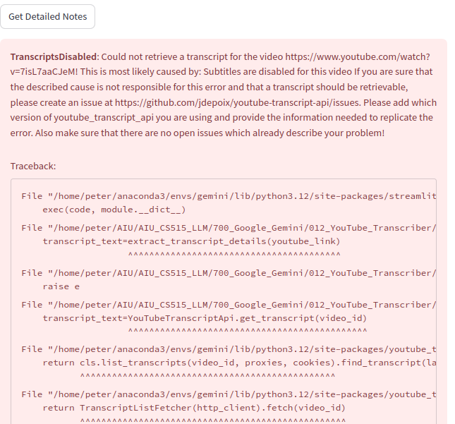
12.10 Test YouTube Transcriber
https://www.youtube.com/watch?v=HFfXvfFe9F8&list=PLZoTAELRMXVNbDmGZlcgCA3a8mRQp5axb&index=12
Test YouTube Transcriber (23:31-24:30/26:14)
Click “Get Detailed Notes”
Video does not have transcript.
Try another one.

Slide 5
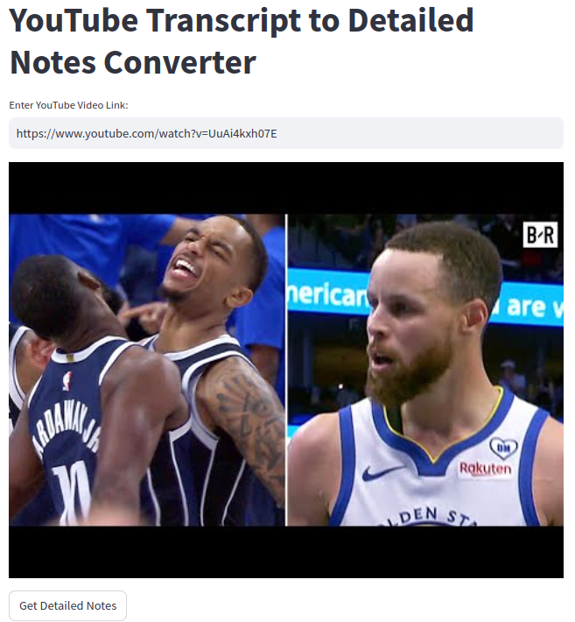
12.10 Test YouTube Transcriber
https://www.youtube.com/watch?v=HFfXvfFe9F8&list=PLZoTAELRMXVNbDmGZlcgCA3a8mRQp5axb&index=12
Test YouTube Transcriber (24:31-25:30/26:14)
Search for “warrior nba with transcript”
Video Link: https://www.youtube.com/watch?v=UuAi4kxh07E

Slide 6
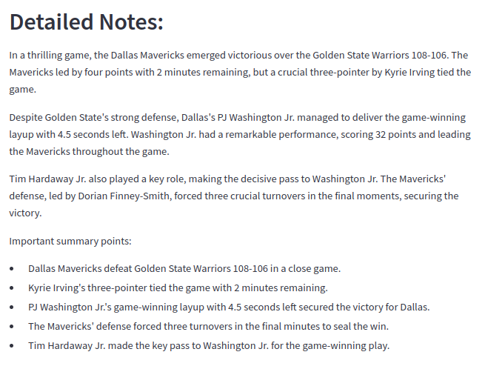
12.10 Test YouTube Transcriber
https://www.youtube.com/watch?v=HFfXvfFe9F8&list=PLZoTAELRMXVNbDmGZlcgCA3a8mRQp5axb&index=12
Test YouTube Transcriber (25:31-26:14/26:14)
Click “Detailed Note”.

Slide 7
End

