Slide 1

10.05 Import Library/Load API Key
Peter H. Chen

Slide 2
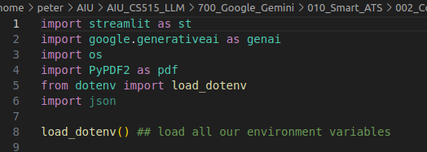
10.05 Import Library/Load API Key
https://www.youtube.com/watch?v=VZOnp2YpY8Q&list=PLZoTAELRMXVNbDmGZlcgCA3a8mRQp5axb&index=10
Import Library and Load API Key (04:21-05:20/18:07)
1. Import Library
1.1 streamlit: GUI
1.2 genai: generative AI
1.3 os: Get API Environment
1.4 PyPDF2: PDF reader
1.5 load_dotenv: Load .env environment variable
1.6 json: JSON parser
2. load_dotenv(): Load API Key

Slide 3
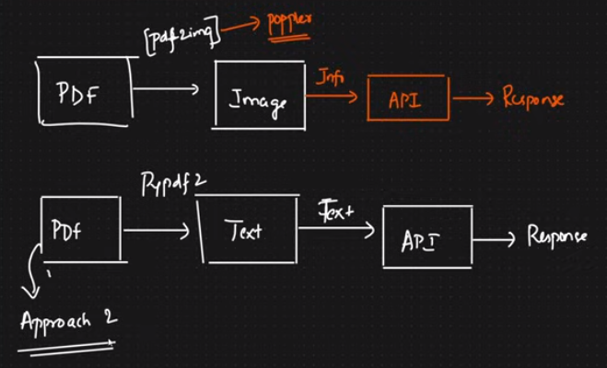
10.05 Import Library/Load API Key
https://www.youtube.com/watch?v=VZOnp2YpY8Q&list=PLZoTAELRMXVNbDmGZlcgCA3a8mRQp5axb&index=10
Import Library and Load API Key (05:21-06:10/18:07)
1. We use approach 1 in “Resume ATS”:
1.1 We convert the PDT into byte image in the OS environment.
1.2 We convert the image into Text.
2. We use approach 2 in “Smart ATS”.
Approach 1

Slide 4
10.06 Configure Gemini Model

Slide 5
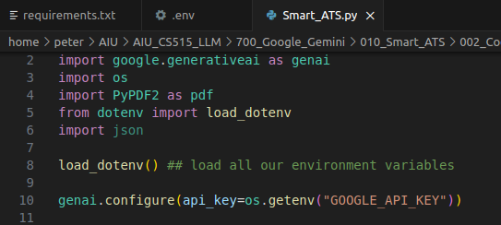
10.06 Configure Gemini Model
https://www.youtube.com/watch?v=VZOnp2YpY8Q&list=PLZoTAELRMXVNbDmGZlcgCA3a8mRQp5axb&index=10
Configure Gemini Model (06:11-09:30/18:07)
Configure Gemini Model with API Key.

Slide 6
10.07 Get Gemini Response

Slide 7

10.07 Get Gemini Response
https://www.youtube.com/watch?v=VZOnp2YpY8Q&list=PLZoTAELRMXVNbDmGZlcgCA3a8mRQp5axb&index=10
Get Gemini Response (07:31-08:30/18:07)
Get Gemini Response.

Slide 8
10.08 Get Gemini Response

Slide 9
10.08 Get Gemini Response
https://www.youtube.com/watch?v=VZOnp2YpY8Q&list=PLZoTAELRMXVNbDmGZlcgCA3a8mRQp5axb&index=10
Get Gemini Response (07:31-08:30/18:07)
Get Gemini response.txt.

Slide 10
10.09 Convert PDF to Text

Slide 11
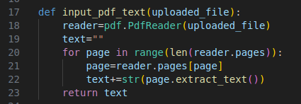
10.09 Convert PDF to Text
https://www.youtube.com/watch?v=VZOnp2YpY8Q&list=PLZoTAELRMXVNbDmGZlcgCA3a8mRQp5axb&index=10
Get Gemini Response (08:31-13:00/18:07)
Convert PDF to Text.
We extract many pages.

Slide 12
10.10 Input Prompt

Slide 13
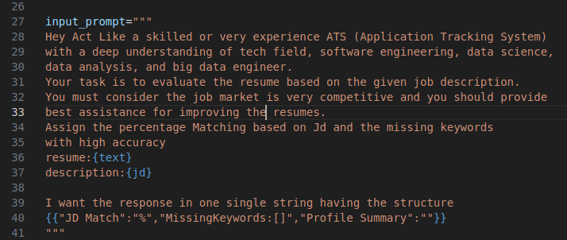
10.10 Input Prompt
https://www.youtube.com/watch?v=VZOnp2YpY8Q&list=PLZoTAELRMXVNbDmGZlcgCA3a8mRQp5axb&index=10
Input Prompt (13:01-14:00/18:07)
We define the input prompt to guide the Gemini AI.
Tell Gemini AI what we want.
There are some prompt examples as below:
https://ai.google.dev/docs/concepts

Slide 14
10.11 Streamlit GUI

Slide 15
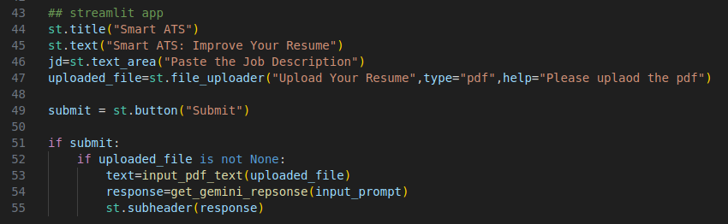
10.11 Streamlit GUI
https://www.youtube.com/watch?v=VZOnp2YpY8Q&list=PLZoTAELRMXVNbDmGZlcgCA3a8mRQp5axb&index=10
Streamlit GUI (14:01-15:50/18:07)
1. Page title: Smart ATS
2. text Description under page title: “Smart ATS: Improve your Resume”
3. Job Description
4. Submit button
5. Process Submission
5.1 Get the text from pdf
5.2 Get response based on PDF text and input prompt which we already defined
5.3 Display response.

Slide 16
End

