Slide 1

10.12 Test Smart ATS
Peter H. Chen

Slide 2
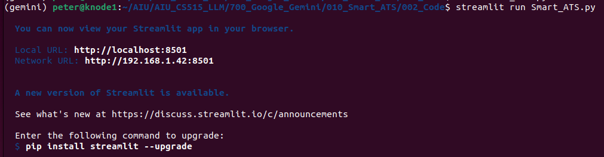
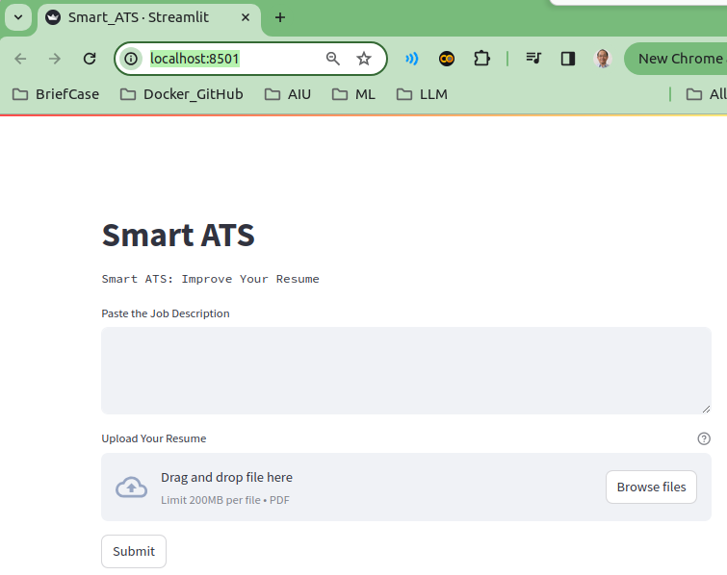
10.11 Test Smart ATS
https://www.youtube.com/watch?v=VZOnp2YpY8Q&list=PLZoTAELRMXVNbDmGZlcgCA3a8mRQp5axb&index=10
Streamlit GUI (15:51-16:30/18:07)
> streamlit run Smart_ATS.py

Slide 3
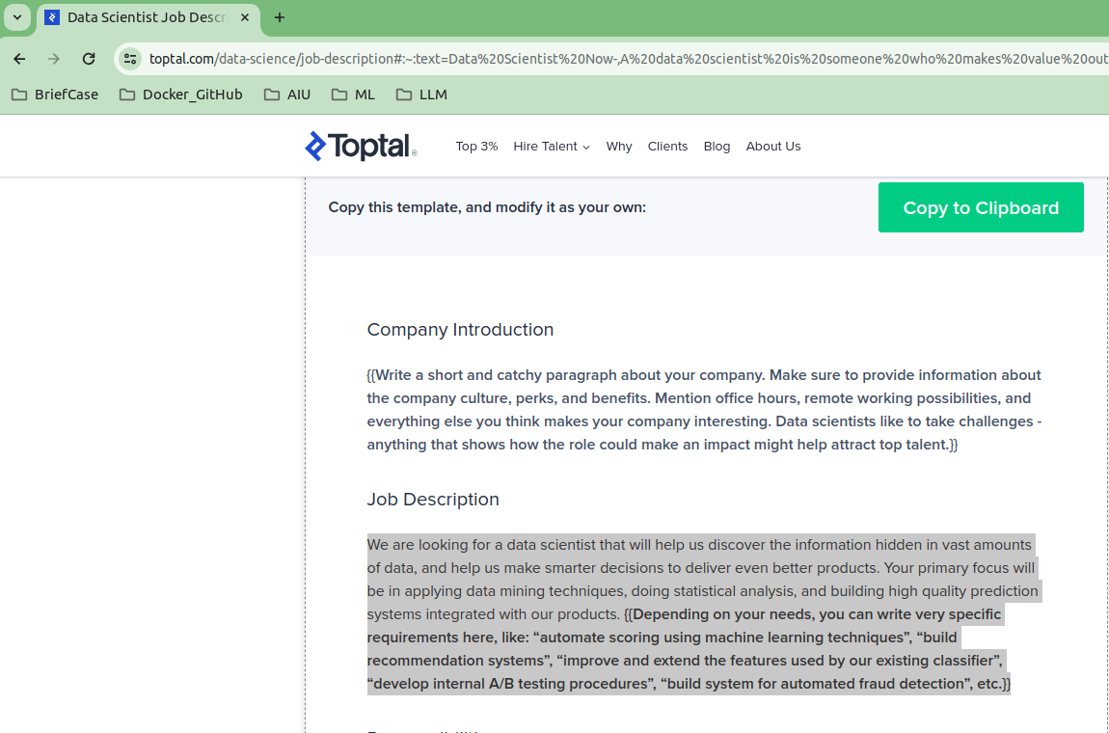
10.11 Test Smart ATS
https://www.youtube.com/watch?v=VZOnp2YpY8Q&list=PLZoTAELRMXVNbDmGZlcgCA3a8mRQp5axb&index=10
Streamlit GUI (16:31-17:30/18:07)
Google Search “Data Science Job description”
Job Description:
We are looking for a data scientist that will help us discover the information hidden in vast amounts of data, and help us make smarter decisions to deliver even better products. Your primary focus will be in applying data mining techniques, doing statistical analysis, and building high quality prediction systems integrated with our products.

Slide 4
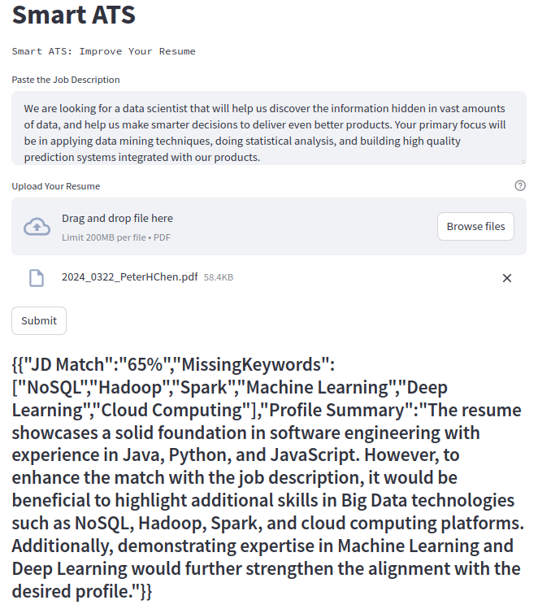
10.11 Test Smart ATS
https://www.youtube.com/watch?v=VZOnp2YpY8Q&list=PLZoTAELRMXVNbDmGZlcgCA3a8mRQp5axb&index=10
Streamlit GUI (17:31-18:07/18:07)
Click “Submit”. We will see only 75% match. Some key words are missing in the resume.

Slide 5
End

