Slide 1

6 Chat with Memory
Peter H. Chen

Slide 2
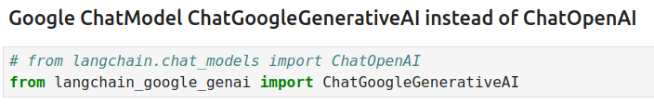
6 Chat with Memory
https://www.youtube.com/watch?v=IrA3Wmm1M0U&list=PLZoTAELRMXVORE4VF7WQ_fAl0L1Gljtar&index=6
Chat with Memory (00:00-01:00/18:30)
We deployed simple google Gemini QA on HuggingFace.
Now, we want to deploy Conversational Q&A Chat on HuggingFace.
In this Conversational Q&A Chat, we will use ChatModel with memory.
We already discussed
1. How to use LangChain,
2. How to use Chains,
3. How to create LLM Chains,
4. How to write your own prompt template,
5. How to combine multiple chains
6. Finally, we have an important ChatModel with Google Chat.

Slide 3
6.01 Google ChatModel

Slide 4
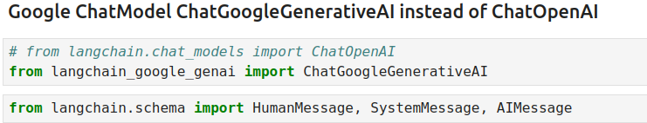
6.01 Google ChatModel
https://www.youtube.com/watch?v=IrA3Wmm1M0U&list=PLZoTAELRMXVORE4VF7WQ_fAl0L1Gljtar&index=6
Google ChatModel (01:01-01:40/18:30)
Now, what are three important points in ChatModel?
1. HumanMessage
2. SystemMessage
3. AIMessage
With the help of three messages, we can create the conversational Q&A chatbot. This mean the chatbot will be able to remember the context.
We already deploy simple QA chatbot on HuggingFace. In this discussion, we will continue to deploy this conversation QA chatbot with the help of messages on HuggingFace Space.
1. What is context [文脈( ぶんみゃく ),コンテクスト/Kontekusuto;语境/前后关系]?
Answer: The word meaning in the current sentence which connect between the previous sentence(s) to next sentence(s).
2. What is semantic [セマンティック/Semantikku; 語意]?
Answer: Some slang and characters embedded other meaning. In Kanji, the word肉 (meat) is simplified into 月 in Kanji. The word 服 (clothe) is related to body (meat). The word 貝 (shell for ancient people to exchange items) is linked to money/value, such as, 買(Buy), 質(Quality), 費(Cost), 貯(Saving), 販(Sell), 資(Capital), 財(fiscal), etc.

Slide 5
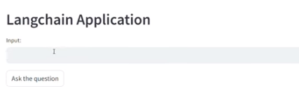
6.01 Schema Message
https://www.youtube.com/watch?v=IrA3Wmm1M0U&list=PLZoTAELRMXVORE4VF7WQ_fAl0L1Gljtar&index=6
Schema Message (01:41-02:20/18:30)
In the previous project, we create a simple Q & A chatbot.
The complexity of Q & A chatbot will be keeping on increasing.
We will create another project “chat.py”

Slide 6
End

