Slide 1

6.02 Chatbot with Memorys
Peter H. Chen

Slide 2
6.02 Chatbot with Memory
https://www.youtube.com/watch?v=IrA3Wmm1M0U&list=PLZoTAELRMXVORE4VF7WQ_fAl0L1Gljtar&index=6
Chatbot with Memory (02:21-03:00/18:30)
We discuss how to create the Conversational Q&A Chatbot with Google ChatModel.
In the companies, they fine-tune their private dataset and create their own powerful LLM model by themselves.

Slide 3
6.03 Get API Key

Slide 4
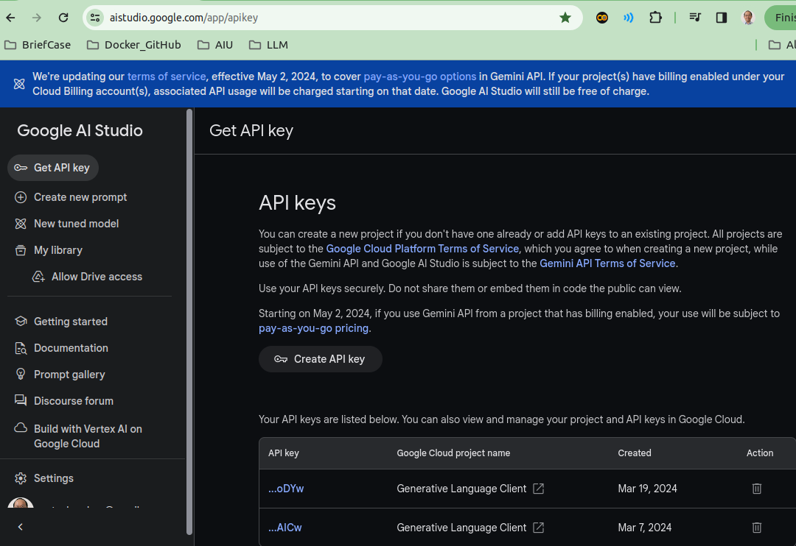
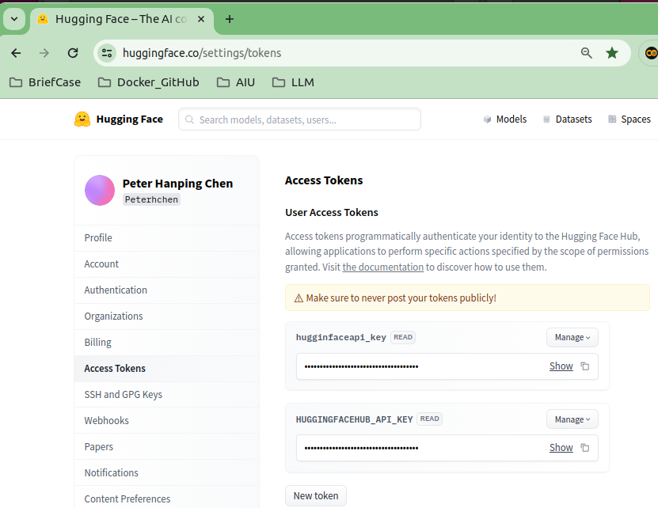
1
6.03 Get API Key
https://www.youtube.com/watch?v=IrA3Wmm1M0U&list=PLZoTAELRMXVORE4VF7WQ_fAl0L1Gljtar&index=6
Get API Key (03:01-03:10/18:30)
1. Create Google API Key:
https://aistudio.google.com/app/apikey
2. Create HuggingFace API Key:
https://huggingface.co/settings/tokens
2

Slide 5
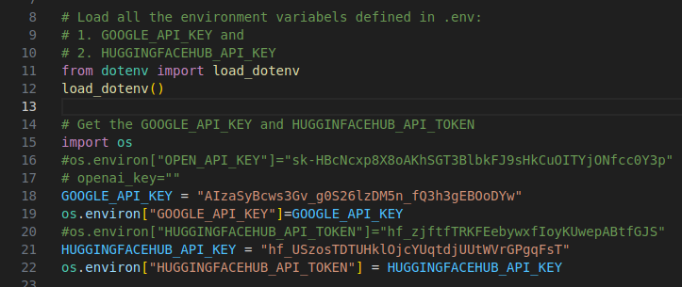
6.03 Get API Key
https://www.youtube.com/watch?v=IrA3Wmm1M0U&list=PLZoTAELRMXVORE4VF7WQ_fAl0L1Gljtar&index=6
Get API Key (03:11-03:30/18:30)
1. Load environment variables with API keys from “.env”:
When we deploy to HuggingFace, we only need to create the “Secret” key. HuggingFace will load the environment variables for us.
We can comment these codes out.
2. Assign variables GOOGLE_API_KEY and HUGGINGFACEHUB_API_TOKEN with API Keys.
1
2

Slide 6
6.04 Import LC Message/ChatModel Library

Slide 7
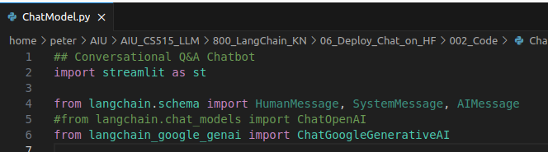
6.04 Import LC Message/ChatModel Library
https://www.youtube.com/watch?v=IrA3Wmm1M0U&list=PLZoTAELRMXVORE4VF7WQ_fAl0L1Gljtar&index=6
Import LC Message/ChatModel Library (03:31-04:00/18:30)
Below, we use
1. streamlit: streamlit has session management to remember the context of each of previous message and incoming message.
2. langchain schema: schema has Human Message, System Message, and AI Message.
3. ChatGoogleGenerativeAI: LangChain for Google LLM ChatModel.

Slide 8
6.05 LC Load Google Chat Model

Slide 9
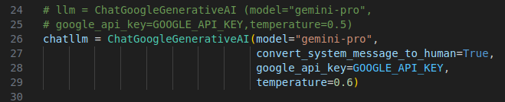
6.05 LC Load Google Chat Model
https://www.youtube.com/watch?v=IrA3Wmm1M0U&list=PLZoTAELRMXVORE4VF7WQ_fAl0L1Gljtar&index=6
LC Load Google Chat Model (04:01-08:30/18:30)
We use LC (LangChain) to create Google chatllm with the Google ChatModel with API Key.
We use Google chatllm to get the google chat response.

Slide 10
6.06 Streamlit: Session State

Slide 11
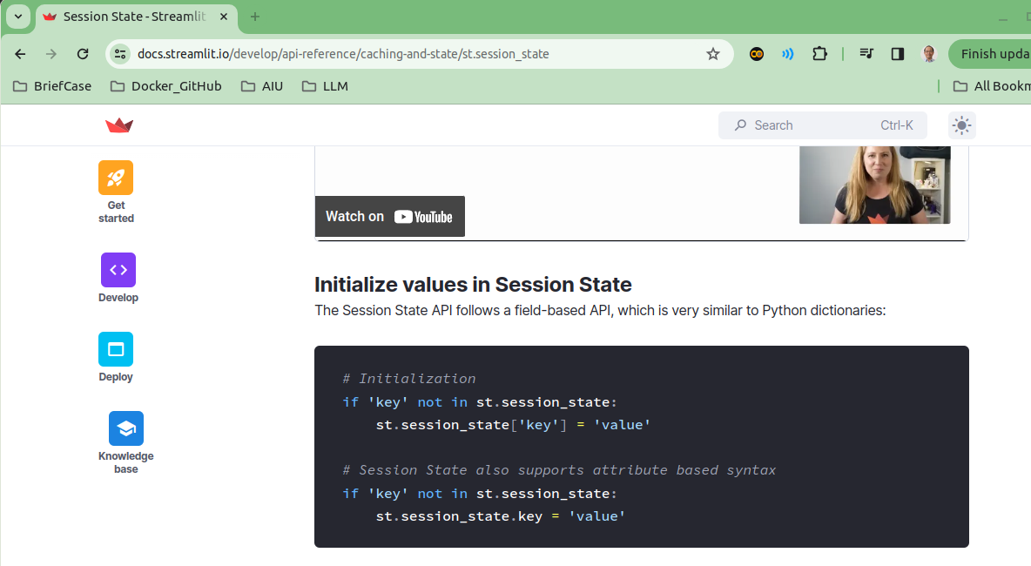
6.06 Streamlit: Session State
https://www.youtube.com/watch?v=IrA3Wmm1M0U&list=PLZoTAELRMXVORE4VF7WQ_fAl0L1Gljtar&index=6
Streamlit: Session State (08:31-09:00/18:30)
Streamlit Session state can be used to store the information between the chats.
In Session state, Key-value pairs are appended as below:
> # Initialization
>if 'key' not in st.session_state:
> st.session_state['key'] = 'value'
https://docs.streamlit.io/develop/api-reference/caching-and-state/st.session_state

Slide 12
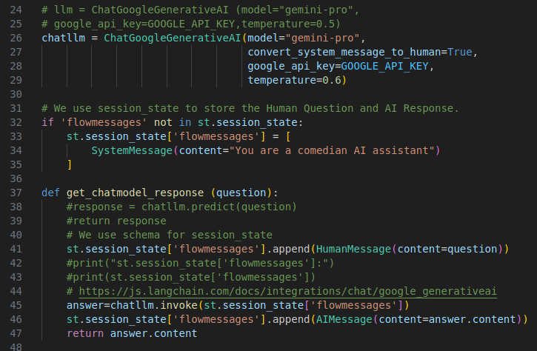
6.06 Streamlit: Session State
https://www.youtube.com/watch?v=IrA3Wmm1M0U&list=PLZoTAELRMXVORE4VF7WQ_fAl0L1Gljtar&index=6
Streamlit: Session State (09:01-14:00/18:30)
We store schema messages (HumanMessage, SystemMessage, and AIMessage) session_state.
Below, we store Human Question and Response AI message in the session_state.
When we call ChatGoogleGeneratitveAI, we use invoke(message_list) and pass in the message_list
https://js.langchain.com/docs/integrations/chat/google_generativeai

Slide 13
6.05 GUI and Display Response

Slide 14
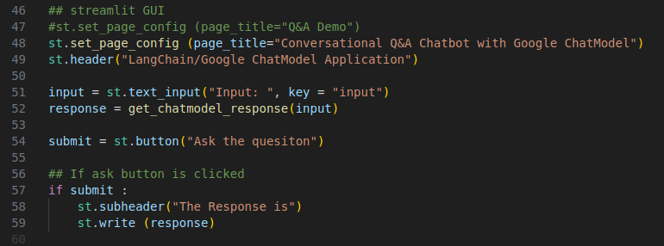
6.05 GUI and Display Response
https://www.youtube.com/watch?v=IrA3Wmm1M0U&list=PLZoTAELRMXVORE4VF7WQ_fAl0L1Gljtar&index=6
Create GUI and Display Response (14:01-14:30/18:30)
1. Create streamlit GUI (Graphical User Interface).
2. Get response from Google ChatModel and session_state.
3. Display the response.

Slide 15
6.06 Test Conversational Q &A Chatbot

Slide 16
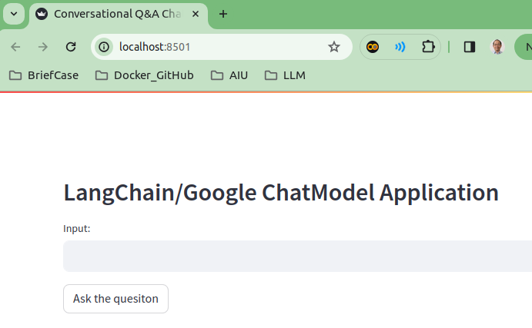
6.06 Test Conversational Q &A Chatbot
https://www.youtube.com/watch?v=IrA3Wmm1M0U&list=PLZoTAELRMXVORE4VF7WQ_fAl0L1Gljtar&index=6
Test Conversational Q & A Chatbot (14:31-15:30/18:30)
> streamlit run chat_with_mem.py

Slide 17
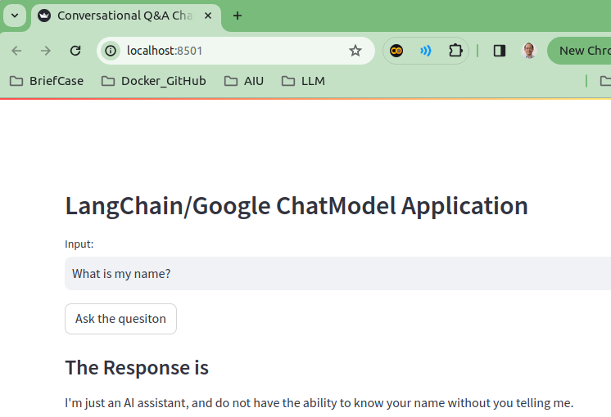
6.06 Test Conversational Q &A Chatbot
https://www.youtube.com/watch?v=IrA3Wmm1M0U&list=PLZoTAELRMXVORE4VF7WQ_fAl0L1Gljtar&index=6
Test Conversational Q & A Chatbot (15:31-16:30/18:30)
> What is my name?
>> I do not know your name.

Slide 18
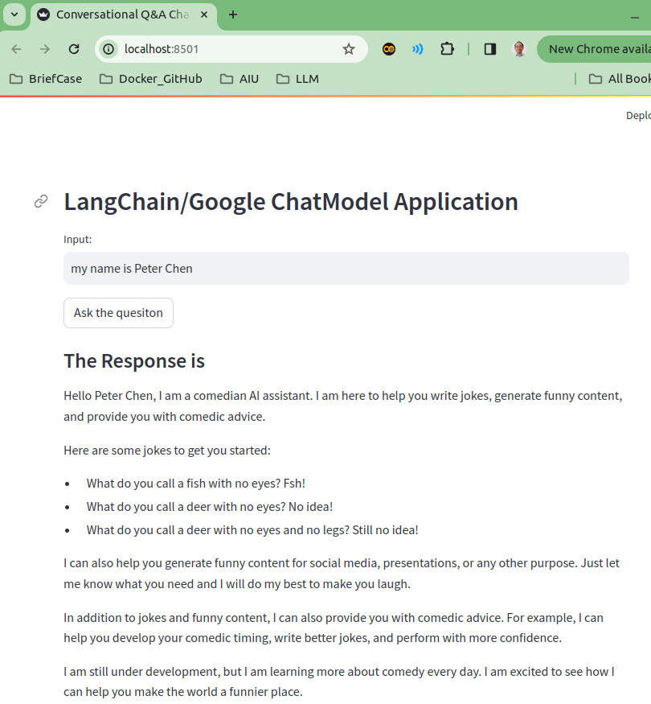
6.06 Test Conversational Q &A Chatbot
https://www.youtube.com/watch?v=IrA3Wmm1M0U&list=PLZoTAELRMXVORE4VF7WQ_fAl0L1Gljtar&index=6
Test Conversational Q & A Chatbot (16:31-17:30/18:30)
> my name is Peter Chen
>> We added the SystemMessage to the schema “You are a comedian AI assistant” at very beginning. The AI Message shows that.

Slide 19
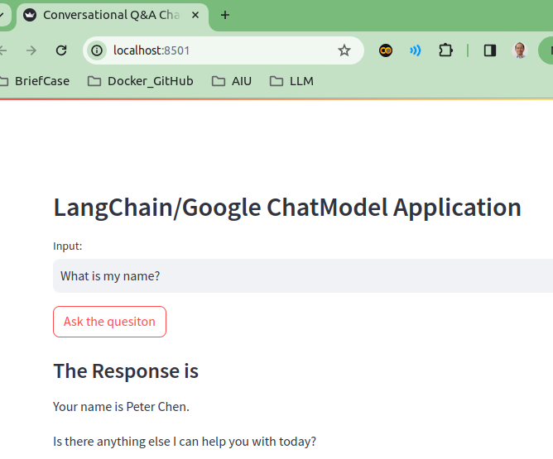
6.06 Test Conversational Q &A Chatbot
https://www.youtube.com/watch?v=IrA3Wmm1M0U&list=PLZoTAELRMXVORE4VF7WQ_fAl0L1Gljtar&index=6
Test Conversational Q & A Chatbot (17:31-17:50/18:30)
> What is my name?
>> I gave AI my name. The Human Message “my name is Peter Chen” was added in schema.
>> Your name is Peter Chen.
>> the AI remember my name.

Slide 20
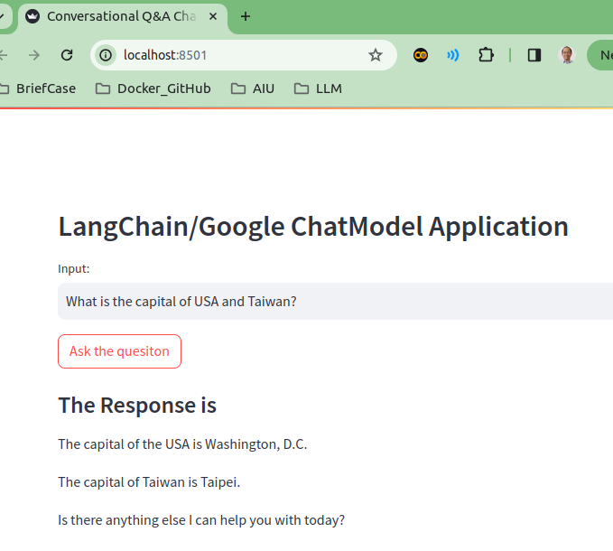
6.06 Test Conversational Q &A Chatbot
https://www.youtube.com/watch?v=IrA3Wmm1M0U&list=PLZoTAELRMXVORE4VF7WQ_fAl0L1Gljtar&index=6
Test Conversational Q & A Chatbot (17:51-18:00/18:30)
> What is the capital of USA and Taiwan?
>> Washington DC and Taipei.

Slide 21
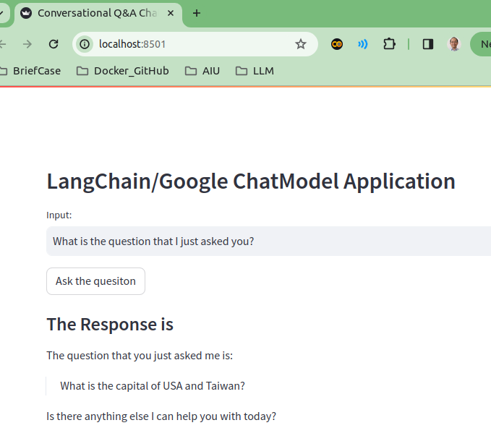
6.06 Test Conversational Q &A Chatbot
https://www.youtube.com/watch?v=IrA3Wmm1M0U&list=PLZoTAELRMXVORE4VF7WQ_fAl0L1Gljtar&index=6
Test Conversational Q & A Chatbot (18:01-18:30/18:30)
> What is the quesiton that I just asked you?
>> “What is the capital of USA and Taiwan?”
>> Google ChatModel with Schema message work!!.

Slide 22
End

