Slide 1

2 LangChain Introduction
Peter H. Chen

Slide 2
2 LangChain Introduction
https://www.youtube.com/watch?v=aWKrL4z5H6w&t=141s
LangChain Introduction (02:15-02:50/4:01:31)
We will be using LangChain for application development.
1. First, we will go through the OpenAI chatGPT-3 and chatGPT-4 examples. We will understand ChatGPT-3 and Chat-GPT4,
2. Google Gemini to achieve OpenAI chatGPT functionalities,
3. Create custom LLM Model,
4. Add Google real-time search platform,
5. Add private information in SQL database
What is exactly LangChain help us?
How do we use LangChain to train the our own custom data?

Slide 3
2.01 LangChain Demo

Slide 4
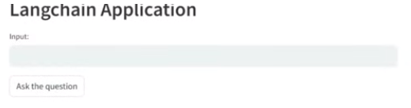
2.01 LangChain Demo
https://www.youtube.com/watch?v=aWKrL4z5H6w&t=141s
LangChain Demo (02:53-03:20/4:01:31)
We start with Demo of LangChain Application.
Then, we will deploy it to HuggingFace. HuggingFace will provide us the space for the complete environment for our application.

Slide 5
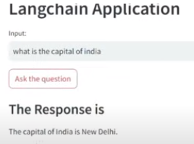
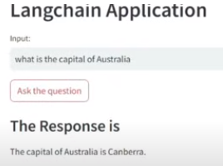
2.01 LangChain Demo
https://www.youtube.com/watch?v=aWKrL4z5H6w&t=141s
LangChain Demo (03:21-03:30/4:01:31)
Question: What is the capital of India
Answer: The Capital of India is New Delhi (ニューデリー;新德里).
Question: What is the capital of Australia
Answer: The Capital of India is Canberra (キャンベラ;堪培拉).

Slide 6
2.02 What is LangChain?

Slide 7
2.02 What is LangChain?
https://www.youtube.com/watch?v=aWKrL4z5H6w&t=141s
What is LangChain? (03:31-05:00/4:01:31)
Before we implement, we need to understand LangChain.
We will understand a lot of functionalities of LangChain and we will implement the end to end project.
1. Get API Key: We will get Google API Key. We will use key to load LLM (Gemini, Llama, OpenAI GPT) Model.
2. Prompt Templates: We create the prompt template will guide LLM. We also have user input: User tell what they want from LLM.
3. LLM: return the response based on prompt template
4. Output Parser: LangChain Output parser take care the output format and return a structured information
5. In LangChain, we have Prompt Template + LLM + Output Parser.

Slide 8
End

