Slide 1

2.03 Get API Key
Peter H. Chen

Slide 2
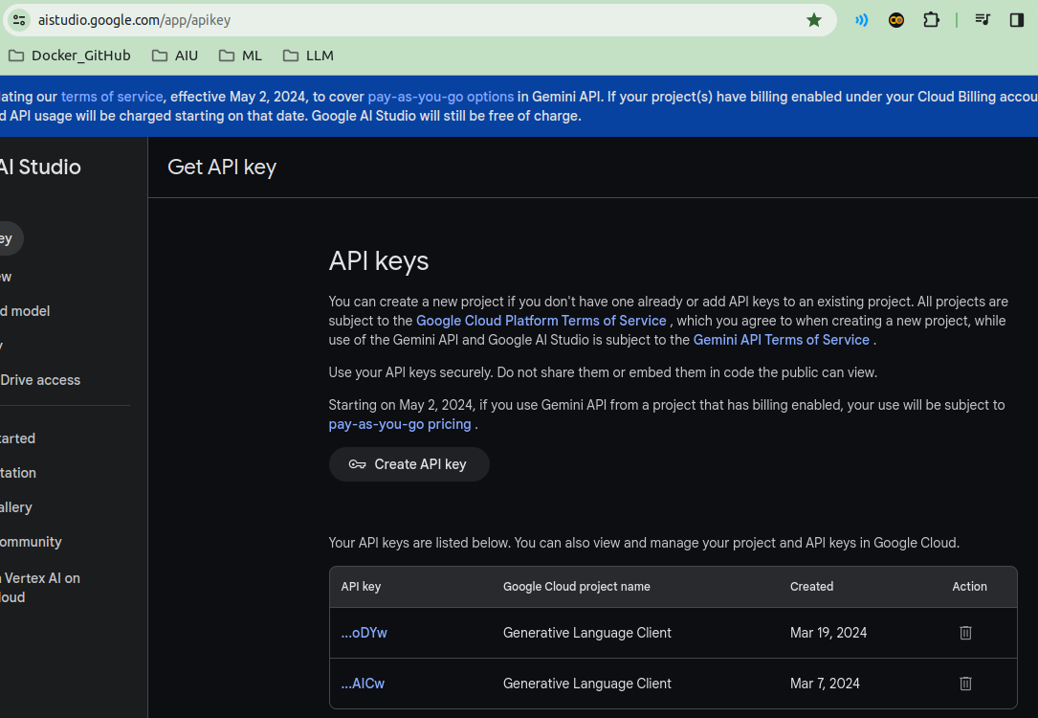
2.03 Get API Key
https://www.youtube.com/watch?v=aWKrL4z5H6w&t=141s
Get API Key (05:11-05:20/4:01:31)
We get the Google API Key (or OpenAI API Key).
Copy the Google API Key and save in the .env file.
https://aistudio.google.com/app/apikey

Slide 3

2.03 Get API Key
https://www.youtube.com/watch?v=aWKrL4z5H6w&t=141s
Get API Key (05:21-06:00/4:01:31)
Copy and paste the Google API Key in the “.env” file.
https://aistudio.google.com/app/apikey

Slide 4
2.03 Get API Key
https://www.youtube.com/watch?v=aWKrL4z5H6w&t=141s
Get API Key (06:01-07:30/4:01:31)
Conda create environment
> conda create --name gemini
> conda activate gemini
#> conda deactivate
#> conda activate gemini

Slide 5
2.04 requirements.txt

Slide 6
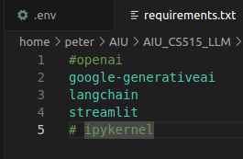
2.04 requirements.txt
https://www.youtube.com/watch?v=aWKrL4z5H6w&t=141s
Requirements.txt (07:31-09:30/4:01:31)
# openai
1. google-generativeai: Gemini
2. langchain: LangChain
3. streamlit: GUI
# ipykernel: “ipykernel” is only for local environment for Jupyter Notebook.
# When we deploy on cloud, ipykernel is not required.
# So, do not put ipykernel in the requirements.txt.
> pip install -r requirements.txt
We install ipykernel separately from requirements.txt
> pip install ipykernel

Slide 7
End

