Slide 1

2.05 Import Library
Peter H. Chen

Slide 2
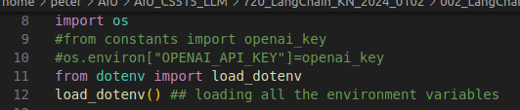
2.05 Import Library
https://www.youtube.com/watch?v=aWKrL4z5H6w&t=141s
Import Library (09:31-15:00/4:01:31)
We Integrate code for LangChain and Gemini instead of LangChain and OpenAI.
1. google.generativeai: Google LLM Gemini-pro
2. ChatGoogleGenerativeAI: LangChain for google.generativeai interface.
3. streamlit: GUI
4. os: get environment for API Key
5. load_dotenv(): Load environment variable for API Key

Slide 3
2.06 Configure Model

Slide 4
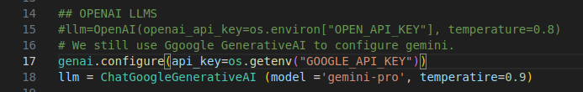
2.06 Configure Model
https://www.youtube.com/watch?v=aWKrL4z5H6w&t=141s
Configure Model (15:01-17:00/4:01:31)
genai.configure (api_key=os.getenv(“GOOGLE_API_KEY”))
Currently,

Slide 5
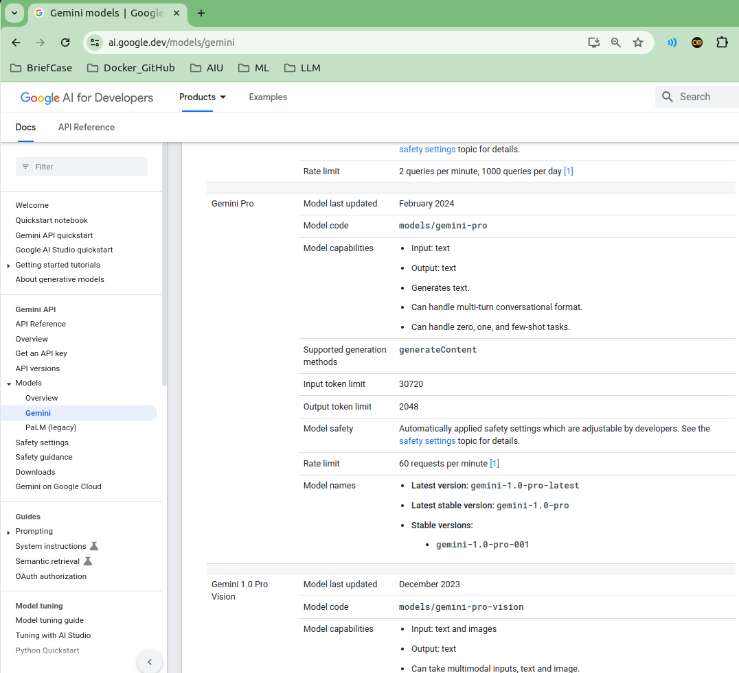
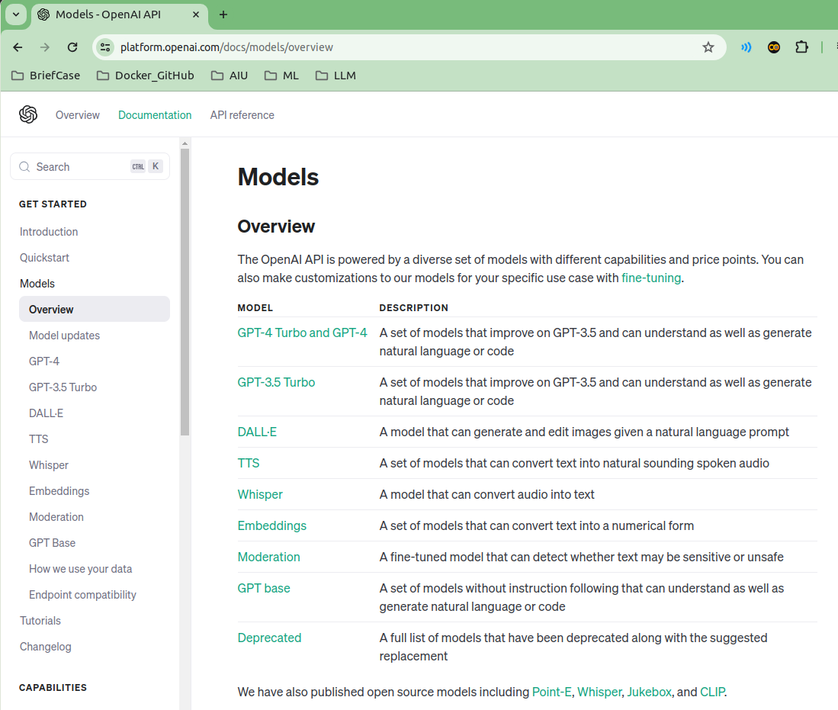
2.06 Configure Model
https://www.youtube.com/watch?v=aWKrL4z5H6w&t=141s
Configure Model (17:01-17:30/4:01:31)
LLM model for
1. Google Gemini: gemini-nano, gemini-pro, gemini-pro-vision, gemini-ultra.
2. openAI GPT: GPT-4 is the most capable model for Open AI.

Slide 6
2.07 Streamlit GUI

Slide 7
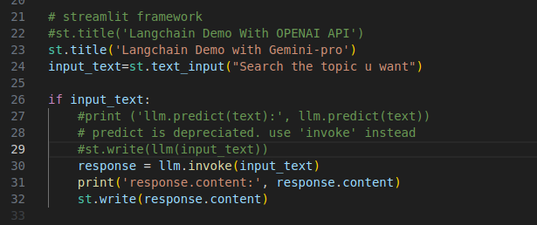
2.07 Streamlit GUI
https://www.youtube.com/watch?v=aWKrL4z5H6w&t=141s
Streamlit GUI (17:31-19:00/4:01:31)
Write GUI input and response.content.

Slide 8
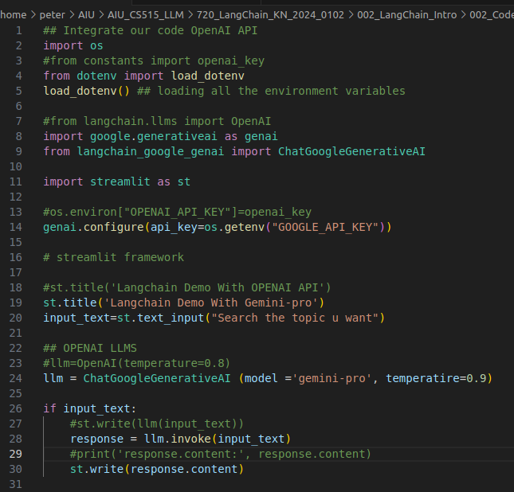
2.07 Streamlit GU
https://www.youtube.com/watch?v=aWKrL4z5H6w&t=141s
Streamlit GUI (19:01-19:10/4:01:31)
Complete LangChain with Gemini-pro code as below:

Slide 9
2.08 Test LangChain and Gemini

Slide 10
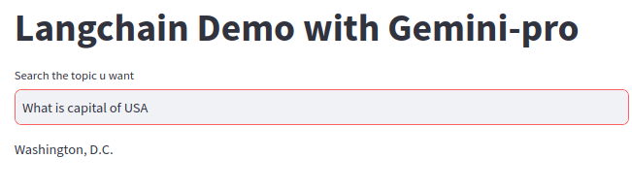
2.08 Test LangChain and Gemini
https://www.youtube.com/watch?v=aWKrL4z5H6w&t=141s
Test LangChain and Gemini (19:11-19:30/4:01:31)
Input: What is capital of USA

Slide 11
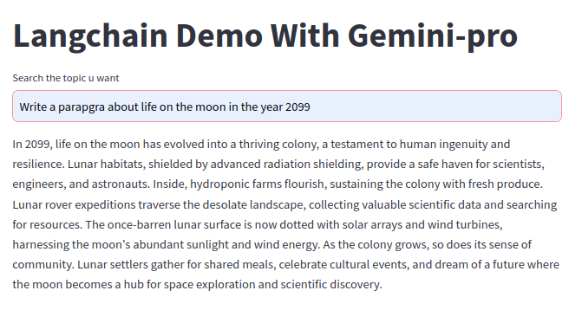
2.08 Test LangChain and Gemini
https://www.youtube.com/watch?v=aWKrL4z5H6w&t=141s
Test LangChain and Gemini (19:31-19:50/4:01:31)
Input: Write a paragraph about the life on the Moon in the year od 2099.

Slide 12
End

